Slide 1
Room Booking
Guide for Moderators
May 2018 – V0.2

Slide 2
Contents
Roles and Responsibilities of a Moderator | 3
Responding to Requests - Planon | 5
Responding to Requests - Outlook | 11
Appendix – Add the ‘Room bookings to be approved’ gadget | 13

Slide 3
Moderator Roles & Responsibilities

Slide 4
Moderator Roles & Responsibilities
Moderators have local knowledge which allows them to identify when a particular room could be made available for meetings other than its primary purpose.
For each room there should be multiple moderators to ensure requests can be responded to at all times during the working week.
Moderators are expected to approve or reject room booking requests as soon as possible, and no later than 3 days after the request has been made.

Slide 5
Moderation in Planon

Slide 6
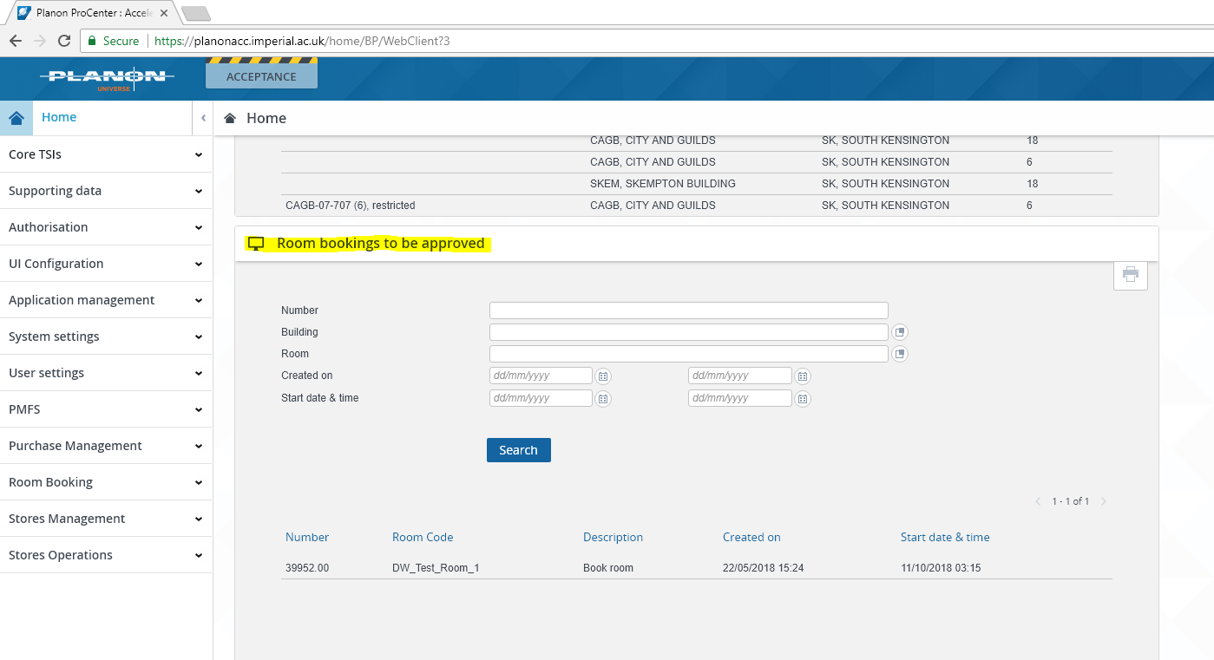
On your Planon homepage, you will find a gadget called ‘Room Bookings to be approved’.
If you do not have this gadget, see the Appendix for instructions on how to add it.
Responding to Requests - Planon

Slide 7
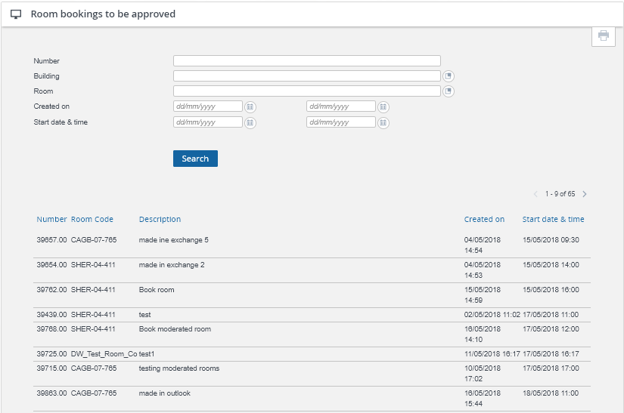
Responding to Requests - Planon
In this gadget, you will see a list of all the rooms in your moderators’ group that have a pending request.
NB: there may be more than one page to scroll through if you have a lot of requests.

Slide 8
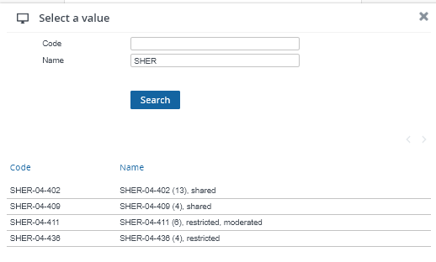
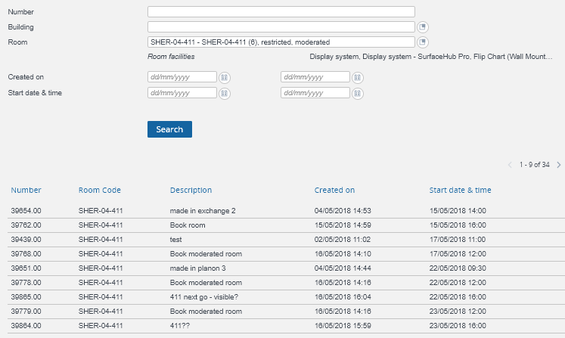
Responding to Requests - Planon
If you would like to see the requests for a particular building, or room, you can filter these at the top of the gadget. For example, to see the requests in a particular room, click on the button at the end of the “Room” field.
In the “Name” field, type the first part of the room name and then click “Search”. Select the room you would like to see.
Back in the gadget, click “Search” again to bring up the filtered results.
4)
5)

Slide 9
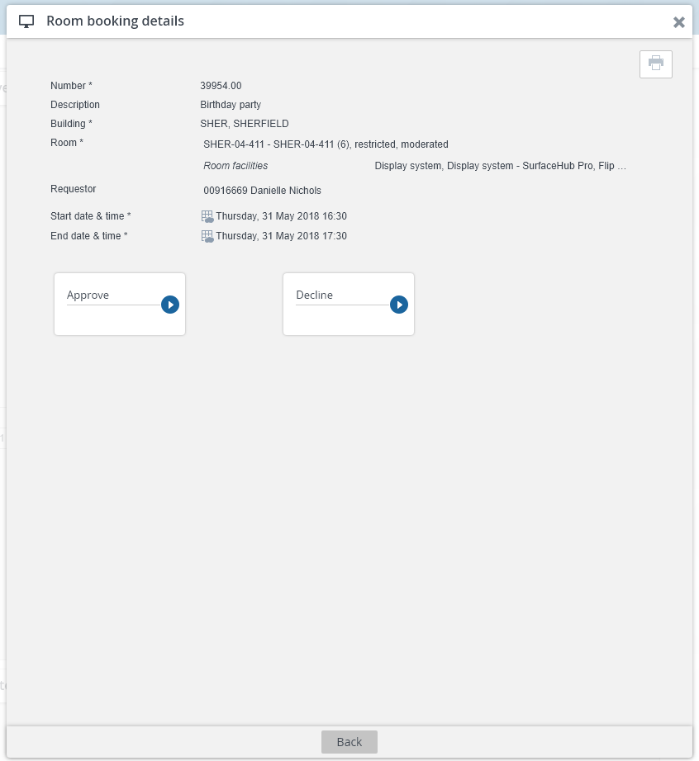
Responding to Requests - Planon
Click on the request you would like to respond to. This will bring up a new window with the details of the booking and option buttons, to Approve or Decline the request.

Slide 10
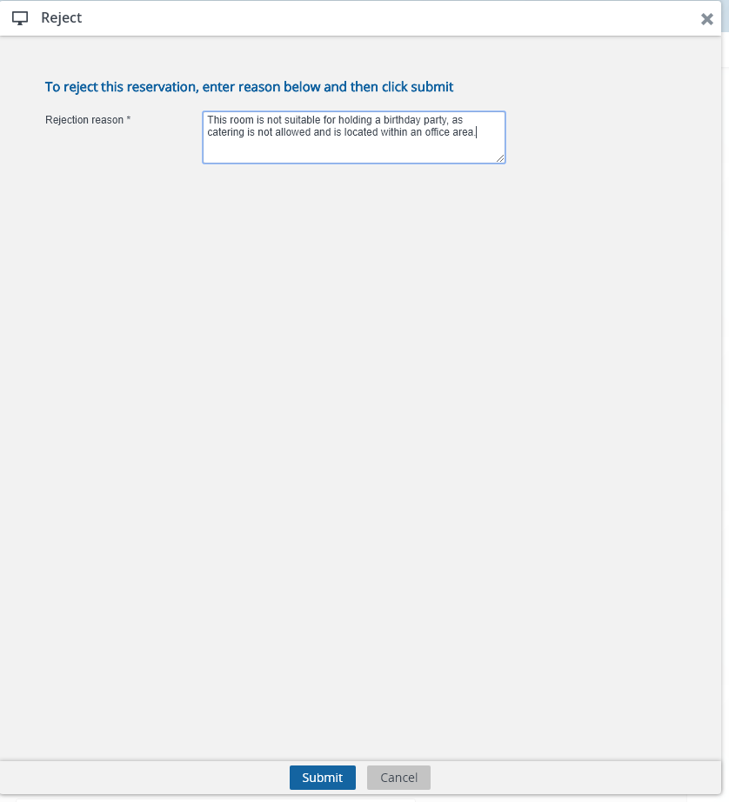
If you approve a request, an email will automatically be sent to the requestor to inform them they can use the room.
If you chose to decline the request, you must provide a reason, which will be included in the automatic email to the requestor to inform them they cannot use the room.
Responding to Requests - Planon

Slide 11
Moderation in Outlook

Slide 12
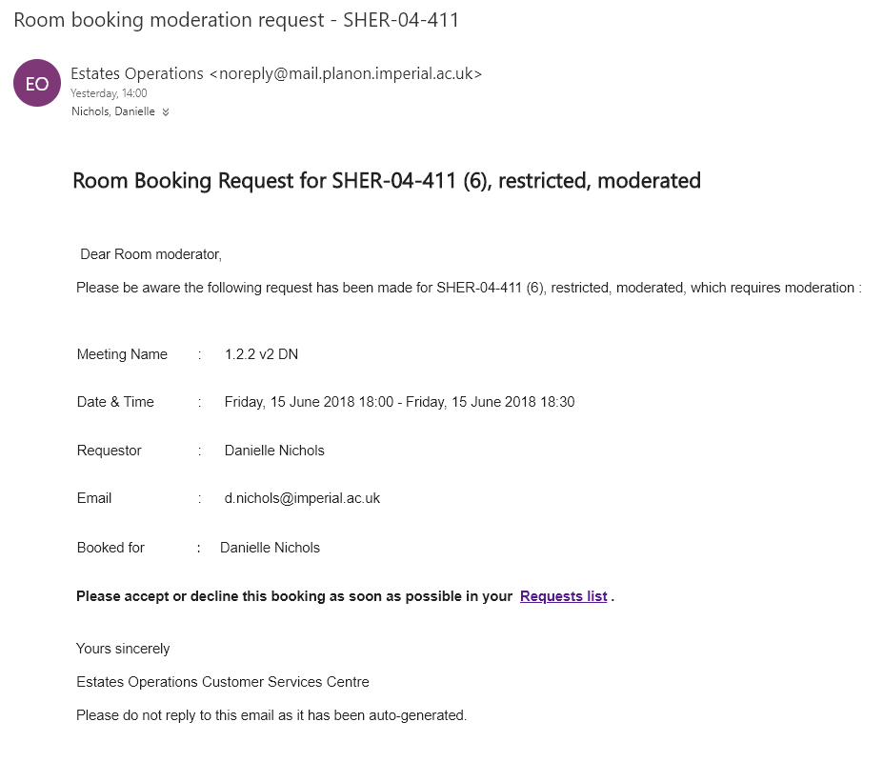
If you are a moderator, you will have access to a shared mailbox, where all requests to book rooms will be sent.
The email will detail which room has been requested, when and by whom.
Click the “Requests list” link in the email, which will take you into Planon. Follow the instructions for approving or rejecting the booking (see pages 6-10)
Responding to Requests - Outlook

Slide 13
Appendix – Add the ‘Room bookings to be approved’ gadget.

Slide 14
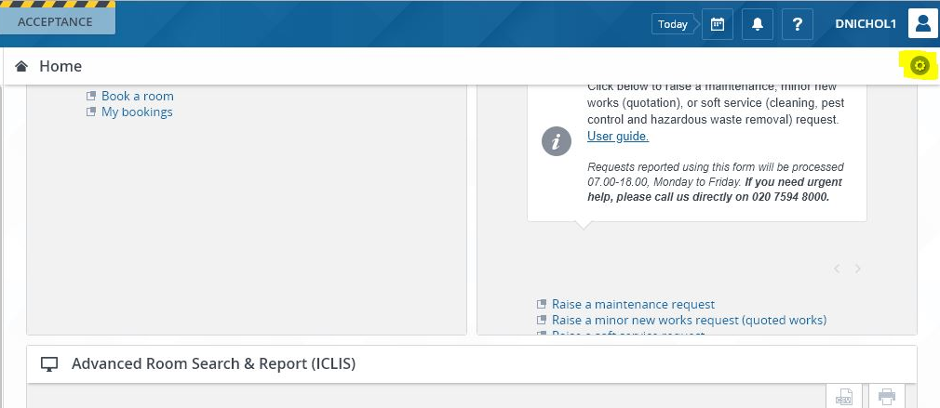
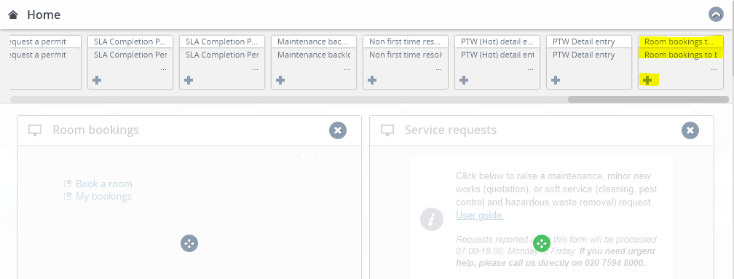
If the ‘Room bookings to be approved’ gadget is not on your homepage, click the cog at the top of screen.
Scroll across until you find the ‘Room bookings to be approved’ gadget.
Click the plus sign to add it to you home screen.
You can drag and drop gadgets to rearrange them.
Click the up arrow in the top right corner to close setup mode.

