Slide 1
Room Booking
Planon User Guide

Slide 2
Contents
Make a Booking | 3
View Your Bookings | 10
Amend or Cancel a Booking | 11
Appendix 1 – How to Add the “Room Bookings” Gadget | 12
Appendix 2 – Repeat (or Recurring Bookings) | 14

Slide 3
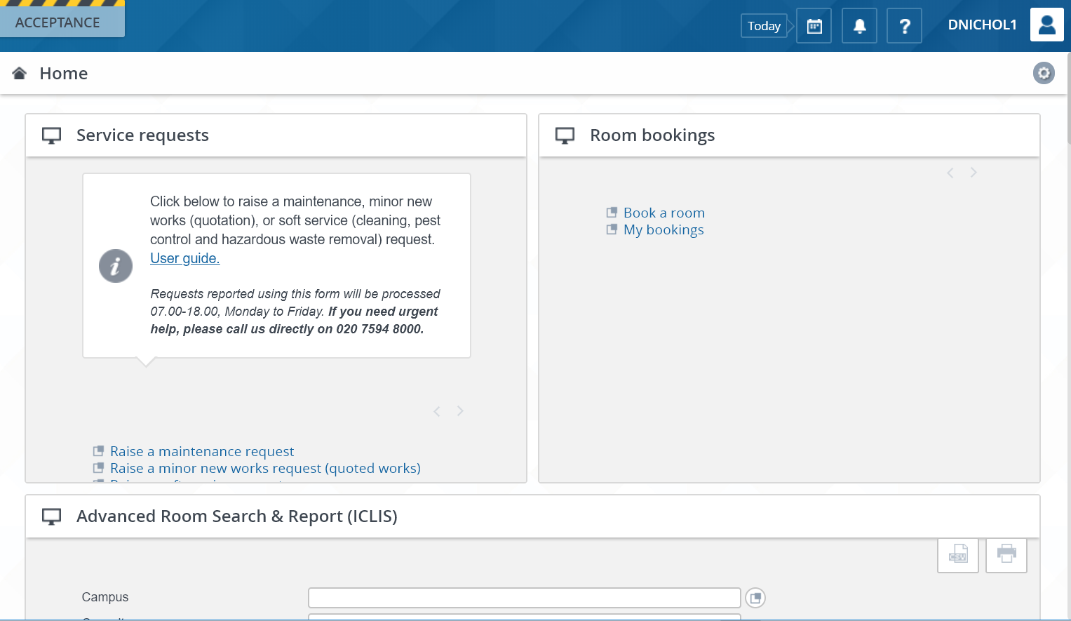
Make a Booking
Navigate to Planon and log in using your usual user name and password.
Go to the gadget* called “Room Bookings” and click “Book a Room” to enter the wizard.
* If this gadget is not on your homepage, see Appendix 1 for instructions on how to add it.

Slide 4
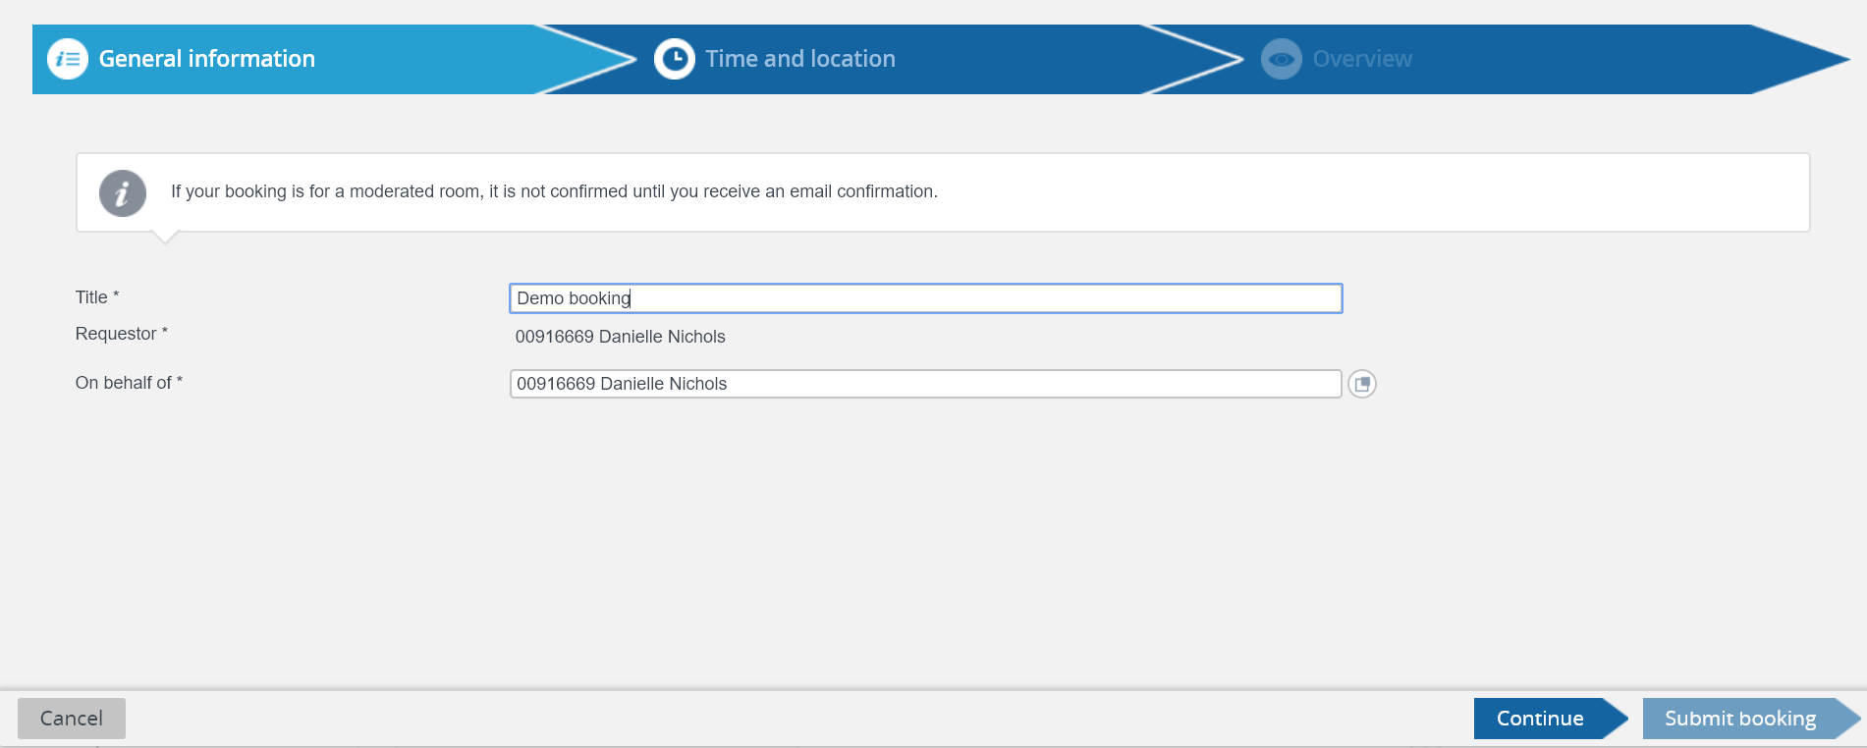
Make a Booking
The Room Booking Wizard will guide you through all the steps to make a room booking. On the first page, give the booking a title. This will be visible in “My Bookings” in Planon, the room’s Outlook calendar, and the confirmation appointment that is sent to your email.
The “On behalf of” field will default to yourself. However, you can make bookings on behalf of colleagues. At the end of the “On behalf of” row, click the pop up button. Search for the colleague you’d like to book on behalf of and select their name.
Click “Continue”

Slide 5
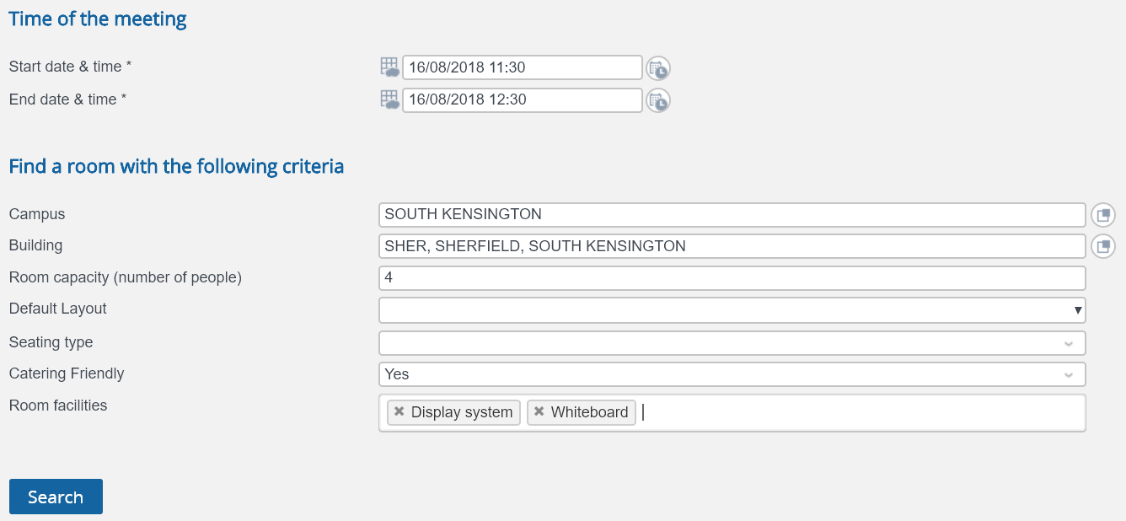
Make a Booking
The next page offers the opportunity to search for rooms based on a range of criteria.
The date & time of the meeting are the only compulsory criteria
You can start writing in these fields and they will prepopulate. Or click on the button at the end of the row to see all the options.
If a “Room capacity” is entered, search results will only show rooms of that size, or above.
“Room facilities” contains a drop-down list of items in a room. As many of these as required can be selected.
Selecting “Yes” will only return rooms where catering is allowed.
Once all the required criteria have been selected, click “Search”. The results will appear below.

Slide 6
Make a Booking
Existing booking
The search results will return a list of rooms that meet your criteria. You can also tick the box to “Show unavailable rooms”, if there is flexibility about what time the meeting can be held. All existing bookings in the room on that day will show up in the planner as blue blocks.
The room name will inform you of its capacity in its default layout, and whether the room is moderated or not.

Slide 7
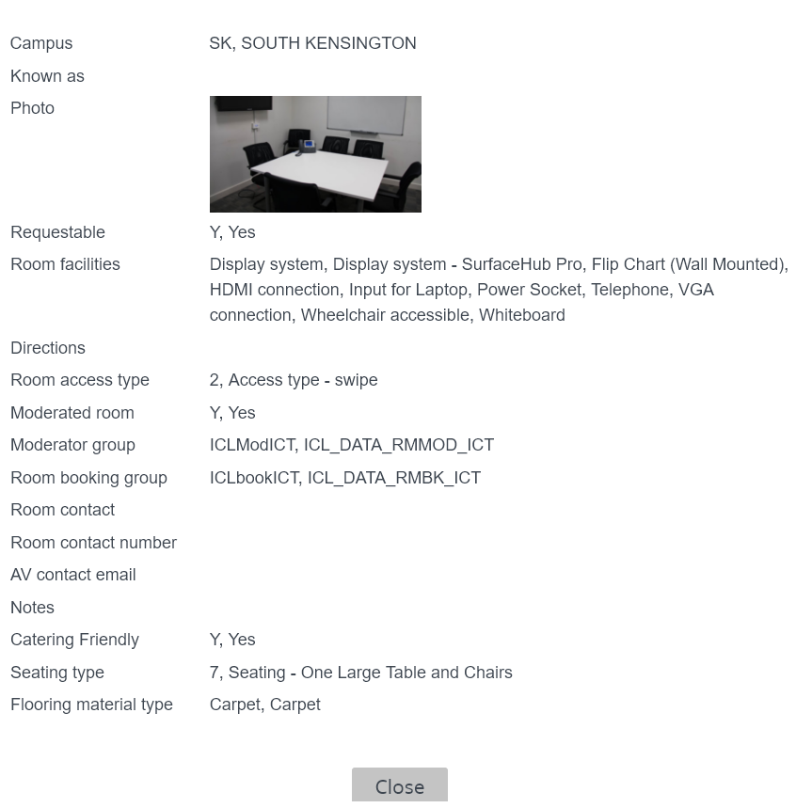
Make a Booking
It is recommended that you also click on the ‘More info’ link next to the room name, which will bring up a new window.
This will give you a photo of the room, details of all facilities in the room and helpful information such as directions to the room and the type of access controls in place.
Once you have decided which room you would like, click on it to highlight in blue, and then either click “Continue” or “Submit booking”, both of which take you to the final screen.

Slide 8
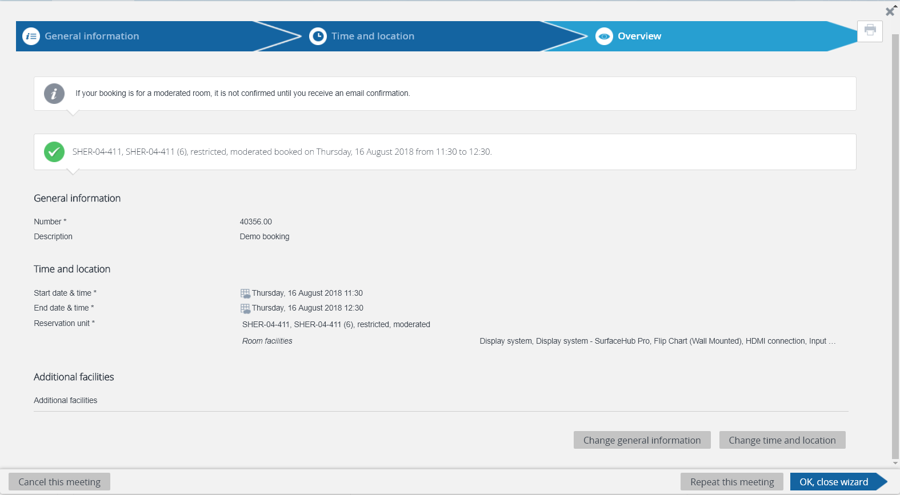
Make a Booking
The final screen is a summary of your booking. Remember, if it is a request for a moderated room, you will need to wait for email confirmation from the room’s moderator.
If you would like to change the title of your booking, you can click on the “Change general information button”. If you would like to amend the time or room, click on the “Change time and location” button. Both of these will take you back into the wizard.

Slide 9
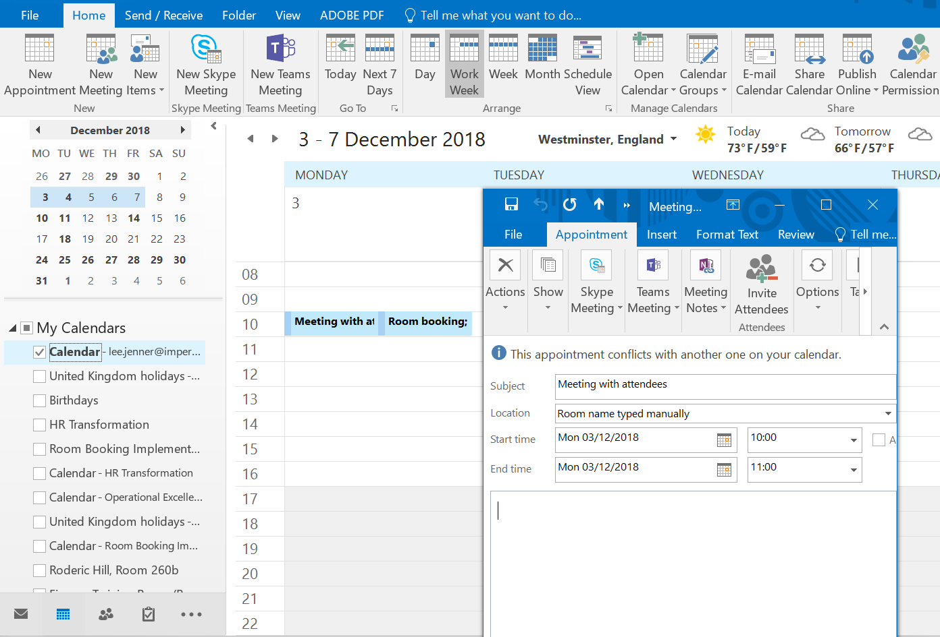
Make a Booking
Planon will send an appointment to your Outlook, which is added to your calendar if you accept it. If you decline the appointment, you will still have the booking, but it won’t show up in your calendar.
This appointment is a room booking only. Create a separate appointment in Outlook to invite attendees and type the room name in the location field. Do not invite the room to that appointment as it is already booked.

Slide 10
View Your Bookings
All upcoming bookings can be viewed in Planon. In the “Room Booking” gadget on the home page, click on “My Bookings”. Depending on how many upcoming bookings you have, you may need to use the arrows at the top to scroll through them all. You also have the option to print the list of your bookings.
By looking at the “Status” column, you can see whether your booking is Confirmed, Cancelled, or Requiring approval from the room’s moderator.
Bookings will stay here until the date has passed, at which point they will be archived. You can still see these in your Outlook calendar, if you accepted the invitation from Planon.

Slide 11
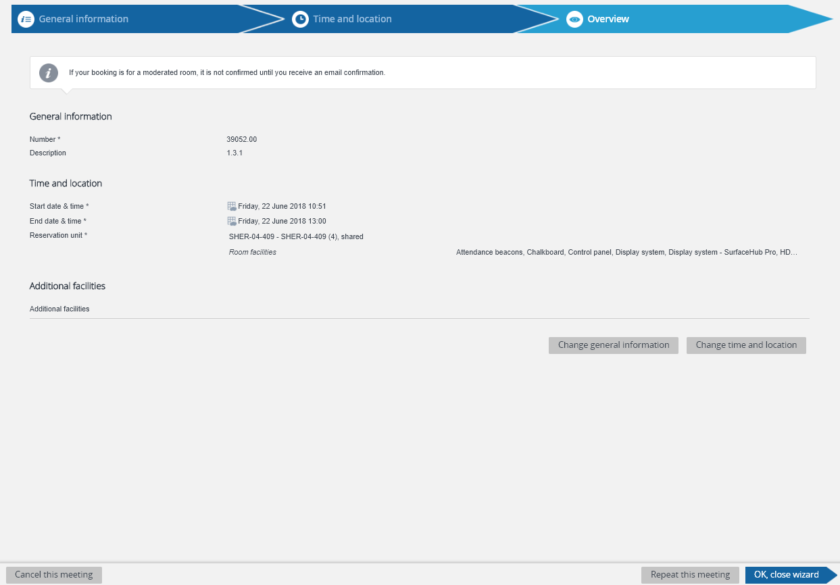
Amend or Cancel a Booking
Navigate to “My Bookings” on the homepage, which will bring up a list of all upcoming bookings.
Double click on the booking you would like to amend or cancel, which will take you into the Room Booking wizard.
Select “Change time and location” to amend your booking or “Cancel this meeting” to cancel it.

Slide 12
Appendix 1 - Add the Room Booking Gadget
On the Planon homepage, click the “Edit mode” cog in the top right-corner of Planon.

Slide 13
Appendix 1 - Add the Room Booking Gadget
Select the “Room bookings” gadget. Gadgets can be re-ordered on the homepage by dragging and dropping, while in this mode. Close the window by clicking on the arrow in the top-right corner.

Slide 14
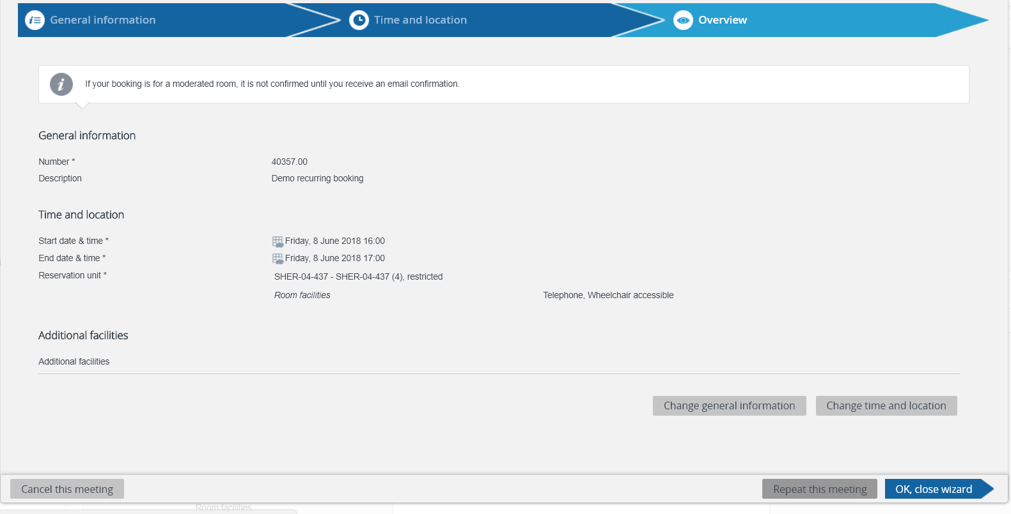
Appendix 2: Repeat Bookings
Planon does not create a series of linked, recurring, bookings, like in Outlook. Rather, you can repeat an existing booking over a desired period in a set pattern. Each of these repetitions is treated as an individual booking and has to be amended or cancelled as such.
To repeat a booking, navigate to “My Bookings” on the homepage and select the meeting you would like to repeat. This will take you into the Room Booking wizard.
Click on the “Repeat this meeting” button on the bottom right on the screen.

Slide 15
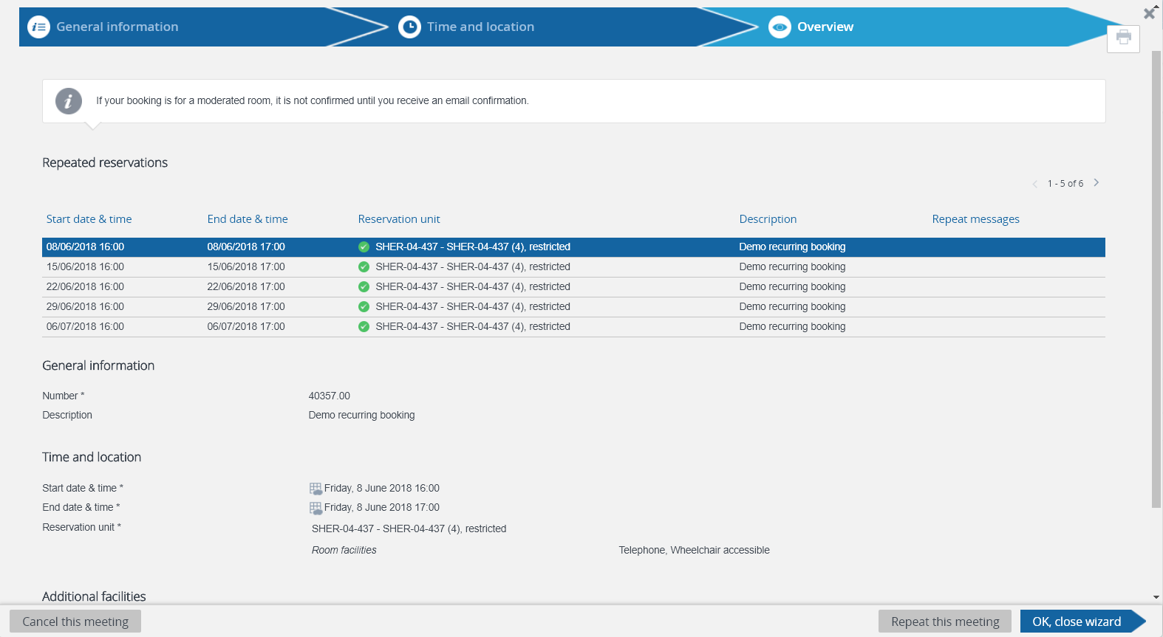
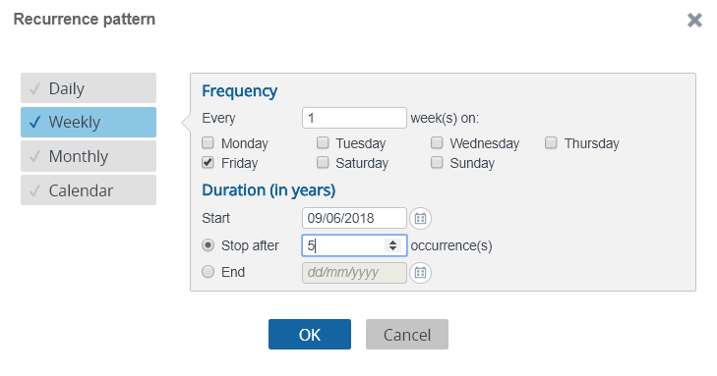
Appendix 2: Repeat Bookings
In the pop-up window, select the frequency of each appointment and then “OK”.
In the Overview screen, all of the bookings will be listed. If they have a green tick next to them, they have been accepted.

Slide 16
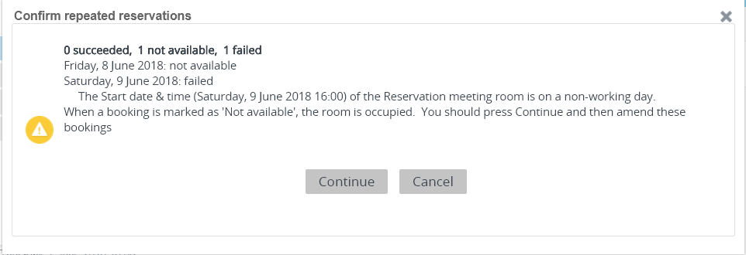
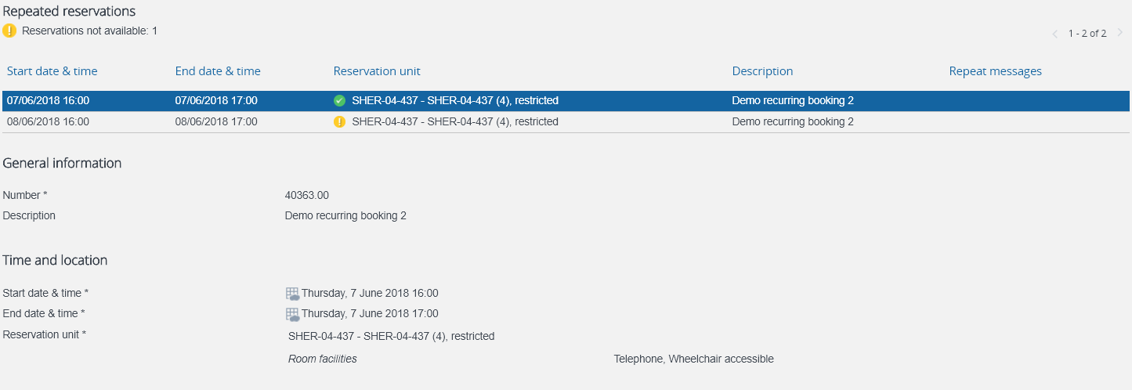
Appendix 2: Repeat Bookings
If you try and make a repeated booking when the room is already booked, it will generate a message saying how many of the requests were accepted, or are not available. Click “Continue”.
Where any bookings have a yellow exclamation mark next to them, you should click on the booking and then “Change time and location”. This will take you back into the Room Booking Wizard, where you can either change the room, or the time, so the booking no longer clashes.
All repeated meetings will be shown in “My Bookings”.

