Slide 1
Computing
Department of Aeronautics
Dr O. Bacarreza
October 2016

Slide 2
IT Services at Aeronautics
Computer Rooms
Imperial College Accounts
Departmental Account (Linux)
Department Rules
College Wide Rules
Printing
High Performance Computing (HPC)
Getting Help
Q&A

Slide 3
Computer Rooms

Slide 4
Main Computer Rooms
Aeronautics offers the following computer rooms:
Aeronautics Only Rooms (Dual boot):
Room RODH 265 – 20 Machines – Study Room, Printers
Room ACEX 254 – 28 Machines – Computer Room, Printer
Shared Rooms (Aeronautics, Civil and Mechanical Engineering):
Room SKEM 208 – 70 Machines (Windows Only), Printer
Room SKEM 317 – 41 Machines (Windows Only), Printer
Room CAGB 203 – 90 Machines (Windows Only), Printer
Room CAGB 761 – 42 Machines (Windows Only), Printer
Room CAGB 762 – 42 Machines (Windows Only), Printer

Slide 5
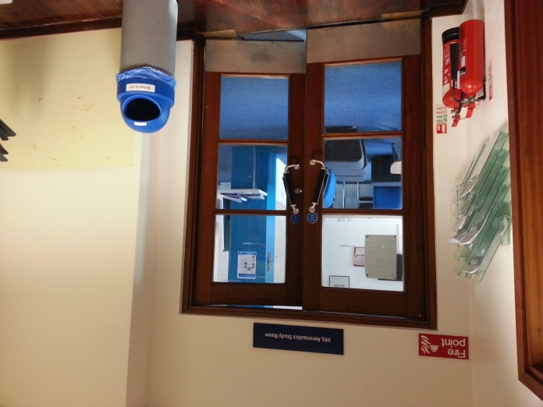
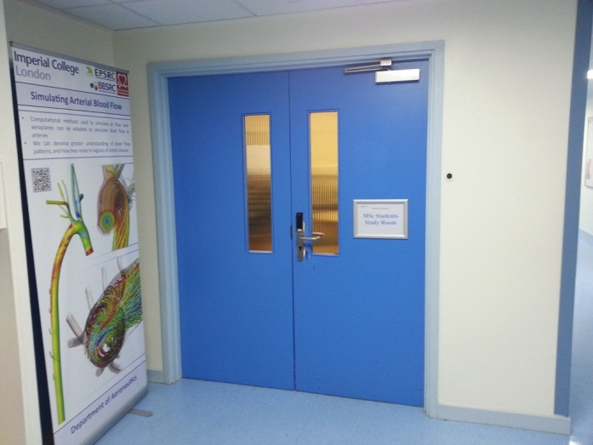
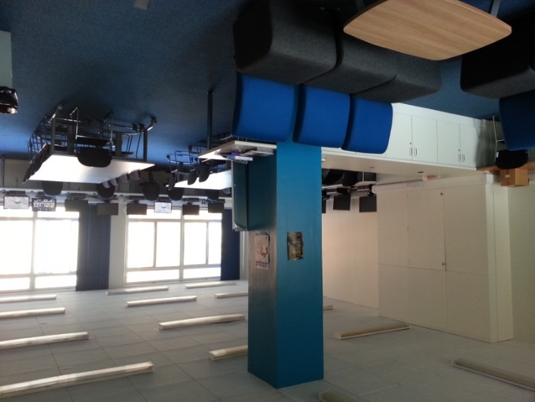
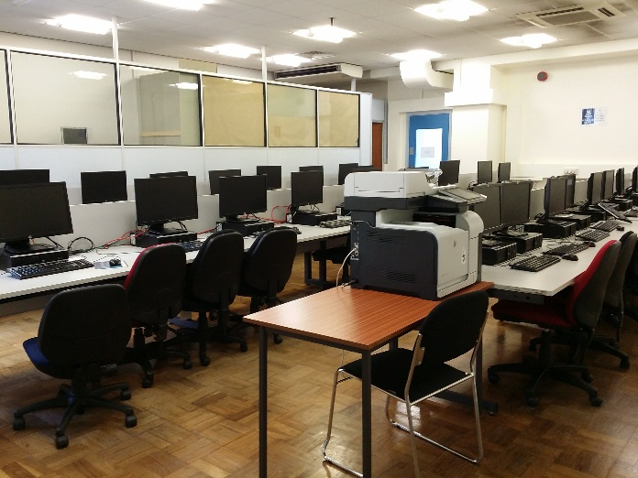
Main Aeronautics Computer Rooms
Study room
(RODH 265)
Computer Room
(ACEX 254)

Slide 6
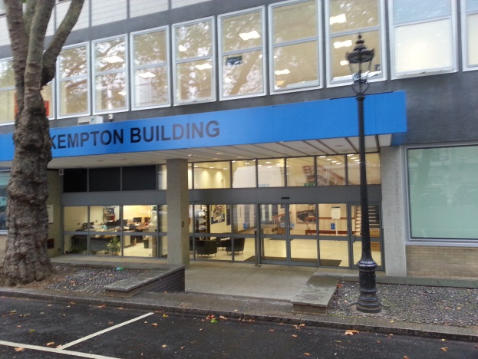
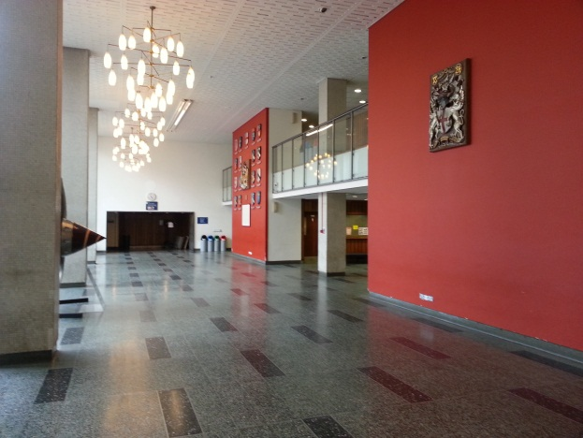
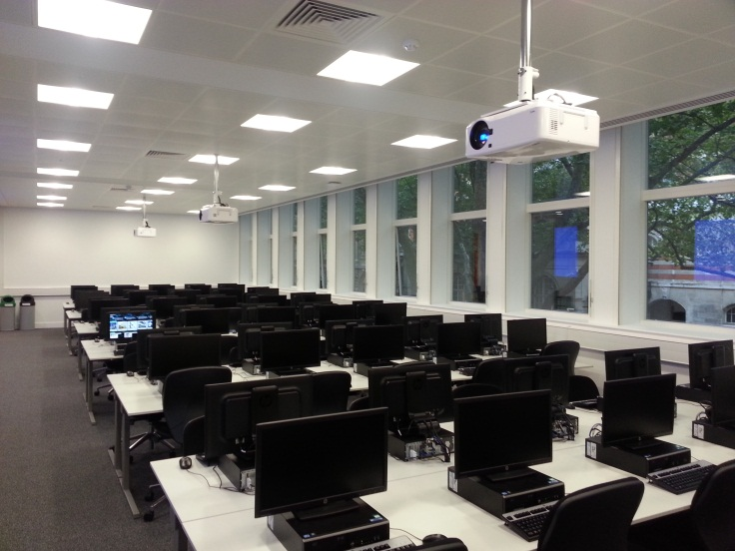
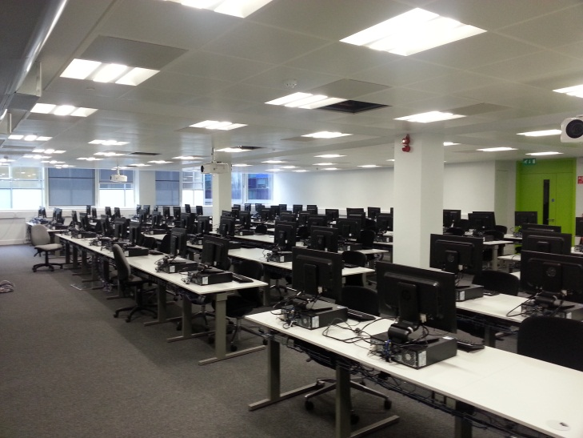
Aero/Civil/Mechanical Rooms
70 Seats Computer Room
(SKEM 208)
Windows Only
90 Seats Computer Room
(CAGB 203)
Windows Only

Slide 7
Imperial College Accounts

Slide 8
Imperial College Account (ICT)
As a new member of College you will automatically be provided with a College username and email address. These enable you to:
Send and receive email,
Log-on to the College network and Virtual Learning Environment (e.g. Blackboard),
Log-on to College Printers,
Access electronic information services provided by the library, etc.
You must activate this account at:
https://www.imperial.ac.uk/ict/activateaccount

Slide 9
Imperial College Account (Linux)
The department of Aeronautics has its own servers and accounts for Linux users. An account has been created for you with the same username and password as your main Imperial College computer account.
Advantages of the Departmental Linux account:
Extra Storage Space (5GB)
Flexibility to run computing jobs for days
Etc

Slide 10
IT Rules

Slide 11
Aero Departmental Rules
Computers can be used between the hours of 8.00 and 22.45. At 23.00 all computers reboot to get updates (except Linux Servers).
Eating or drinking is not allowed in computer rooms.
Reboot Dual Boot PCs to use the system of choice (Linux or Windows) but never turn off the computers.
Users doing low priority tasks, such as e-mail or web browsing, must let others use the computer when there is a queue of people waiting.

Slide 12
Aero Departmental Rules
Report any software or hardware faults promptly to ICT service.desk@imperial.ac.uk and o.bacarreza-nogales@imperial.ac.uk
It is requested that you keep noise levels down, particularly please use mobile phones outside the rooms.

Slide 13
College Wide Rules
Password and Login Names cannot be disclosed to anyone else.
Use is restricted to non-commercial college related work.
Displaying, handling, or sending offensive, derogatory or pornographic material is strictly forbidden.
Users must respect copyright laws and intellectual property rights.

Slide 14
College Wide Rules
Users must comply with the DATA PROTECTION ACT 1998 regulating the use of data about living persons.
More information about ICT policies can be found at:
http://www.imperial.ac.uk/admin-services/ict/self-service/be-secure/information-systems-security-policies/
Failure to observe the college rules will lead to disciplinary action. Penalties can go from temporary suspension from all use of the computing facilities to in serious cases, expulsion and dismissal from the college.

Slide 15
Printing

Slide 16
Printing
ICT provides ICTprintservice where the functions of printing, scanning and copying are available on a multi-function printer (“MFP”).
The ICTprintservice is available on most campuses, with the MFPs located in libraries, departments and PC clusters.
MFPs may be mono or colour with respect to the output printed but all MFPs will scan in colour. Some MFPs are capable of producing output in A3 size but most are A4.

Slide 17
Printing
The ICTprintservice MFPs provide a "pay-for-print" service using your College ID card for authentication and payment.
There are money loaders, which accept both coins and notes, at the Central library (in the Wolfson IT Suite on level 1). However, the easiest way to add credit is by using your credit or debit card online (ePay). For more information, please visit the ICTprintservice web site:
http://www.imperial.ac.uk/admin-services/ict/self-service/computers-printing/printing/

Slide 18
Printing
Aeronautics Print/Copy/Scan Facilities
Two A4 colour printer/copier/scanner are located near and in room RODH 265 (Study Room).
One A4 colour printer/copier/scanner is in room ACEX 254 (Computer Room).
Many other Printing/Copying/Scanning Facilities are available across College (e.g. Library)

Slide 19
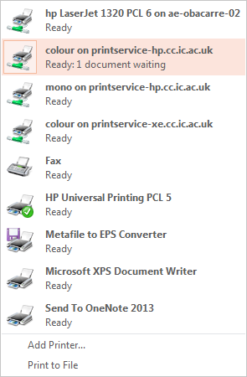
Printing
Drivers to print in college facilities
http://www.imperial.ac.uk/admin-services/ict/self-service/computers-printing/photocopying-scanning/
https://www.imperial.ac.uk/admin-services/ict/self-service/computers-printing/printing/how-to-print/

Slide 20
High Performance Computing (HPC)

Slide 21
High Performance Computing (HPC)
Central Linux-based HPC facilities available to all college users. For help with central HPC facilities, contact ICT.
http://www.imperial.ac.uk/admin-services/ict/self-service/research-support/hpc/
Aero has also its own HPC Student facility. For Aero's HPC, contact Omar Bacarreza
(o.bacarreza-nogales@imperial.ac.uk).
This Linux platform is permanently running and can be accessed remotely from any Windows, Mac or Linux computer (inside or outside college).

Slide 22
Getting Help

Slide 23
Getting Help
For all enquiries about Windows, accounts, login problems or email contact ICT:
Ext. 49000, 4th floor of Sherfield Building.
service.desk@imperial.ac.uk
For queries with access to courses or content on Blackboard please contact the Teaching Office on: ae.office@imperial.ac.uk

Slide 24
Getting Help
For any software/hardware issues in Aeronautics computer rooms then please contact:
Dr. Omar Bacarreza
o.bacarreza-nogales@imperial.ac.uk
Useful information on using Aero HPC Student facility can be found at:
http://torque.ae.ic.ac.uk/docs/

Slide 25
Any Question??

