Slide 1
WP2
Network control, dynamic reconfiguration and load management
General assembly
Imperial College London, 14-15 march 2-16

Slide 2
Overview
Contributors: ICL, IITKGP, IITD, UoS
Objective: develop advanced strategies for optimization, control, management and dynamic reconfiguration of the hybrid microgrid.
Milestones envisaged:
Characterize hybrid microgrid system operation (identify issues and associated effects)
Develop optimization tools for cost-effective operation and management of resources
Develop optimization-based schemes for voltage and frequency stability control in operation
Implement state estimation-based management for on-grid/off-grid dynamic reconfiguration and load management

Slide 3
Milestones achieved so far by ICL
Characterize hybrid microgrid system operation (identify issues and associated effects) ! (partly)
We are referring to and characterizing a general and realistic hybrid microgrid architecture, suited to represent different contexts and energy users areas (coastal areas, remote urban/rural communities, etc.)
We are considering a wide range of energy resources (DG, ES, RES), load profiles and demand requirements
Still missing is the characterization of the RESCUES prototype (only AC system identified) → we are waiting specs from WP1
An important problem is the lack of established standards for the DC feeder’s voltage

Slide 4
Milestones achieved so far by ICL
Develop optimization tools for cost-effective operation and management of resources (completed)
We have developed a practical economic dispatch (ED) tool, suitable for integration into the energy management system and robust to uncertainties in the system
We have demonstrated the robustness and efficiency of this tool by simulations on a general hybrid microgrid architecture
We have demonstrated its applicability in different operating scenarios, also considering contingencies
This work has produced an IEEE Transaction journal paper

Slide 5
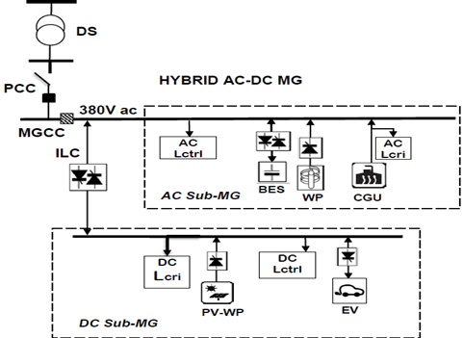
Optimization tools for cost-effective operation and management of resources
Economic Dispatch tool
Hybrid microgrid case study

Slide 6
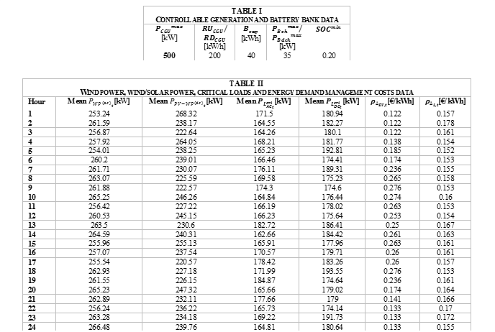
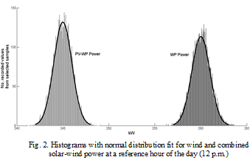
Database

Slide 7
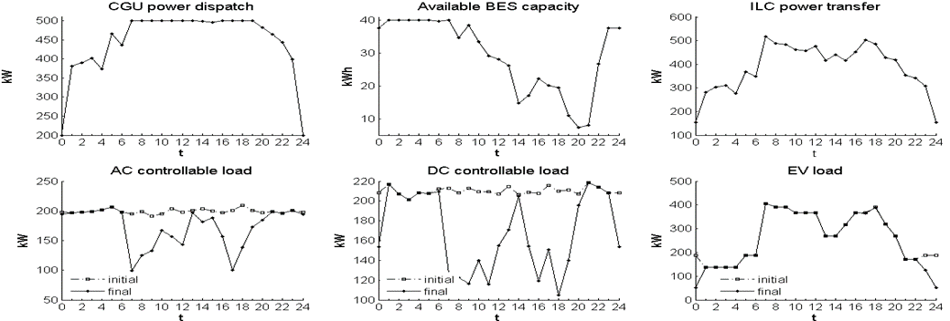
Some results (case A: normal conditions)
Optimal operating conditions of the hybrid MG resources in case A

Slide 8
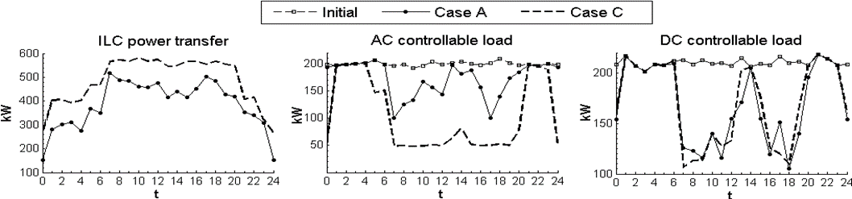
Some results (absence of battery storage)
Increased curtailment of controllable AC loads, particularly during daytime
Curtailment similar to that of Case A for controllable DC loads.
Interlinking converter forced to transfer more power from AC sub-MG to DC sub-MG

Slide 9
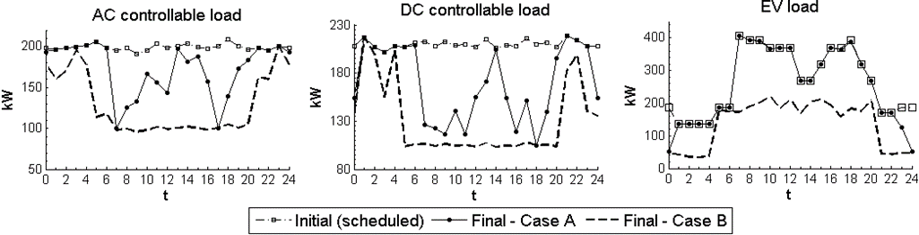
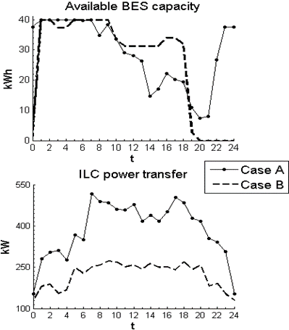
Some results (loss of one controllable generator)
Increased curtailment of AC & DC loads, especially in daytime
about 50% curtailment of scheduling at all times for EVs
Interlinking converter’s AC-DC power transfer reduced (up to 50%) compared to Case A
Free battery storage space generally higher until early night (20:00-02:00).

Slide 10
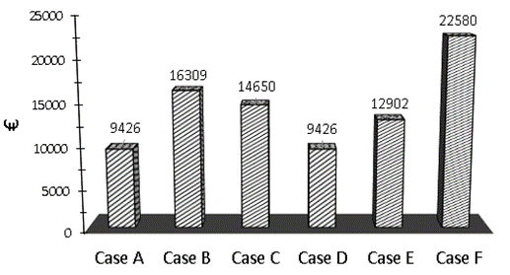
Operational costing
Alignment between economic and technical outcomes, as higher costs are seen in the most inconvenient operating scenarios:
Reduced controllable generation’s capacity (Case B)
Battery storage not included in energy management (Case C)
Reduced EV controllability (Case E)

Slide 11
Key aspects we have to consider in the study of hybrid microgrids for remote installation
In remote areas, microgrids (simple AC/DC or hybrid AC-DC) are especially interesting and convenient as stand-alone systems (disconnected from main distribution grid)
Typical stand-alone applications, already existing, are insular microgrids (UK, Japan, Greece, Portugal, Turkey)
Insular microgrid (FiNEST): renewable-powered, stand-alone microgrid integrated with various energy storage technologies and devices
  main benefit is the ability to reliably and continually produce electricity on site using local resources (solar, wind, water stream and bio-mass)
    supply the specific demand needs with both reduced environmental impact and improved economic efficiency
    reduce or eliminate the need to build traditional utility infrastructure

Slide 12
Key aspects we have to consider in the study of hybrid microgrids for remote installation
Stand-alone microgrids benefit of load management schemes alongside energy storage. So it is important to consider embedding these features into the energy management system, not only for schedule compliance but also for power balance management and thus voltage and frequency stability
The characterization of a hybrid microgrid mostly relies on the DC side characterization.
  This is why the specs of the DC side are so important for RESCUES objectives
The characterization of the DC side also depends on the on-grid or stand-alone option.

Slide 13
Next milestone for ICL
Develop optimization-based scheme for voltage stability control in operation of stand-alone AC-DC microgrid for remote installation.
Our first objective is to develop a practical methodology and practical computational tools for a system such as the hybrid AC-DC microgrid, the characteristics, aspects and challenges of which are still not completely evaluated and defined.

Slide 14
Two-step methodology to combine voltage stability management and optimization of operation in remote AC/DC microgrids

Slide 15
Methodological framework
We will consider first static voltage stability
  Static voltage stability is the basic issue for energy management.
  Dynamic voltage stability and frequency control have to be considered separately, and they will be in future work.
We will investigate the relation between voltage stability and the isolated steady-state nature of the microgrid, which determines an intrinsic weakness of the reference bus:
  Voltage instability can especially arise when relevant energy corridors or areas of the system are subject to high variations of load or generation - even jumps, e.g. due to RES – or to load management operations.

Slide 16
Methodology proposal
Preliminary study:
1. We will start from the microgrid characterization (structure - energy resources and power loads, logic configuration, technologies, service and production mission, operation program and detailed scheduling, O&M time scenarios)
2. We will develop realistic operative scenarios for voltage stability studies
3. We will define power regulation and compensation tools
4. We will define capacity and performance limits of resources

Slide 17
Methodology proposal
Aim: integrate steady state voltage stability management and optimization tasks in the Energy Management System
  The optimization will address typical problems related to voltage stability (e.g., min. of power losses, min. of reactive power flows, reactive power compensation)
  We will consider steady-state voltage stability first
  We will consider voltage stability management associated with dispatch of battery storage and control of interlinking converter.
The envisaged methodology is two-step, combining:
  load flow (LF) based voltage stability analysis (step 1)
  optimal power flow (OPF) assessment (step 2)

Slide 18
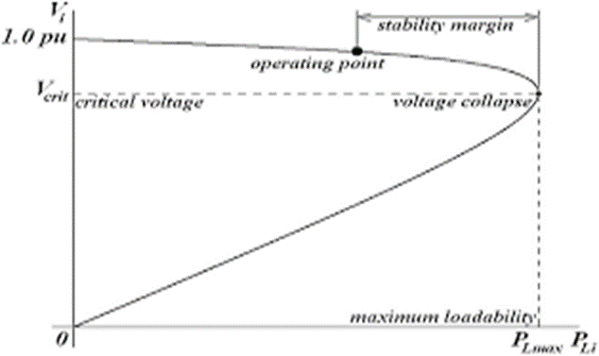
Methodology
Step 1: Load Flow based (LF) method for voltage stability scenarios and index characterization
Aim: Identify the points of voltage collapse (“critical points” on “PV curves) for all microgrid’s buses, and thus the weakest buses within AC and DC sub-systems.
The collapse point can be used as a “voltage stability index” (VSI) to assess the level of voltage stability in the system.
The VSI index is the means we will use to control the voltage stability in the optimization process.

Slide 19
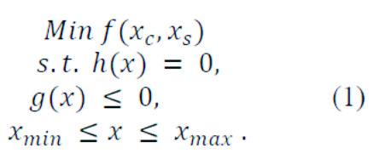
Methodology
Step 2: VSI-constrained optimal power flow for optimal microgrid operation and voltage stability control
Traditional OPF formulation for power losses minimization
Characterization and control of voltage stability through VSI constraint, in the OPF
Use of battery storage dispatch and interlinking converter control for voltage stability improvement

Slide 20
Further step: dynamic voltage stability
Voltage instability is well-established as a dynamic phenomenon.
Further, there are aspects of the problem which cannot be predicted by static load flow calculations.
In the dynamics of voltage collapse, an important component is load modeling
The usual load models are of two types. Most researchers use the nonlinear static models where real and reactive power are expressed as functions of voltage.
Proposal (to be investigated): generalize the static load model to a dynamical one. Focus on dynamic load with exponential recovery model

Slide 21
SPARE SLIDES

Slide 22
Typical hybrid AC-DC microgrid system
Stand-alone microgrid representing typical installations for isolated small urban centers (about 5.000-8.000 inhabitants – 30-50 MW installed power).

Slide 23
Composition of the AC-DC microgrid
These composition and configuration are tailored to voltage stability studies.
AC sub-system: 2 wind power plants (buses 4, 10), 1 thermal generation (bus 12), battery storage (bus 1), critical (buses 11, 12) and controllable (buses 2, 3, 5, 6, 7, 8, 9) AC loads .
  Loads represent an industrial district (15 MW) and a railway-electric traction substation (6 MW). Such loads are critical to voltage stability for their demand variability, which is maximum in relation to their respective scheduled on/off operation.
DC sub-system: photovoltaics (bus 19), 1 EV charging station (bus 20), critical (buses 18, 21) and controllable (buses 13-18) DC loads .
  The EV station can serve for dispatchability of the PV plant, especially when the AC bus calls for support to voltage stability.
  Loads represent residential DC minigrids, industrial small factories, data centre systems, public lighting provided with LED lamps.

