Slide 1
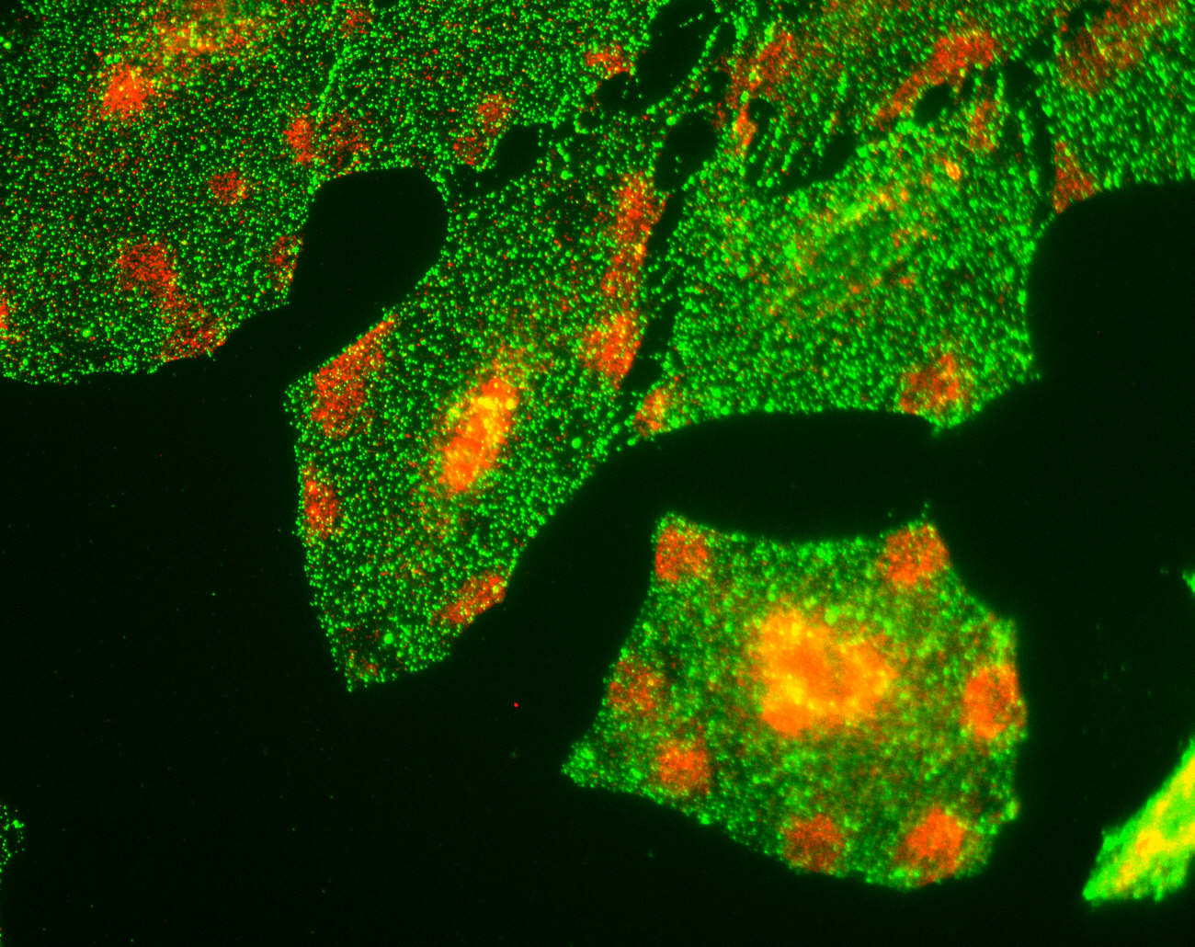
Department of Medicine
Campus visits
October 2012
Head of Department, Gavin Screaton
Departmental Manager, Matt Lee
Academic Opportunities Committee Chair, Jane Saffell

Slide 2
Purpose of the session
Let you know about thinking and progress since the Workshops in June
Receive feedback from you on our proposed changes/new initiatives – which would have the most/least impact?
Receive other practical suggestions from you for improving the department
(Emphasis is on open discussion of solutions … decisions will not be made today)

Slide 3
Context
The Department of Medicine has committed itself to developing a strong academic community of staff and students working together to fulfil our Mission, which is to:
Deliver outstanding medical research
Educate the next generation of leaders in medicine
Apply the benefits of discovery to improve public health

Slide 4
As part of this commitment, an Academic Opportunities Committee was set up in April
Reports to the Head of Department
Remit
Provide a conduit for communication from the grass roots to the Management Board
Monitor and advise on aspects of Department life relating to culture and organisation
Help develop an environment where all members can flourish and reach their potential
Also serves as Self-Assessment Team for work towards an Athena SWAN award application
Needs a new name – suggestions welcome

Slide 5
Workshops organised in June
Aim: to hear the broad views of members about the Department
Held 25-26 June 2012 at St Mary’s and HH campuses
Eight 1-hour sessions, four at each campus
Six open session & two for women only
70 attendees (academics, clinicians, post docs, PhD students and support staff)
Academic staff [clinical & non-clinical] 43%, research staff 32%, other clinicians 7%, administrative staff 14%, PhD students 3%
Facilitated by Fiona Richmond, Learning & Development Centre
How many present attended?

Slide 6
Broadly the workshops were structured to generate views around the following themes:
What are the blocks and obstacles in the department – barriers to performing?
Getting started in the Department
Retention and progression
Communication and engagement
Culture – What is it like now? What should it be like to enable people to achieve their best?
One thing that would make a difference – the silver bullet question.
The women-only groups also focussed on key career transition points.

Slide 7
Key themes that emerged …
Identification and engagement with the Department of Medicine
Communication
Individualism/collaboration - shared purpose
Administrative support/getting things done
Being valued and what is valued within the Department
Relationship with NHS
Culture

Slide 8
The women only groups were seeking to identify those issues that were specific to women and these included:
Career breaks/flexible ways of having an academic career and children
Lack of women role models and lack of alternatives to the linear, grants, high impact publications career path
Lack of good practice/open discussion about the real issues of maternity leave and short term contracts
Desire for culture that more women-friendly – less aggressive and greater valuing of different career paths and different contributions

Slide 9
“If you could make one change to the Department what would it be?”
“Communication between lab groups and individuals from across all areas of the department”
“Value good science and good behaviour over money”
“Valuing the whole – all qualities that make an excellent academic”
“Inclusive, supportive culture”
“I want to work in a department where I am known and valued; where I know what is expected of me; and I know who my colleagues are”
“Making it easier to get the day to day admin done”
“Make individuals feel more valued for their input into the department – teaching as well as grant income”
“Meeting for all staff to allow networking and keep everyone informed of what’s happening in the department”
Having a “community” feeling
“More personal engagement and interest from above”
“To value other things apart from publications”
“Consult and listen to the people who know what the job is about”
“More information when starting and more personal induction – can feel lost at the start”
“Communication of opportunities”
“Concrete acceptance that teaching is a bona fide activity worth recognising”
Support and mentorship

Slide 10
Academic Opportunities Committee discussed the Workshop findings and made recommendations to the Management Board, centred around …
Interaction
Communication
Starting in the Department
Career development & support
Initiatives for postdocs
These were put to Department members in a recent questionnaire.

Slide 11
Divisional staff meetings
Divisional away days
Christmas Departmental social
Cross-divisional symposia
New website features
Head of Dept suggestion box
Head of Dept campus visits
Departmental newsletter
Postdoc mailing list
Welcome reception
Welcome pack
New academic staff talks
Buddies
Discipline-centred workshops for postdocs Early-Career Committee
“Research & family life” panel discussion
Regular PRDP for all staff
Academic promotions support
Membership rotation on Department committees
Mentoring scheme

Slide 12
Divisional staff meetings (26)
Divisional away days (15)
Christmas Departmental social (6)
Cross-divisional symposia (18)
In Questionnaire top 3
out of 113 responses, 67F/45M
New website features (20)
Head of Dept suggestion box (10)
Head of Dept campus visits (11)
Departmental newsletter (8)
Postdoc mailing list (8)
Welcome reception (7)
Welcome pack (22)
New academic staff talks (15)
Buddies (8)
Discipline-centred workshops for postdocs (4) Early-Career Committee (7)
“Research & family life” panel discussion (1)
Regular PRDP for all staff (17)
Academic promotions support (17)
Membership rotation on Department committees (7)
Mentoring scheme (23)
Brackets: number of respondents who placed the item in their top three most important.

