Slide 1
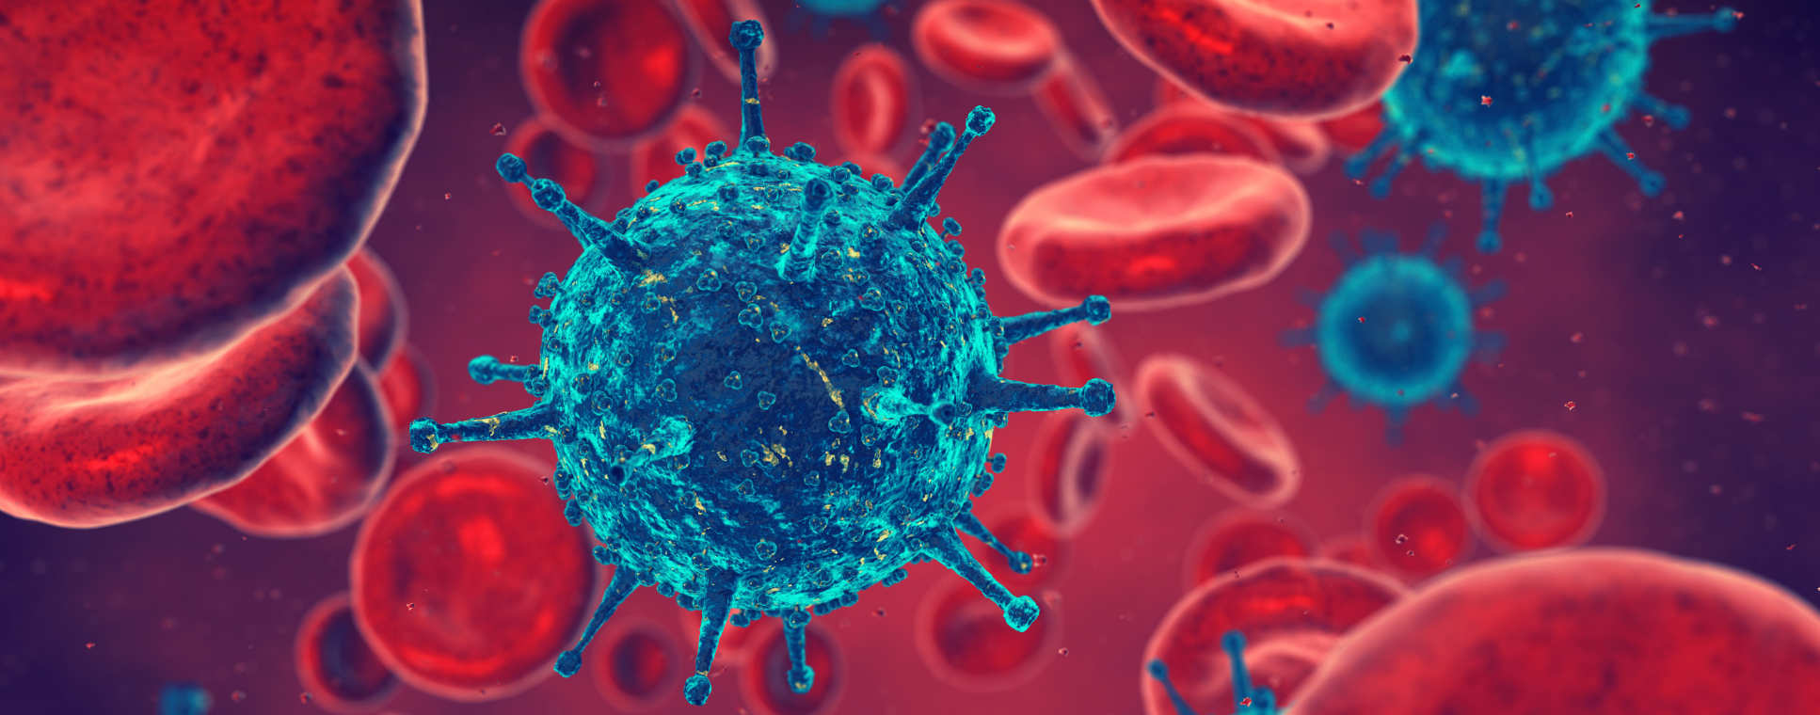
DIVISION OF INFECTIOUS DISEASES SYMPOSIUM
FRIDAY 24TH MARCH 2017
PROFESSOR CHARLES BANGHAM

Slide 2
DIVISION OF INFECTIOUS DISEASES
OVERVIEW: STAFF AND SECTIONS
SECTIONS
VIROLOGY | Professor Charles Bangham
INFECTIOUS DISEASES AND IMMUNITY | Professor Jon Friedland
MICROBIOLOGY | Professor Ramesh Wigneshweraraj
PAEDIATRICS | Professor Andrew Bush
138 research degree students across 5 sites.
343 staff members, of which 80 are senior academic staff.
Over 45 new staff members joined in 2016.

Slide 3
DIVISION OF INFECTIOUS DISEASES
OVERVIEW: STAFF AND SECTIONS
VIROLOGY: themes | Professor Charles Bangham
Molecular Virology (SMH) | Professor Paul Farrell
GU Medicine (SMH) | Professor Myra McClure
Mucosal Infection and Immunity (SMH) | Professor Robin Shattock
Immunology (SMH, CHW, NWP) | Professor Charles Bangham
INFECTIOUS DISEASES AND IMMUNOLOGY (HH) | Professor Jon Friedland
MICROBIOLOGY (SK) | Professor Ramesh Wigneshweraraj
PAEDIATRICS (SMH, HH, CHW, NWP, SK) | Professor Andrew Bush

Slide 4
DIVISION OF INFECTIOUS DISEASES
APPOINTMENTS 2016/7
Mitch Blair Professor of Paediatrics & Child Public Health
Alan Winston Professor of Genito-Urinary Medicine
Sarah Fidler Professor of HIV and Communicable Diseases
Jill Gilmour Professor of Practice
Paul Kellam Theme Lead for Viral Genetics
Jethro Herberg Clinical Senior Lecturer in Paediatric Infectious Diseases
Angela Brueggemann Senior Lecturer in Microbiology
Chris Chiu Senior Clinical Research Fellow in Infectious Diseases
Grzegorz Sarek Lecturer in Virology
Recruitment to the 2016/7 campaign for clinical/non-clinical SLs/Readers/Profs is underway.
New 0.2 FTE:
Dr Rino Rappuoli
In process:
Kirsty Mehring Le Doare - Clinical Senior Lecturer in Paediatrics
Louis Grandjean - Clinical Senior Lecturer in Paediatrics
Liz Whittaker - Senior Clinical Research Fellow

Slide 5
DIVISION OF INFECTIOUS DISEASES
Administration team
Divisional Manager
Cathy Tupman (SM)
(mat. cover to Jan 18)
Divisional Operations Assistant
Tubah Sarwar (SM)
(interim to Apr 17)
Virology
Professor Charles Bangham
Section Managers
Brett Onslow – Molecular Virology (SM) and Immunology & Vaccinology (C&W)
Sian Haynes – GU Medicine (SM), IAVI (C&W)
Michelle Kiely (interim to Apr 17) – GU Medicine, Mucosal Infection and Immunity, Retroviral Immunology, Viral Genetics (SM)
Alison Scoggins – ARPG (NWP)
Paediatrics
Professor Andy Bush
Section Manager
Chris Sanders (SM)
Sian Haynes – O/S (SM)
Brett Onslow – Neonates (C&W)
Infectious Diseases and Immunity
Professor Jon Friedland
Section Manager
Tammy Barrett (HH)
Microbiology
Professor Ramesh Wigneshweraraj
Section Manager
Sophie Dunhill (SK)
Centre for Infection Prevention & Management (CIPM)
Lead Alison Holmes
Operations Managers
Sara Yadav (HH)
Juliet Allibone (HH)
Centre for Molecular Bacteriology & Infection (CMBI)
Lead David Holden
Centre Manager
Kylie Glasgow (SK)
Centre for International Child Health (CICH)
Lead Beate Kampmann
Operations Assistant
Krupa Shukla (SM)

Slide 6
DIVISION OF INFECTIOUS DISEASES
RECENT AWARDS AND SUCCESSES
Grant income awarded in 2016 - £38.4m
2012 to date - £165.1m
Principal Investigator | Sponsor | Scheme | Awarded Amount
Raheelah Ahmad | NIHR | Knowledge Mobilisation Fellowship | £275K
Wendy Barclay | Wellcome Trust | Investigator Award | £1.5m
Angelika Grundling | MRC | Project Grant | £449K
Beate Kampmann | Bill and Melinda Gates Foundation | Project Grant | £987K
Beate Kampmann | Pfizer | Commercial Grant | £474K
Beate Kampmann | MRC | Global Challenges Research Fund - Foundation Award | £500K
Gwen Knight | MRC | Skills Development Fellowship | £325K
Paul Langford | BBSRC | Highlight notice in novel tools and technologies for vaccinology | £400K
Kath Maitland | University of Oxford | KEMRI-Wellcome Trust Research Programme | £1.5m
Avinash Shenoy | MRC | New Investigator Research Grant | £480K
Tom Williams | Wellcome Trust | Senior Research Fellowship in Clinical Science | £2m

Slide 7
DIVISION OF INFECTIOUS DISEASES
Open access publishing
HEFCE Open Access policy for the next REF:
Outputs should be discoverable and accessible.
Journal articles and conference proceedings: the peer-reviewed version must be deposited in Spiral (Imperial’s REF-compliant repository) within 3 months of acceptance.
It is the PI’s responsibility to ensure that they comply with this policy.
The College strongly advises you to deposit as soon as accepted.
Need help?
Tubah Sarwar (Divisional Operations Assistant) t.sarwar@imperial.ac.uk
Sam O’Connell (Department Open Access Champion) s.oconnell@imperial.ac.uk
Library Open Access Team openaccess@imperial.ac.uk
Research Data Management : www.imperial.ac.uk/research-data-management
The RDM team are happy to deal with any queries: rdm-enquiries@imperial.ac.uk

Slide 8
DIVISION OF INFECTIOUS DISEASES
Research Data Management (RDM)
What is Research Data Management (RDM)?
RDM is the planning, organization and preservation of the evidence that underpins all research conclusions. Good data management ensures data are safely stored, findable and can be used to reproduce findings.
Why is it important?
The College requires all research staff to have a plan for the storage and deposit of ‘live’ research data.
Reduces the risk of data loss.
Ensures research findings are transparent and can be verified.
Ensures that data can be reused.
Many funders require it.
Imperial College London Research Data Management Guide

Slide 9
DIVISION OF INFECTIOUS DISEASES
PROGRAMME
09:00: INTRODUCTION: Professor Charles Bangham | 13:30: PAEDIATRICS – Chair: Professor Andrew Bush
09:15 – IMMUNOLOGY; MUCOSAL INFECTION AND IMMUNITY Anurag Kulkarni, Michi Miura and Paul Kellam | 13:35 – Paul Turner and Alex Shaw
10:25: GU MEDICINE – Chair: Professor Myra McClure | 14:15: INFECTIOUS DISEASES AND IMMUNITY – Chair: Professor Jon Friedland
10:30 – Katrina Pollock and Sarah Fidler | 14:20 – Angela Brueggemann and Nicki Lynskey
11:10: Hayley Kendall-Berry and Professor Kevin Murphy (PhD supervision) | 15:10: COFFEE BREAK
11:20: COFFEE BREAK | 15:25: MICROBIOLOGY – Chair: Professor Ramesh Wigneshweraraj
11:45: MOLECULAR VIROLOGY – Chair: Professor Paul Farrell | 15:30 – Sophie Helaine and Alex Willis
11:50 – Grzegorz Sarek and Adam Cawte | 16:10: KEYNOTE LECTURE – Professor Luca Guidotti San Raffaele Scientific Institute
12:30: LUNCH | 17:00: Closing remarks
17:05-18:00: RECEPTION

