Slide 1
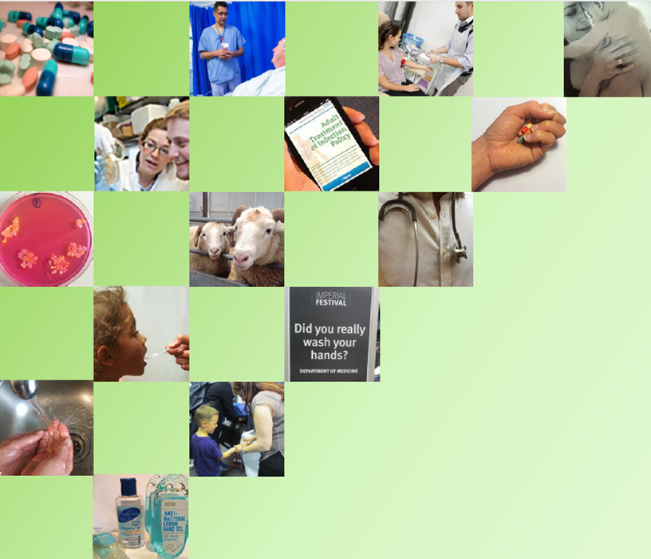




Micro-organisms, evolution and antibiotic resistance
Health Protection Research Unit in Healthcare Associated Infections and Antimicrobial Resistance at Imperial College London.

Slide 2
I am learning…
What microbes are in general and about bacteria specifically
What evolution is and how the environment causes bacteria to adapt to survive
What antibiotic resistance is and why it is important

Slide 3
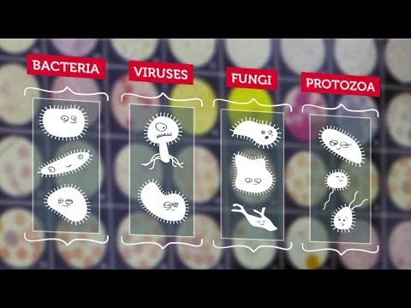
What are Microbes ?

Slide 4
What are Microbes ?
Microbes are tiny living things
They are so small that they cannot be seen by the naked eye
There are 4 main classes of microbe- bacteria, viruses, fungi and protozoa
Microbes can be helpful, or unhelpful

Slide 5
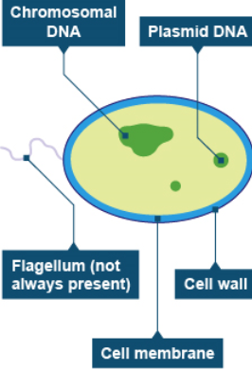
Bacteria basics
Unlike viruses, bacteria have a cell wall which surrounds the outside….
Bacteria don’t have a nucleus, unlike plant or animal cells. Instead they have two types of DNA floating around plasmid and chromosomal. The chromosomal DNA carries most of the genetic information, the plasmid DNA often carries genes that may benefit the survival of the bacteria, for example antibiotic resistance genes …..

Slide 6
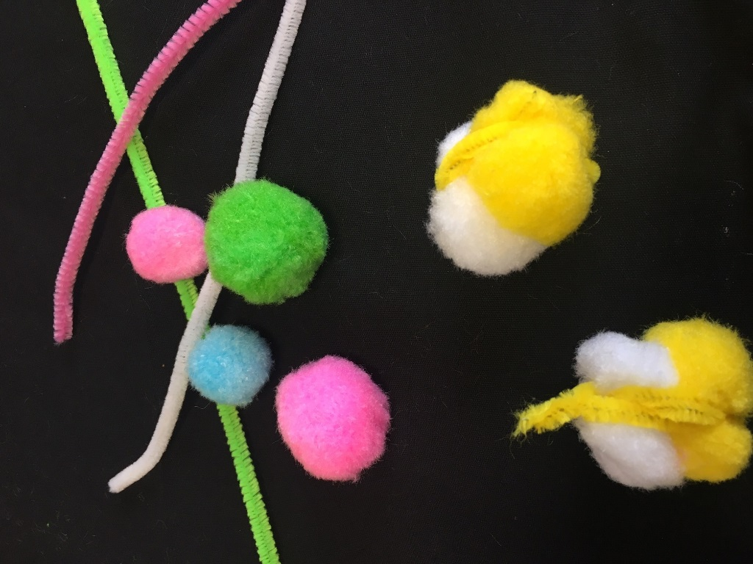
Bacteria building
We are now going to make a model bacteria.
We will use a pipe-cleaner to represent the cell wall.
We will use any two pom-poms to represent your bacterial plasmid and chromosomal DNA
Squash the pom-poms together and wrap your pipe-cleaner around the outside to hold them together

Slide 7
Bacteria colony…
Now the class has made a number of bacteria. This is called a colony. While individual bacteria cannot be seen by the naked eye, sometimes a colony can be.
Examine the bacteria.
They are all the same type and they all look more or less the same – however there is natural variation…
  The DNA (pom-pom) colours chosen may differ from one to another
  The colour of the cell wall (pipe cleaner) may be different
  Some cell walls may be wrapped tighter than others

Slide 8
Natural variation…
This natural variation can be seen in all groups of living things which are the same species.
Every time a bacterium replicates itself, there is an opportunity for small variation.
Some bacteria can replicate in as little as 20 minutes. For example, a single E. coli cell divides approximately every 15-20 minutes, so it can multiply to 16 million within eight hours.
Sometimes, these small variations, can lead to one bacteria having some sort of advantage over another when it comes to survival.
These “mutants” may replicate faster than the others, or be better at fighting off other bacteria, or better at surviving in a tough environment.

Slide 9
Naturally occurring resistance…
Some variations allow bacteria to survive the presence of ANTIBIOTICS
Antibiotics are compounds which kill bacteria. They are developed into medicines to kill disease-causing bacteria.
Antibiotics have allowed us to effectively treat disease since their discovery in the 1920s.
They have prevented us from dying from minor infections and allowed us to develop modern medical procedures including all kinds of surgery and cancer medicine.

Slide 10
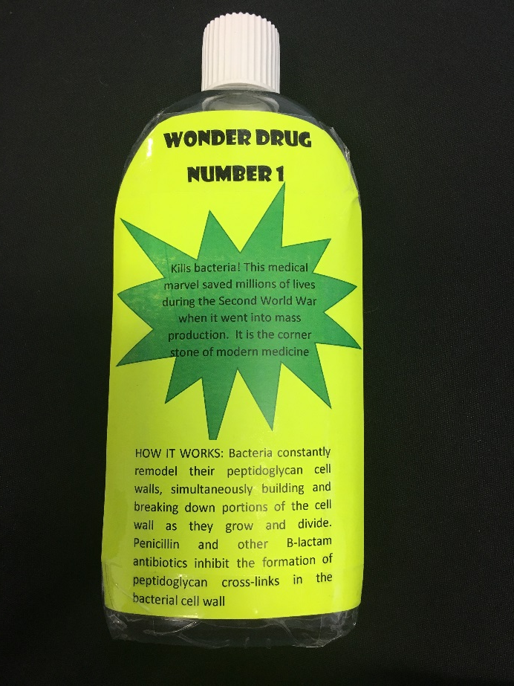
Naturally occurring resistance…
Let us demonstrate –
These bacteria are making us quite ill, so we are treated with an antibiotic: “Wonderdrug No. 1”
It kills all bacteria in the environment…except some, which have developed a mutation that stops the drug recognising the bacterium. This mutation is indicated by a pom-pom which is a ------------colour
This is naturally occurring (intrinsic) resistance.
All other bacteria are destroyed!
(please disassemble killed bacteria)

Slide 11
The antibiotic has probably made us better, but maybe we didn’t use them exactly as instructed, but not finishing the course.
If your bacteria were destroyed- please make another one in the same way.
Note that “Wonderdrug No 1” is still in the environment.

Slide 12
Selection pressure
If you chose a pom-pom which is colour ------------- because of the presence of “Wonderdrug no 1” your bacteria have responded to “selection pressure”.
Selection pressure happens when the conditions in the environment cause one type of organism to thrive over others. It is also called evolutionary pressure, or natural selection.
In our case it means that the presence of antibiotics in the environment allows only resistant bacteria thrive because the competition is killed off.
Antibiotic Resistance is a potential side-effect of the use of antibiotics

Slide 13
Acquired resistance
If you didn’t choose a pom-pom which is colour----------- don’t worry.
Our resistant bacteria can transfer their resistance to other bacterial, by sharing some of their plasmid DNA.
When bacteria evolve in response to selection pressure, or get resistant DNA from another bacteria, this is called acquired resistance.
Terrifyingly bacteria can share their DNA not only with their own kind, but with other species of bacteria too!
This is part of the reason antibiotic resistance is such a threat to global health.

Slide 14
Drug resistant bacteria
Review the bacteria again
As we exposed them to antibiotics we have now created a colony of drug resistant bacteria. These are going to cause drug-resistant illnesses.
If you go into hospital with an illness caused by these bacteria, giving you “wonderdrug no 1” will not work as the bugs are no longer susceptible.
You will have to be treated with a different drug

Slide 15
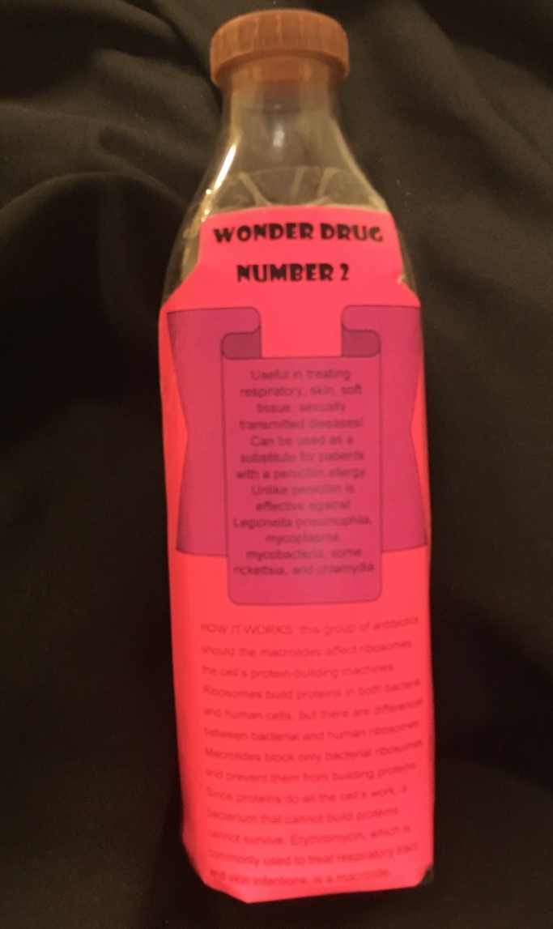
Wonderdrug no. 2
Luckily, we still have “wonderdrug no. 2” this works using a different mechanism and dissolves the cell wall
However, some bacteria may have a natural resistance to it, which in this case is indicated by a ------------ cell wall (pipe-cleaner)
All other bacteria are destroyed!
(please disassemble killed bacteria)

Slide 16
Multidrug resistant bacteria
All our bacteria, were already resistant to “wonderdrug no. 1”
Those which also already have natural resistance to “wonderdrug no. 2” are therefore now resistant to two types of drugs- they are called multi-drug resistant bacteria or multi-drug resistant organisms (MDRO)
Having used “wonderdrug no. 2” in the environment - what happens now if you are asked to make another bug?

Slide 17
Multidrug resistant bacteria
If the bacterium you made was destroyed- please make another in the same way
Bear in mind both “wonderdrug no.1” and “wonderdrug no. 2” are present in the environment
You can respond to the selection pressure by building a whole new bacterium or acquire the two types of resistance through the transfer of plasmid DNA

Slide 18
Multidrug resistant bacteria
We now have a colony of multi-drug resistant bacteria which are no longer susceptible to “wonderdrug no. 1” or “wonderdrug no. 2”
If you were to go to hospital with a disease caused by this bacteria, the hospital may not be able to treat you at all….
The ability and speed with which bacteria evolve like this, means the same pattern will occur if we were to introduce a “wonderdrug no. 3

Slide 19
Overuse and misuse of antibiotics
Our over-use of antibiotics not only in human health, but also in food producing animals has lead to antibiotic resistance becoming a global health threat
There are now organisms which are multi-drug resistant to all antibiotics including the antibiotics of last resort
There are no new antibiotics in the pipeline- and even if there were, as this exercise demonstrates, this is not going to solve the problem
Using antibiotics properly and only as and when they are truly needed is the only way to ensure that they will continue working in the future. They are a precious resource and should be treated as such!

Slide 20
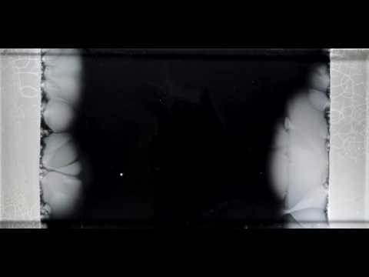
Video- Evolution in progress
You can watch the evolution of bacteria as we have just demonstrated, happening in real life in the following video clip

