Slide 1
Developments in Global Nuclear Markets
David Hess
Communication Manager
12 October 2016
Imperial College Nuclear Engineering Seminar Series
Notes:
Where nuclear energy is today, where it’s headed and where it needs to go

Slide 2
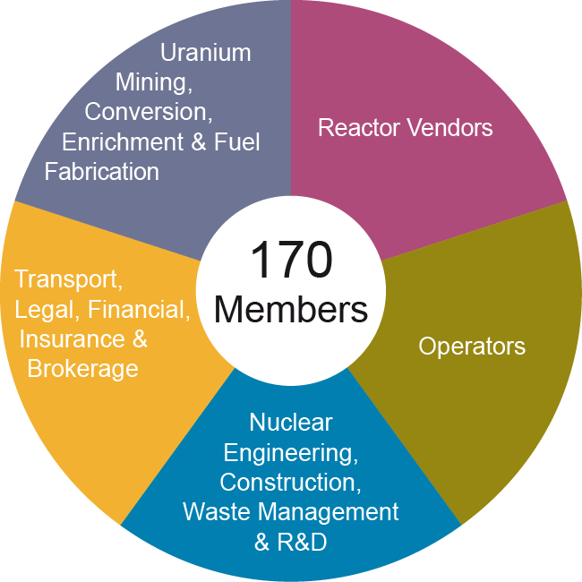
World Nuclear Association - Our members
Notes:
International
Represent industry

Slide 3
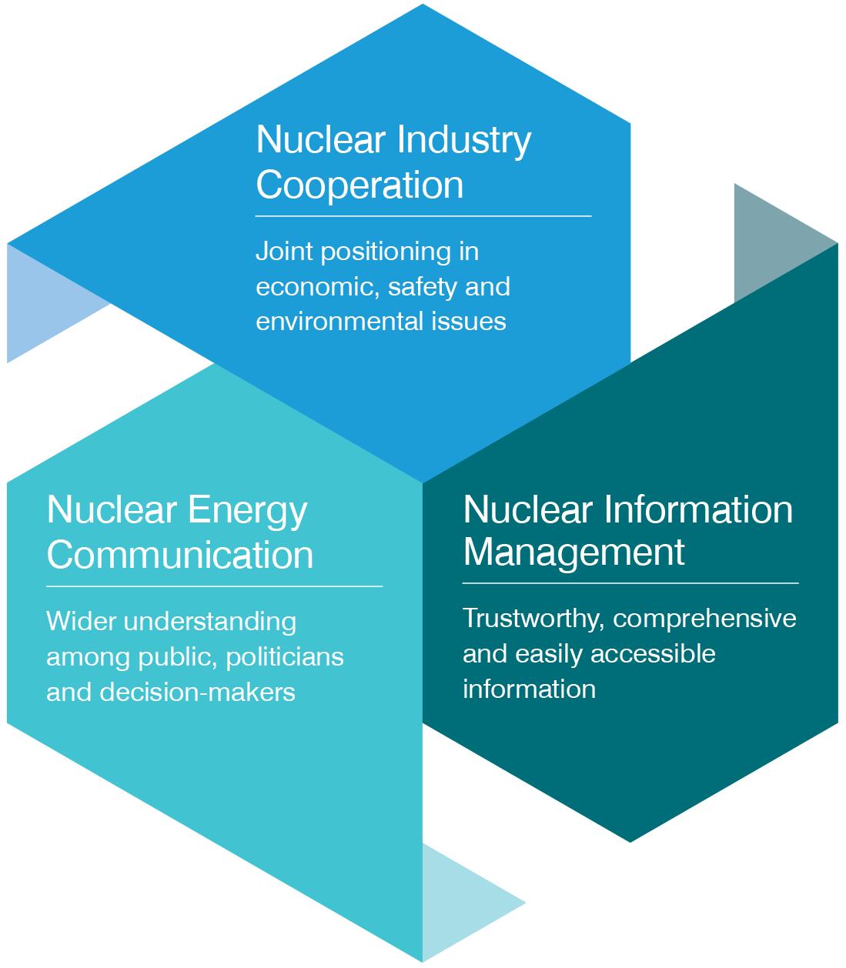
World Nuclear Association -What We Do
“The World Nuclear Association is committed to ensuring that the nuclear industry is best represented in all forums where its interests are at stake, enabling cooperation between its members, and communicating the benefits of nuclear energy in order to improve the market environment and secure greater support from key stakeholders”
Notes:
Our missions – read!
We actively promote nuclear energy
Mention areas
“ I have worked in all 3 – making me unique at WNA
Mention WNU

Slide 4
1. nuclear energy IN tHE WORLD TODAY

Slide 5
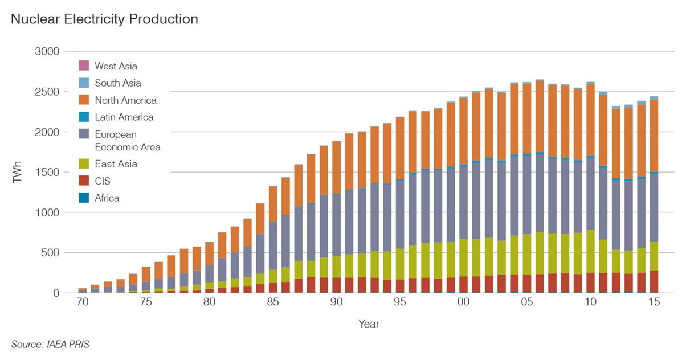
Global nuclear generation
450 operational reactors
392 GWe
~11% supply
Notes:
Click paras
We are growing but also ecovering
Not just new build CF, uprates improved
Note FD accident –
But compensated by reactors under construction

Slide 6
High level of construction worldwide 55 reactors
20
7
Russia
China
5
India
4
France
USA
Belarus
2
1
1
Finland
Chinese Taipei
2
3
1
Brazil
South Korea
Pakistan
3
Argentina
1
4
UAE
Slovakia
2
2
Japan
Notes:
Not all bad!
A little while ago it was 60 reactors under construction
but China keeps connecting the things!
Importance of China- China help = awesome

Slide 7
Global nuclear energy status
“The report of my death was an exaggeration” – global nuclear industry
Notes:
A lot of stuff going on in industry – uprates – life extension
~75% of world’s population live in countries with nuclear or planning nuclear
Click Nuclear industry is dynamic - exciting in many countries
Overall story is nuanced

Slide 8
Updates of interest 1
Interesting updates by country. Right click links to find source!
Argentina: 3 operational, 1 under construction
Progressing with CAREM SMR construction link.
Agreement for two Chinese-built reactors – PHWR (Atucha 3), the second a Hualong One link.
Cooperation agreement with Russia for a sixth nuclear unit. (2015) Link
Belgium: 7 operational
Nuclear policy is negative, but the oldest units, Doel 1 and 2 were recently (Dec 2015) cleared to operate until 2025 link
Recent high level reports push Belgium to change policy link
Brazil: 2 operational, 1 under construction
The Brazil nuclear industry has been drawn into country-wide graft probe with arrest of Electronuclear CEO link
Country will start enriching (for export to Argentina CAREM)
Notes:
Presentation gets a bit read-ey for a bit
Argentina – note Siemen winning BOP
Mention Brazil hydro drought emergency
Belgium policy technical has a phase out
Problems with RPV highlighted need for nuclear

Slide 9
Updates of interest 2
Canada: 19 operational
CANDU reactor refurbishment work worth >10 billion USD going ahead. Will see reactors operate 30 - 35 years longer link link
China: 35 operational, 20 under construction, (about 58 GWe expected by 2020)
5 units connected so far in 2016, 1 construction start link
Unexpected set back as locals in Lianyungang protest being possible reprocessing facility site link
Czech Republic: 6 operational
Utility CEZ requests environmental impact assessment for 2 further units at Dukovany link
Finland: 4 operational, 1 under construction
Delayed Olkiluoto 3 is now scheduled to start up in late 2018 link
Early site works have started on the Hanhikivi reactor link
Notes:
Bruce and Darlington reactors
China – size and diversity of programme
Czechs – long term increase in nuclear

Slide 10
Updates of interest 3
France: 58 operational, 1 under construction
New (2015) energy policy will see nuclear reduced to 50% of power generation by 2025 Link. Some doubts over if this will happen
EDF has agreed to take over Areva reactor division link
Regulator continues to investigate QA issues with forgings link
Germany: 8 operational, hard phase-out policy
Gov threaten utilities with 35% ‘risk premium’ for waste liabilities link
Hungary: 4 operational
Environmental approval received for 2 reactor Paks II project link
India: 22 operational (6GWe), 5 under construction
Second Kudankulam reactor (VVER) connected this year (2016) link
Joint statement with USA makes US AP1000s more likely link
Iran: 1 operational.
Ceremony (Sep 2016) marks start of Bushehr II project (2 VVERs) link
Notes:
France: not necessarily shut downs
Areva now more like Cogema
Germany – rip and ship, not delay and decay
Hungary with Russia
India, liability arrangements, lots or reactors little capacit
Iran: has mentioned as many as 8 projects

Slide 11
Updates of interest 4
Kazakhstan: 1 decommissioned, world’s biggest uranium miner
Country moving to supply fuel pellets in addition to uranium link
Pakistan: 3 under construction, 3 operational
Ground broken (2015) on a Chinese Hualong One reactor link
Romania: 2 operational
Agreement signed with China in Nov 2015 for 2 additional PHWRs at Cernavoda link
Russia: 36 operational, 7 under construction
Suspended nuclear cooperation and Pu agreement with USA link
making great progress with fast reactors link link
South Africa: 2 operational
Country will announce tender for 9.6GWe new nuclear programme – any day now. link
Notes:
Apologise for not much on fuel cycle
Kazakhstan is biggest U supplier
Russia – export and tech leader. Current political atmosphere very unfortunate

Slide 12
Updates of interest 5
South Korea: 25 operational, 3 under construction
First APR 1400 grid connected in January 2016 link
Construction permits for two more APR1400s granted in June link
Sweden 9 operational
Nuclear tax and poor market conditions means country will lose 4 reactors by 2020 link. Other units considered ‘at risk’
In some good news, the tax has been repealed (June 2016) link
UAE: 4 under construction (nuclear newcomer country)
Construction of four APR1400s on time and (presumably) budget. Now 70% complete. First unit should be online 2017 link
USA: 100 operational, 4 under construction
First new reactor in 30 years (Watts Bar II) grid connected link
However 5 reactors have closed since 2013 and at least 10 more are ‘at risk’ link
Notes:
South Korea: Industry prospects improving. Nuclear very competitive there
Sweden: big problems
USA needs to fix markets to avoid closures
EU also needs to fix broken markets

Slide 13
Highlight: Japan reactor fleet is slowly restarting
3 out of 42 operable reactors in Japan are now operating
Notes:
Good news restarts have happened (2015)
Replacement fuel bill in excess of FD clean up costs
Bad news – pace is glacial
Currently operating Sendia 1 and 2, Ikata
Takahama 3 and 4 restarted earlier this year. Taken offline due to a trip + court injunction

Slide 14
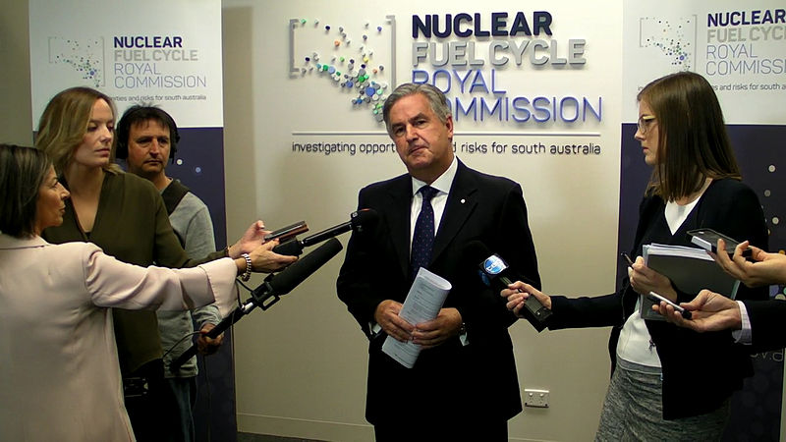
Highlight: Australia considers multi-national waste facility
Notes:
12 recommendations delivered 2016
Nuclear energy recognised for benefits – but would require correct market structure
Exciting multi-national waste! Citizens jury to try and build social license

Slide 15
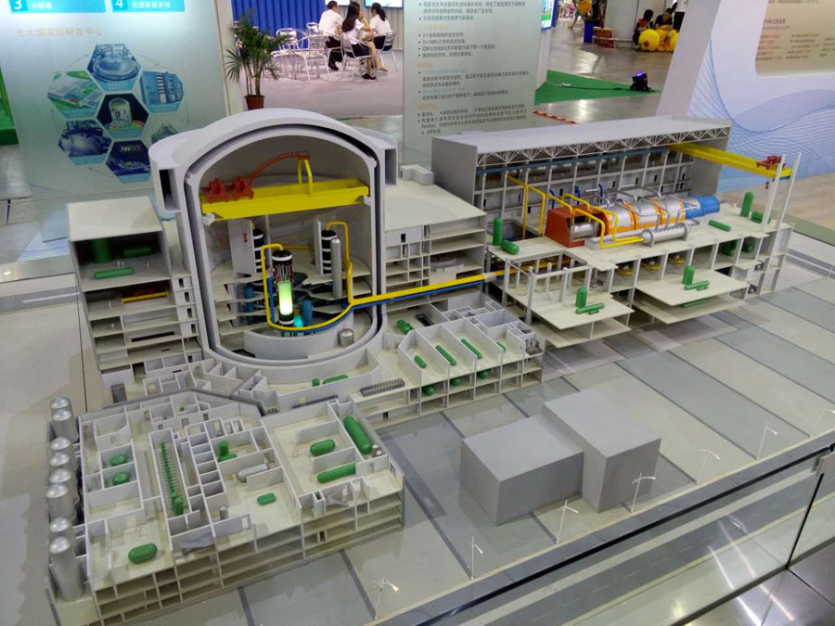
Highlight: China starts to increase reactor exports
Hualong One
Notes:
Hualong 1 Indigenous – under construction 2015. JV joint venture in March 2016
Also to develop AFCR with SNC Lavalin
Not just reactors - forgings
Can they do what they have for other large infrastructure projects (rail and hydro)?
Export countries: Pakistan, Argentina, Romania)
Others: South Africa? Saudi? UK?

Slide 16
Recent Highlight: Hinkley Point C approved!
Notes:
International project – Announced at our conference
Taken the blows for other UK projects. Paves the way
Opens up new build in Europe
I’m happy to discuss why I think HPC is good idea
Strategic (other options not ready or as good), it’s ready now, safety and security, international partnership, regional growth

Slide 17
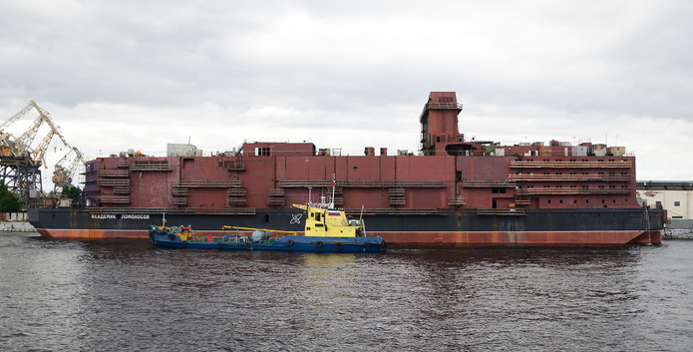
Recent Highlight: SMRs are happening.
First Russian floating nuclear power plant under construction – picture taken May 2015
With 2 x 40 MWe reactors. Destined for Pevek, NE Siberia
Notes:
SMRs are happening
Comment - but likely to fill niche markets

Slide 18
2. The current nuclear energy outlook
Notes:
Recap on exciting developments

Slide 19
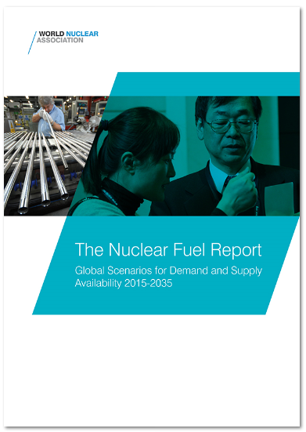
What about the future?
We have published reports on the supply and demand of nuclear fuel since our foundation in 1975
The 2015 report is the 17th in the series
It describes the supply capacities in natural uranium, conversion, enrichment and fabrication services
It provides three scenarios for future reactor development

Slide 20
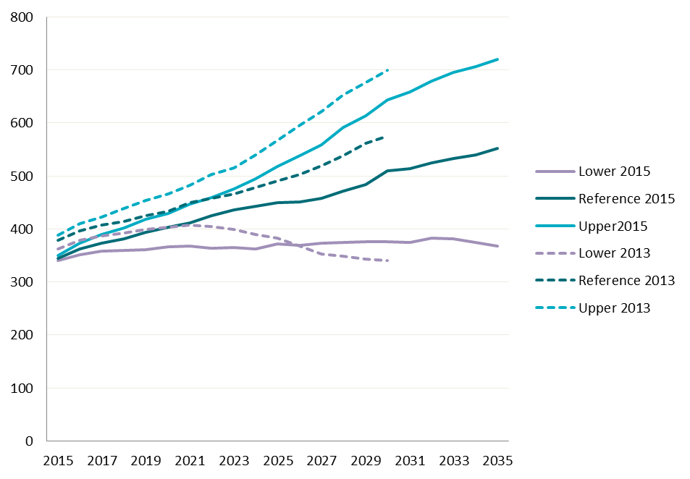
World Nuclear Association Market Report scenarios
GWe
Notes:
We have published reports since our foundation in 1975
In real terms –growing In relative terms shrinking
Difference between two: Mostly about delays rather than cancellatioon’

Slide 21
Reference Case Capacity GWe 2015 & 2035
operating
serious
emerging
Notes:
21
China especially dominates projections
Important for industrialisation

Slide 22
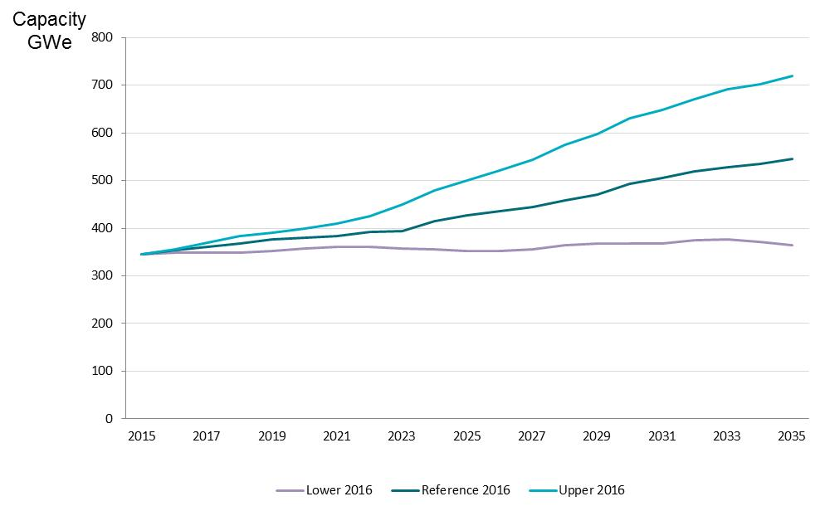
Market Report scenarios 2016 update
Notes:
Similar to old scenario – Even more of a contraction

Slide 23
3 The nuclear energy growth we actually need if we are to MEET ENERGY and ENVIRONMENTAL GOALS

Slide 24
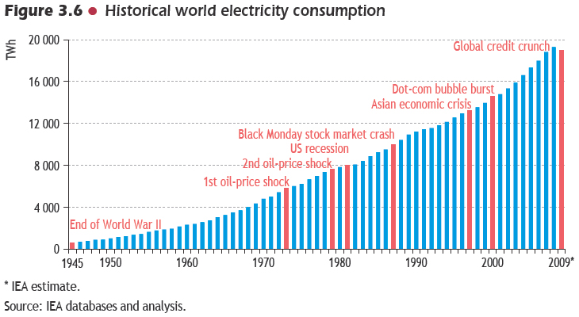
Global electricity consumption more than doubles by 2050
World Energy Outlook
Notes:
That is a remarkable growth!
I call this upwardly slanty graph part of presentation

Slide 25
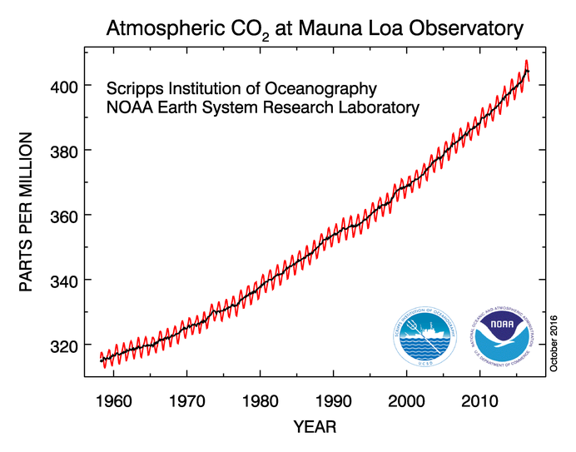
CO2 levels – still growing fast
Notes:
Accelerating?

Slide 26
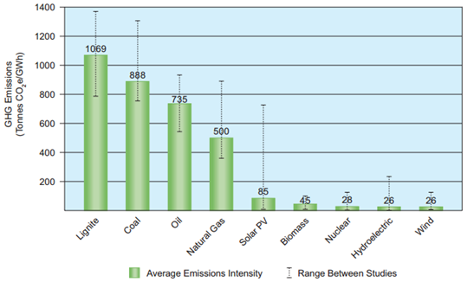
Nuclear energy among lowest CO2 emissions
Source: World Nuclear Association meta study, incl. IPCC 2014
Notes:
You guys probably don’t need this but…

Slide 27
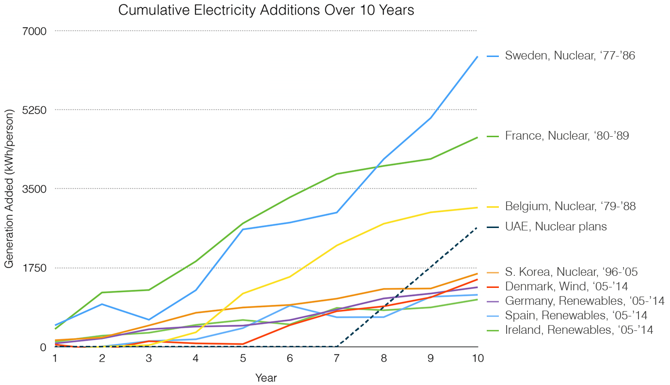
Nuclear energy can scale quickly
Source: Breakthrough Institute

Slide 28
IEA 2DS: Nuclear provide the largest contribution to global electricity in 2050
Source: International Energy Agency
Notes:
Nuclear has the biggest role to play 17%
But has very interesting assumptions for other tech

Slide 29
World Nuclear Association Harmony vision
1000 gigawatt new nuclear capacity by 2050
Level playing field
Nuclear energy working with other low C tech to balance the needs of human development with those of environment
Harmonised regulatory processes
Effective safety paradigm
Nuclear providing 25% of electricity supply by 2050
Notes:
Targets
Explain difference
Promote people. Protect the planet
We will concentrate on…

Slide 30
The Harmony target
GW
TWh
11000
25% of generation
1200
9000
1000
GW
8000 TWh
1250 GW
10000 TWh
1000
7000
800
5000
600
3000
11% of generation
396 GW
400
150
GW
1000
200
2411
TWh
0
Retirements
Additions
0
2014
2050
Source: World Nuclear Association. Growth required for nuclear energy to supply 25% of electricity in 2050 under demand forecast of two-degree scenario (see IEA, 2015, Energy Technology Perspectives 2015.
Assumption: 91% capacity factor
30
Notes:
Over tripling in size. Ambitious, but doable

Slide 31
The Harmony timeline
Period Connection rate Added capacity
GW per year GW
2016-2020 10 50
2021-2025 25 125
2026-2050 33 825
_________________________________
Total new nuclear capacity 1000 GW

Slide 32
The Harmony timeline
Period Connection rate Added capacity
GW per year GW
2016-2020 10 50
2021-2025 25 125
2026-2050 33 825
_________________________________
Total new nuclear capacity 1000 GW
Yearly connection of new nuclear:
Below 5 GW the last 15 years
Doubled to 10 GW in 2015
Historically 31 GW in mid 1980s

Slide 33
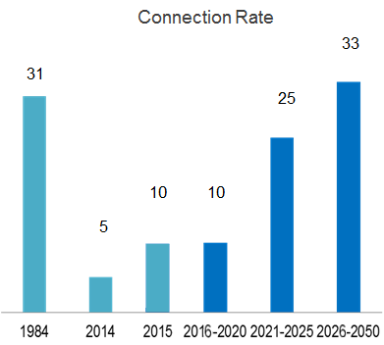
The Harmony timeline
Period Connection rate Added capacity
GW per year GW
2016-2020 10 50
2021-2025 25 125
2026-2050 33 825
_________________________________
Total new nuclear capacity 1000 GW
Yearly connection of new nuclear:
Below 5 GW the last 15 years
Doubled to 10 GW in 2015
Historically 31 GW in mid 1980s
Connection rate
Notes:
If we reacted to CC same as energy crises, job would be done for nuclear

Slide 34
Harmony
diversity, balance, concord
www.nuclearfootrpints.org
Notes:
Why Harmony
3 basic ways to produce energy –
trapped chemical. Renewable (kinetic or solar energy) Nuclear
Diversity – energy security
Balance – supply demand, competing factors
concord – industry working towards common goal
Balanced diet, investment – want that in energy

