Slide 1
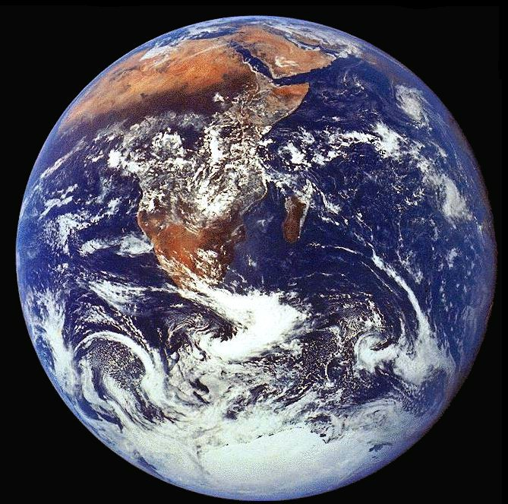
Imaging in the Earth Sciences:
Techniques and challenges
Imaging the Earth: a problem of scale
The Earth surface
  Geology, Biology, Physics
The Atmosphere
  Climate dynamics
The Earth interior
  Geochemistry
  Geophysics
The Ocean interior
  Chemistry
Corpus-Pembroke Northwest Centre for Science
Dr. Yves Plancherel
yvesp@earth.ox.ac.uk
Corpus Christi College, Oxford, June 26th, 2014

Slide 2
Well… just take a picture and we’re done.
Notes:
Arrows point to an optically continuous K-feldspar grain separated by quartz-filled fractures in orthogneiss (82MW0017). K-feldspar is stained green in this image, and sodic perthite appears orange. Click here for a zip file with full resolution image.kfs: K-feldspar qtz: quartz
Feldspars (KAlSi₃O₈ – NaAlSi₃O₈ – CaAl₂Si₂O₈) are a group of rock-forming tectosilicate minerals that make up as much as 60% of the Earth's crust.
Quartz is the second most abundant mineral in the Earth's continental crust, after feldspar. It is made up of a continuous framework of SiO₄ silicon–oxygen tetrahedra, with each oxygen being shared between two tetrahedra, giving an overall formula SiO₂.
When placed between two polarizing filters set at right angles to each other, the optical properties of the minerals in the thin section alter the colour and intensity of the light as seen by the viewer. As different minerals have different optical properties, most rock forming minerals can be easily identified. Plagioclase for example can be seen in the photo on the right as a clear mineral with multiple parallel twinning planes. The large blue-green minerals are clinopyroxene with some exsolution of orthopyroxene.Thin sections are prepared in order to investigate the optical properties of the minerals in the rock. This work is a part of petrology and helps to reveal the origin and evolution of the parent rock.

Slide 3
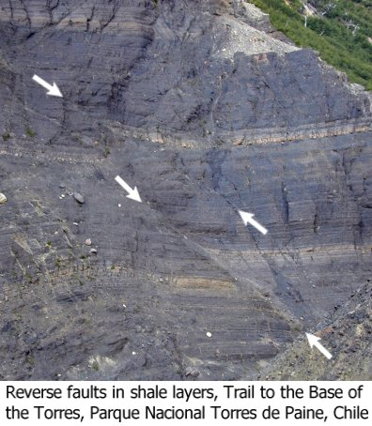
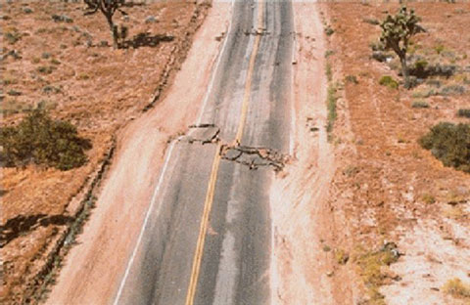
Reverse faults
Just taking pictures … of rocks
Crustal deformation (Geomorphology)
Strike-slip fault
Landers earthquake in California
(magnitude 7.3)
Scientific questions:
How far do faults go? Why?
Are there sizes typical? Why?
Where do we see faults? …
http://facweb.bhc.edu/academics/science/harwoodr/geol101/study/structur.htm
Wikipedia
Notes:
A fault in the Grands Causses as seen from Bédarieux, France. The left side moves down while the right side moves up. The warping of the rock layers on the right is likely due to drag folding.

Slide 4
Just taking pictures … of fluids (air, water)
How can we see the air move? Large-scale fluid dynamics
A picture: On May 22, 2013, the MODIS instrument, on Aqua, one of NASA’s Satellite, captured this natural-color image behind Isla Socorro, a volcanic island in the Pacific Ocean, located a few hundred kilometers off the west coast of Mexico.
A physical phenomenon: This is an example of von Karman vortices in the atmosphere, a Karman street, seen thanks to clouds
Scientific questions:
What sets the size of these vortices?
Why are they so regular?
Why do they only exist “below” the island?
Credit: NASA image courtesy Jeff Schmaltz, LANCE/EOSDIS MODIS Rapid Response Team at NASA GSFC. Caption by Adam Voiland.

Slide 5
…or we can also take more complicated pictures
… using the whole of the electromagnetic spectrum
Notes:
Arrows point to an optically continuous K-feldspar grain separated by quartz-filled fractures in orthogneiss (82MW0017). K-feldspar is stained green in this image, and sodic perthite appears orange. Click here for a zip file with full resolution image.kfs: K-feldspar qtz: quartz
Feldspars (KAlSi₃O₈ – NaAlSi₃O₈ – CaAl₂Si₂O₈) are a group of rock-forming tectosilicate minerals that make up as much as 60% of the Earth's crust.
Quartz is the second most abundant mineral in the Earth's continental crust, after feldspar. It is made up of a continuous framework of SiO₄ silicon–oxygen tetrahedra, with each oxygen being shared between two tetrahedra, giving an overall formula SiO₂.
When placed between two polarizing filters set at right angles to each other, the optical properties of the minerals in the thin section alter the colour and intensity of the light as seen by the viewer. As different minerals have different optical properties, most rock forming minerals can be easily identified. Plagioclase for example can be seen in the photo on the right as a clear mineral with multiple parallel twinning planes. The large blue-green minerals are clinopyroxene with some exsolution of orthopyroxene.Thin sections are prepared in order to investigate the optical properties of the minerals in the rock. This work is a part of petrology and helps to reveal the origin and evolution of the parent rock.

Slide 6
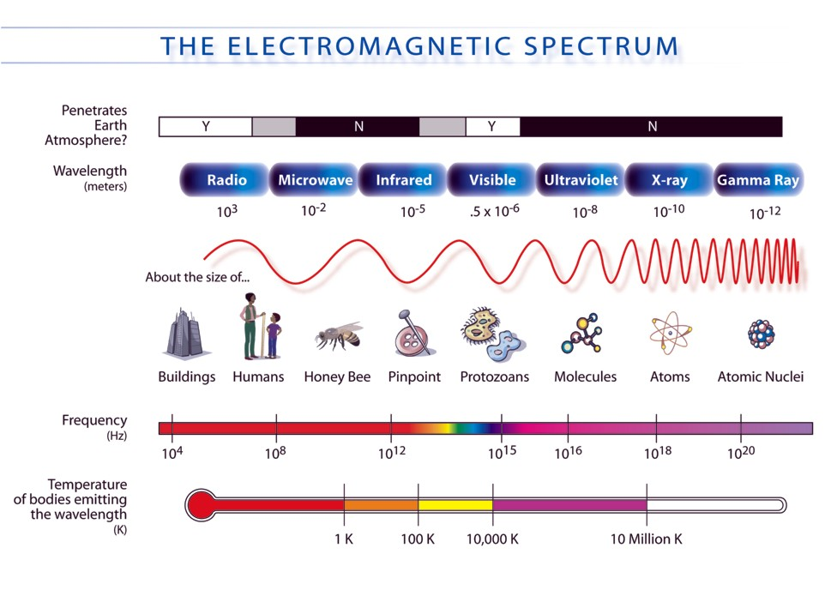
What the human eye sees vs. what technology can do
http://mynasadata.larc.nasa.gov/science-processes/electromagnetic-diagram/
Notes:
was the first artificial Earth satellite. It was a 58 cm (23 in) diameter polished metal sphere, with four external radio antennas to broadcast radio pulses.
Sputnik itself provided scientists with valuable information. The density of the upper atmosphere could be deduced from its drag on the orbit, and the propagation of its radio signals gave information about the ionosphere.

Slide 7
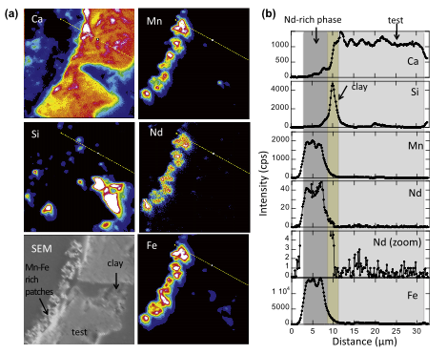
Basic physical principles behind most imaging techniques used in Earth Sciences
Altimetry (time)
  Distances
Interferometry (phase)
  Distances
Absorption/Emission/Scattering (magnitude)
  Spectroscopy, Composition
  Identification, Quantification
Polarization (angle)
  Composition/structure of an object
Tomography (reconstruction)
  Interior structure of objects
Scale up
Scale down

Slide 8
Imaging the Earth Surface (“star-wars” style)
Notes:
Arrows point to an optically continuous K-feldspar grain separated by quartz-filled fractures in orthogneiss (82MW0017). K-feldspar is stained green in this image, and sodic perthite appears orange. Click here for a zip file with full resolution image.kfs: K-feldspar qtz: quartz
Feldspars (KAlSi₃O₈ – NaAlSi₃O₈ – CaAl₂Si₂O₈) are a group of rock-forming tectosilicate minerals that make up as much as 60% of the Earth's crust.
Quartz is the second most abundant mineral in the Earth's continental crust, after feldspar. It is made up of a continuous framework of SiO₄ silicon–oxygen tetrahedra, with each oxygen being shared between two tetrahedra, giving an overall formula SiO₂.
When placed between two polarizing filters set at right angles to each other, the optical properties of the minerals in the thin section alter the colour and intensity of the light as seen by the viewer. As different minerals have different optical properties, most rock forming minerals can be easily identified. Plagioclase for example can be seen in the photo on the right as a clear mineral with multiple parallel twinning planes. The large blue-green minerals are clinopyroxene with some exsolution of orthopyroxene.Thin sections are prepared in order to investigate the optical properties of the minerals in the rock. This work is a part of petrology and helps to reveal the origin and evolution of the parent rock.

Slide 9
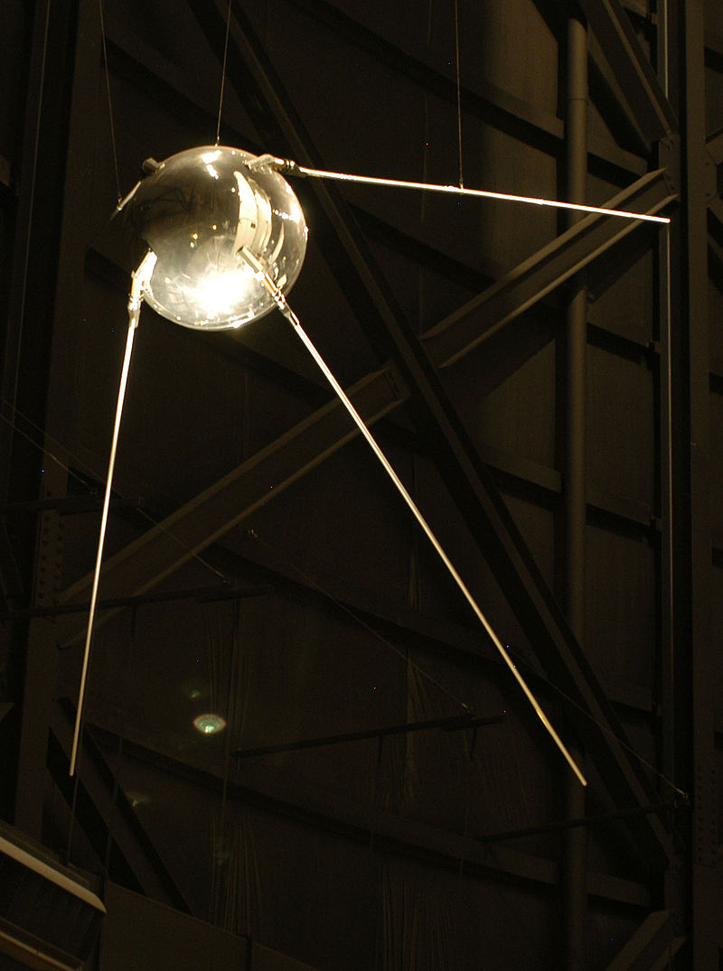
The first artificial satellite
4 Oct 1957: Sputnik 1
Primary goal:
Show off/intimidate in a context of Cold War
Scientific gains:
  estimate the density of the upper atmosphere by observing drag on orbital trajectory
  propagation of radio signal = information on ionosphere
Wikipedia
Notes:
was the first artificial Earth satellite. It was a 58 cm (23 in) diameter polished metal sphere, with four external radio antennas to broadcast radio pulses.
Sputnik itself provided scientists with valuable information. The density of the upper atmosphere could be deduced from its drag on the orbit, and the propagation of its radio signals gave information about the ionosphere.

Slide 10
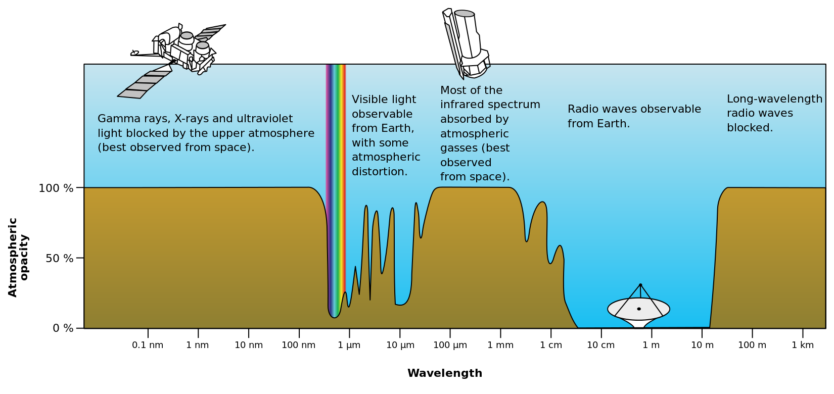
The electromagnetic spectrum and the atmosphere
(A.K.A. Choosing the right frequency)
Wikipedia
Would it be useful for the human eye to see radio-waves?
Notes:
was the first artificial Earth satellite. It was a 58 cm (23 in) diameter polished metal sphere, with four external radio antennas to broadcast radio pulses.
Sputnik itself provided scientists with valuable information. The density of the upper atmosphere could be deduced from its drag on the orbit, and the propagation of its radio signals gave information about the ionosphere.

Slide 11
Dabbling in the microwaves.
Notes:
Arrows point to an optically continuous K-feldspar grain separated by quartz-filled fractures in orthogneiss (82MW0017). K-feldspar is stained green in this image, and sodic perthite appears orange. Click here for a zip file with full resolution image.kfs: K-feldspar qtz: quartz
Feldspars (KAlSi₃O₈ – NaAlSi₃O₈ – CaAl₂Si₂O₈) are a group of rock-forming tectosilicate minerals that make up as much as 60% of the Earth's crust.
Quartz is the second most abundant mineral in the Earth's continental crust, after feldspar. It is made up of a continuous framework of SiO₄ silicon–oxygen tetrahedra, with each oxygen being shared between two tetrahedra, giving an overall formula SiO₂.
When placed between two polarizing filters set at right angles to each other, the optical properties of the minerals in the thin section alter the colour and intensity of the light as seen by the viewer. As different minerals have different optical properties, most rock forming minerals can be easily identified. Plagioclase for example can be seen in the photo on the right as a clear mineral with multiple parallel twinning planes. The large blue-green minerals are clinopyroxene with some exsolution of orthopyroxene.Thin sections are prepared in order to investigate the optical properties of the minerals in the rock. This work is a part of petrology and helps to reveal the origin and evolution of the parent rock.

Slide 12
Principle of altimetry: speed = distance/time so distance = speed * time
Speed: speed of light time: fraction of seconds
Notes:
Arrows point to an optically continuous K-feldspar grain separated by quartz-filled fractures in orthogneiss (82MW0017). K-feldspar is stained green in this image, and sodic perthite appears orange. Click here for a zip file with full resolution image.kfs: K-feldspar qtz: quartz
Feldspars (KAlSi₃O₈ – NaAlSi₃O₈ – CaAl₂Si₂O₈) are a group of rock-forming tectosilicate minerals that make up as much as 60% of the Earth's crust.
Quartz is the second most abundant mineral in the Earth's continental crust, after feldspar. It is made up of a continuous framework of SiO₄ silicon–oxygen tetrahedra, with each oxygen being shared between two tetrahedra, giving an overall formula SiO₂.
When placed between two polarizing filters set at right angles to each other, the optical properties of the minerals in the thin section alter the colour and intensity of the light as seen by the viewer. As different minerals have different optical properties, most rock forming minerals can be easily identified. Plagioclase for example can be seen in the photo on the right as a clear mineral with multiple parallel twinning planes. The large blue-green minerals are clinopyroxene with some exsolution of orthopyroxene.Thin sections are prepared in order to investigate the optical properties of the minerals in the rock. This work is a part of petrology and helps to reveal the origin and evolution of the parent rock.

Slide 13
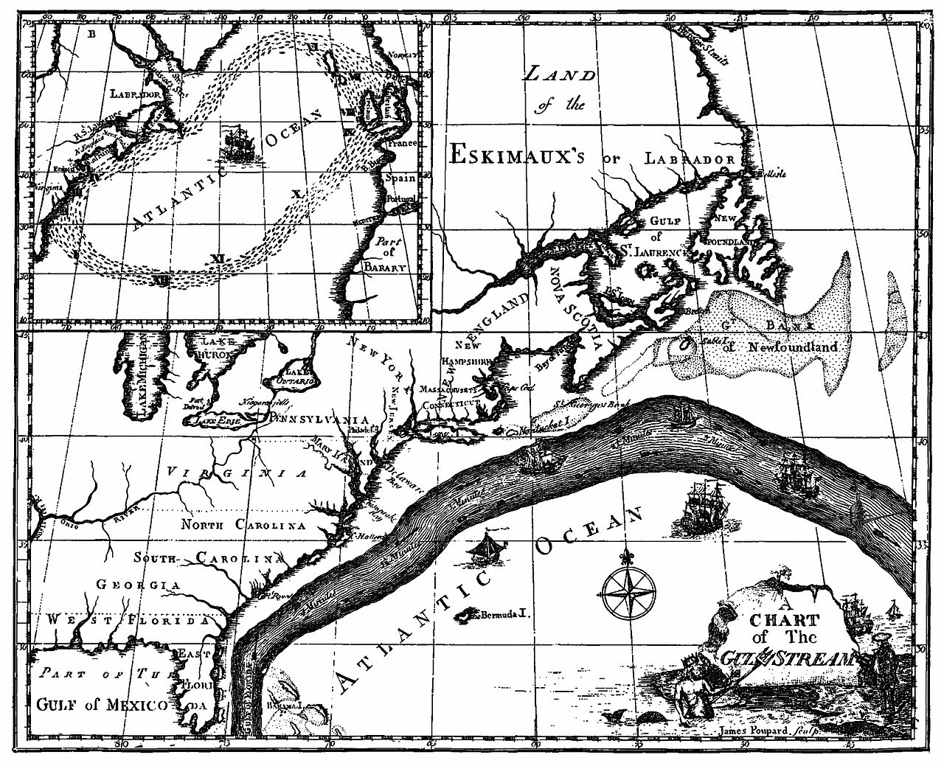
Physics: Ocean circulation and surface properties
(Gulf Stream first observed by Ponce de Leon, 1513)
Benjamin Franklin’s map (1769)
Current speed about 1m/s = 3.6 km/hr = 2.2 miles/hr
Can we do better today?
Notes:
Benjamin Franklin, Gulf Stream map, contrast with today’s SST maps.

Slide 14
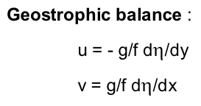
Sea surface height and current velocity
Sea surface
Sea surface
Geopotential
= lines of constant gravity
No pressure gradient =
No velocity
Pressure gradient
=
Velocity
…so if one can:
estimate the “height” of the sea surface relative to the geopotential,
one should be able to estimate ocean currents!
Notes:
Arrows point to an optically continuous K-feldspar grain separated by quartz-filled fractures in orthogneiss (82MW0017). K-feldspar is stained green in this image, and sodic perthite appears orange. Click here for a zip file with full resolution image.kfs: K-feldspar qtz: quartz
Feldspars (KAlSi₃O₈ – NaAlSi₃O₈ – CaAl₂Si₂O₈) are a group of rock-forming tectosilicate minerals that make up as much as 60% of the Earth's crust.
Quartz is the second most abundant mineral in the Earth's continental crust, after feldspar. It is made up of a continuous framework of SiO₄ silicon–oxygen tetrahedra, with each oxygen being shared between two tetrahedra, giving an overall formula SiO₂.
When placed between two polarizing filters set at right angles to each other, the optical properties of the minerals in the thin section alter the colour and intensity of the light as seen by the viewer. As different minerals have different optical properties, most rock forming minerals can be easily identified. Plagioclase for example can be seen in the photo on the right as a clear mineral with multiple parallel twinning planes. The large blue-green minerals are clinopyroxene with some exsolution of orthopyroxene.Thin sections are prepared in order to investigate the optical properties of the minerals in the rock. This work is a part of petrology and helps to reveal the origin and evolution of the parent rock.

Slide 15
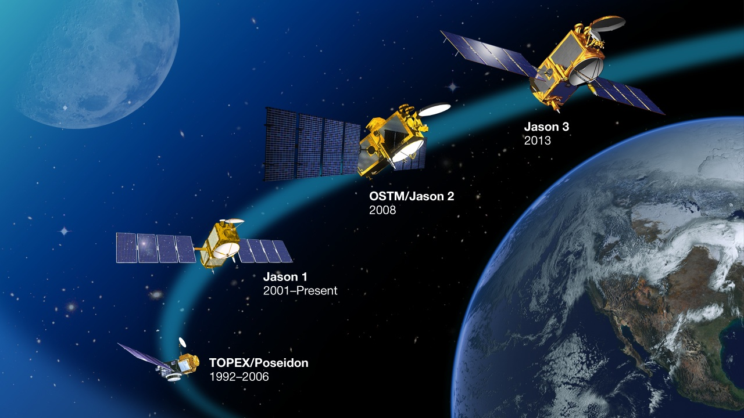
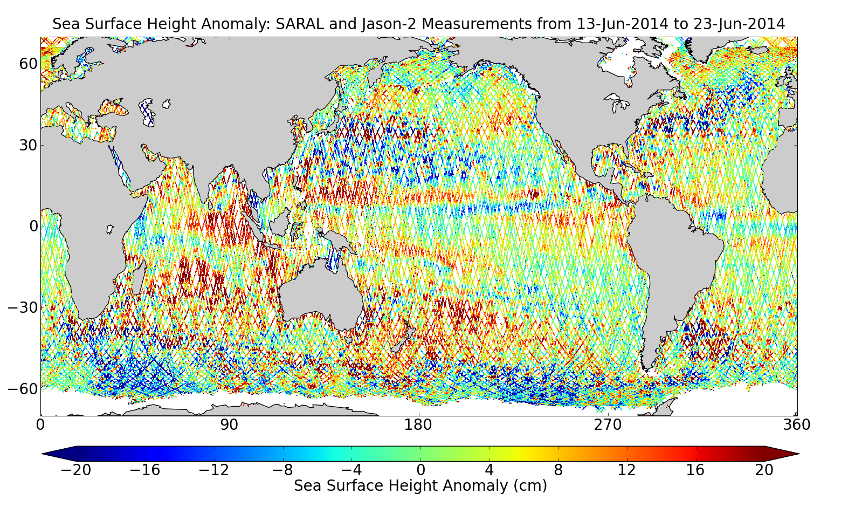
Topex/Poseidon, Jason
Sea surface height from space
(global coverage in 10 days, radar altimetry)
Notes:
This is like active sonar in submarine, but with microwaves instead of sound pressure waves.

Slide 16
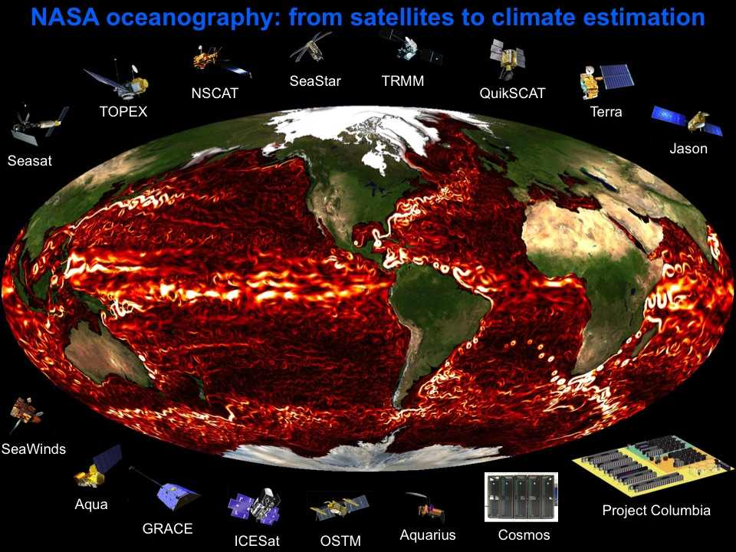

Slide 17
That’s nice … but does the Earth gravity field also vary?
Why would it vary?
Notes:
Arrows point to an optically continuous K-feldspar grain separated by quartz-filled fractures in orthogneiss (82MW0017). K-feldspar is stained green in this image, and sodic perthite appears orange. Click here for a zip file with full resolution image.kfs: K-feldspar qtz: quartz
Feldspars (KAlSi₃O₈ – NaAlSi₃O₈ – CaAl₂Si₂O₈) are a group of rock-forming tectosilicate minerals that make up as much as 60% of the Earth's crust.
Quartz is the second most abundant mineral in the Earth's continental crust, after feldspar. It is made up of a continuous framework of SiO₄ silicon–oxygen tetrahedra, with each oxygen being shared between two tetrahedra, giving an overall formula SiO₂.
When placed between two polarizing filters set at right angles to each other, the optical properties of the minerals in the thin section alter the colour and intensity of the light as seen by the viewer. As different minerals have different optical properties, most rock forming minerals can be easily identified. Plagioclase for example can be seen in the photo on the right as a clear mineral with multiple parallel twinning planes. The large blue-green minerals are clinopyroxene with some exsolution of orthopyroxene.Thin sections are prepared in order to investigate the optical properties of the minerals in the rock. This work is a part of petrology and helps to reveal the origin and evolution of the parent rock.

Slide 18
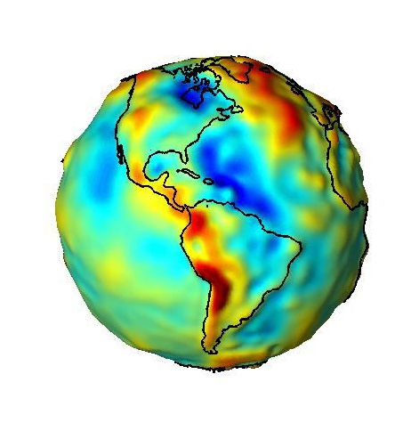
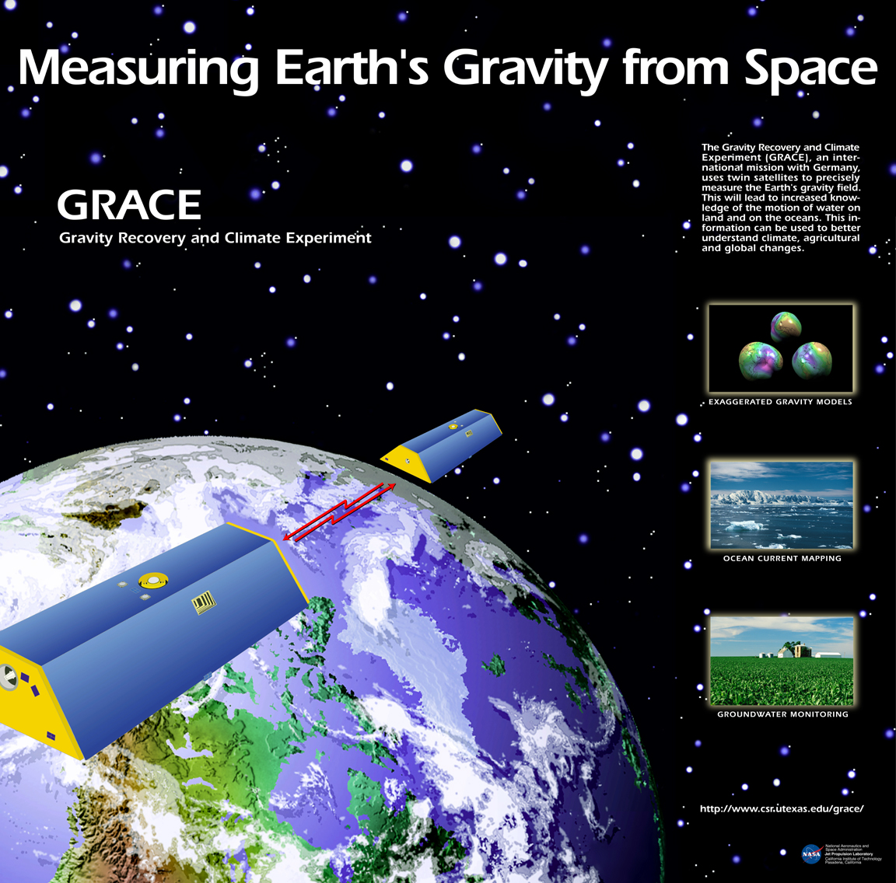
Image the Earth Gravitational Field
Study:
variations in space
variations in time
Measure the distance between 2 satellite using microwaves
(like altimetry, but between two satellites)
http://grace.jpl.nasa.gov/
Learn about: - Solid earth
- Hydrology
- Ice
- Ocean
Notes:
Grace Application: hydrology, ice, solid earth, ocean

Slide 19
More on measuring distances…
Notes:
Arrows point to an optically continuous K-feldspar grain separated by quartz-filled fractures in orthogneiss (82MW0017). K-feldspar is stained green in this image, and sodic perthite appears orange. Click here for a zip file with full resolution image.kfs: K-feldspar qtz: quartz
Feldspars (KAlSi₃O₈ – NaAlSi₃O₈ – CaAl₂Si₂O₈) are a group of rock-forming tectosilicate minerals that make up as much as 60% of the Earth's crust.
Quartz is the second most abundant mineral in the Earth's continental crust, after feldspar. It is made up of a continuous framework of SiO₄ silicon–oxygen tetrahedra, with each oxygen being shared between two tetrahedra, giving an overall formula SiO₂.
When placed between two polarizing filters set at right angles to each other, the optical properties of the minerals in the thin section alter the colour and intensity of the light as seen by the viewer. As different minerals have different optical properties, most rock forming minerals can be easily identified. Plagioclase for example can be seen in the photo on the right as a clear mineral with multiple parallel twinning planes. The large blue-green minerals are clinopyroxene with some exsolution of orthopyroxene.Thin sections are prepared in order to investigate the optical properties of the minerals in the rock. This work is a part of petrology and helps to reveal the origin and evolution of the parent rock.

Slide 20
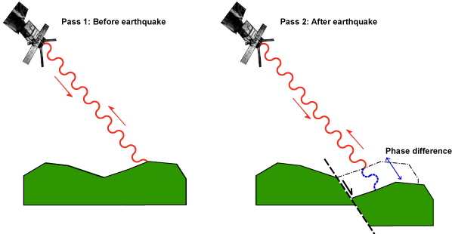
Interferometric synthetic aperture radar-InSAR
Geophysical monitoring of natural hazards:
  Earthquakes, volcanoes, landslides, structural stability (engineering), glacier movement, etc.
Active Radar
Microwave frequencies not absorbed by atmosphere
InSAR can see through clouds and at night
USE: Measure centimeter-scale deformations
N-wavelengths
N-wavelengths + ??
http://comet.nerc.ac.uk/index.html
Wikipedia
Notes:
Radar interferometry is a technique where radar data, recorded by a satellite, is used to map the topography or deformation of the ground. Earth scientists use radar interferometry for a wide range of applications including measuring surface change caused by earthquakes, volcanoes, glacier flow, landslides, and ground subsidence.
At COMET, scientists use radar interferometry to make surface deformation maps, or interferograms, to study the warping of the Earth's surface during the earthquake cycle. The interferograms allow scientists to determine the location, magnitude and type of an earthquake, and investigate the future seismic hazard for an area.In this area of the site you will learn how COMET scientists used interferometry to study an earthquake that struck the town of Izmit in northern Turkey in 1999. You will learn about:

Slide 21
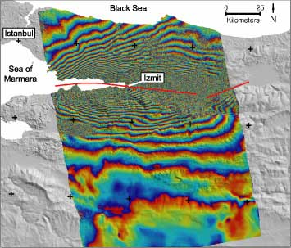
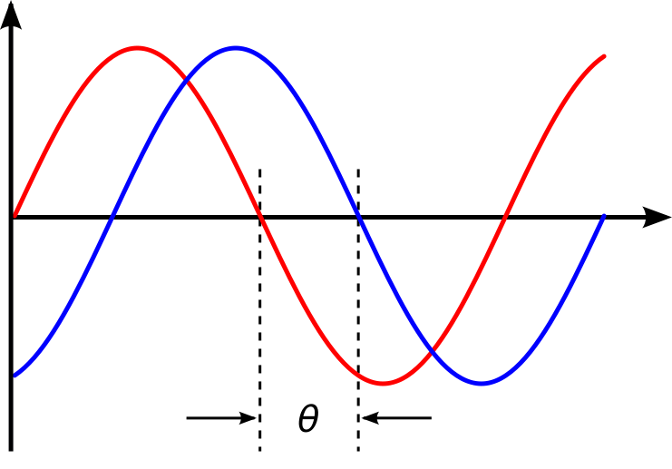
InSAR- Interferometric synthetic aperture radar
Wave send from the satellite
Reflected signal received
Interferogram: Difference in phase = after - before
56 mm
First time
28 mm
Second time
http://comet.nerc.ac.uk/index.html
Notes:
The adjacent contours (interference fringes) of the same colour represent one wavelength's difference between the phase recorded before the earthquake and the phase recorded after the earthquake.The wavelength of the radar waves used is 5.6 cm. This means that the distance between adjacent fringes represents a ground movement of 2.8 cm - half the radar wavelength. It is half the wavelength because each wave travels from the satellite to the ground and then back again. Thus, the phase change at the ground is doubled by the time the wave has bounced back to the satellite.The closer the fringes are together, the greater the strain on the ground. The red lines show where the fringes are closest together and therefore the source of the earthquake (the North Anatolian Fault in this example).To calculate the ground movement at the fault, count the fringes from the edge of the interferogram (approximately 25 on each side) and multiply by 28 mm. In this case, the area immediately south of the fault moved more than 70 cm closer to the satellite. The area to the north moved by a similar amount away from the satellite.Another interesting aspect is shown when a cross-section of the interferogram is taken along the line A-A'. The displacement along A-A' is shown to the right of the interferogram. It reveals the characteristic rebound form of a strike-slip earthquake.

Slide 22
Saying goodbye to microwaves
…Absorption/emission and biology
Notes:
Arrows point to an optically continuous K-feldspar grain separated by quartz-filled fractures in orthogneiss (82MW0017). K-feldspar is stained green in this image, and sodic perthite appears orange. Click here for a zip file with full resolution image.kfs: K-feldspar qtz: quartz
Feldspars (KAlSi₃O₈ – NaAlSi₃O₈ – CaAl₂Si₂O₈) are a group of rock-forming tectosilicate minerals that make up as much as 60% of the Earth's crust.
Quartz is the second most abundant mineral in the Earth's continental crust, after feldspar. It is made up of a continuous framework of SiO₄ silicon–oxygen tetrahedra, with each oxygen being shared between two tetrahedra, giving an overall formula SiO₂.
When placed between two polarizing filters set at right angles to each other, the optical properties of the minerals in the thin section alter the colour and intensity of the light as seen by the viewer. As different minerals have different optical properties, most rock forming minerals can be easily identified. Plagioclase for example can be seen in the photo on the right as a clear mineral with multiple parallel twinning planes. The large blue-green minerals are clinopyroxene with some exsolution of orthopyroxene.Thin sections are prepared in order to investigate the optical properties of the minerals in the rock. This work is a part of petrology and helps to reveal the origin and evolution of the parent rock.

Slide 23
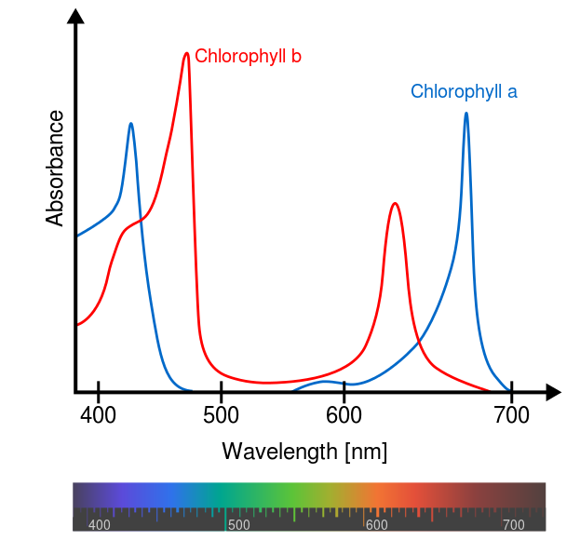
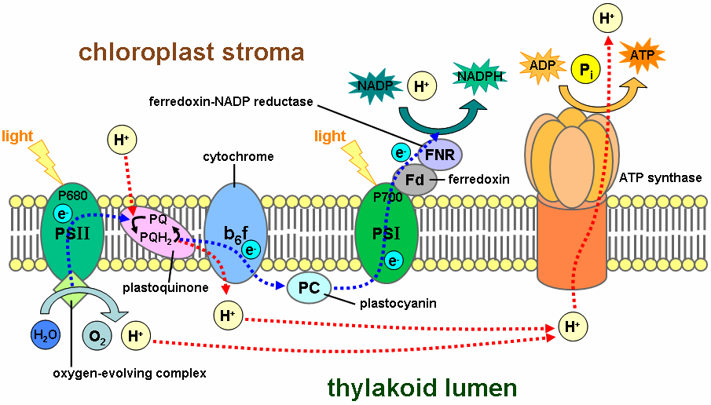
Biology: Light and photosynthesis
Chl-a does not absorb green light
Wikipedia
We know the light spectrum going towards Earth
Measure the light spectrum leaving Earth
How can we interpret the difference?
Notes:
Photosynthetically Active Radiation (PAR)A daily PAR estimate is obtained for each instantaneous pixel, assuming the cloud/surface system is stable during the day and corresponds to the satellite observation. Daily PAR estimates obtained separately from different orbits and individual sensors are binned using a simple, linear averaging scheme (arithmetical mean).The GlobColour PAR demonstration product is based on a merged MERIS/SeaWiFS PAR product.

Slide 24
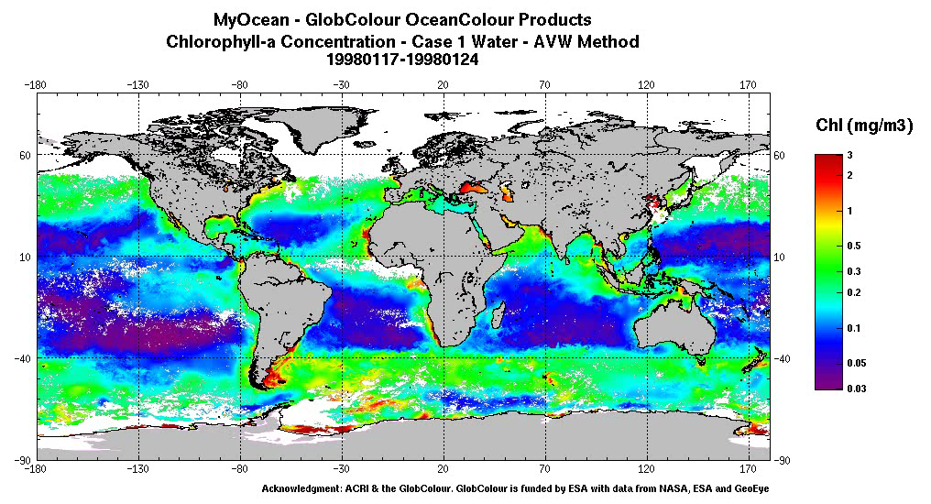
MERIS + SeaWIFS (1997-2010, 8 channels)
MEdium Resolution Imaging Spectrometer + Sea-Viewing Wide Field-of-View Sensor
PAR➔Chlorophyll-a➔Primary production➔CO₂
Study biological variations in space and time!
http://www.globcolour.info/gallery.html
Notes:
This visualization shows ocean surface currents around the world during the period from June 2005 through December 2007. The visualization does not include a narration or annotations; the goal was to use ocean flow data to create a simple, visceral experience.
his visualization was produced using model output from the joint MIT/JPL project: Estimating the Circulation and Climate of the Ocean, Phase II or ECCO2. ECCO2 uses the MIT general circulation model (MITgcm) to synthesize satellite and in-situ data of the global ocean and sea-ice at resolutions that begin to resolve ocean eddies and other narrow current systems, which transport heat and carbon in the oceans. ECCO2 provides ocean flows at all depths, but only surface flows are used in this visualization. The dark patterns under the ocean represent the undersea bathymetry. Topographic land exaggeration is 20x and bathymetric exaggeration is 40x.
This visualization was shown at the SIGGRAPH Asia 2012 Computer Animation Festival.

Slide 25
Imaging the Atmosphere
What about climate change?
Notes:
Arrows point to an optically continuous K-feldspar grain separated by quartz-filled fractures in orthogneiss (82MW0017). K-feldspar is stained green in this image, and sodic perthite appears orange. Click here for a zip file with full resolution image.kfs: K-feldspar qtz: quartz
Feldspars (KAlSi₃O₈ – NaAlSi₃O₈ – CaAl₂Si₂O₈) are a group of rock-forming tectosilicate minerals that make up as much as 60% of the Earth's crust.
Quartz is the second most abundant mineral in the Earth's continental crust, after feldspar. It is made up of a continuous framework of SiO₄ silicon–oxygen tetrahedra, with each oxygen being shared between two tetrahedra, giving an overall formula SiO₂.
When placed between two polarizing filters set at right angles to each other, the optical properties of the minerals in the thin section alter the colour and intensity of the light as seen by the viewer. As different minerals have different optical properties, most rock forming minerals can be easily identified. Plagioclase for example can be seen in the photo on the right as a clear mineral with multiple parallel twinning planes. The large blue-green minerals are clinopyroxene with some exsolution of orthopyroxene.Thin sections are prepared in order to investigate the optical properties of the minerals in the rock. This work is a part of petrology and helps to reveal the origin and evolution of the parent rock.

Slide 26
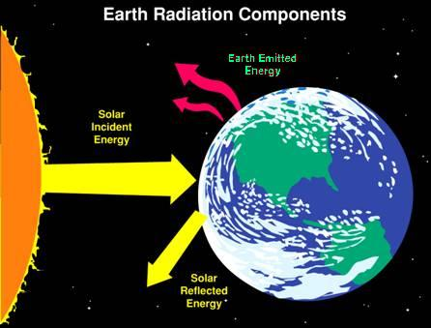
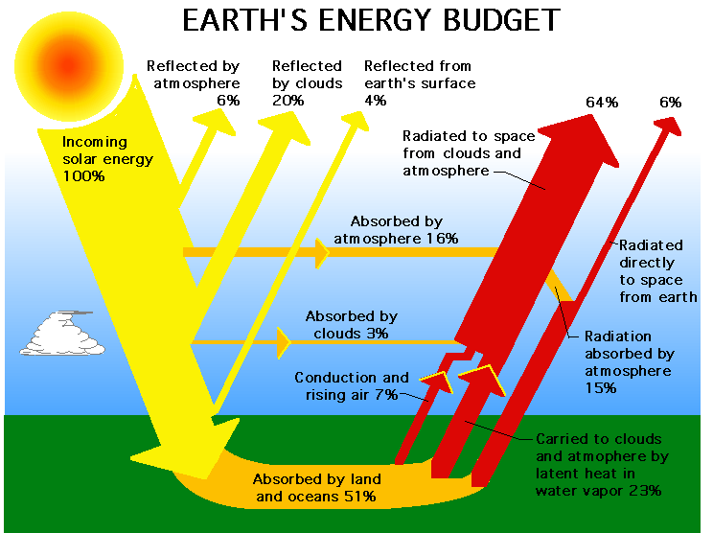
The Earth energy budget (Climate)
Radiation balance (and imbalance)
At steady state: energy in = energy out
The role of the atmosphere
(and greenhouse gases)

Slide 27
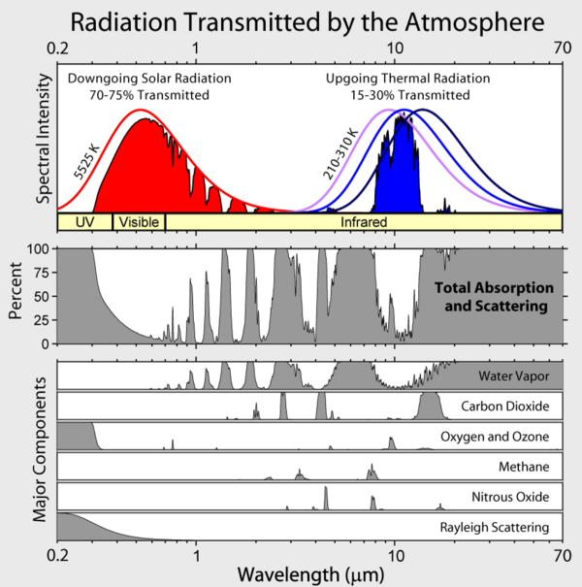

Slide 28
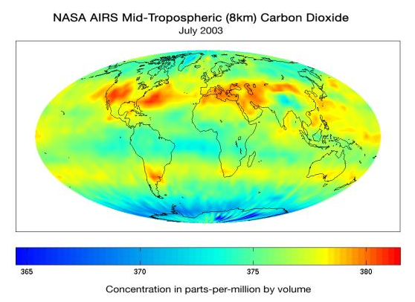
AIRS: Atmospheric Infrared Sounder
One of six instruments aboard the Aqua satellite (2378 spectral channels)
First global picture of CO₂ in the atmosphere (Spatial patterns)
(http://airs.jpl.nasa.gov/)
Notes:
Photosynthetically Active Radiation (PAR)A daily PAR estimate is obtained for each instantaneous pixel, assuming the cloud/surface system is stable during the day and corresponds to the satellite observation. Daily PAR estimates obtained separately from different orbits and individual sensors are binned using a simple, linear averaging scheme (arithmetical mean).The GlobColour PAR demonstration product is based on a merged MERIS/SeaWiFS PAR product.

Slide 29
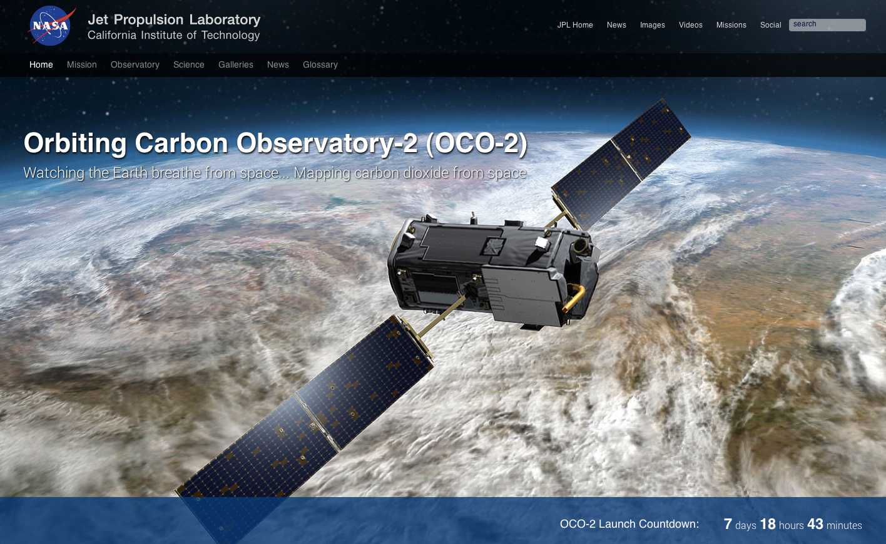
OCO-2: Orbiting Carbon Observatory
About to launch (July 1st, 2014)!
http://oco.jpl.nasa.gov/
Notes:
AIRS was not designed to measure CO2. OCO-2 is designed for CO2

Slide 30
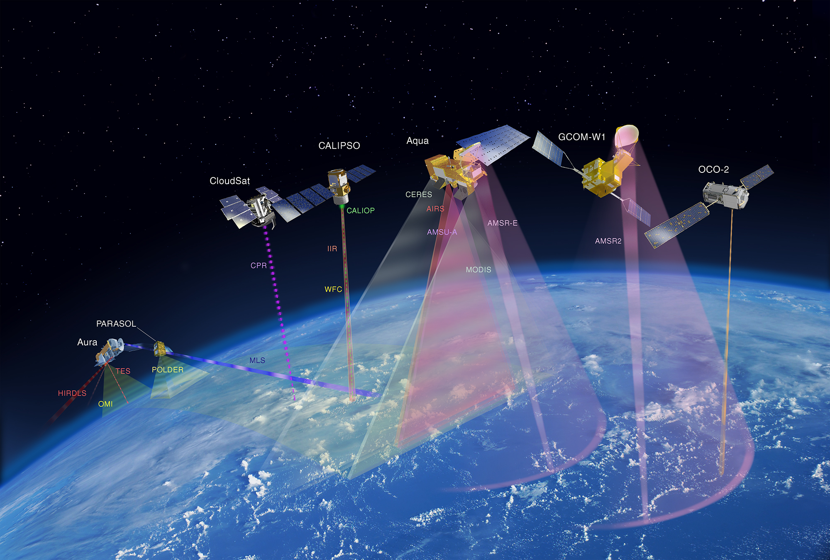
Observing the Earth from space
The A-Train, an Earth Observing System
Notes:
Do you know what altitudes these A-train satellites fly? (about 700-800km)
Do you know what the radius of the Earth is? (6370km)

Slide 31
Imaging the Earth Interior
How do we know the Earth is an onion?
Notes:
Arrows point to an optically continuous K-feldspar grain separated by quartz-filled fractures in orthogneiss (82MW0017). K-feldspar is stained green in this image, and sodic perthite appears orange. Click here for a zip file with full resolution image.kfs: K-feldspar qtz: quartz
Feldspars (KAlSi₃O₈ – NaAlSi₃O₈ – CaAl₂Si₂O₈) are a group of rock-forming tectosilicate minerals that make up as much as 60% of the Earth's crust.
Quartz is the second most abundant mineral in the Earth's continental crust, after feldspar. It is made up of a continuous framework of SiO₄ silicon–oxygen tetrahedra, with each oxygen being shared between two tetrahedra, giving an overall formula SiO₂.
When placed between two polarizing filters set at right angles to each other, the optical properties of the minerals in the thin section alter the colour and intensity of the light as seen by the viewer. As different minerals have different optical properties, most rock forming minerals can be easily identified. Plagioclase for example can be seen in the photo on the right as a clear mineral with multiple parallel twinning planes. The large blue-green minerals are clinopyroxene with some exsolution of orthopyroxene.Thin sections are prepared in order to investigate the optical properties of the minerals in the rock. This work is a part of petrology and helps to reveal the origin and evolution of the parent rock.

Slide 32
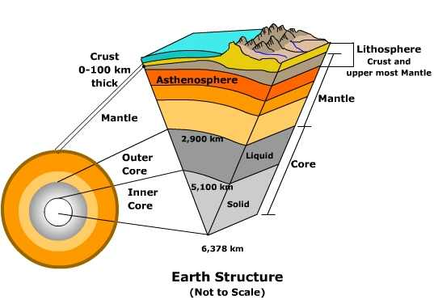
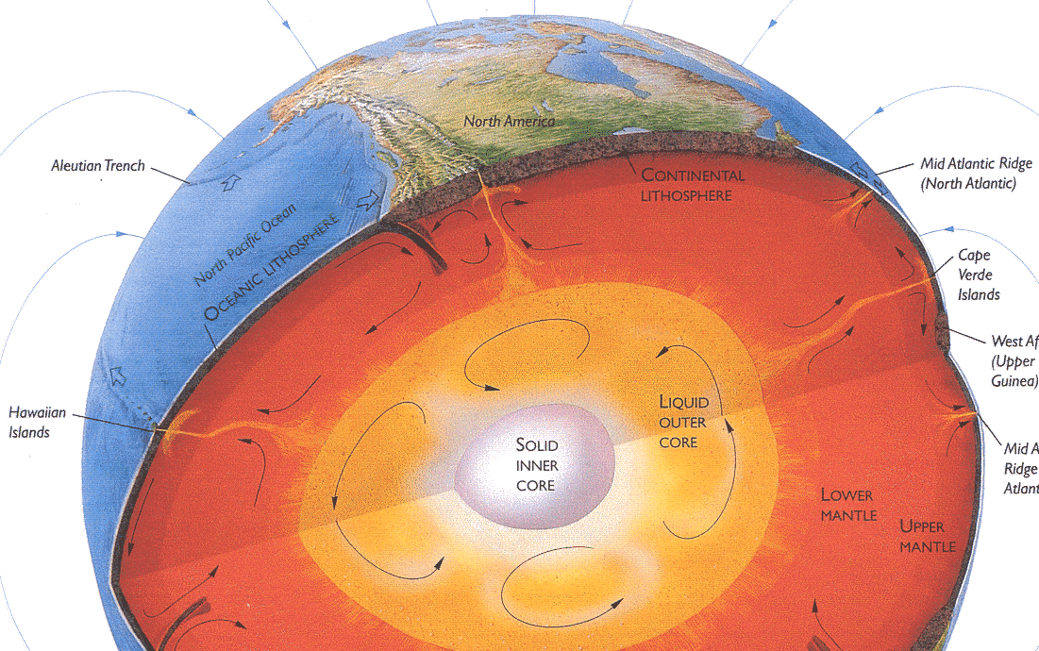
The solid earth loses its internal heat by convection: cold rock sinks, hot rock rises.
Plate generation at oceanic spreading ridges = heat loss.
Plate recycling of old, cooled oceanic plates back into the mantle.
Mantle plumes: upwellings of heat directly from the core.

Slide 33
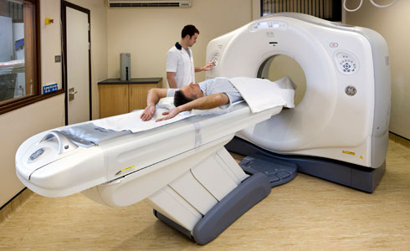
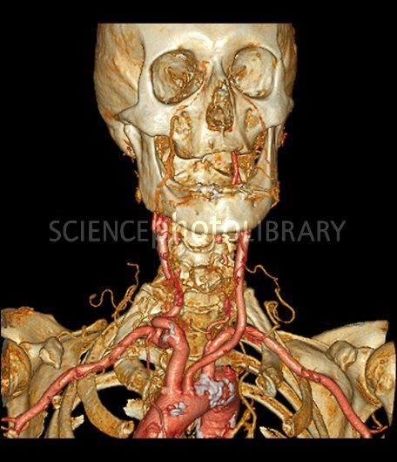
Tomography
Reconstruct internal 3D picture of human body
Take X-rays (or others) from multiple angles (CT scan)
- How can we take a CT Scan of the Earth?

Slide 34
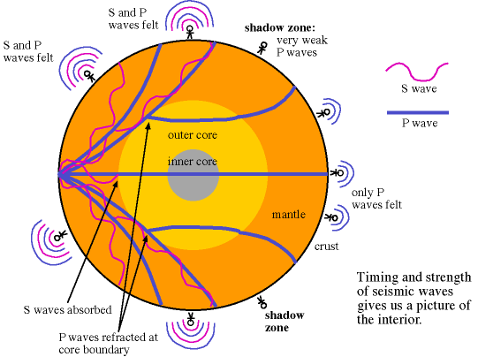
Seismograms: Monitor earthquakes from different locations
Follow propagation of particular features in space (waves)
Path of waves affected by interior density/elasticity
2 kinds of waves: S-waves (shear); P-waves (pressure)
Notes:
What is veclocity V=D/T, so slopes on seismogramcomposite shows velocity

Slide 35
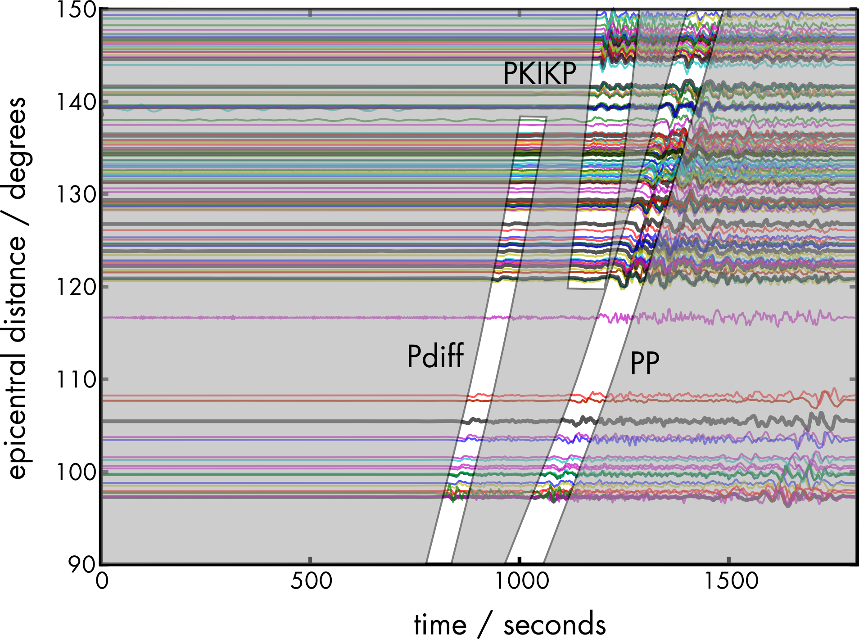
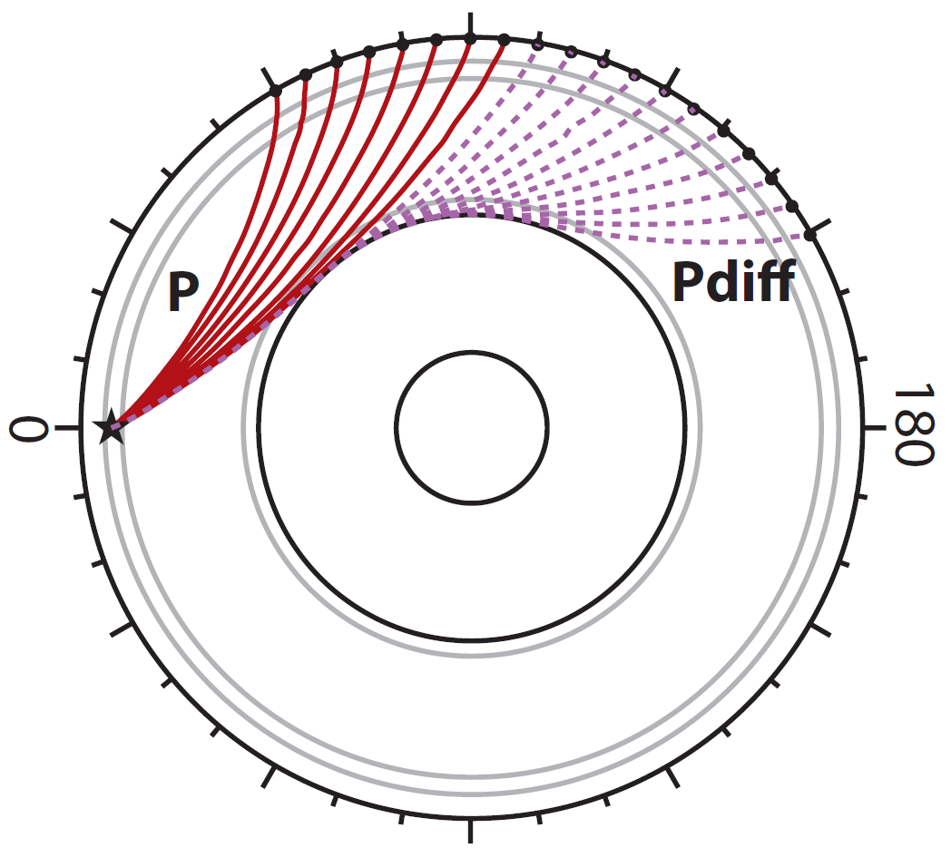
Seismograms: Monitor earthquakes from different locations
Velocity = distance/time
Wave speeds depend on composition (solid vs. melt, etc)
Images from Karin Sigloch, Kasra Hosseini
Notes:
What is veclocity V=D/T, so slopes on seismogramcomposite shows velocity

Slide 36
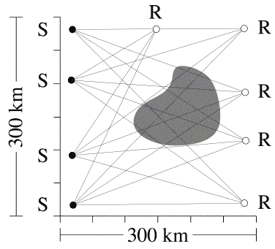
Seismic tomography: Reconstruct interior structures
- The technique is based on knowing travel times and distances between sources and receivers and solving for velocity
- Since velocity depends on composition, on can cross-constrain composition from multiple observations
- This is a big statistical exercise (like fitting a line through data)
S=Sources
R= Receivers

Slide 37
Imaging the Ocean Interior
Notes:
Arrows point to an optically continuous K-feldspar grain separated by quartz-filled fractures in orthogneiss (82MW0017). K-feldspar is stained green in this image, and sodic perthite appears orange. Click here for a zip file with full resolution image.kfs: K-feldspar qtz: quartz
Feldspars (KAlSi₃O₈ – NaAlSi₃O₈ – CaAl₂Si₂O₈) are a group of rock-forming tectosilicate minerals that make up as much as 60% of the Earth's crust.
Quartz is the second most abundant mineral in the Earth's continental crust, after feldspar. It is made up of a continuous framework of SiO₄ silicon–oxygen tetrahedra, with each oxygen being shared between two tetrahedra, giving an overall formula SiO₂.
When placed between two polarizing filters set at right angles to each other, the optical properties of the minerals in the thin section alter the colour and intensity of the light as seen by the viewer. As different minerals have different optical properties, most rock forming minerals can be easily identified. Plagioclase for example can be seen in the photo on the right as a clear mineral with multiple parallel twinning planes. The large blue-green minerals are clinopyroxene with some exsolution of orthopyroxene.Thin sections are prepared in order to investigate the optical properties of the minerals in the rock. This work is a part of petrology and helps to reveal the origin and evolution of the parent rock.

Slide 38
Imaging the Ocean interior
The ocean is “horrible”
  It’s deep: pressure is very high
  It’s salty and corrosive: metals rust quickly
  It’s dark: largely opaque to electromagnetic spectrum
  It’s cold: about 2-3ºC below 2000m, <0ºC near poles
  It’s viscous: traveling through it is slow and expensive
  It can be rough: bad weather, waves, sea-sickness…
  Algae grow on everything (biofouling)
  Because the ocean is a resource, politics comes into play
  (Things with teeth can eat you, etc...)
In fact, observing the deep sea is harder than going into space

Slide 39
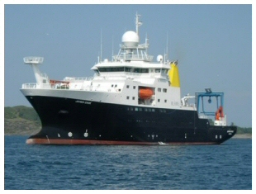
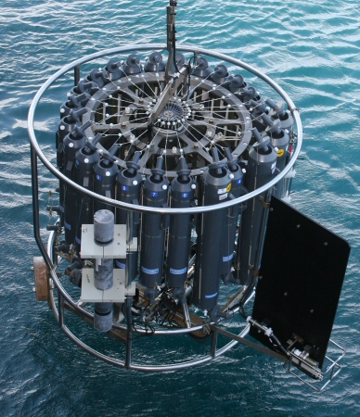
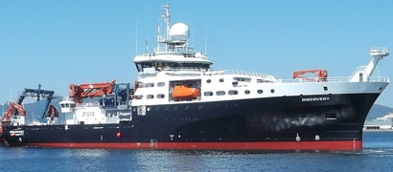
Research vessels, ocean sampling
RRS James Cook
“Rosette”
RRS Discovery

Slide 40
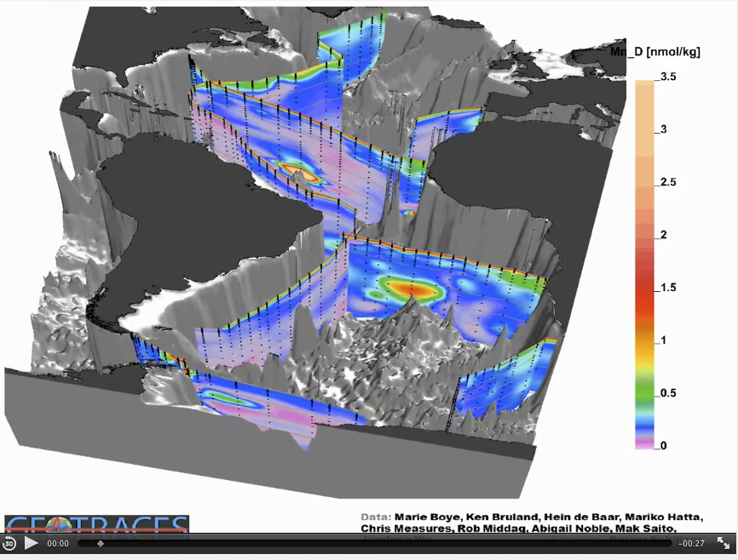
Mapping chemical ocean properties (Mn=Manganese)

Slide 41
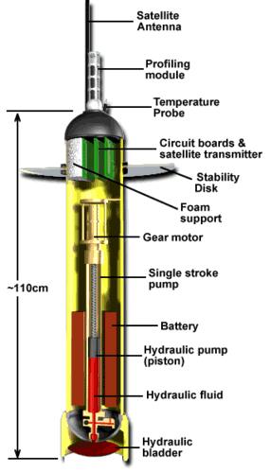
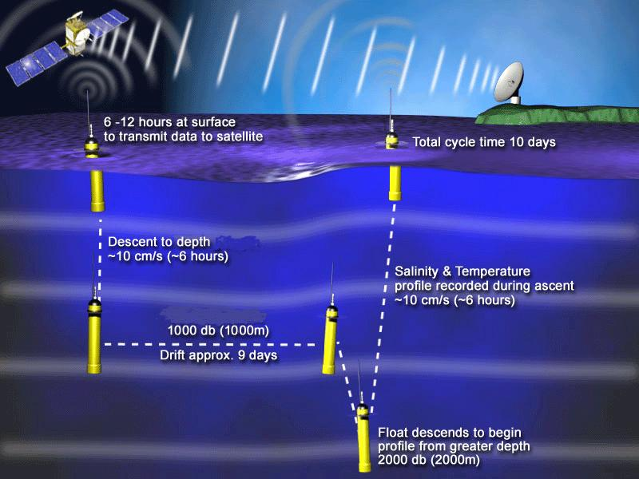
The Ocean interior
The ARGO program: T,S,(O₂,…)
http://www.argo.ucsd.edu/index.html

Slide 42
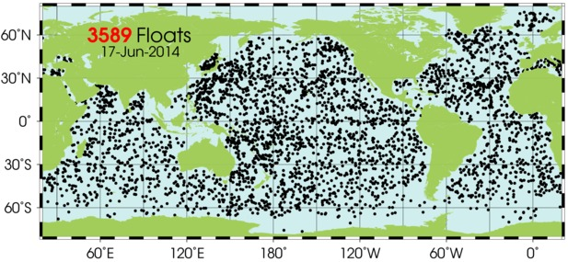
The Ocean interior
The ARGO program: T,S,(O₂,…)
http://www.argo.ucsd.edu/index.html

Slide 43
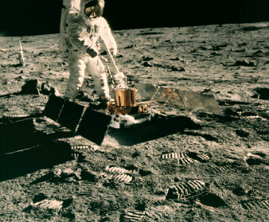
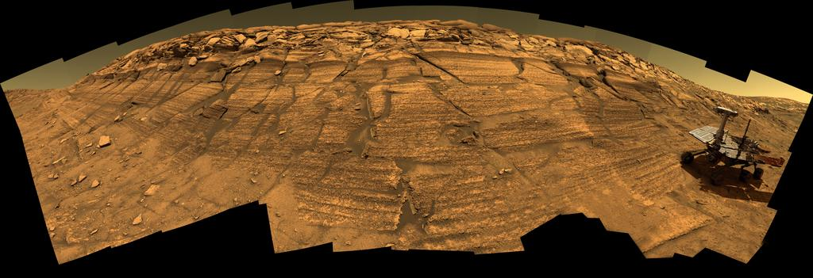
The Moon, Mars and beyond
Telescopic observations of the electromagnetic spectrum arriving to Earth
  From Earth, from space (Hubble)
Satellites orbiting other planets
Seismic recording stations
Rovers on the planets
Moon
Mars Opportunity

Slide 44
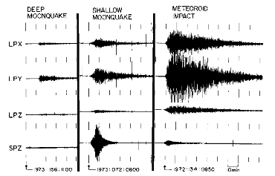
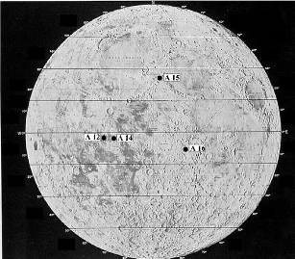
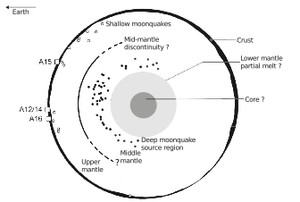
Seismograms on the Moon!
Khan et al. (2013)

