Slide 1
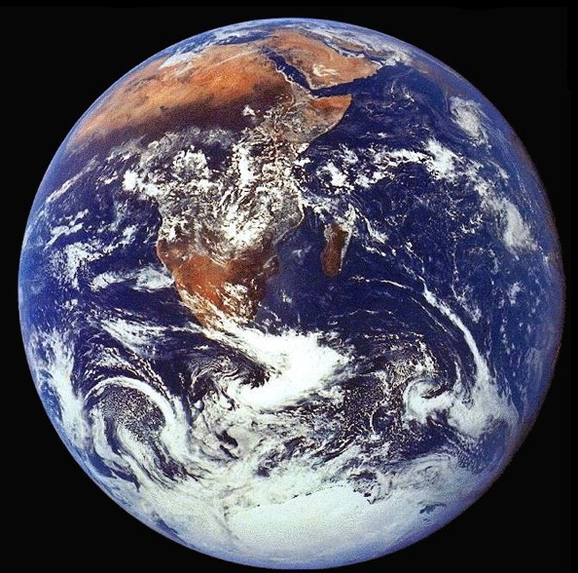
An introduction to oceanography, ocean circulation and climate
The ocean from space
  Biology
  Physics
The ocean interior
Role in climate
Future directions
Matthew Arnold School, Oxford
Dr. Yves Plancherel
yves.plancherel@earth.ox.ac.uk
Matthew Arnold School, Oxford, November 6th, 2017

Slide 2
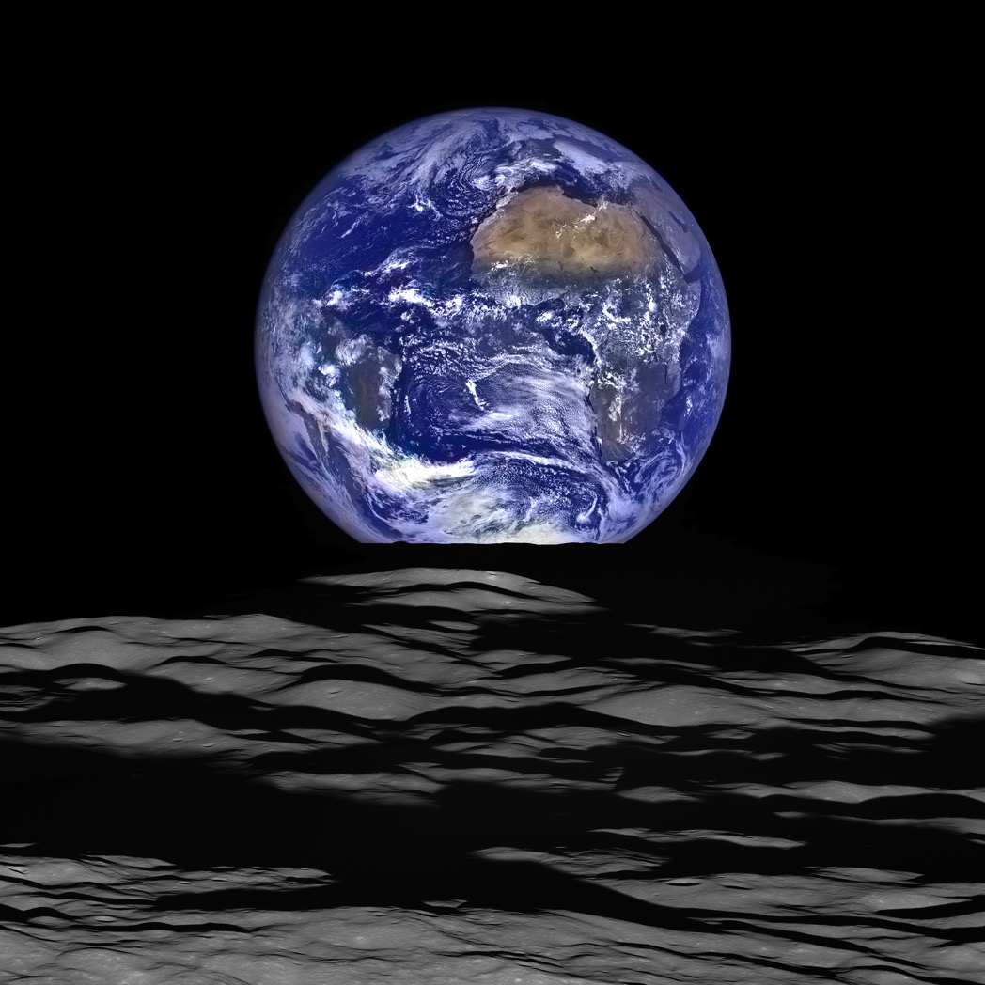
~ 70% Ocean
What can we see from space?
What can we learn from space?
https://www.nasa.gov/image-feature/goddard/lro-earthrise-2015
Notes:
How do we look at it? ...it’s big!
If we look, what can we see?
What can we learn from what we see?

Slide 3
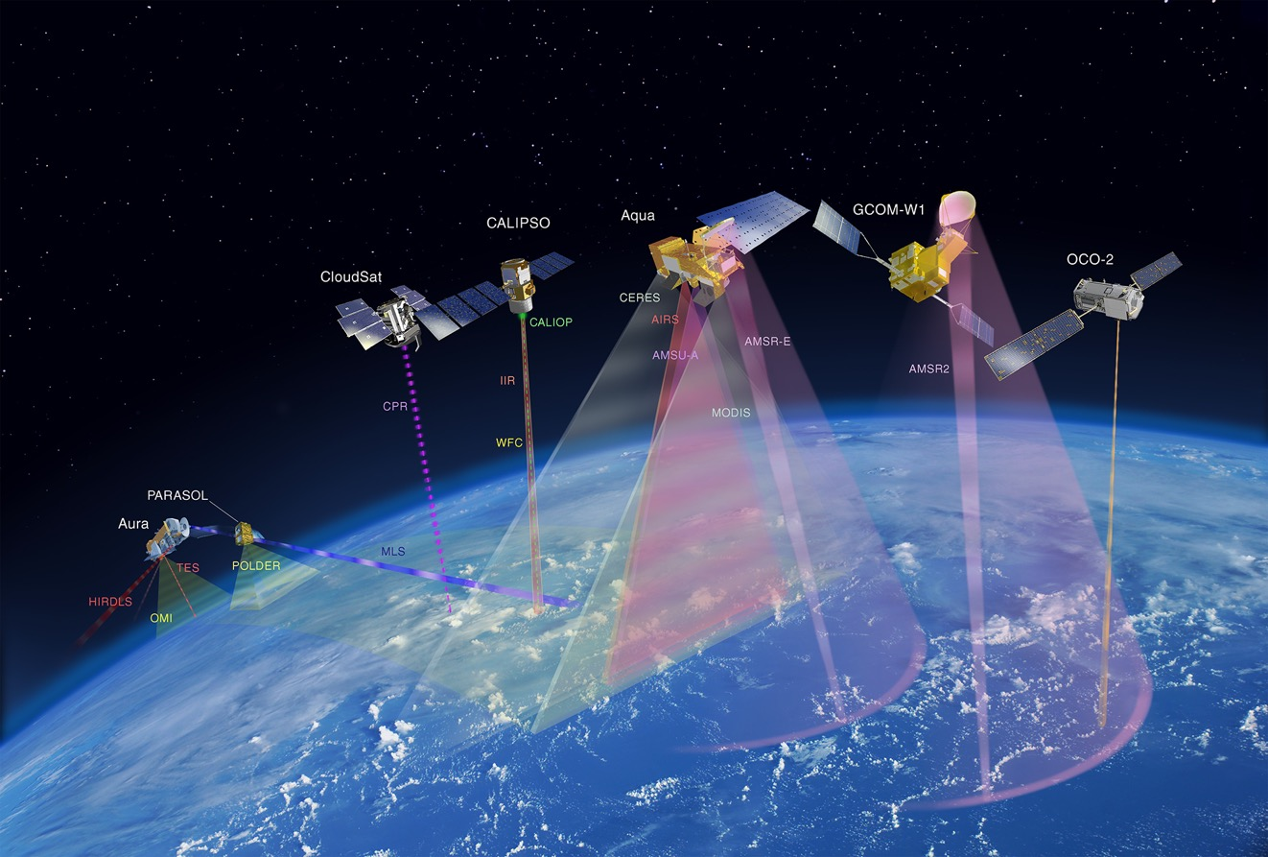
Observing the Earth from space
NASA
GOES (Geostationary Operiational Environmental Satellites)
The “A-Train”
SeaWifs, Modis
Topex/Poseidon
ESA
Copernicus/Sentinel Programme
Notes:
Do you know what altitudes these A-train satellites fly? (about 700-800km)
Do you know what the radius of the Earth is? (6370km)

Slide 4
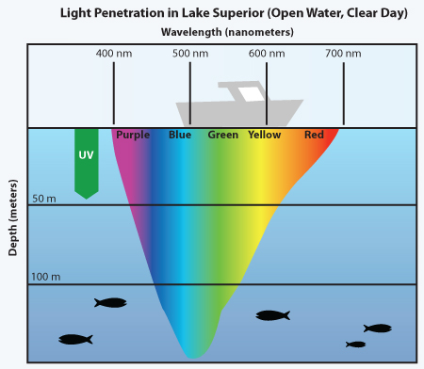
Limitations: Water absorbs blue light last
https://manoa.hawaii.edu/exploringourfluidearth/physical/ocean-depths/light-ocean

Slide 5
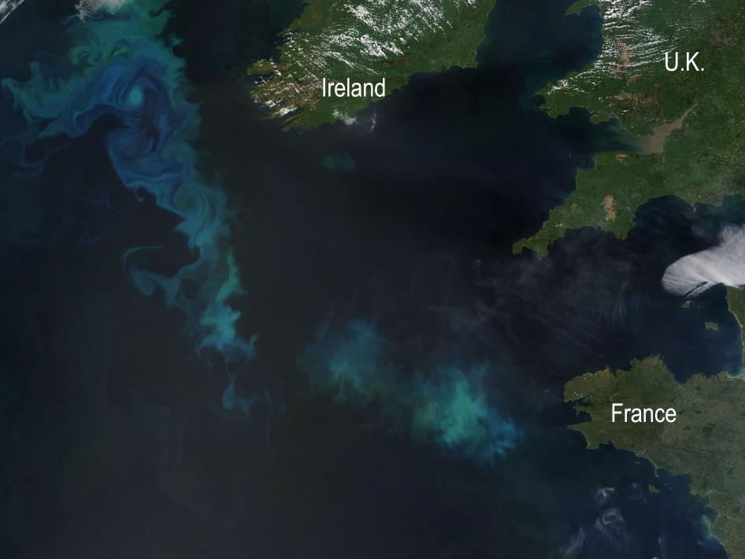
Surface of the ocean from space
MODIS Terra, 22 May 2010, natural color image
https://www.nasa.gov/topics/earth/features/n_atlantic_bloom.html

Slide 6
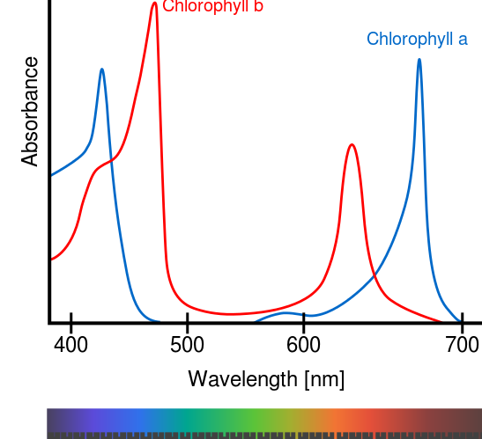
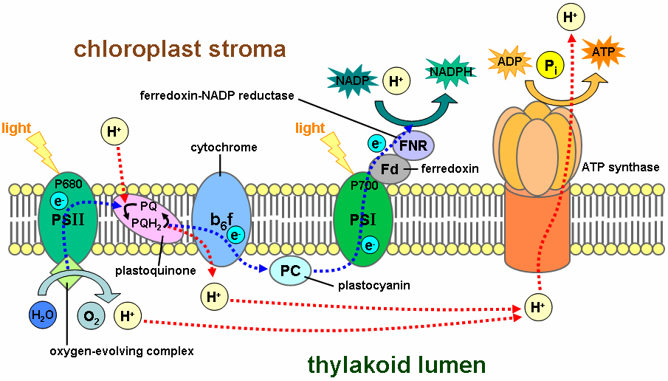
Ocean color and biology
Light and photosynthesis
Chl does not absorb green light
Wikipedia
We know the light spectrum going towards Earth
Measure the light spectrum leaving Earth
How can we interpret the difference?

Slide 7
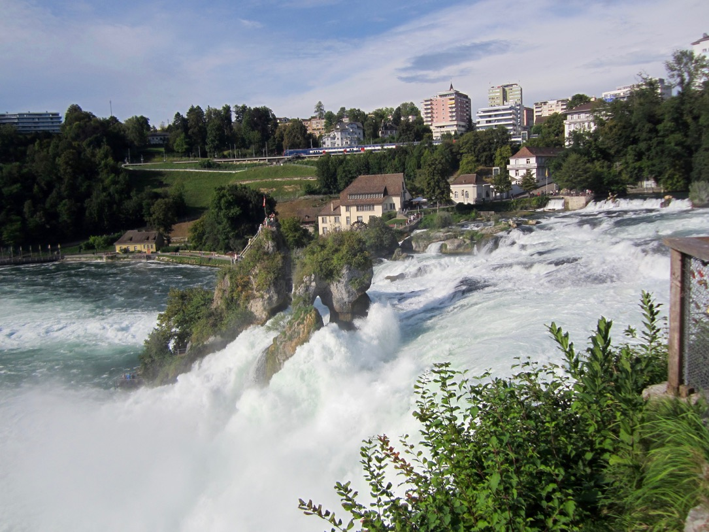
Physics: Why do rivers flow?
Rhein Falls, Switzerland

Slide 8
Physics: Why do fluids flow?
Pressure gradient force
Line of constant gravity
Air
Air
Water
Air
High pressure
Low pressure
Notes:
Benjamin Franklin, Gulf Stream map, contrast with today’s SST maps.

Slide 9
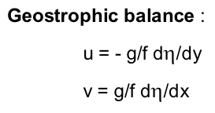
From sea surface height to current velocity
Sea surface
Sea surface
Geopotential
= lines of constant gravity
No pressure gradient =
No velocity
Pressure gradient
=
Velocity
…so if one can:
estimate the “height” of the sea surface relative to the geopotential,
one should be able to estimate ocean currents!

Slide 10
Principle of altimetry: speed = distance/time so distance = speed * time
Speed: speed of light time: fraction of seconds

Slide 11
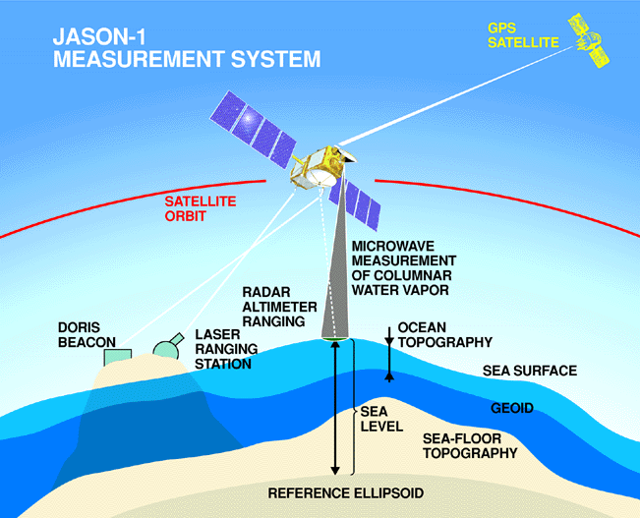
Measuring Sea Surface Height from Space

Slide 12
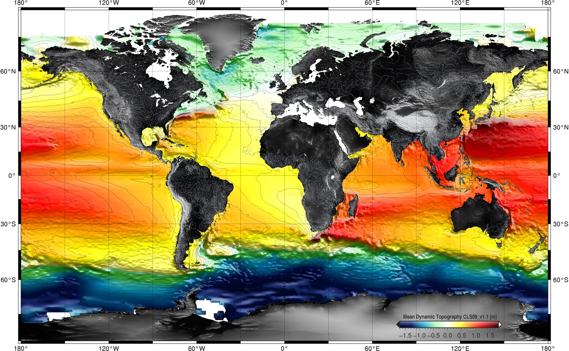
Mean Dynamic topography i.e. average ocean height
(= measured height minus gravity/non-sphericity effects)

Slide 13
What’s beneath the waves?
The ocean is “horrible”
  It’s deep: pressure is very high
  It’s salty: metals rust quickly, highly corrosive
  It’s dark: largely opaque to electromagnetic spectrum
  It’s cold: about 2-3ºC below 2000m, <0ºC near poles
  It’s viscous: traveling through it is slow and expensive
  It can be rough: bad weather, waves, sea-sickness…
  Algae grow on everything (biofouling)
  Because the ocean is a resource, politics comes into play
  (Things with teeth can eat you, etc...)
Going in the deep sea is harder than going into space!

Slide 14
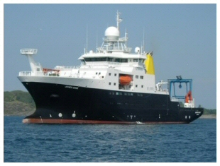
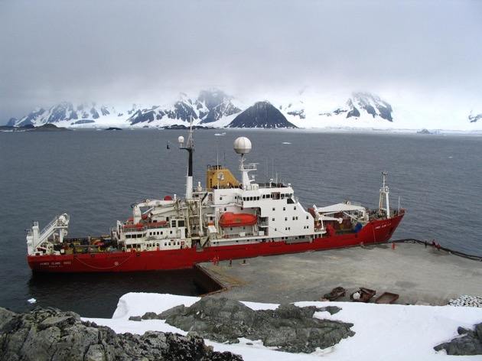
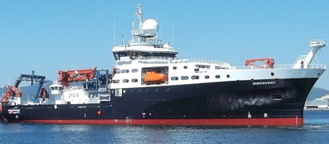
Research vessels, ocean sampling
RRS James Cook
RRS James Clark Ross
RRS Discovery
+ “Boaty McBoatface”
i.e.
RRS Sir David Attenborough

Slide 15
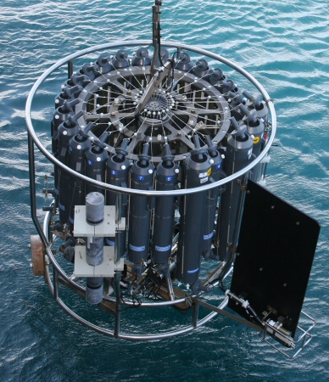
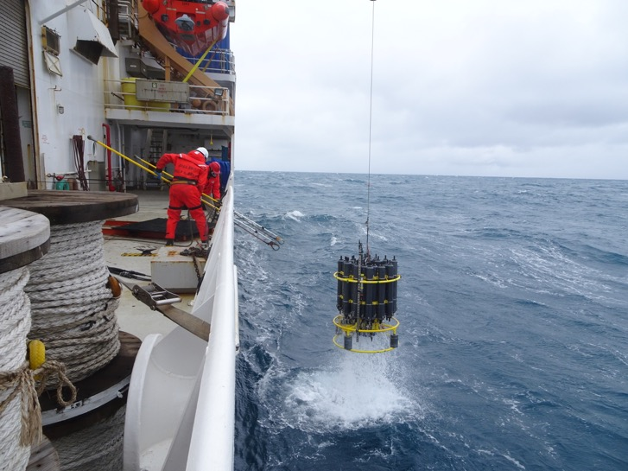
Paradox: Getting water in the ocean is actually suprisingly difficult! Why?
“Rosette”

Slide 16
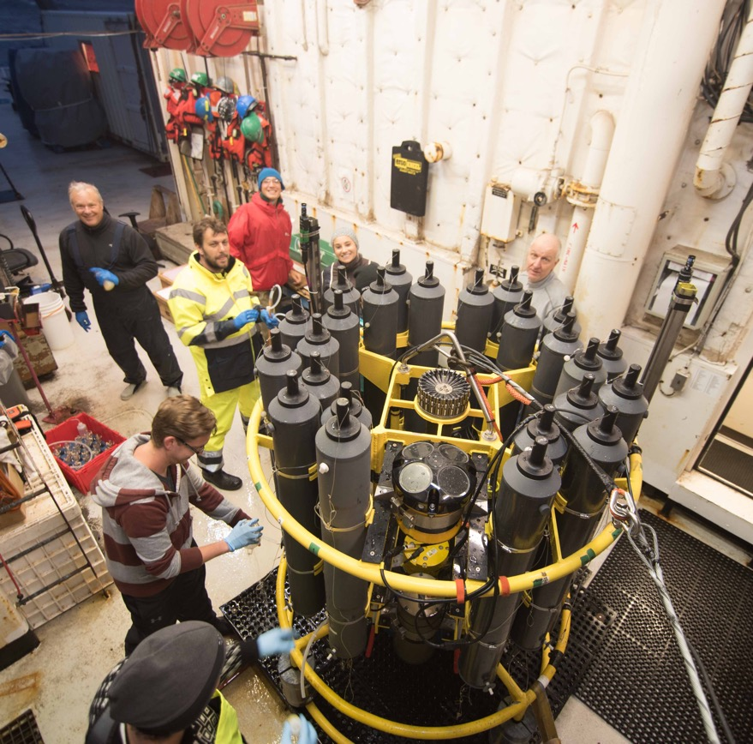
Then the fun stops... from this point on it’s chemistry and statistics!
“Rosette”

Slide 17
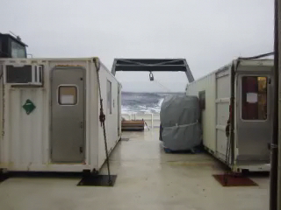
Working conditions...
(an average day in the Southern Ocean)
R/V Ronald H. Brown, P18, Jan 2017

Slide 18
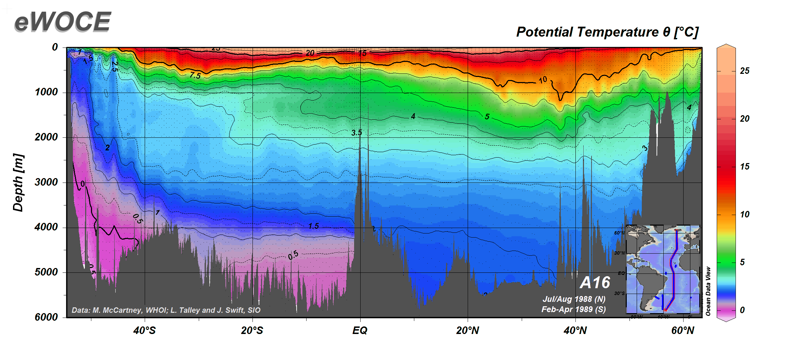
Mapping chemical ocean properties
Temperature
Cold vs warm regions – Why?

Slide 19
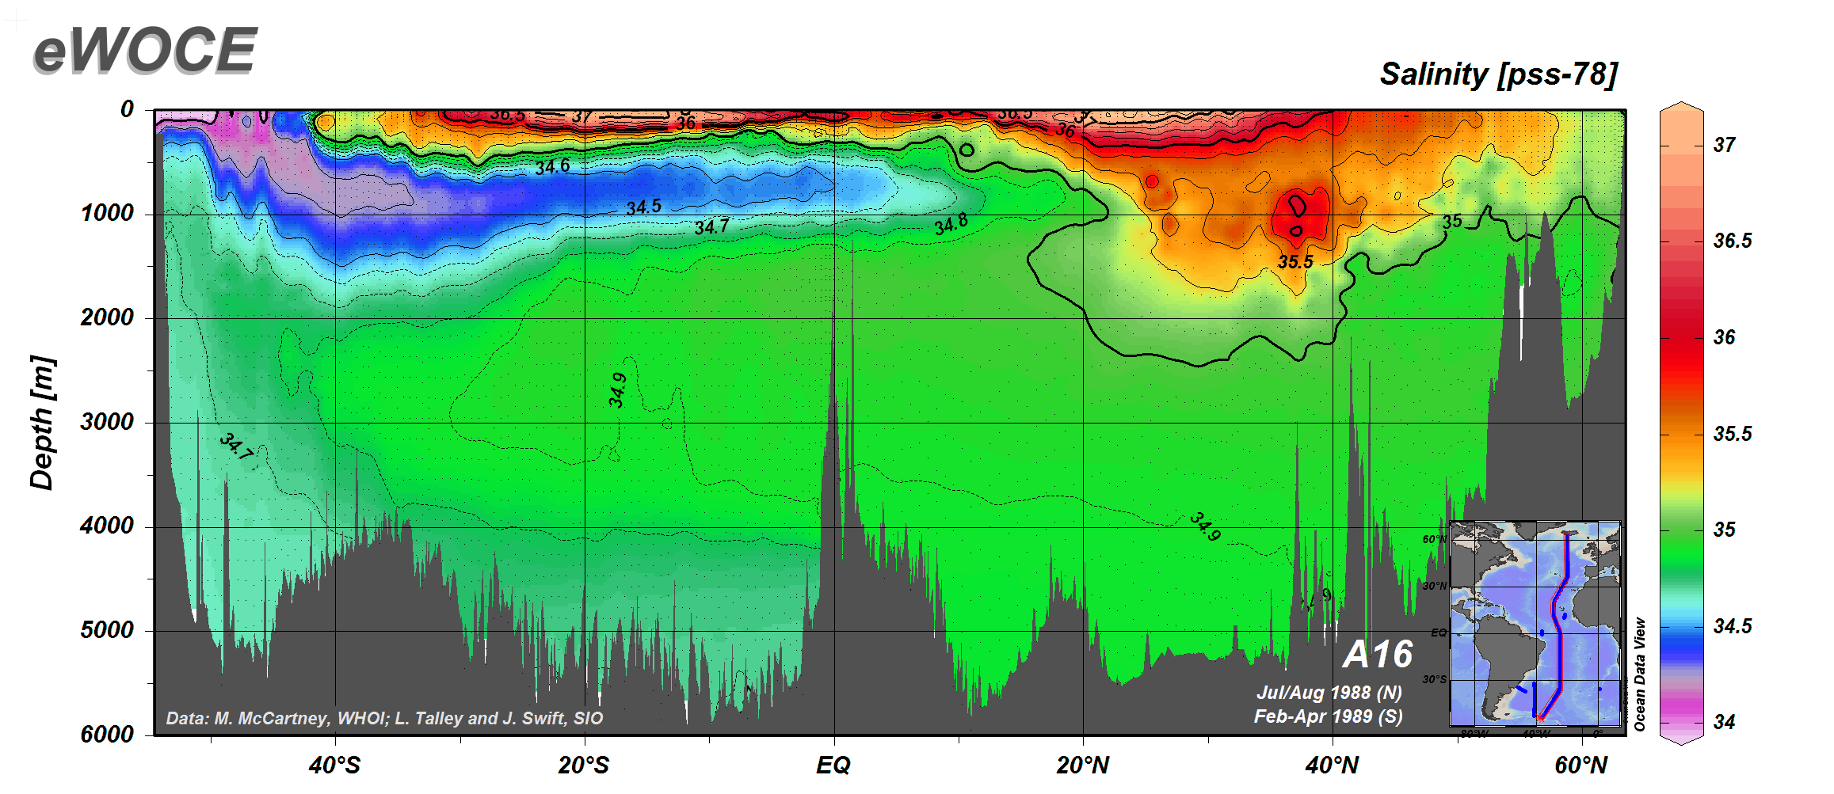
Mapping chemical ocean properties
Salinity
Saline vs fresh regions – Why?

Slide 20
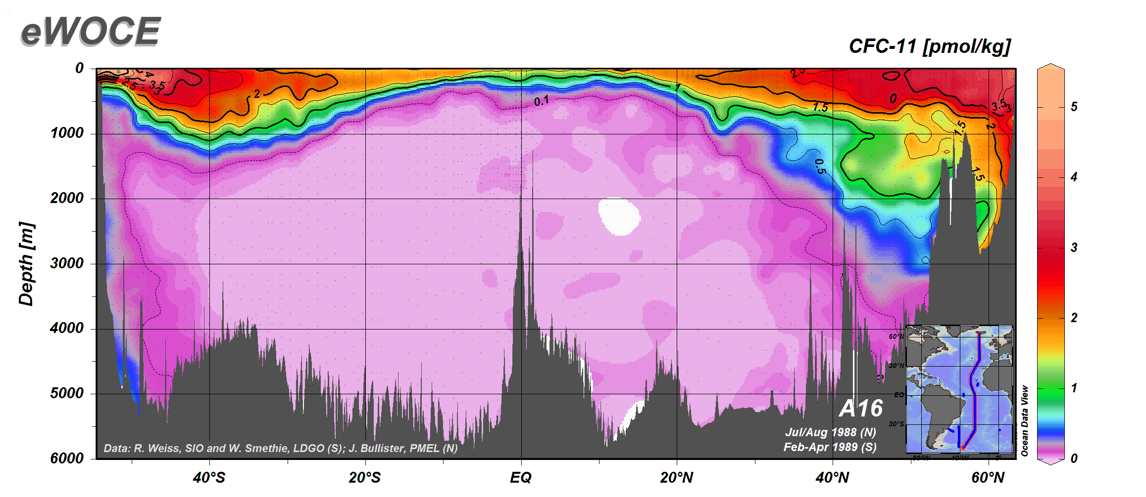
Mapping chemical ocean properties
CFC11 (a man made pollutant – ozone hole!)
High vs low regions – Why?

Slide 21
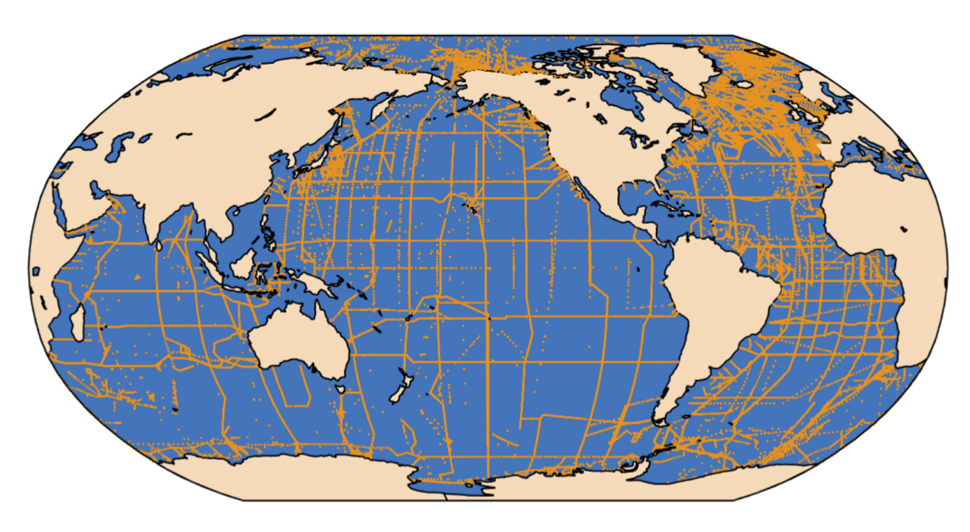
Scope and limitation of sampling from boats (imagine the effort!)
(all data from the 1970s to today)
GLODAPv2
https://odv.awi.de/fileadmin/user_upload/odv/data/GLODAP_bottle/NDP_093.pdf

Slide 22
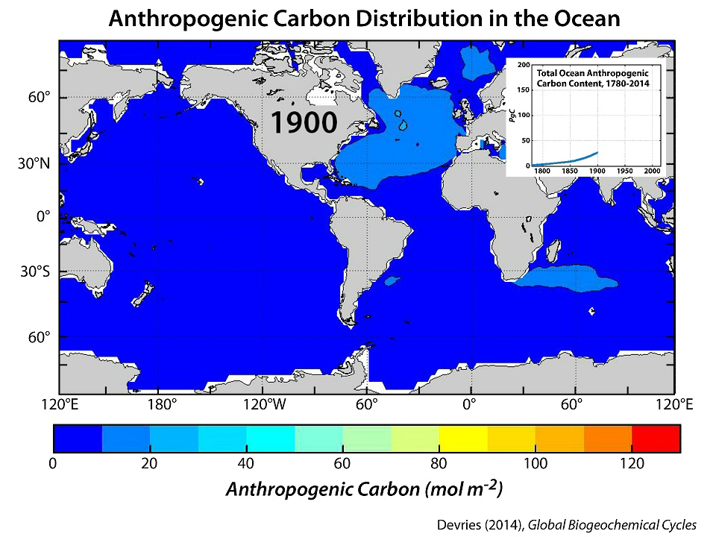
26% into ocean
31% into land
43% remains in atmosphere
DeVries (2014)
Notes:
This slide shows us where the anthropogenic carbon is stored in the ocean and how that has changed through time.
1900-2014 (24 seconds)

Slide 23
Atmospheric CO2 through time
Year 2000 ~ 368ppm
https://scripps.ucsd.edu/programs/keelingcurve/

Slide 24
Atmospheric CO2 through time
Year 2000 ~ 368ppm
Max over 800000 years ~ 300ppm
Industrial revolution
French
Revolution
Elizabeth II
Victoria
WWII
WWI
https://scripps.ucsd.edu/programs/keelingcurve/

Slide 25
Atmospheric CO2 through time
Year 2000 ~ 368ppm
Max over 800000 years ~ 300ppm
Agriculture
Egyptians
Middle Ages
Romans
https://scripps.ucsd.edu/programs/keelingcurve/

Slide 26
Atmospheric CO2 through time
Size of
Ice Age!
Max over 800000 years ~ 300ppm
Ice Age
Ice Age
Ice Age
Ice Age
Ice Age
Ice Age
Ice Age
Ice Age
Min over 800000 years ~ 170ppm
https://scripps.ucsd.edu/programs/keelingcurve/

Slide 27
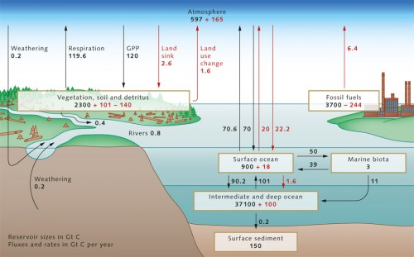
Oceans are the largest carbon reservoir
http://worldoceanreview.com/en/wor-1/ocean-chemistry/co2-reservoir/

Slide 28
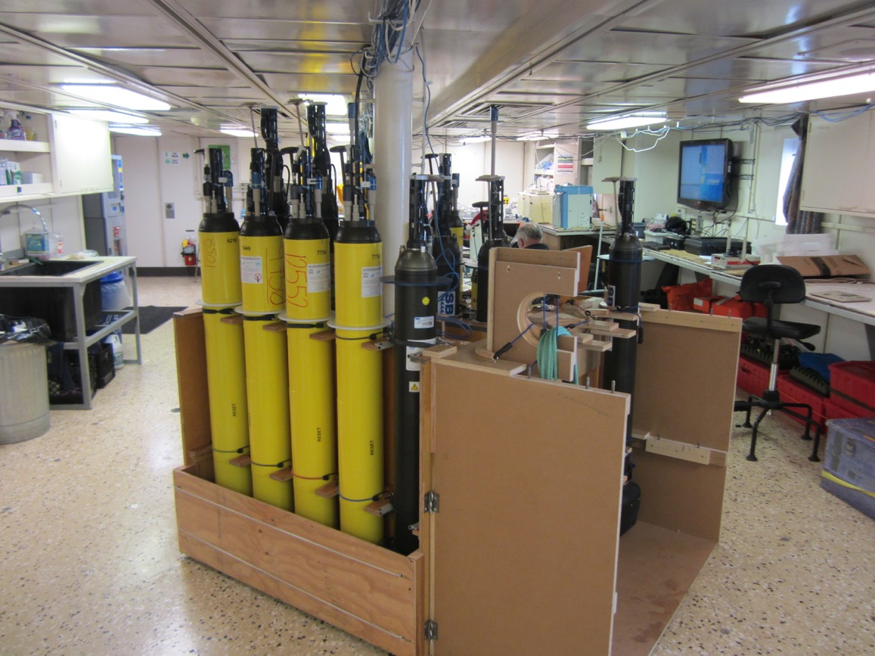
ARGO floats

Slide 29
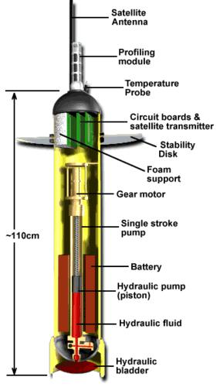
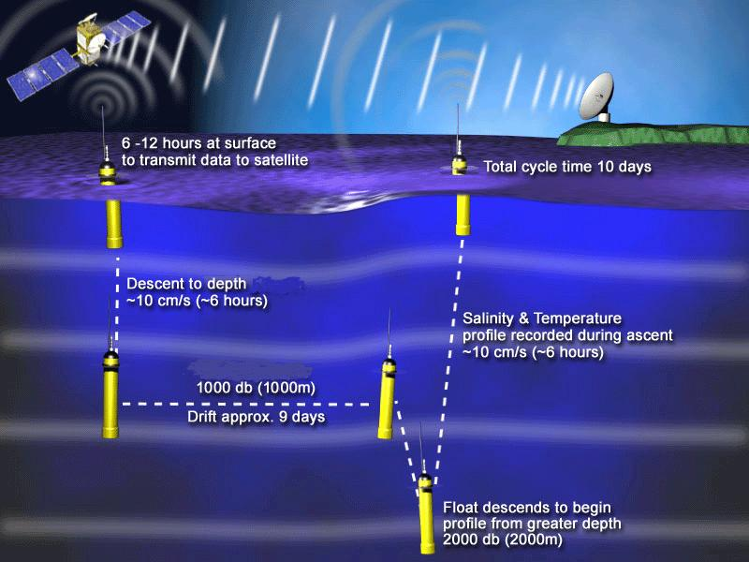
The Ocean interior (with robots!)
The ARGO program: T,S,(O₂,…)
http://www.argo.ucsd.edu/index.html

Slide 30
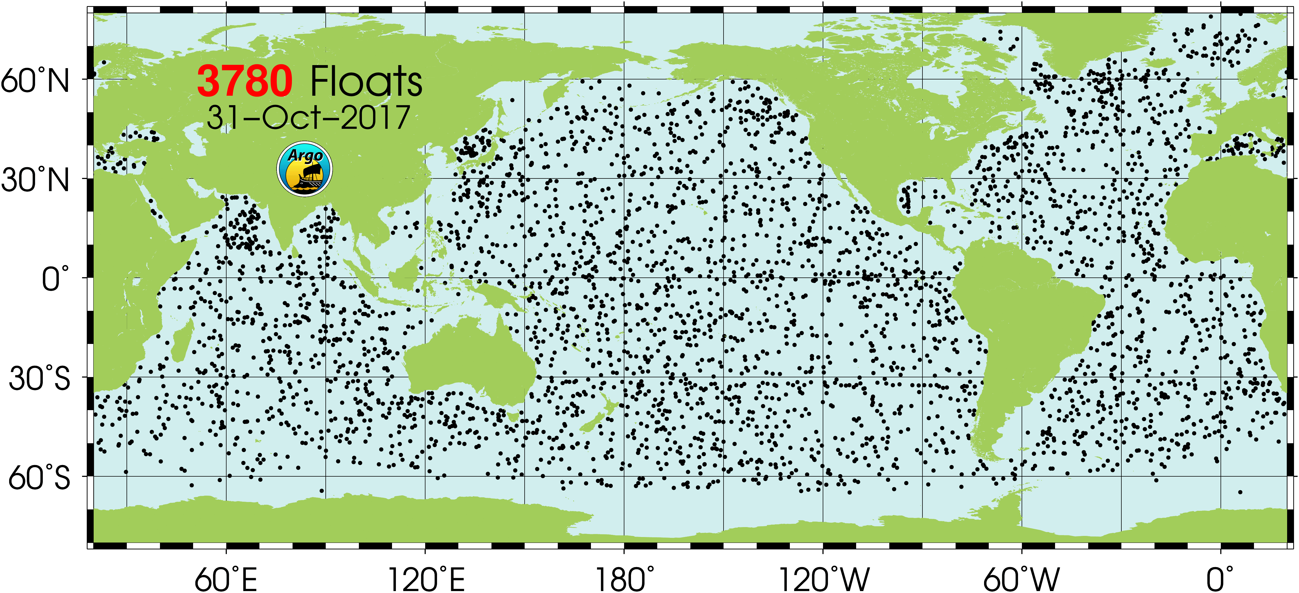
The Ocean interior
The ARGO program: T,S,(O₂,…)
http://www.argo.ucsd.edu/index.html

Slide 31
Take home messages
Always think both in space and in time!
  Measure one location at one time
    Measure one location in time
      Measure many location only once
        Measure everywhere all the time
Observations themselves are typically simple
  It’s the logistics of getting them that is challenging
Creativity more than technical expertise
  ...but technical ability to interpret data necessary!

