Slide 1
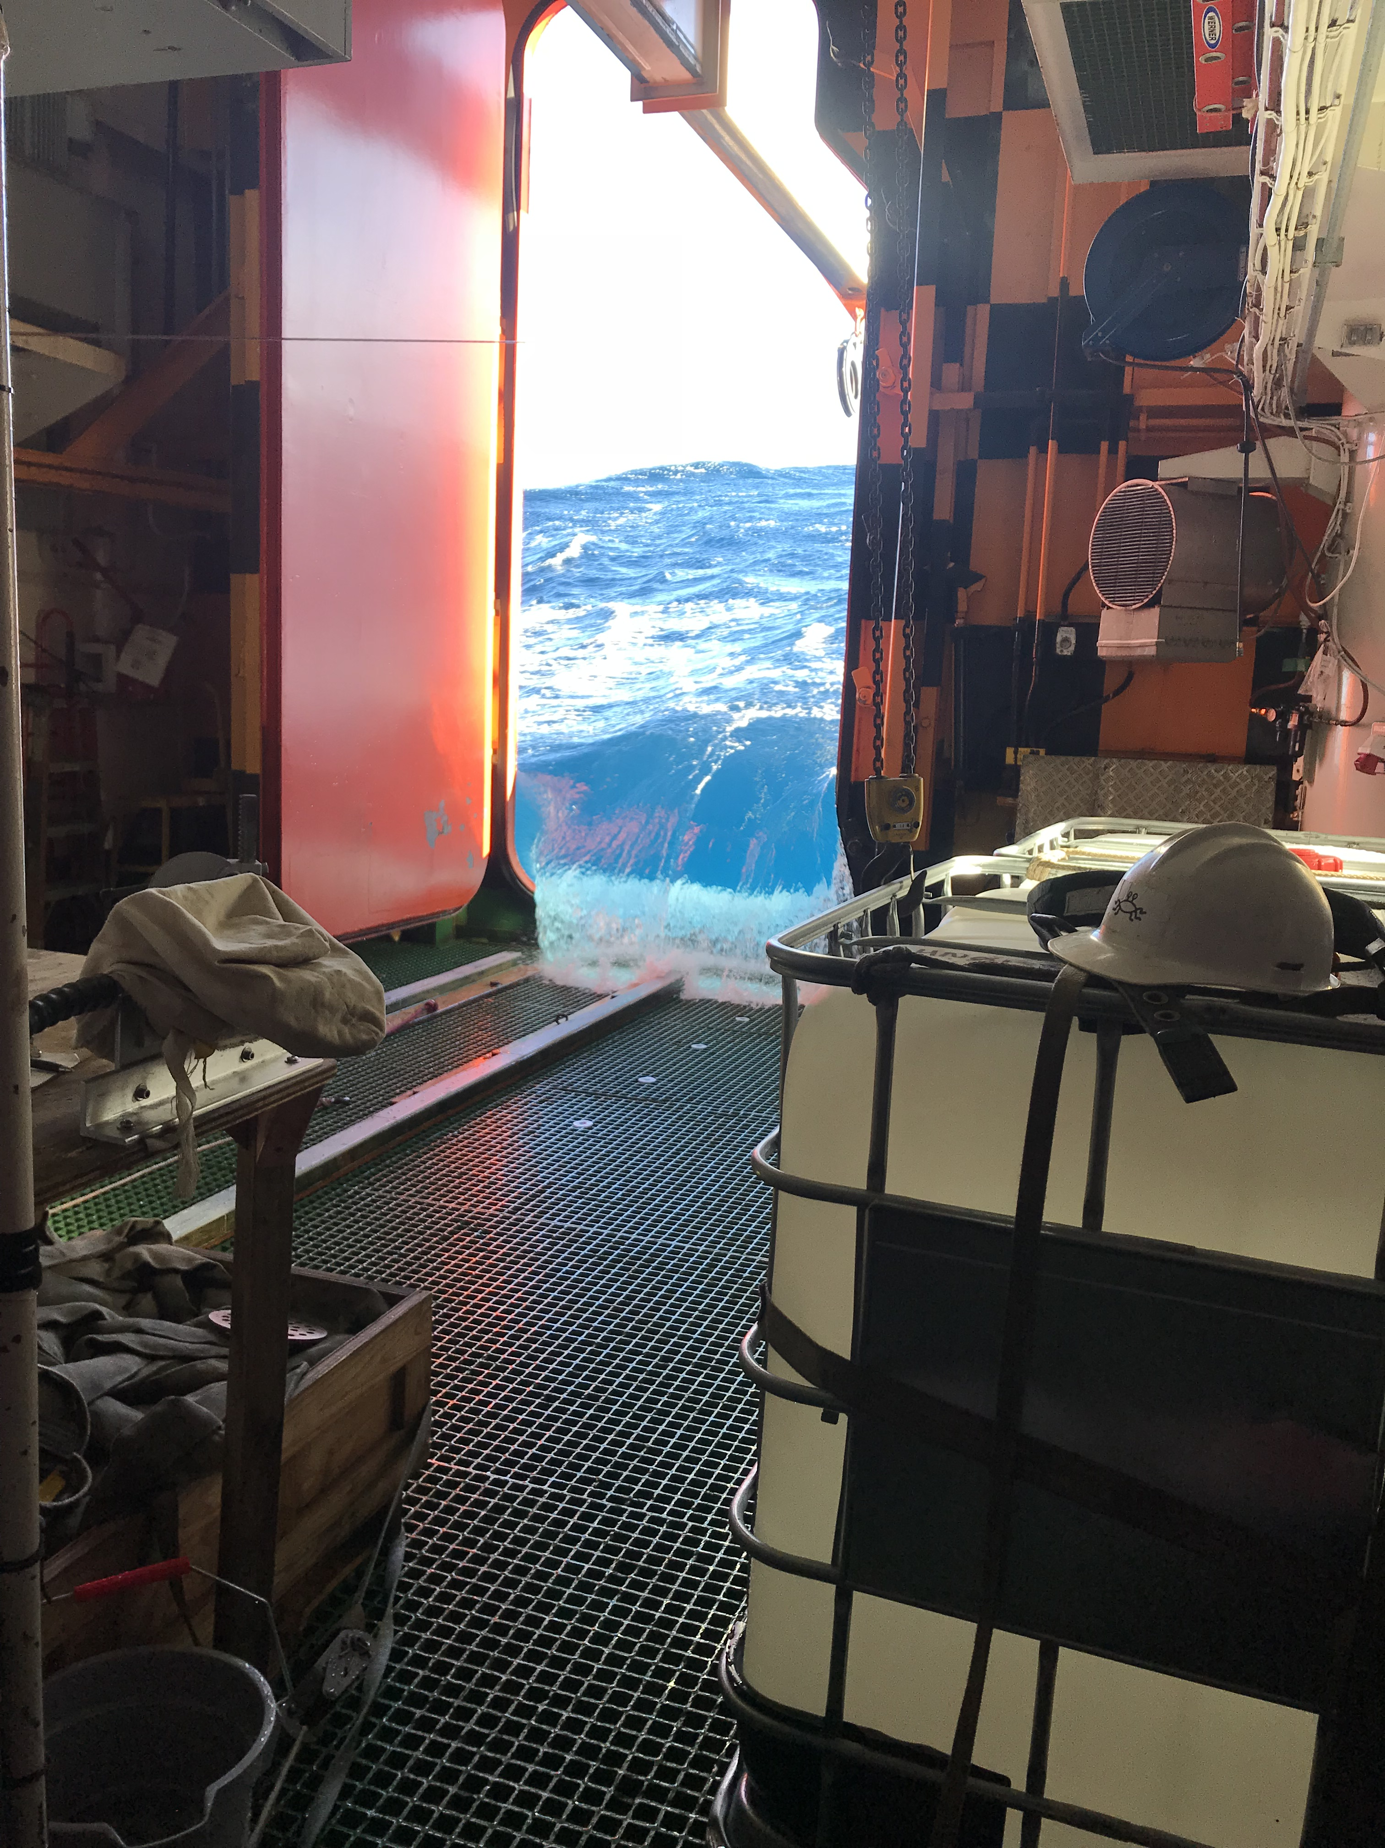
Ongoing programmes and initiatives
Global programmes
  GOSHIP
  GEOTRACES
  ARGO/BIOARGO/SOCCOM
Marine Biogeochemistry Training School
Yves Plancherel
yves.plancherel@earth.ox.ac.uk
Portugal, Faro, 5th June 2018

Slide 2
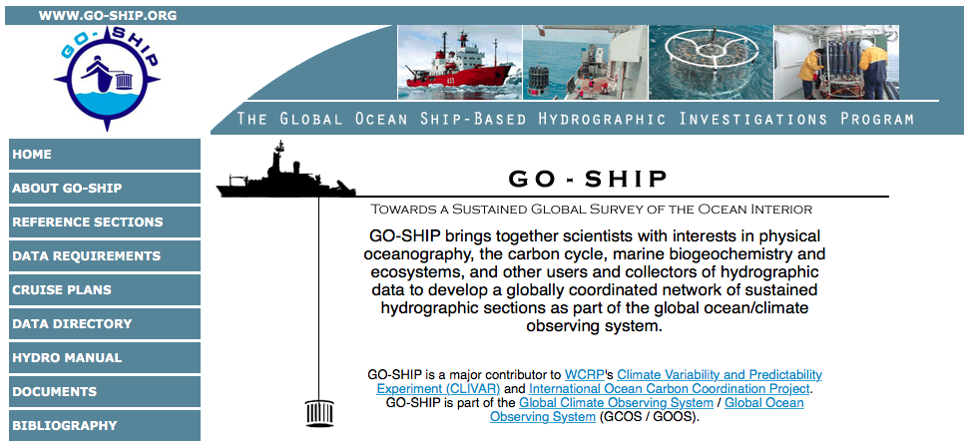
Current global hydrographic programme

Slide 3
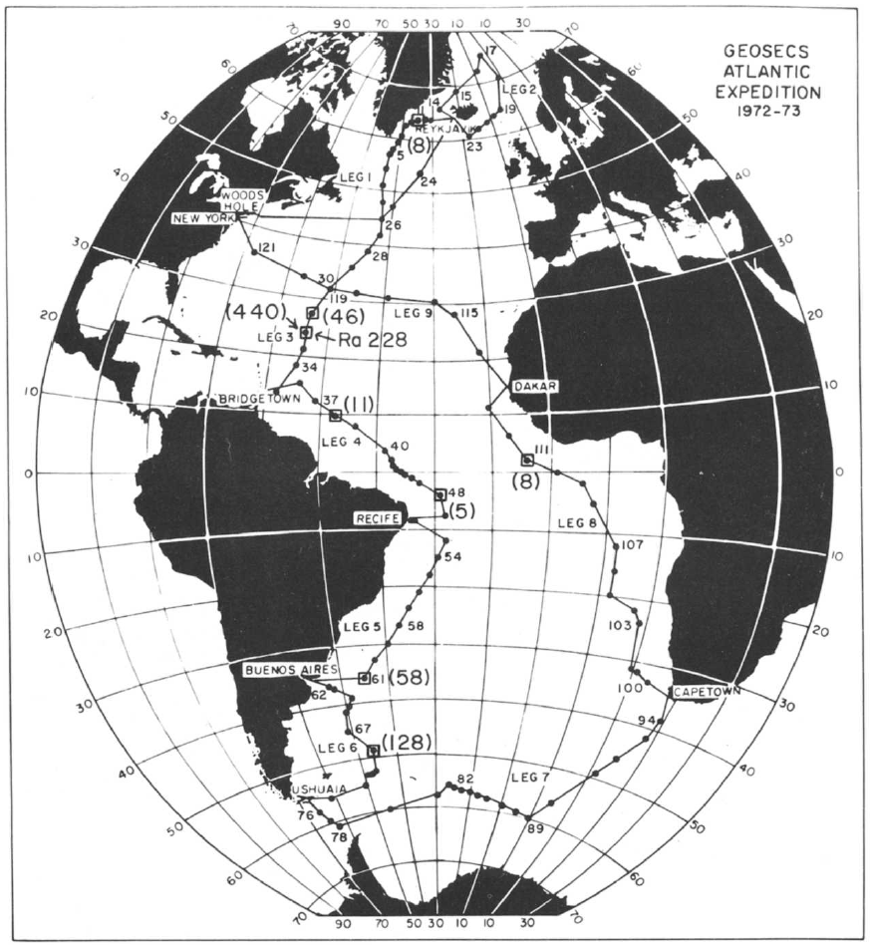
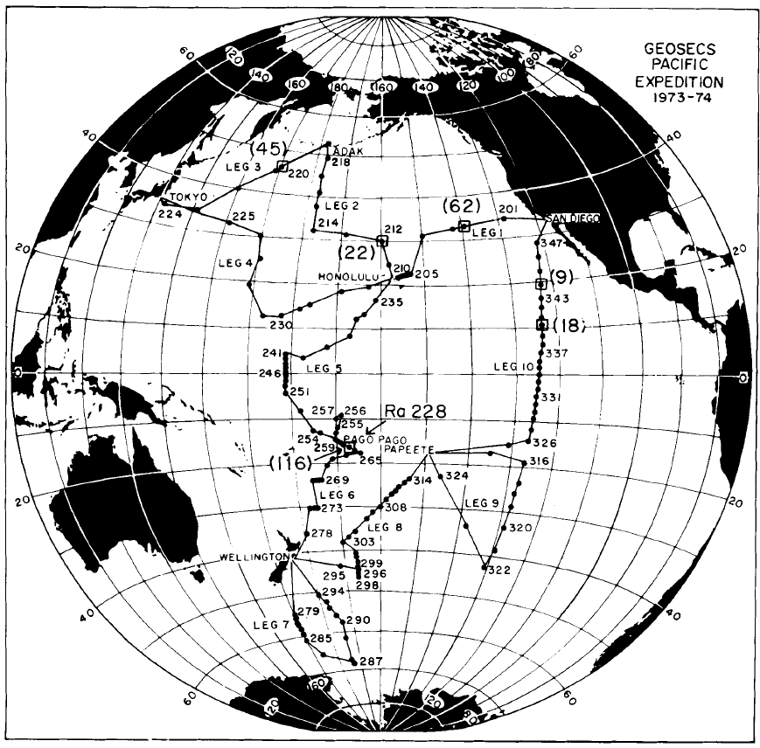
GEOSECS (1980s)

Slide 4
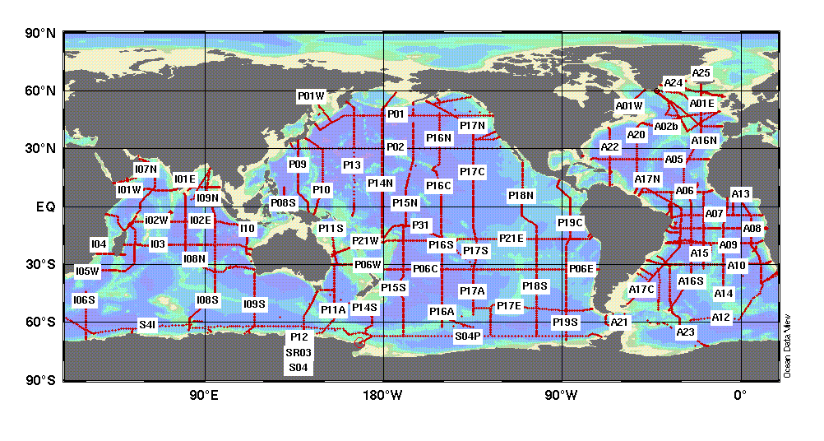
WOCE/JGOFS (1990s)

Slide 5
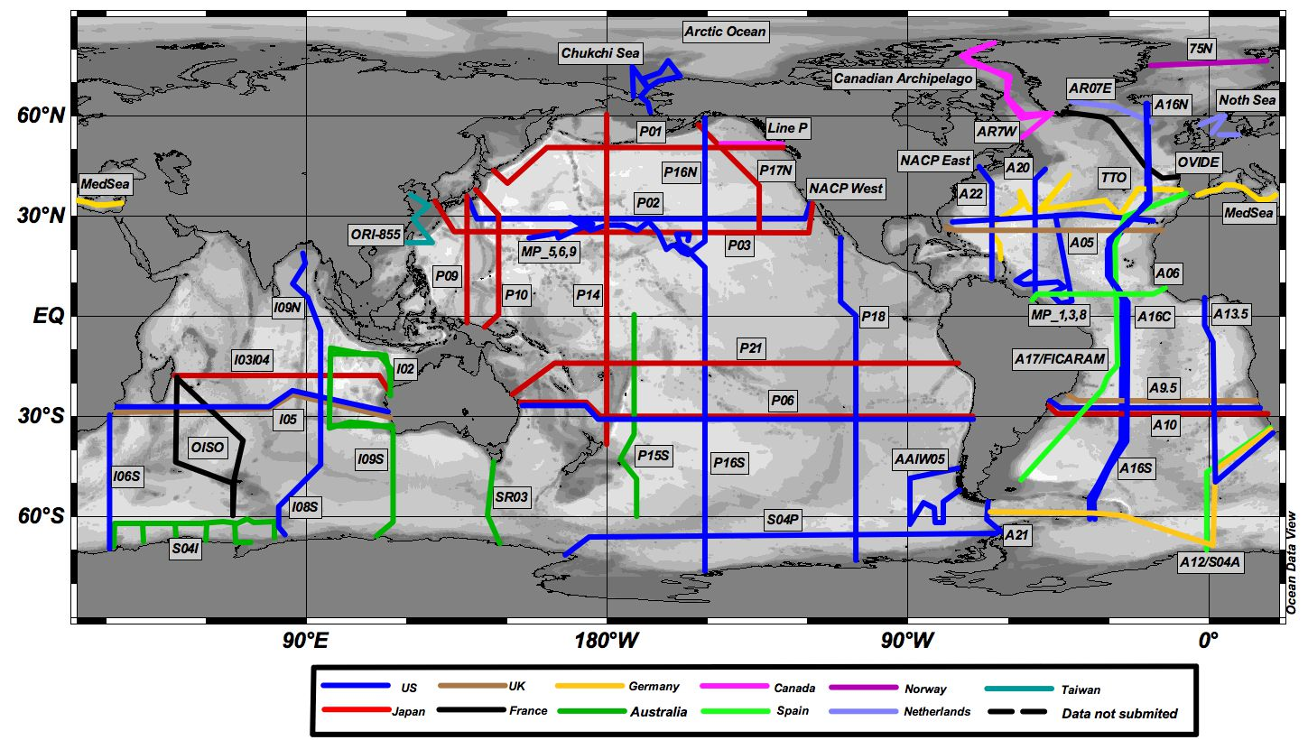
CLIVAR, REPEAT HYDROGRAPHY (2000s)

Slide 6
Go-ship.org (2010s): status

Slide 7
contributions

Slide 8
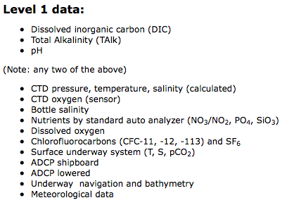

Slide 9
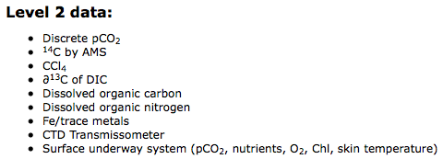

Slide 10
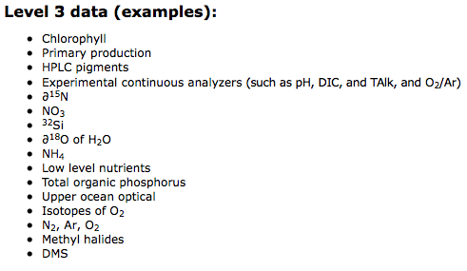

Slide 11
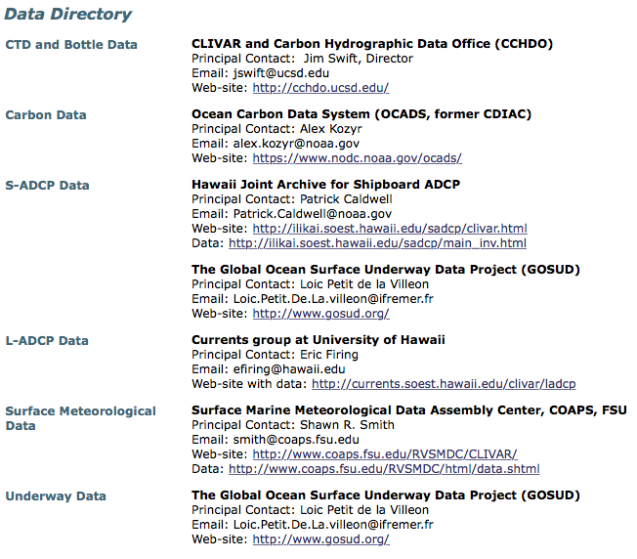

Slide 12
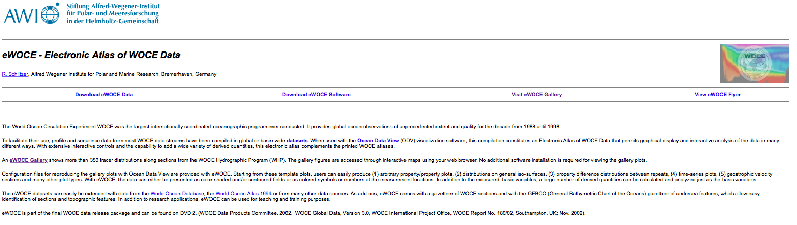
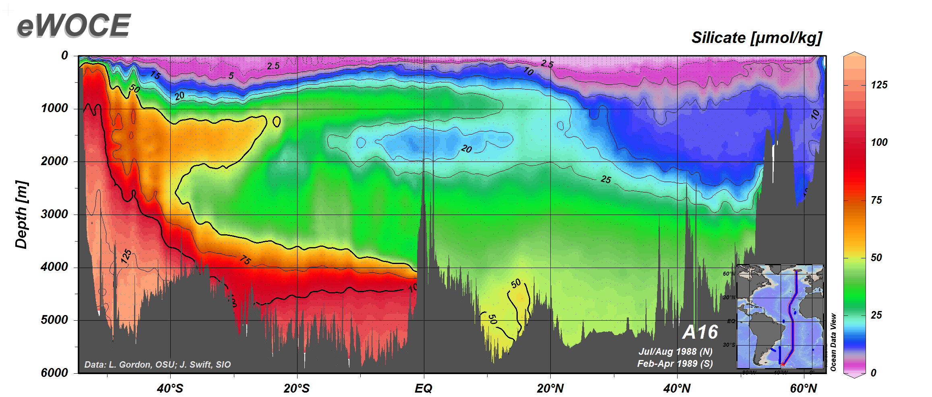

Slide 13
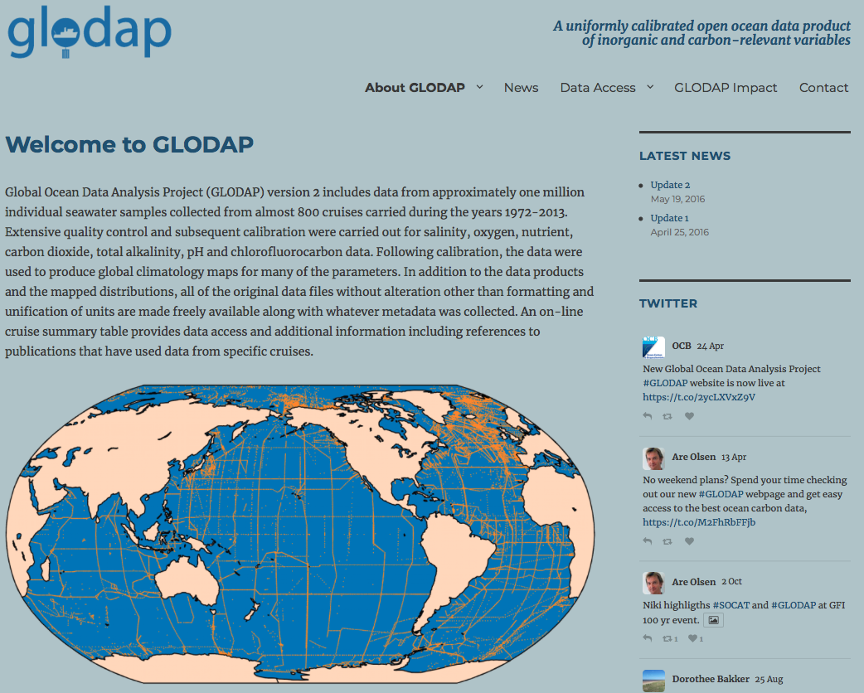
Ocean carbon: GLODAP

Slide 14
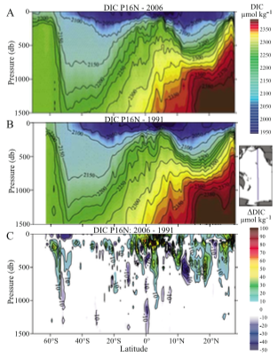
Learning from repeat sections
Sabine et al. (2008)

Slide 15
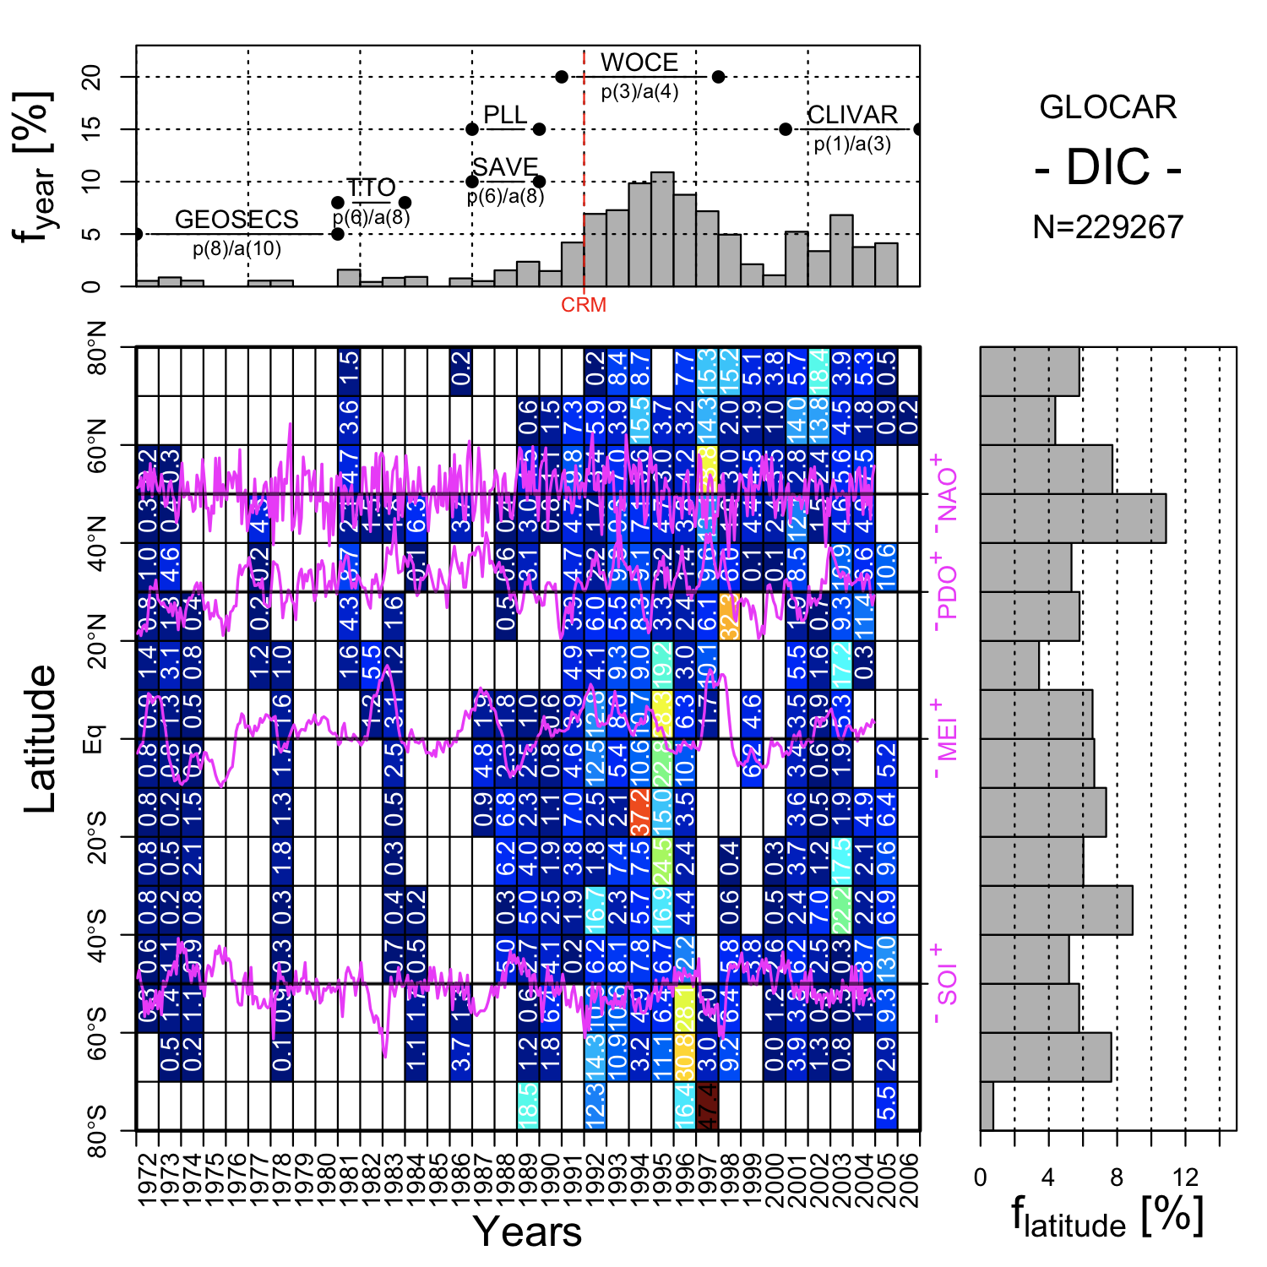

Slide 16
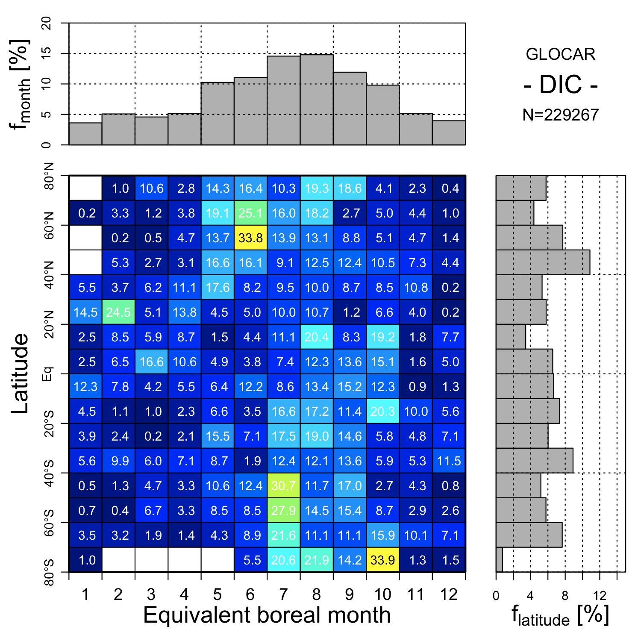

Slide 17
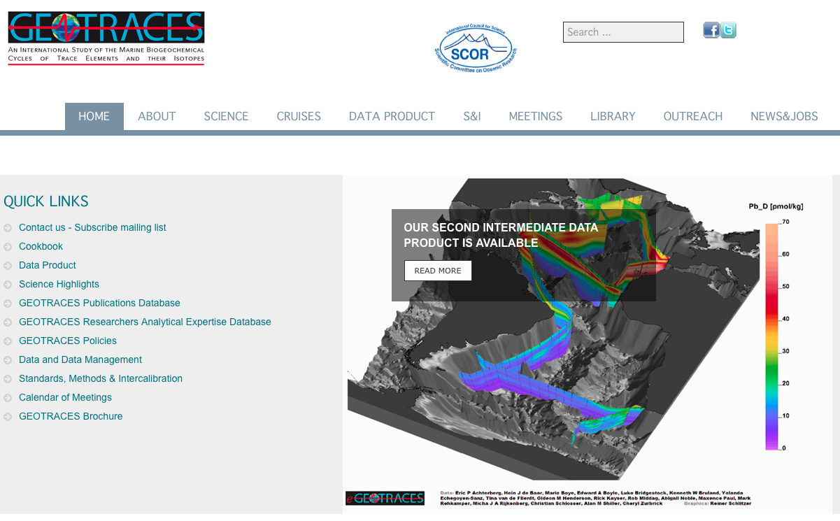
Trace elements and isotopes (GEOTRACES)

Slide 18
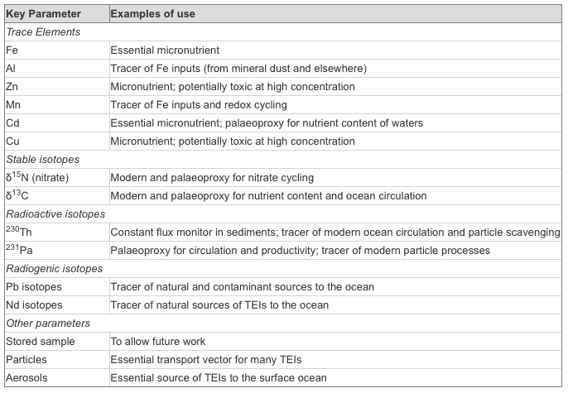

Slide 19
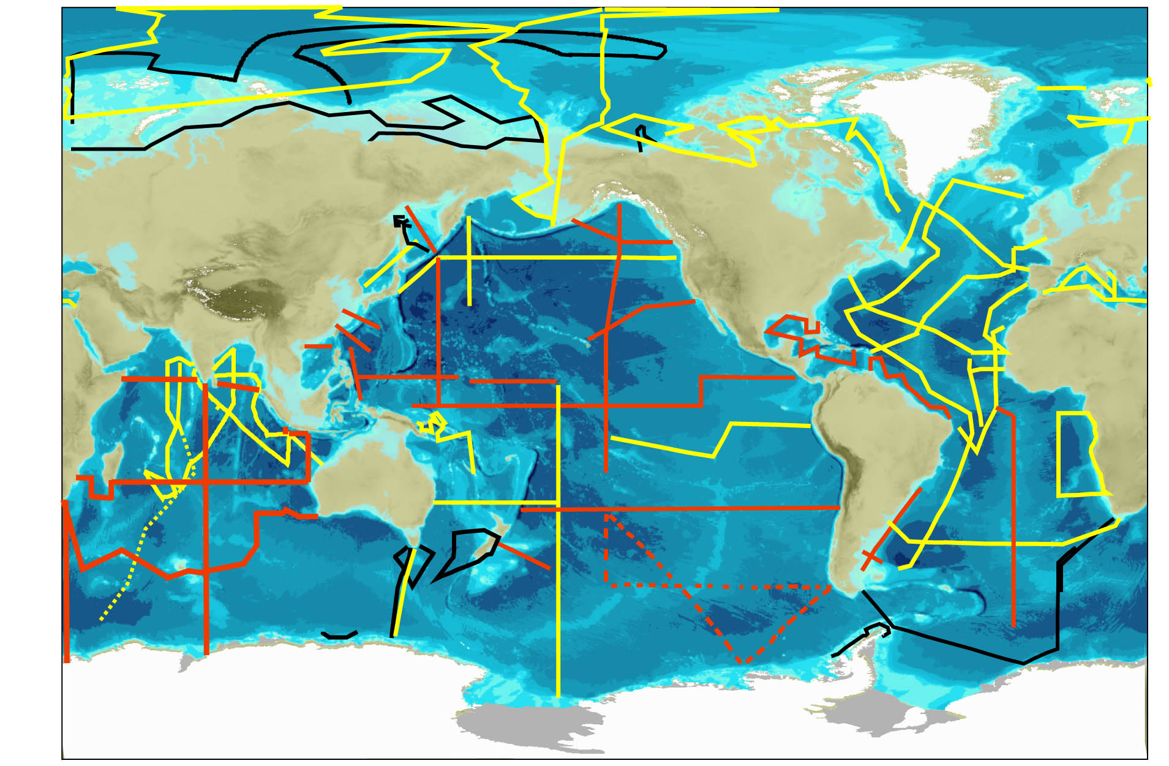

Slide 21
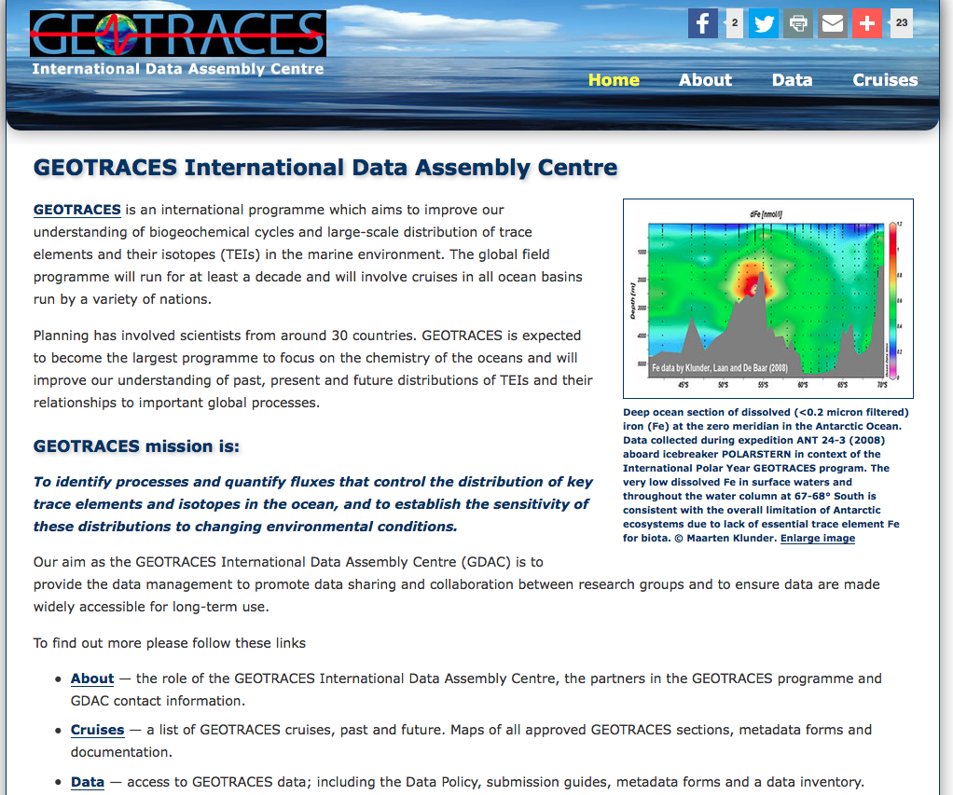

Slide 22
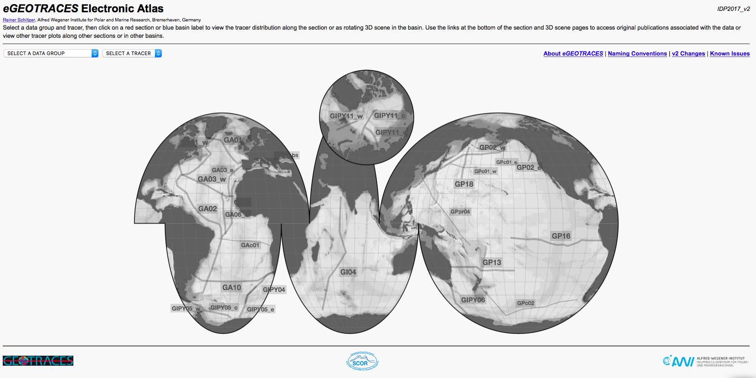

Slide 23
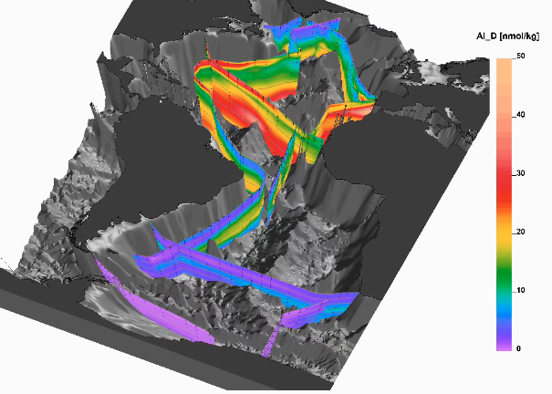

Slide 24
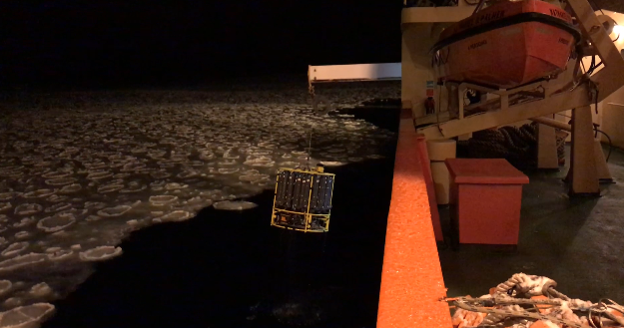
Modern hydrographic sampling

Slide 25
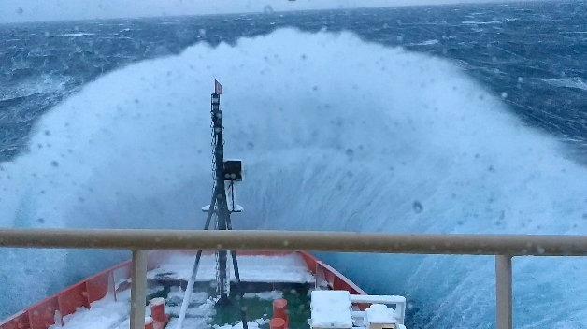
Sampling challenge (May 2018)

Slide 26
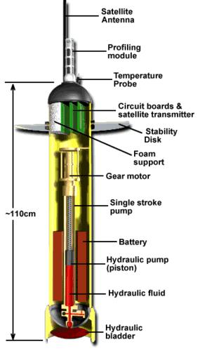
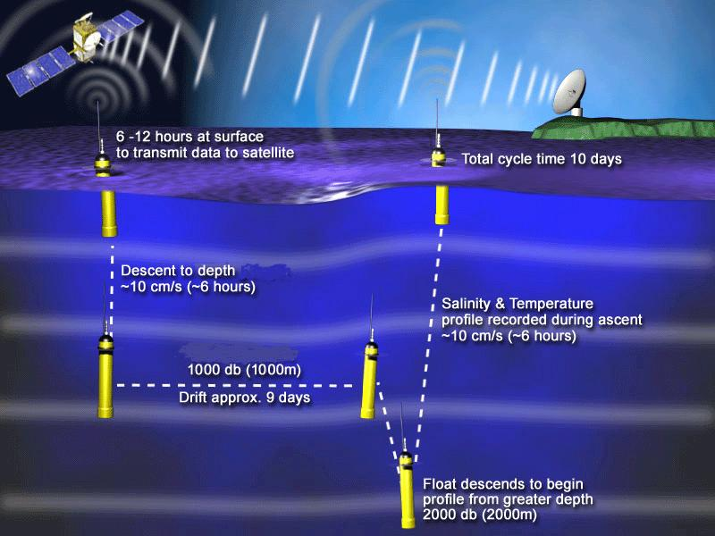
The Ocean interior (with robots!)
The ARGO program: T,S,(O₂,…)
http://www.argo.ucsd.edu/index.html

Slide 27
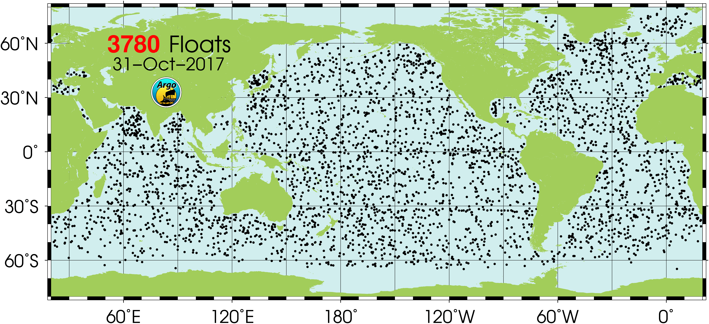
The Ocean interior
The ARGO program: T,S,(O₂,…)
http://www.argo.ucsd.edu/index.html

Slide 28
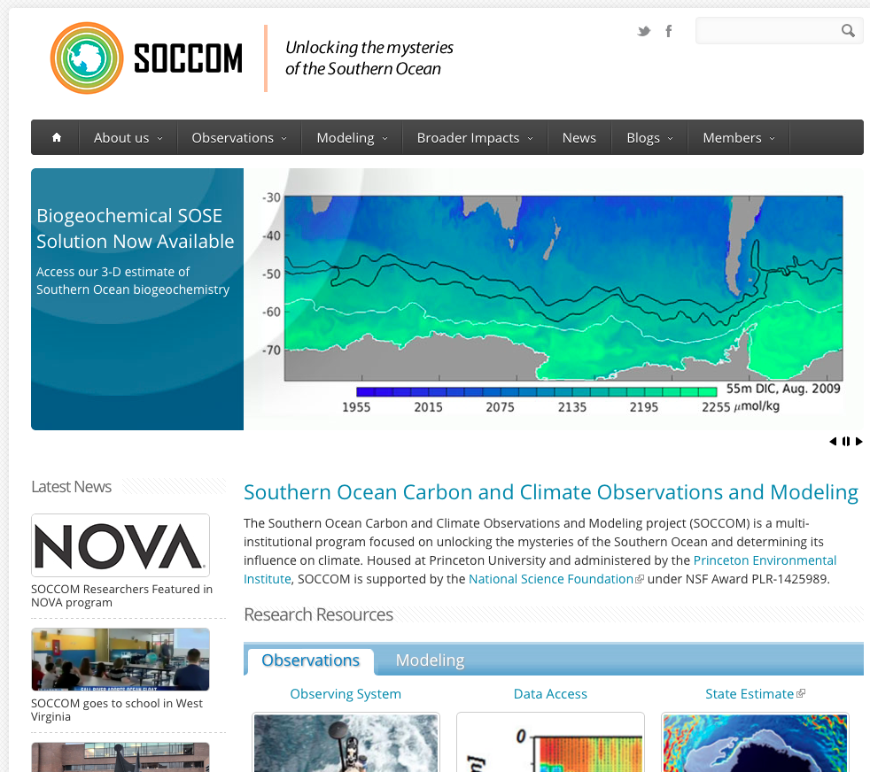

Slide 29
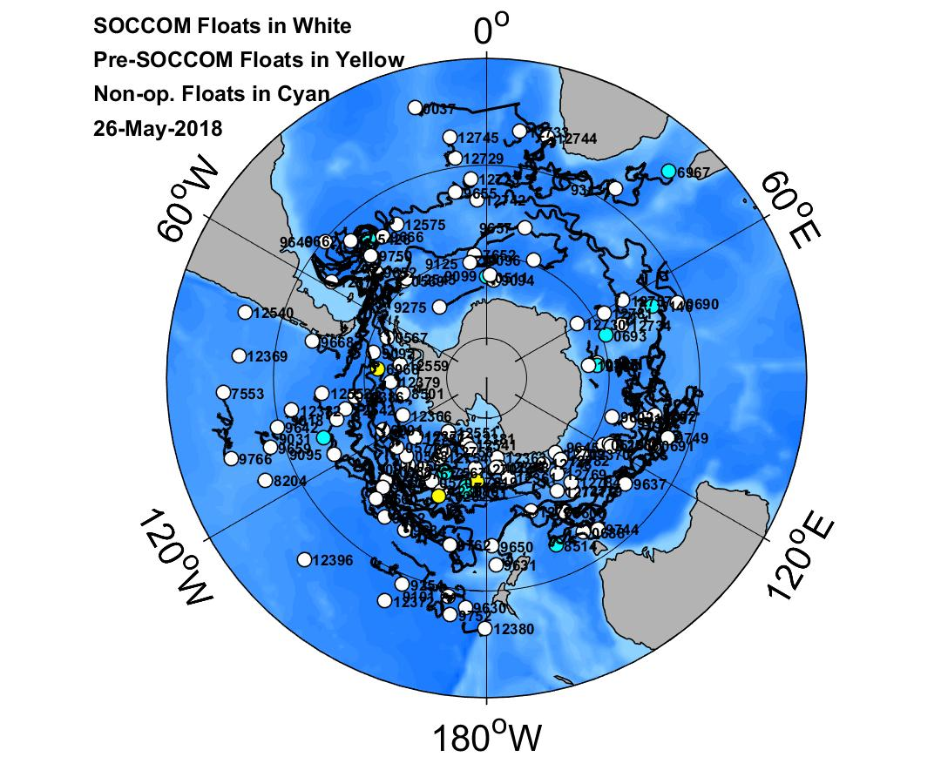

Slide 30
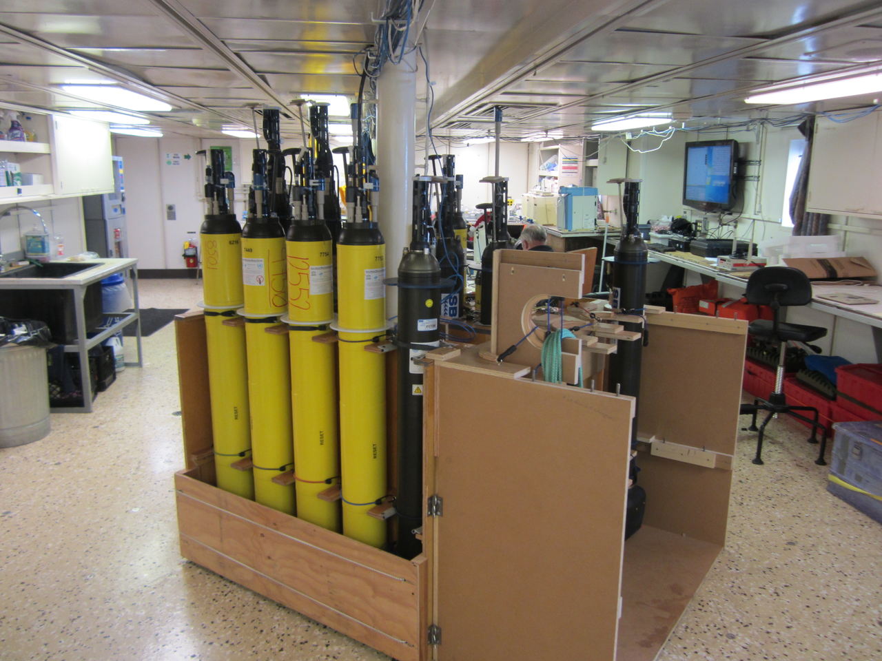

Slide 31
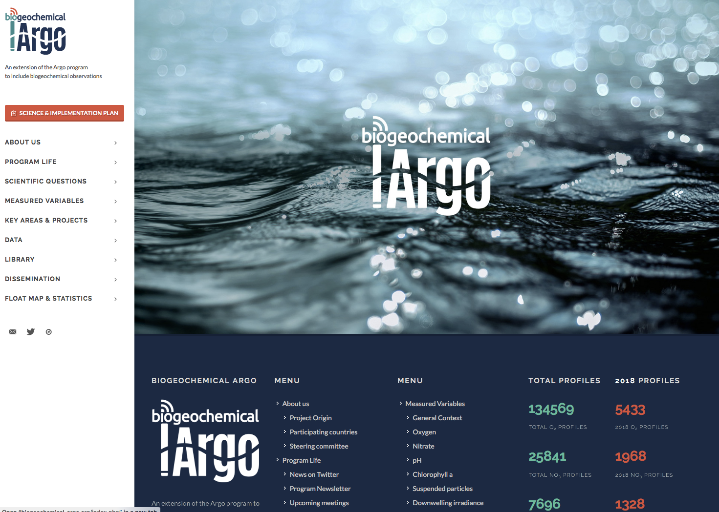
Biogeochemical-ARGO

Slide 32
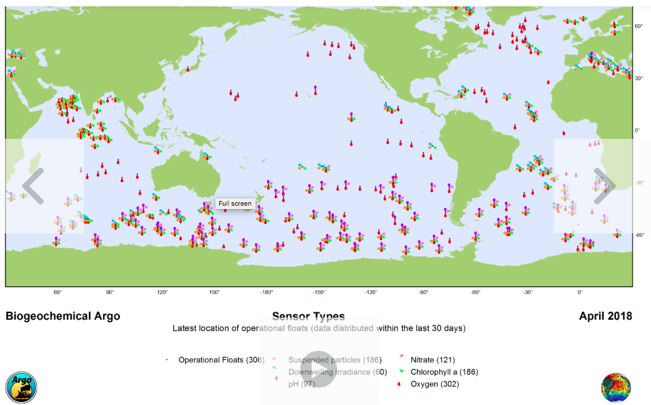
Biogeochemical-ARGO

Slide 33
