Slide 1
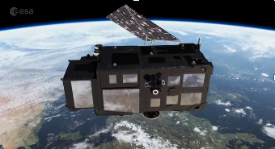
An introduction to satellite oceanography
(remote sensing)
Satellite basics
Radiometry
Scatterometry
Altimetry
Gravimetry
Outlook
Copernicus-Sentinel 3A/B (orbit 814.5km ~ Faro-A Coruna)
Marine Biogeochemistry Training School
Yves Plancherel
yves.plancherel@earth.ox.ac.uk
Portugal, Faro, 5th June 2018

Slide 2
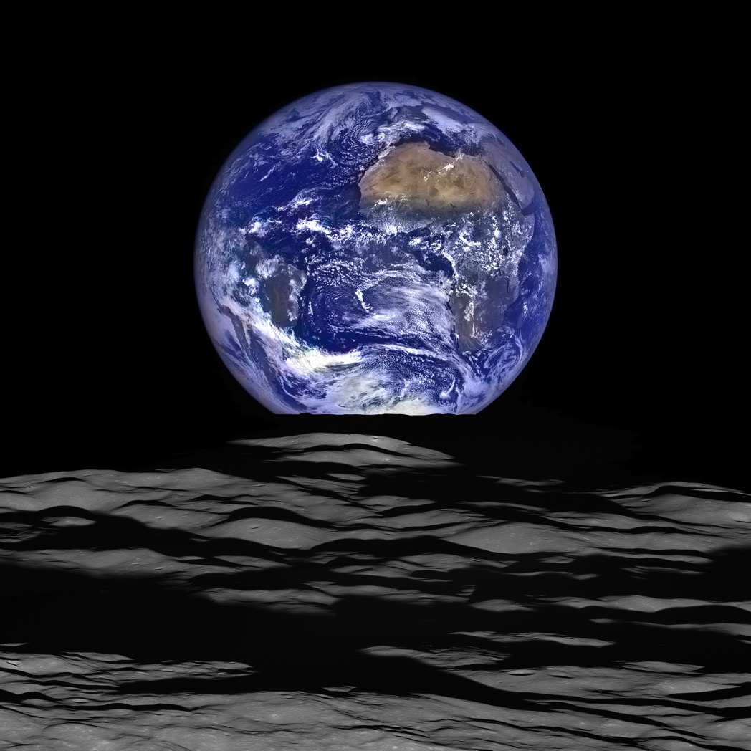
~ 70% Ocean
What can we see from space?
What can we learn from space?
https://www.nasa.gov/image-feature/goddard/lro-earthrise-2015
Notes:
How do we look at it? ...it’s big!
If we look, what can we see?
What can we learn from what we see?

Slide 3
Satellite oceanography – the good
Range of spatial coverage
  global, synoptic scales, down to meters or centimeters
Repeat views
Access (caveat: not unlimited):
  Ships avoid storms/bad weather
  Buoys steered away from divergence zones
Near real time (possible)
Notes:
How do we look at it? ...it’s big!
If we look, what can we see?
What can we learn from what we see?

Slide 4
Satellite oceanography – the “not so good”
Only a limited types/number of variables can be observed
Only the surface (or nearly)
Atmosphere is in the way
Clouds are in the way
Extensive calibrations needed
Expensive
Notes:
How do we look at it? ...it’s big!
If we look, what can we see?
What can we learn from what we see?

Slide 5
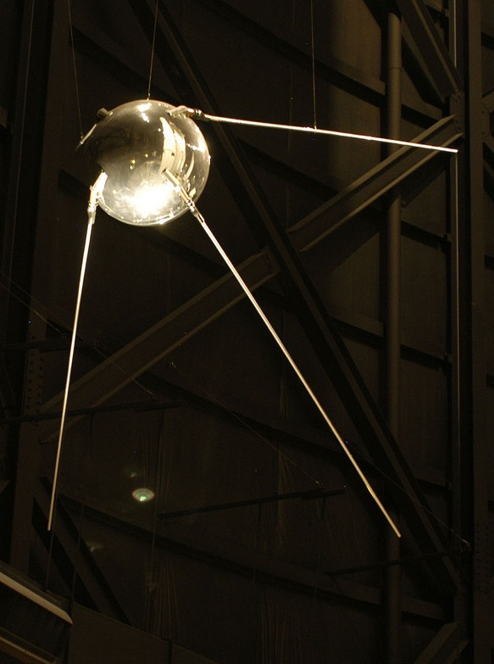
History: The first artificial satellite
4 Oct 1957: Sputnik 1
Primary goal:
Show off/intimidate in a context of Cold War
Launched the “space race”
Scientific gains:
  estimate the density of the upper atmosphere by observing drag on orbital trajectory
  propagation of radio signal = information on ionosphere
Wikipedia
Notes:
was the first artificial Earth satellite. It was a 58 cm (23 in) diameter polished metal sphere, with four external radio antennas to broadcast radio pulses.
Sputnik itself provided scientists with valuable information. The density of the upper atmosphere could be deduced from its drag on the orbit, and the propagation of its radio signals gave information about the ionosphere.

Slide 6
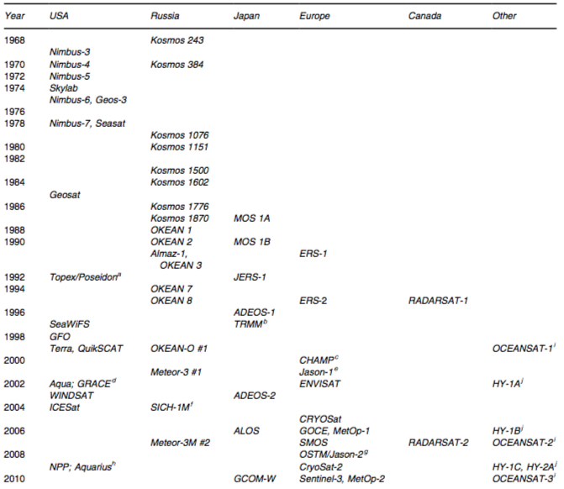
Some major ocean-related missions
Wilson et al. (2008)
CZCS
Altimeter

Slide 7
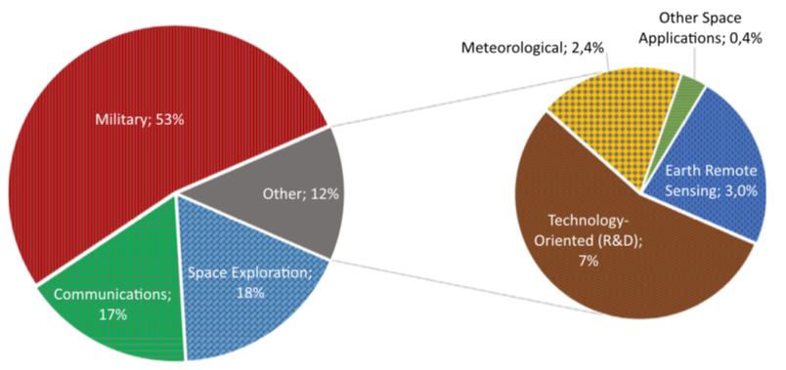
Distribution of 7472 (2013) spacecrafts
~ 3000 in orbit, ½ are Russian-owned
Guerra et al. (2016)
~ 400 dedicated to meteorology or earth remote sensing

Slide 8
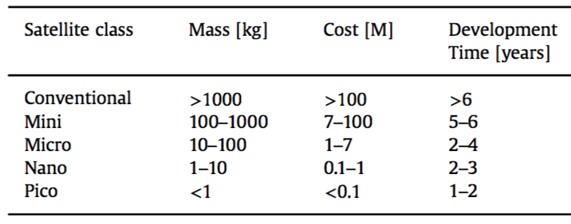
Size matters
(as it limits the cost/payload/science objectives)
Guerra et al. (2016)
i.e. Today’s satellites operate “old” technology!

Slide 9
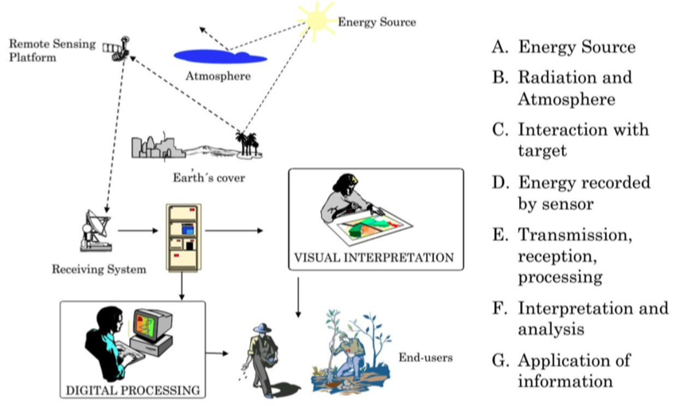
Not just the satellites: Remote Sensing framework
Ebenezer (2015), https://coessing.files.wordpress.com/2016/08/ebenezer_rmu2015_lec1_re.pdf
Notes:
How do we look at it? ...it’s big!
If we look, what can we see?
What can we learn from what we see?

Slide 10
Where are satellites and why?

Slide 11
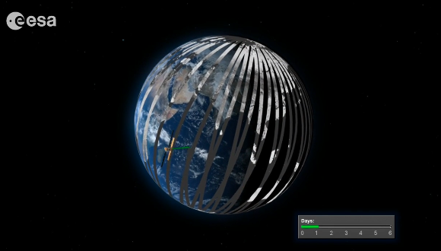
Orbits - Copernicus/Sentinel 1A/B
(Synthetic Aperture Radar, SAR, interferometry)
http://www.esa.int/spaceinvideos/Videos/2016/01/A_multitalented_mission
Notes:
300 m x 1270km swath, overlaping SLSTR (infrared radiometer) on Sentinel 3 also. OLCI has 21 bands in the visible.

Slide 12
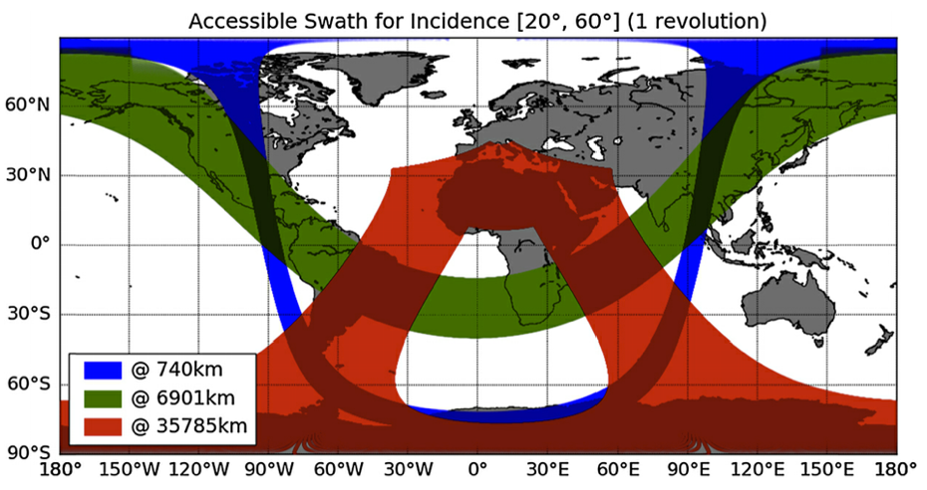
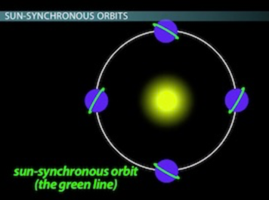
Orbits
“Shape”
  Polar, sun-synchronous, geosynchronous (geostationary)
“Height”
  Footprint/swath
  Friction, contamination, velocity/gravity, thrust
Sun-synchronous orbit
Emery and Camps (2017)

Slide 13
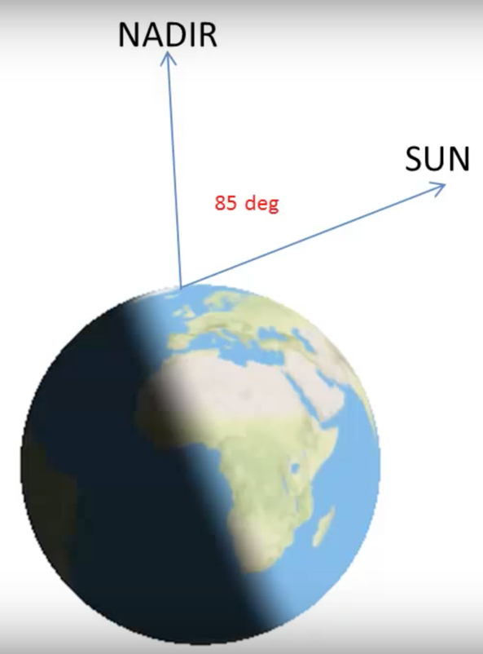
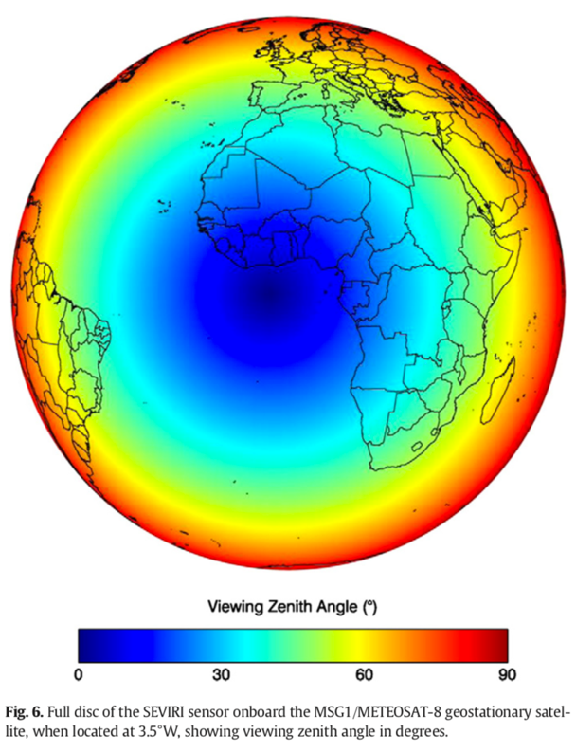
Zenith angles: who sees what how
Sun zenith angle
Viewing/sensor zenith angle
Ruddick et al. (2014)

Slide 14
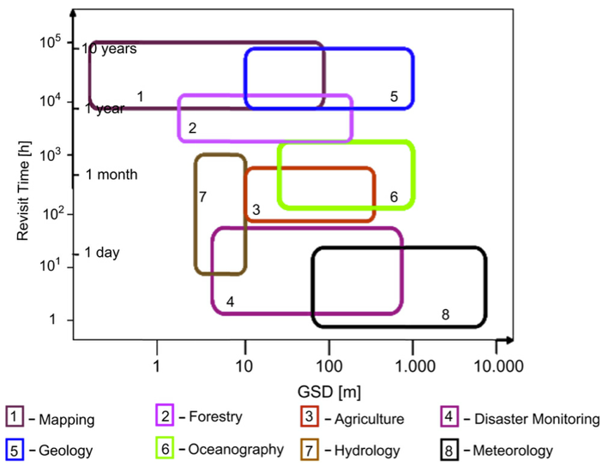

Some choices are set by science objectives
Emery and Camps (2017)

Slide 15
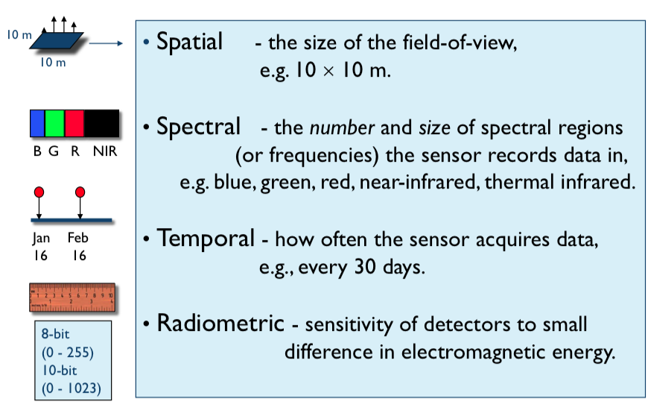
Resolution considerations
Ebenezer (2015), https://coessing.files.wordpress.com/2016/08/ebenezer_rmu2015_lec1_re.pdf

Slide 16
How do satellites and their sensors work?

Slide 17
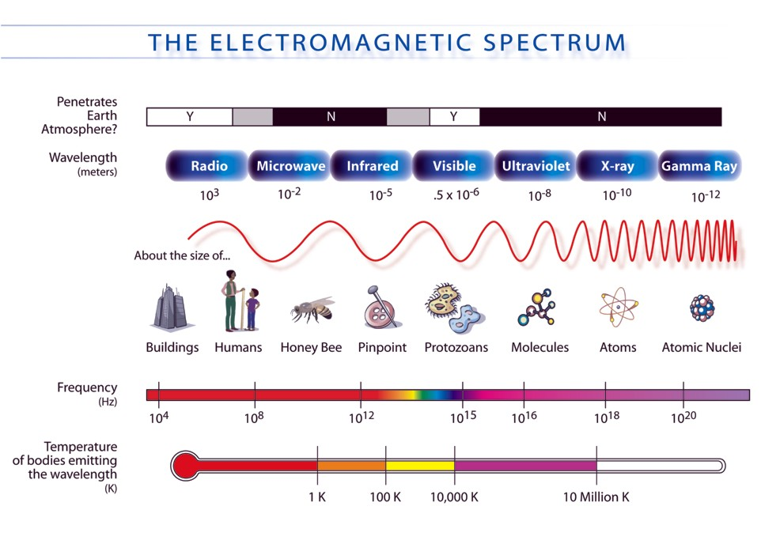

Slide 18
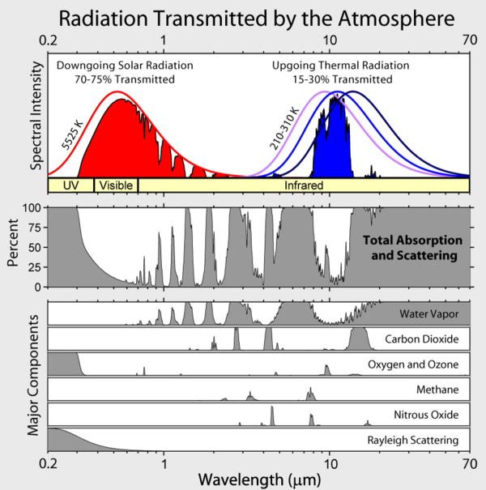

Slide 19
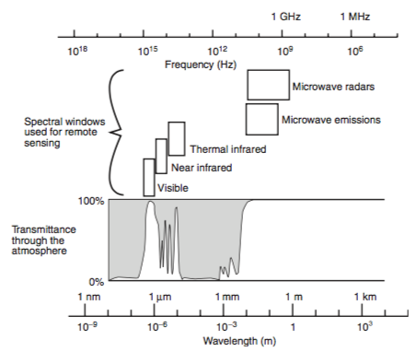
Spectral windows used for remote sensing
Wilson et al. (2008)

Slide 20
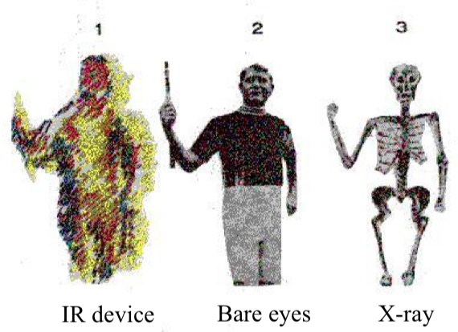
Electromagnetic spectrum
How we look affects what we see
Ebenezer (2015), https://coessing.files.wordpress.com/2016/08/ebenezer_rmu2015_lec1_re.pdf

Slide 21
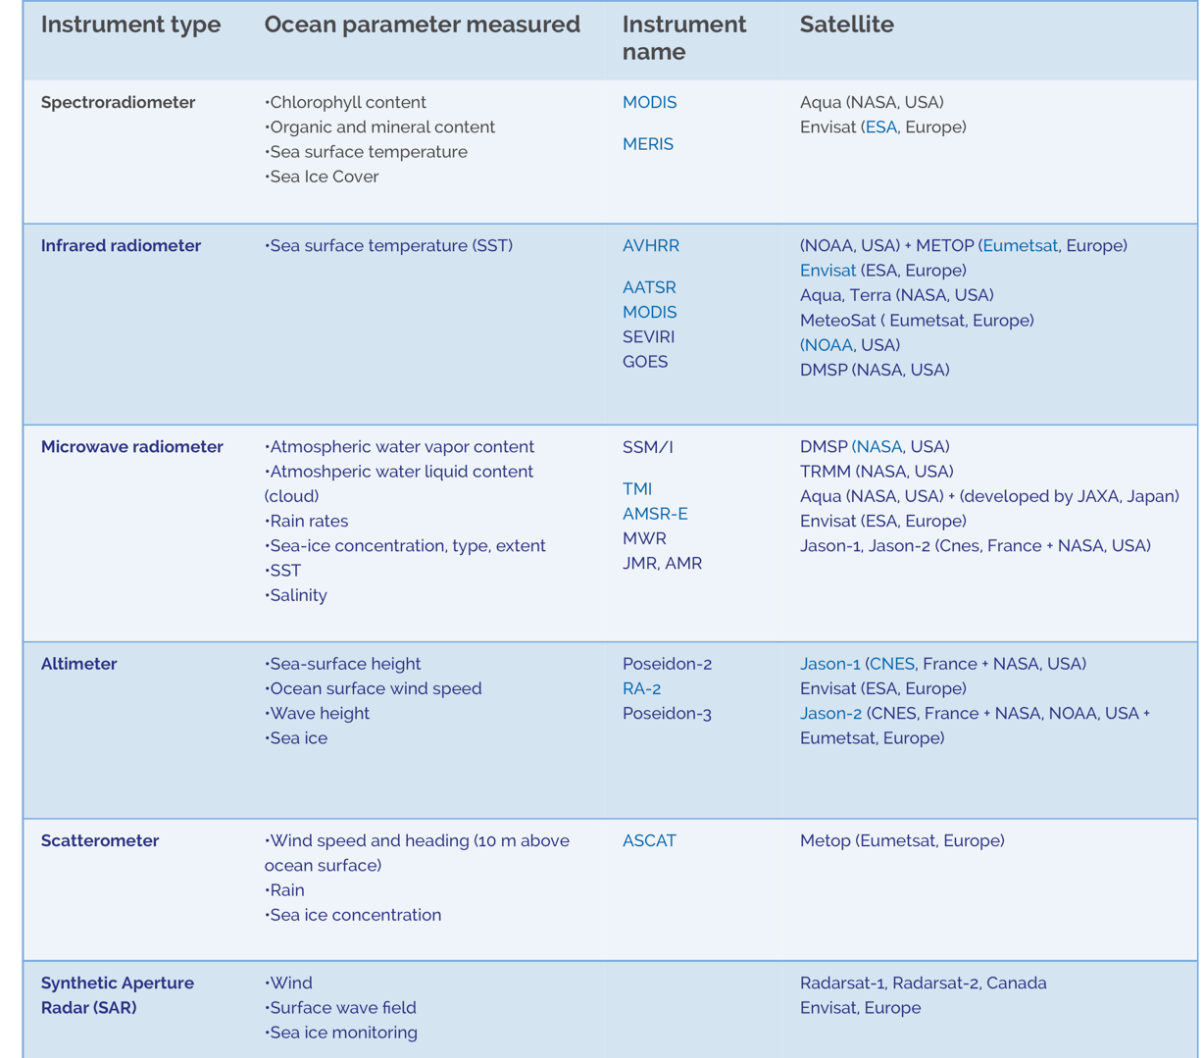
Spectro-
radiometer
Infrared-
radiometer
PASSIVE
Microwave-
radiometer
Altimeter
ACTIVE
Scatter-
ometer
Synthetic
aperture
radar (SAR)
http://marine.copernicus.eu/training/education/observation/satellites/

Slide 22
Ocean colour
(visible and infrared)

Slide 23
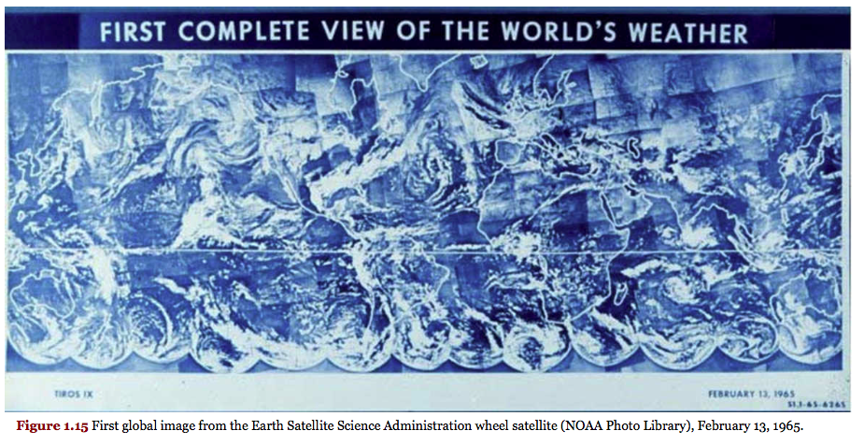
First picture
TIROS
Emery and Camps (2017)

Slide 24
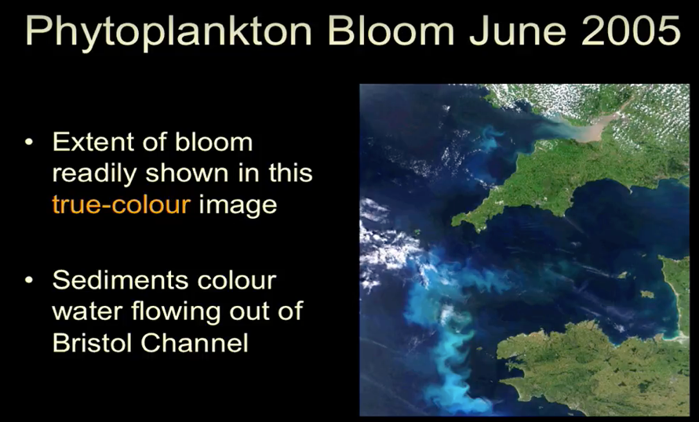
True color picture:
Ocean colour = art of interpreting this
https://www.youtube.com/playlist?list=PLWz3L6GkKap5U7QM5IDag4vkruykAE94U
Case 2
Case 1

Slide 25
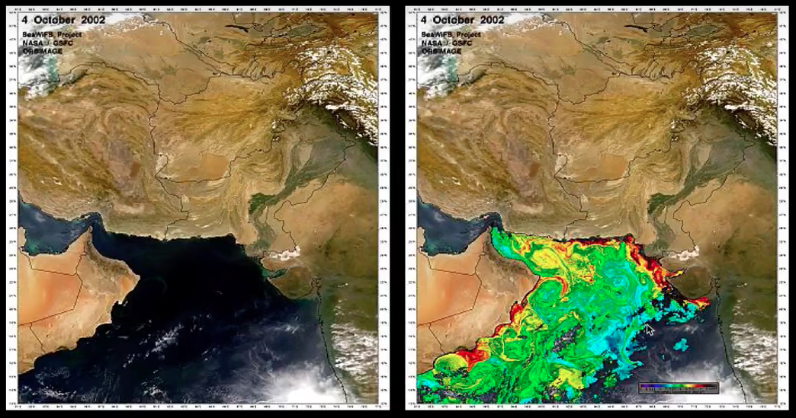
True vs “false” (i.e. processed) color
SEAWIFS (2002)
https://www.youtube.com/playlist?list=PLWz3L6GkKap5U7QM5IDag4vkruykAE94U

Slide 26
Applications of ocean colour
Phytoplankton phenology
Carbon inventory
Heat budget
Ocean dynamics
Fisheries
Ecosystem management, polllution, oil spills
Toxic algal blooms
Eutrophication
Etc.

Slide 27
Popular sensors
CZCS (Coastal Zone Color Scanner) – proof of concept
Sea-viewing Wide Field of View Sensor (SeaWIFS, 1997)
Moderate Resolution Imaging Spectroradiometer (MODIS) on the Earth Observing system Terra (1999) and Aqua (2002)
ENVISAT – MERIS (Medium resolution imaging spectometer)
Copernicus/Sentinel 3: Ocean and Land Colour Instrument (OLCI)

Slide 28
Historical sensors

Slide 29
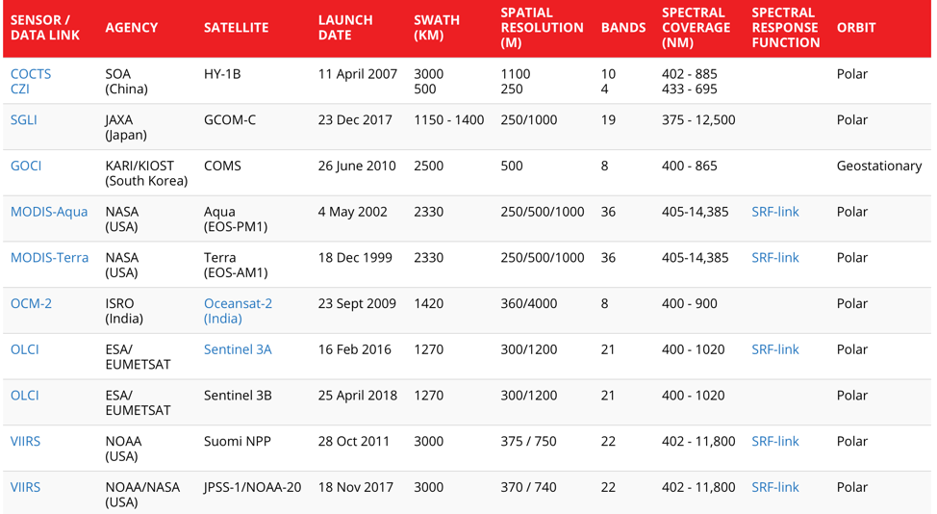
Current sensors

Slide 30
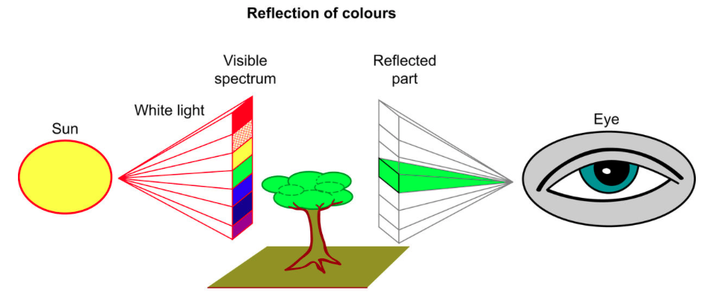
Basic idea: passive radiometry sun shines, we detect remaining light
satellite
Why is the tree green?
Emery and Camps (2017)

Slide 31
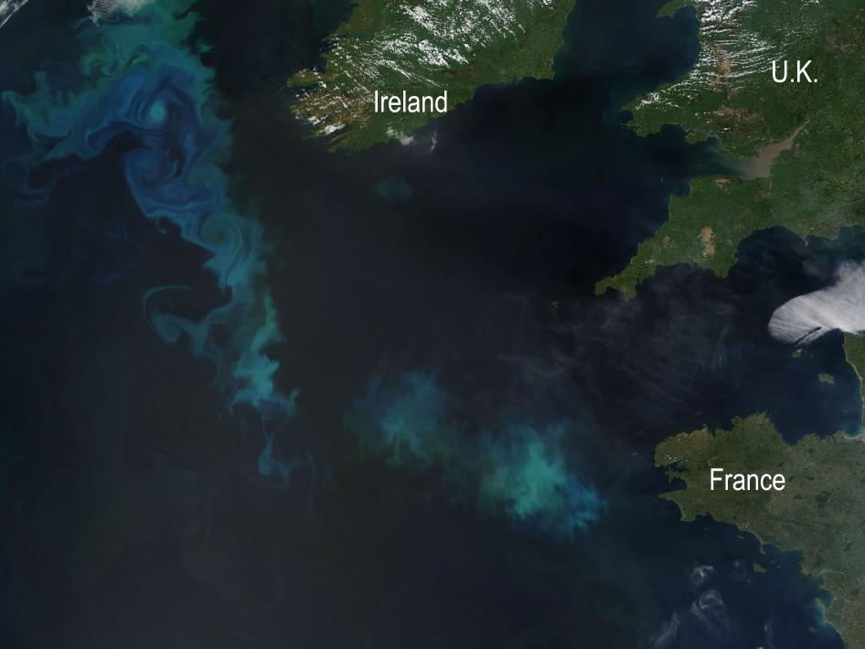
Basic idea: passive radiometry
Why is the sea green/blueish/etc?
MODIS Terra, 22 May 2010, true color image
https://www.nasa.gov/topics/earth/features/n_atlantic_bloom.html

Slide 32
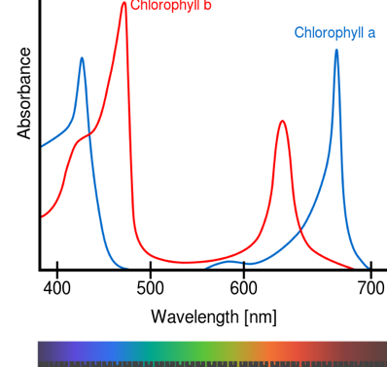
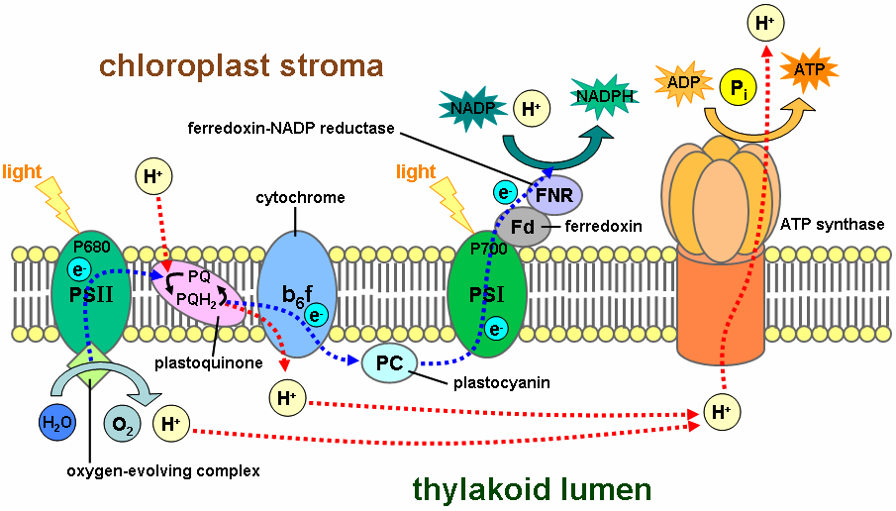
Ocean color and biology
Light + pigments = photosynthesis
Chl does not absorb green light
Wikipedia
We know the light spectrum going towards Earth
Measure the light spectrum leaving Earth
Interpret the difference

Slide 33
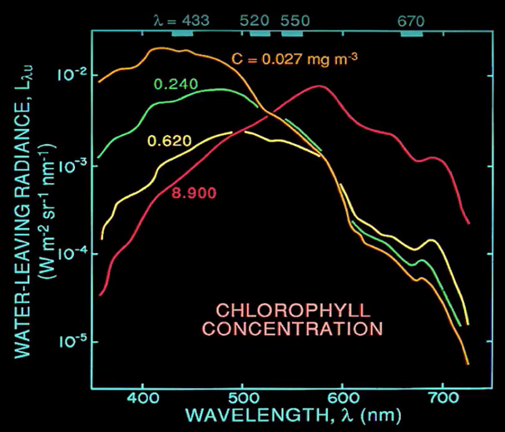
Measured spectra in the ocean at different chlorophyll concentrations
https://www.youtube.com/playlist?list=PLWz3L6GkKap5U7QM5IDag4vkruykAE94U

Slide 34
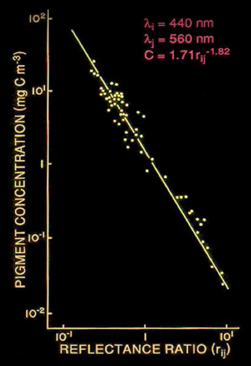
Algorithms: Reflectance ratios at fixed spectral band and calibration with in situ data
Basic idea
Evolving algorithms and calibrations:
Case 1 vs case 2 waters
Viewing & zenith angles
Thin clouds
Sun glints
Available spectral bands vary
https://www.youtube.com/playlist?list=PLWz3L6GkKap5U7QM5IDag4vkruykAE94U

Slide 35
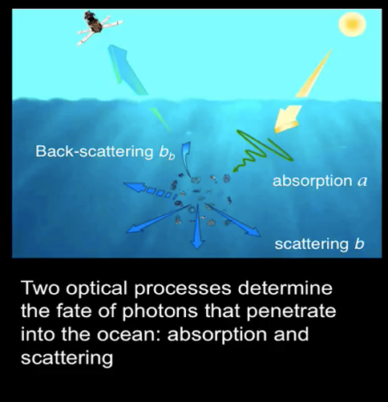
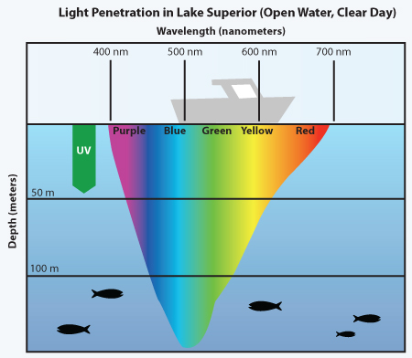
Fate of light in water
What can go wrong?
https://www.youtube.com/playlist?list=PLWz3L6GkKap5U7QM5IDag4vkruykAE94U

Slide 36
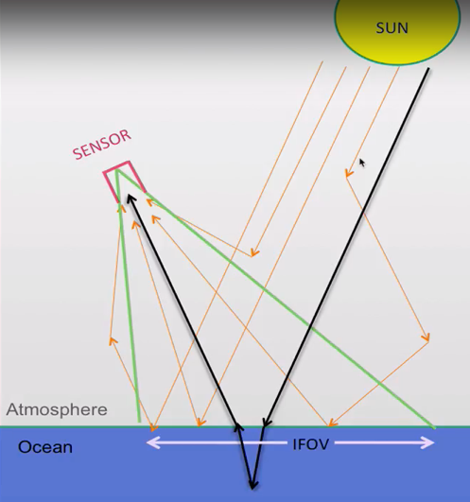
From the sun to the sensor
What can go wrong?
Atmospheric
absorption
Only 10-20% is signal
80-90% is noise/atmospheric effects
Corrections based on
  Modelling
  Parallel measurements
    Other spectral bands
    Other sensors
the “one” beam that matters
Reflection
(clouds)
Atmospheric
scattering
Atmospheric
scattering
Reflection
(white caps, glint,
Sun and sensor zenith angle)
https://www.youtube.com/playlist?list=PLWz3L6GkKap5U7QM5IDag4vkruykAE94U

Slide 37
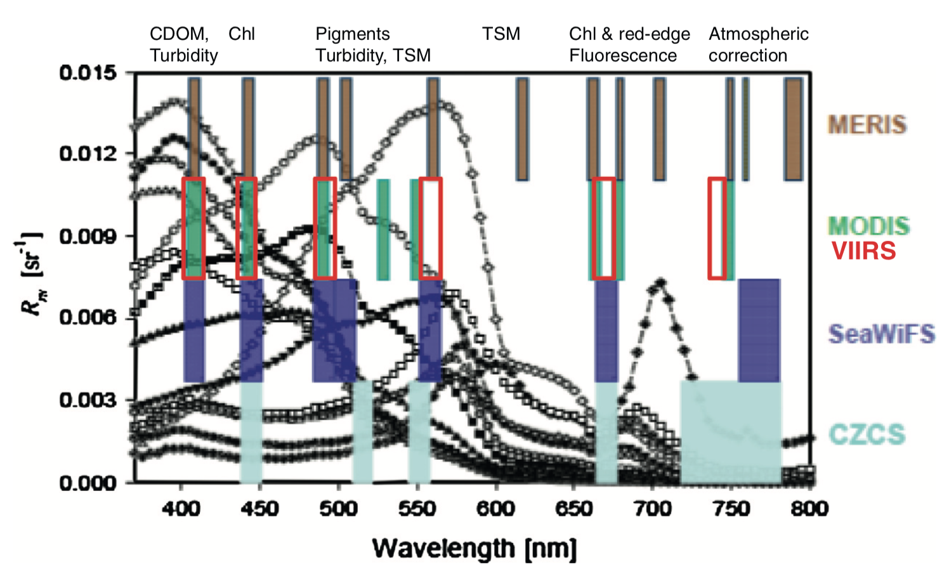
Spectral band selection and purpose
Blondeau-Patissier et al. (2014)

Slide 38
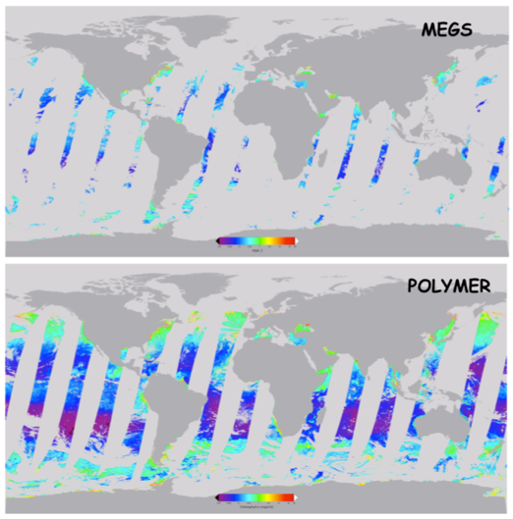
Data availability
Merging products, algorithmic improvements
Algorithmic improvement to account for wider viewing angles
https://oceancolor.gsfc.nasa.gov/meetings/scienceteam/ocrt/may2010/Frouin_OCRT_NewOrleans.pdf

Slide 39
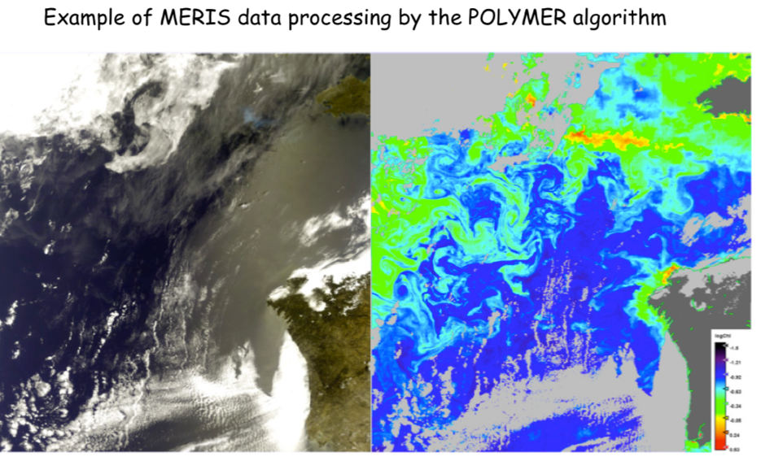
Interpretting data: algorithms, algorithms, algorithms...
https://oceancolor.gsfc.nasa.gov/meetings/scienceteam/ocrt/may2010/Frouin_OCRT_NewOrleans.pdf

Slide 40
Practical data issues: data types
https://oceancolor.gsfc.nasa.gov/products/
Level 0 (raw data)
Level 1A, 1B (cleaned data)
Level 2 (geophysical variable)
Level 3 (mapped, binned)
Level 4 (derived products)

Slide 41
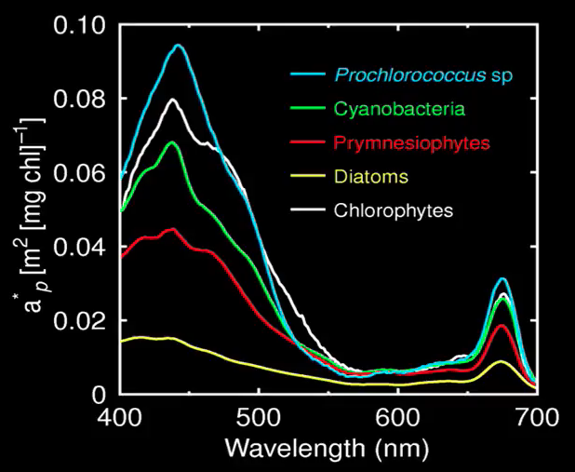
Applications: Ecology
Different species absorb light differently
https://www.youtube.com/playlist?list=PLWz3L6GkKap5U7QM5IDag4vkruykAE94U

Slide 42
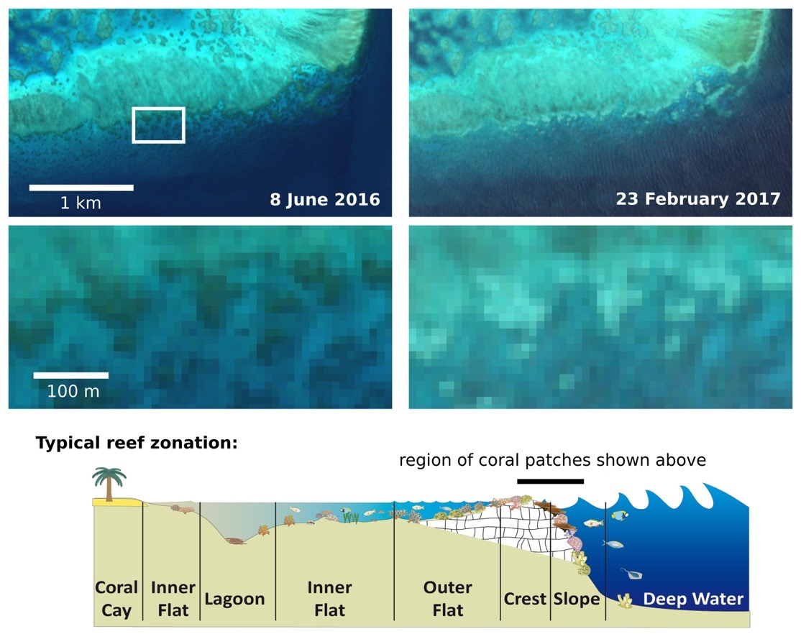
Applications: Acidification, coral health
Copernicus/Sentinel 2A: hyperspectral imager
Coral bleaching
http://www.esa.int/spaceinimages/Images/2017/05/Sentinel-2_captures_coral_bleaching
Notes:
Coral bleaching, Adelaide Reef, Central Great Barrier Reef

Slide 43
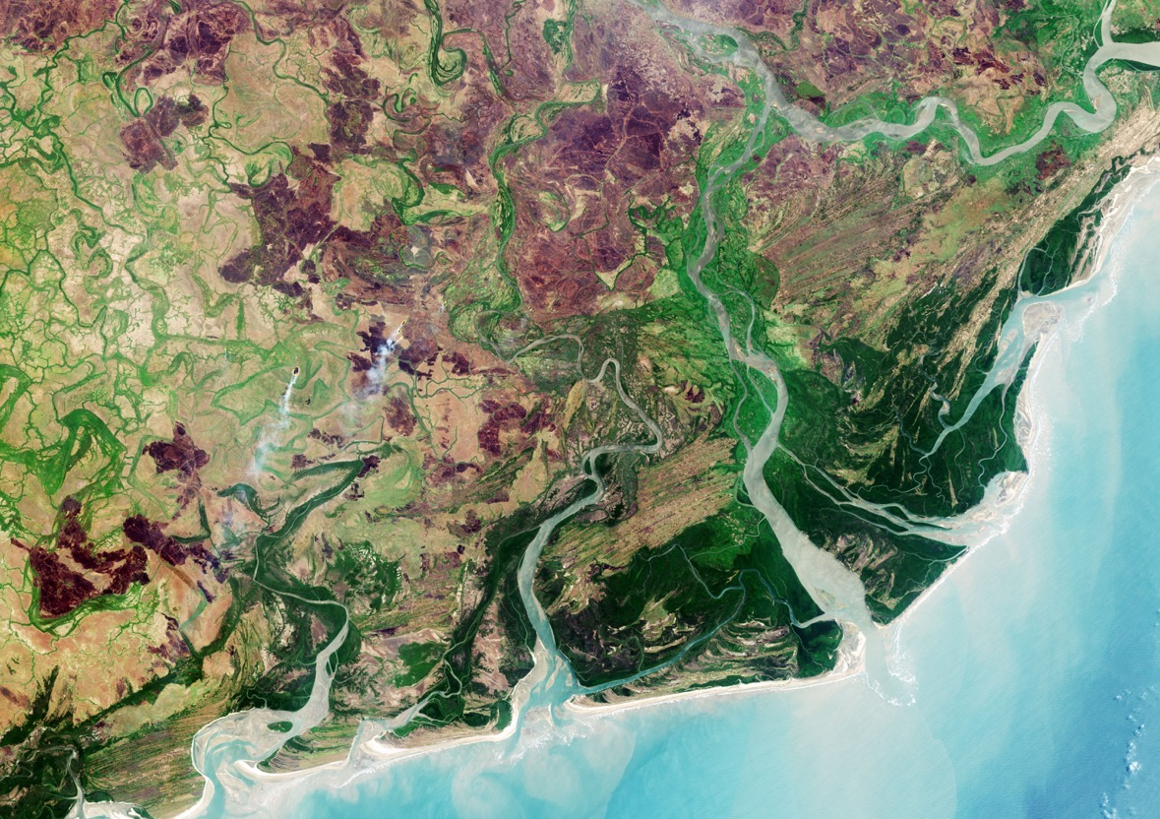
Beyond Chlorophyll: Land cover
Copernicus/Sentinel 2A: hyperspectral
http://www.esa.int/spaceinimages/Images/2018/05/Zambezi_Delta_diversity
Zambezi Delta (20m resolution!)
Notes:
20m resolution land use map created from sentinel 2A on 28 September 2016

Slide 44
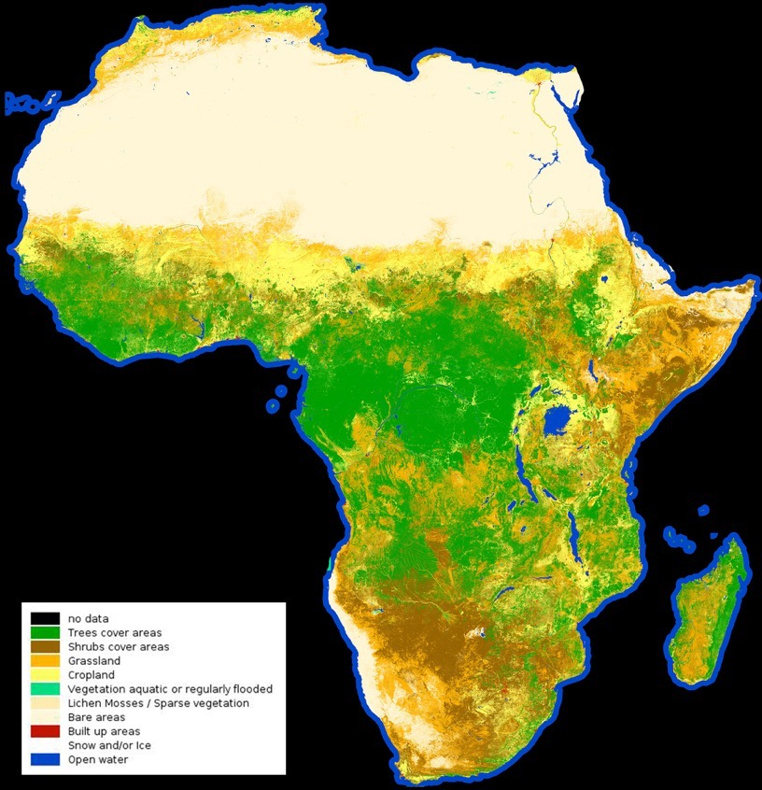
Beyond Chlorophyll: Land cover
Copernicus/Sentinel 2A: hyperspectral imager http://2016africalandcover20m.esrin.esa.int
http://www.esa.int/spaceinimages/Images/2017/10/African_land_cover
180000 images!
Sentinel 2A
Dec 2015-2016
Land cover
Notes:
20m resolution land use map created from 180000 images from sentinel 2A between december 2015 and 2016.

Slide 45
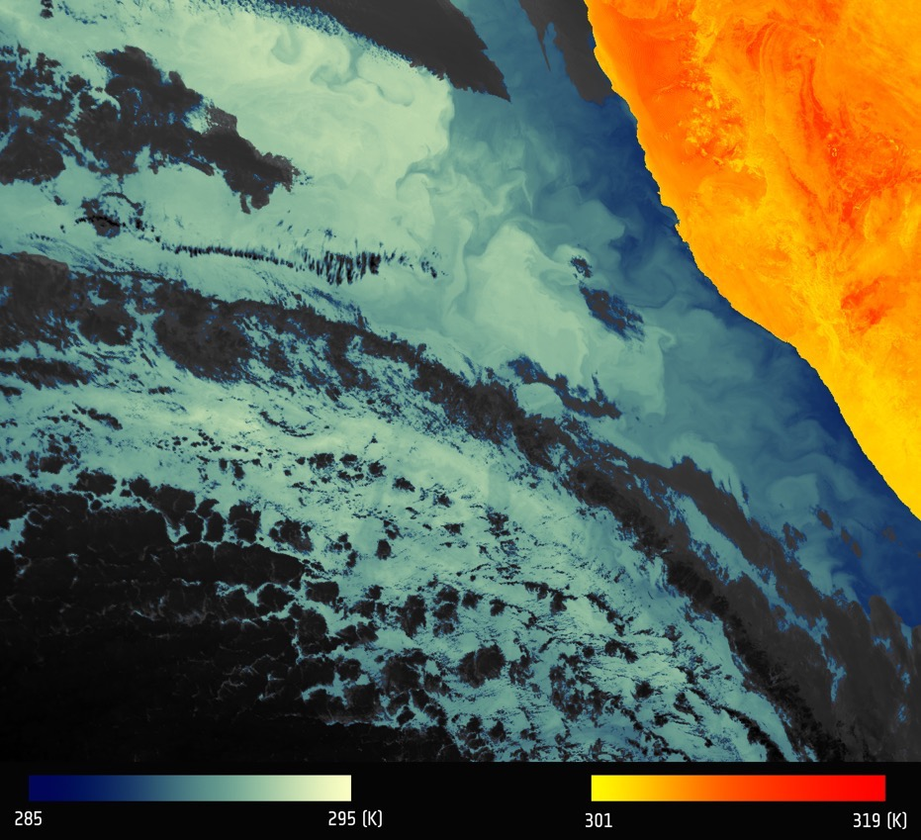
Sea surface temperature:
Copernicus/Sentinel 3A: SLSTR
Namibian upwelling
http://www.esa.int/spaceinimages/Images/2016/04/Thermal_signature_of_Namibian_coastline
Notes:
Sentinel 3A, SLSTR

Slide 46
Passive radiometry and climate
Products need to be sensor independent, consistent and continuous across satellite missions
Substantial work needed to understand and link data from different sources to create consistent time series
  Orbits (sensor and zenith angles, swath area)
  Calibrations
  Drifts
  Contamination (clouds, sub-pixel, glint)
  Spectral bands

Slide 47
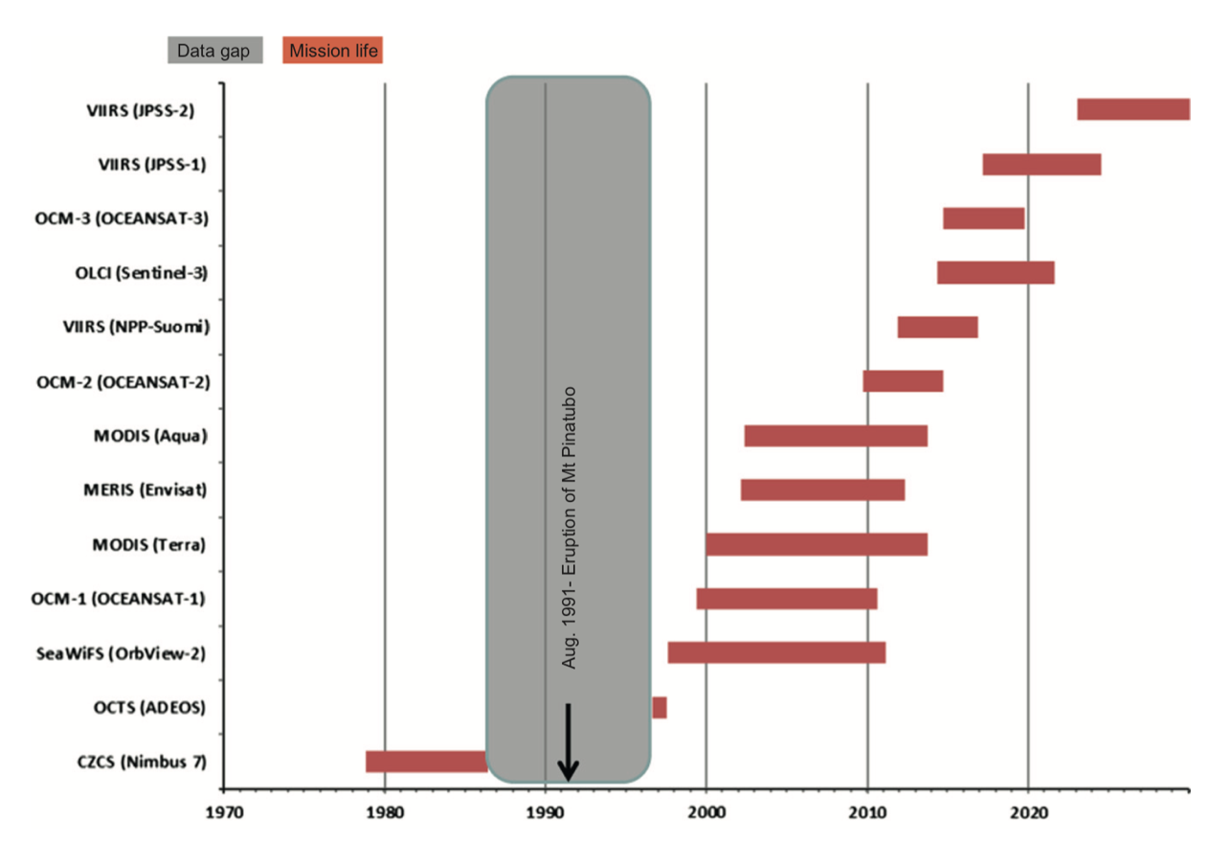
A succession of sensors and sensor design
Blondeau-Patissier et al. (2014)

Slide 48
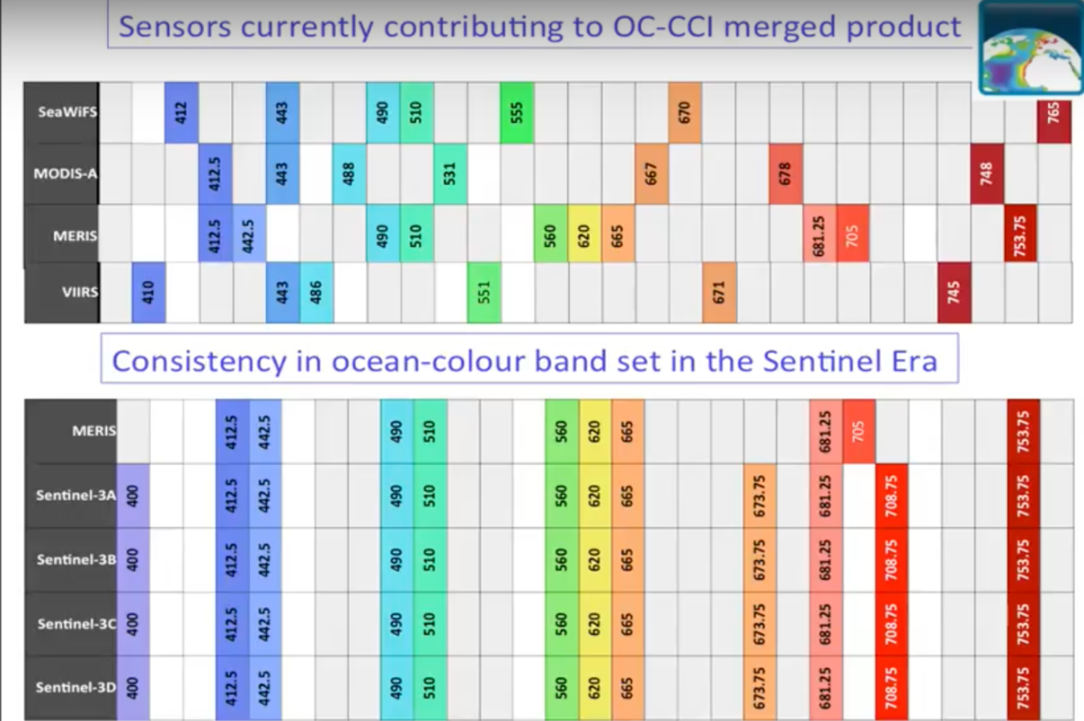
Band bias across sensors and sensor design
https://www.youtube.com/playlist?list=PLWz3L6GkKap5U7QM5IDag4vkruykAE94U

Slide 49
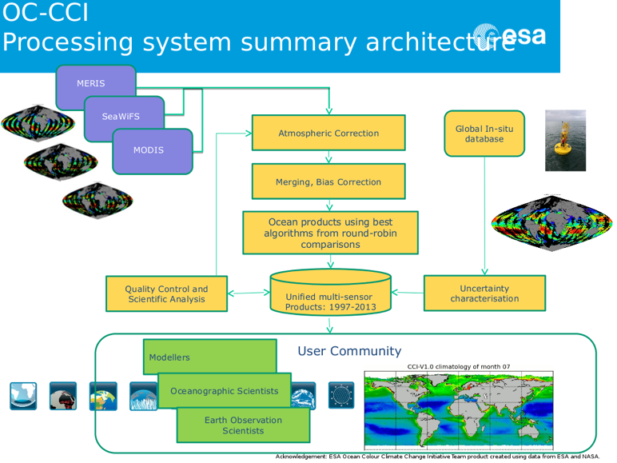
Significant data processing

Slide 50
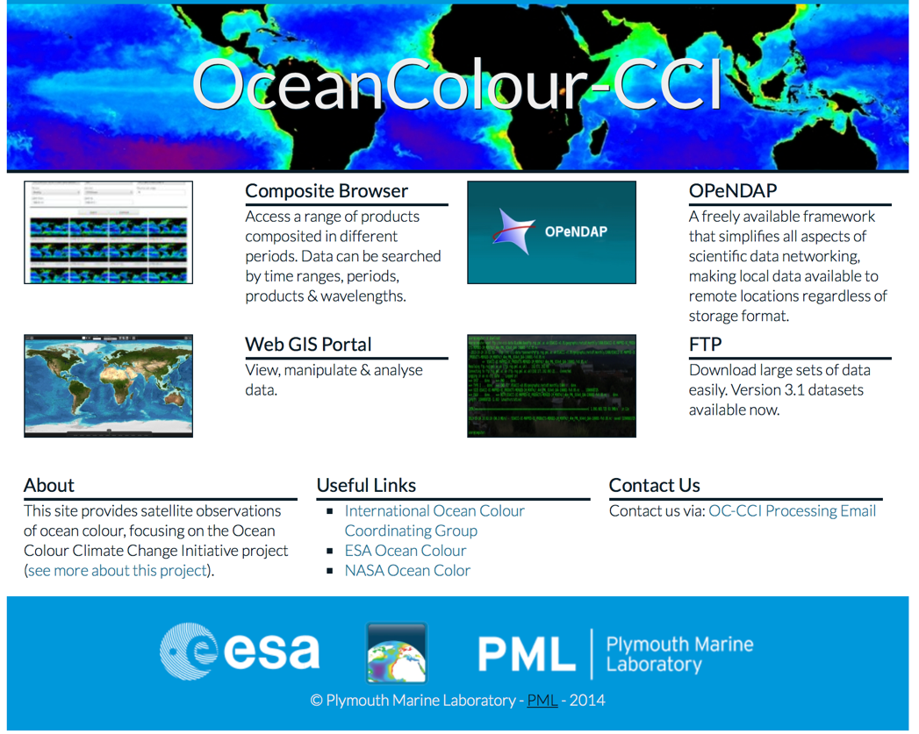
Data resources
www.oceancolour.org

Slide 51
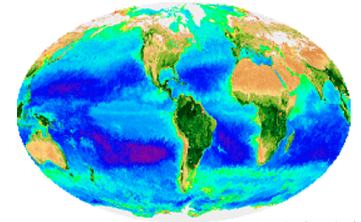
MERIS + SeaWIFS (1997-2010, 8 channels)
MEdium Resolution Imaging Spectrometer + Sea-Viewing Wide Field-of-View Sensor
PAR➔Chlorophyll-a➔Primary production➔CO₂
Biological variations in space and time
https://oceancolor.gsfc.nasa.gov
Notes:
This visualization shows ocean surface currents around the world during the period from June 2005 through December 2007. The visualization does not include a narration or annotations; the goal was to use ocean flow data to create a simple, visceral experience.
his visualization was produced using model output from the joint MIT/JPL project: Estimating the Circulation and Climate of the Ocean, Phase II or ECCO2. ECCO2 uses the MIT general circulation model (MITgcm) to synthesize satellite and in-situ data of the global ocean and sea-ice at resolutions that begin to resolve ocean eddies and other narrow current systems, which transport heat and carbon in the oceans. ECCO2 provides ocean flows at all depths, but only surface flows are used in this visualization. The dark patterns under the ocean represent the undersea bathymetry. Topographic land exaggeration is 20x and bathymetric exaggeration is 40x.
This visualization was shown at the SIGGRAPH Asia 2012 Computer Animation Festival.

Slide 52
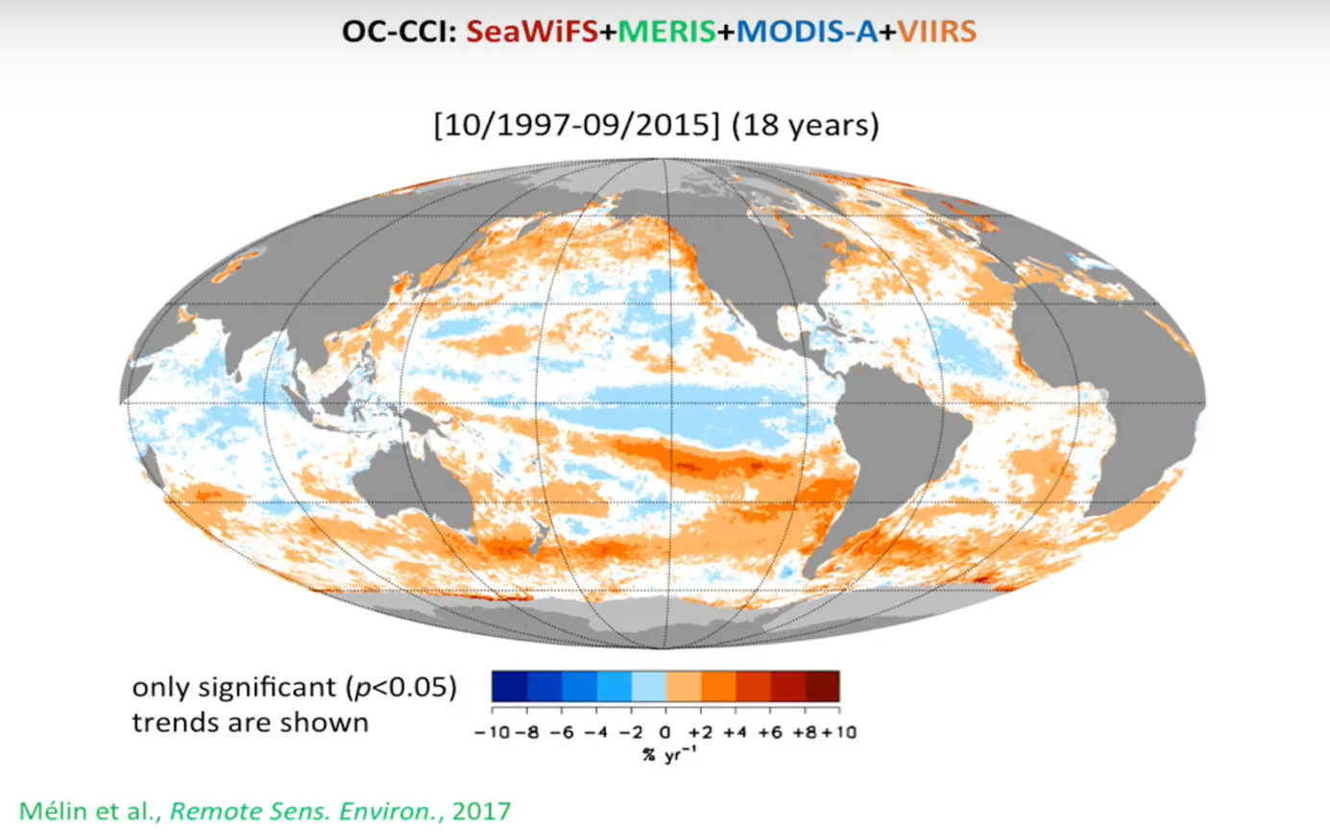
Merged products allow for longer time series and detection of trends
https://www.youtube.com/playlist?list=PLWz3L6GkKap5U7QM5IDag4vkruykAE94U

Slide 53
Orbiting vs geosynchronous
Sun-synchronous orbiting satellites
  E.g. MODIS
  Data available once a day, at most
  Low altitude (~800km)
  Temporal aliasing issues due to fast changes in cloudiness (i.e. weather), time of day (no data at night)
Geostationary
  GOCI, AHI, SEVERI
  Data available up to every few minutes
  High altitude (35786km)

Slide 54
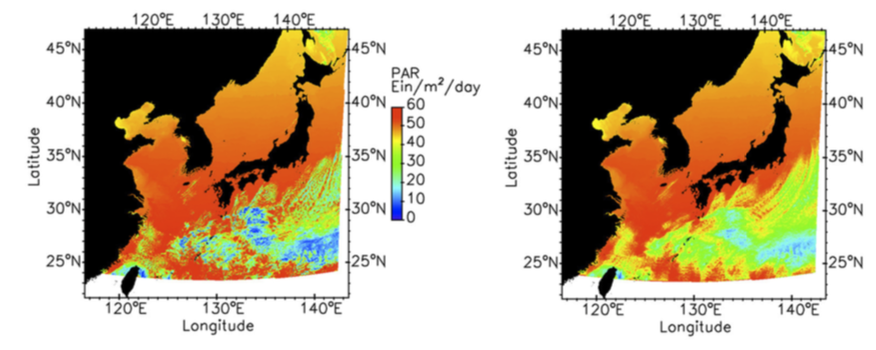
Sensors in geosynchronous orbits
(local coverage but high temporal resolution)
e.g. GOCI
Single observation (03:16GMT)
8-hour average
Frouin et al. 2016

Slide 55
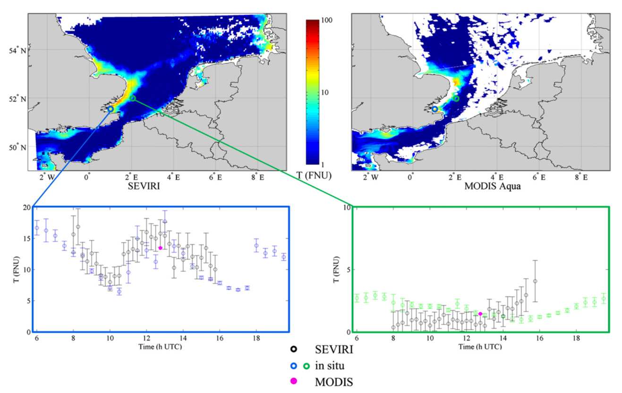
Sensors in geosynchronous orbits
(Thames river: SEVIRI, MODIS-Aqua, in-situ sensors)
Geosynchronous (SEVIRI)
Sun-synchronous (MODIS)
Ruddick et al. (2014)

Slide 56
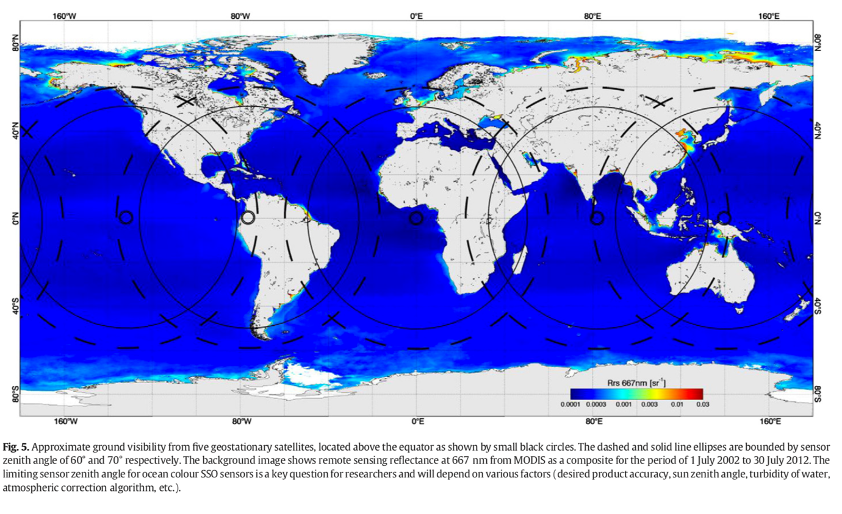
Hypothetical setup for ocean color
(5 geostationary satellites)
Ruddick et al. (2014)

Slide 57
Scheduled ocean colour sensors

Slide 58
Scatterometry
(Radar)
NASA: Seasat, NSCAT, QuickSCAT, Seawinds
ESA: AMI, …

Slide 59
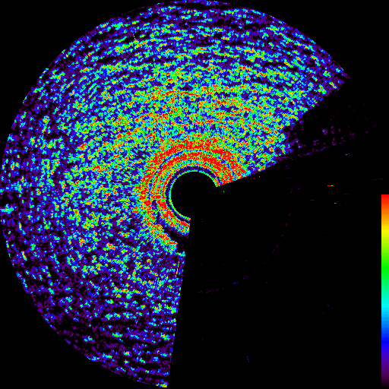
What is this?
http://www.sea-image.com/Site/images/film1.gif
Notes:
Radar image from a ship

Slide 60

Emery and Camps (2017)

Slide 61


Scatterometry = the art of studying the return pulse
Emery and Camps (2017)

Slide 62


Emery and Camps (2017)

Slide 63

Shape of return pulse = physical interpretations
Wind speed, surface roughness, wave height...
Emery and Camps (2017)

Slide 64


Emery and Camps (2017)

Slide 65

Wind speed + direction
(SeaWinds, aboard Adeos-2 (Japan), 2003)
https://winds.jpl.nasa.gov/gallery/earlyimages/?ImageID=33
Notes:
First image from seawinds, 2003, showing wind speed and direction from scatterometry

Slide 66


Radars see through stuff
(clouds, leaves, ice/snow, ...)
Emery and Camps (2017)

Slide 67

Emery and Camps (2017)

Slide 68
Altimetry
(Radar, microwave)

Slide 69
Principle of altimetry: speed = distance/time so distance = speed * time
Speed: speed of light time: fraction of seconds

Slide 70

Measuring Sea Surface Height from Space

Slide 71
Applications for Altimetry
Applications
Sea surface height
Significant wave height
Wind speed
Ice/land/lake characteristics
Applications depend also on precision
  Synthetic Aperture Radar (SAR)
Ocean circulation
Tides
Navigation
Sea level change
Ocean variability
Hydrography
Modelling
Planetary waves

Slide 72

Emery and Camps (2017)

Slide 73

Emery and Camps (2017)

Slide 74


Climate change from altimetry: sea level
Emery and Camps (2017)

Slide 75

Garcia-Soto et al. (2012)

Slide 76

Emery and Camps (2017)

Slide 77
Physics: Why do fluids flow?
Pressure gradient force
Line of constant gravity
Air
Air
= GEOID
Water
Air
Land
High pressure
Low pressure
Notes:
Benjamin Franklin, Gulf Stream map, contrast with today’s SST maps.

Slide 78

From sea surface height to current velocity
Sea surface
Sea surface
Geopotential
= lines of constant gravity
No pressure gradient =
No acceleration
Pressure gradient
=
acceleration
…so if one can:
estimate the “height” of the sea surface relative to the geopotential,
one should be able to estimate ocean currents

Slide 79

Mean dynamic topography =
Mean SSH over 20 years – GOCE geoid
http://www.esa.int/Our_Activities/Observing_the_Earth/GOCE/Understanding_the_OC_in_GOCE

Slide 80

Sea surface height anomalies
(a movie of SSHa from 1950 to 2009)
El Nino, turbulence and “eddies”

Slide 81

Data resources: AVISO
https://www.aviso.altimetry.fr/en/home.html

Slide 82
Gravimetry
(measuring gravity)

Slide 83


Image the Earth Gravitational Field
Study:
variations in space
variations in time
Measure the distance between 2 satellite using microwaves
(like altimetry, but between two satellites)
http://grace.jpl.nasa.gov/
Learn about: - Solid earth
- Hydrology
- Ice
- Ocean
Notes:
Grace Application: hydrology, ice, solid earth, ocean

Slide 84

Gravity Recovery and Climate Experiment (GRACE)
(GOCE, GRACE-FO ...)
Ebenezer (2015), https://coessing.files.wordpress.com/2016/08/ebenezer_rmu2015_lec2_re.pdf

Slide 85


Ice loss measured by GRACE
Harig and Simons (2015)

Slide 86

Seasonal changes in water storage from GRACE
https://grace.jpl.nasa.gov/resources/3/total-water-storage-from-grace-2007/

Slide 87
Ongoing missions, constellations and outlook

Slide 88

NASA: A-train, GOES
The “Afternoon-Train” (A train): 1:30pm at equator
GOES (Geostationary Operational Environmental Satellites)
https://atrain.nasa.gov/index.php
Notes:
Do you know what altitudes these A-train satellites fly? (about 700-800km)
Do you know what the radius of the Earth is? (6370km)

Slide 89

ESA: Copernicus and the sentinel family
http://www.esa.int/Our_Activities/Observing_the_Earth/Copernicus/Overview4
3-A
3-B
Notes:
Sentinel 3 and 6 focus on the ocean

Slide 90

ESA’s earth explorer
http://www.esa.int/spaceinimages/Images/2014/01/Earth_Explorers_new_views_of_dynamic_Earth
GOCE
SMOS
CryoSAT

Slide 91

Integrated observing systems
Ebenezer (2015), https://coessing.files.wordpress.com/2016/08/ebenezer_rmu2015_lec2_re.pdf

Slide 92

Guerra et al. (2016)
Notes:
Benjamin Franklin, Gulf Stream map, contrast with today’s SST maps.

Slide 93


Constellation of small, affordable satellites
SmallSats, Cubesats
Guerra et al. (2016)

Slide 94

Other planets...
TEST: Why don’t we have colour routine altimetry, gravimetry, missions on other planets yet?

