Slide 1
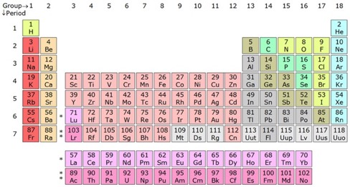
Distribution of trace elements and isotopes in the Ocean
Basics & motivations
Examples
  Micronutrients
  As tracers (REEs)
  Boundary (eNd)
  Transient (Pb)
  Decay chains (U)
Marine Biogeochemistry Training School
Yves Plancherel
yves.plancherel@earth.ox.ac.uk
Portugal, Faro, 6th June 2018

Slide 2
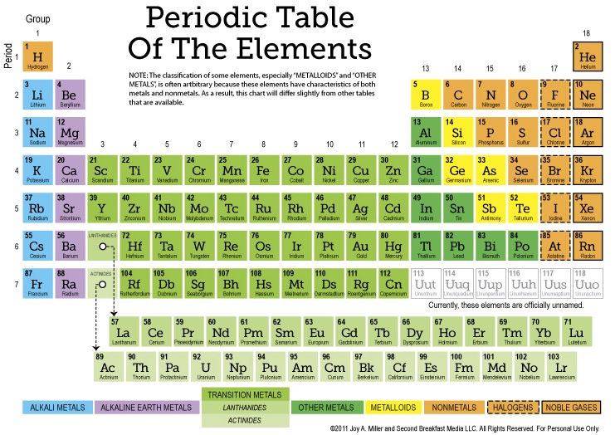
Chemical behaviour ~ electronic structure

Slide 3
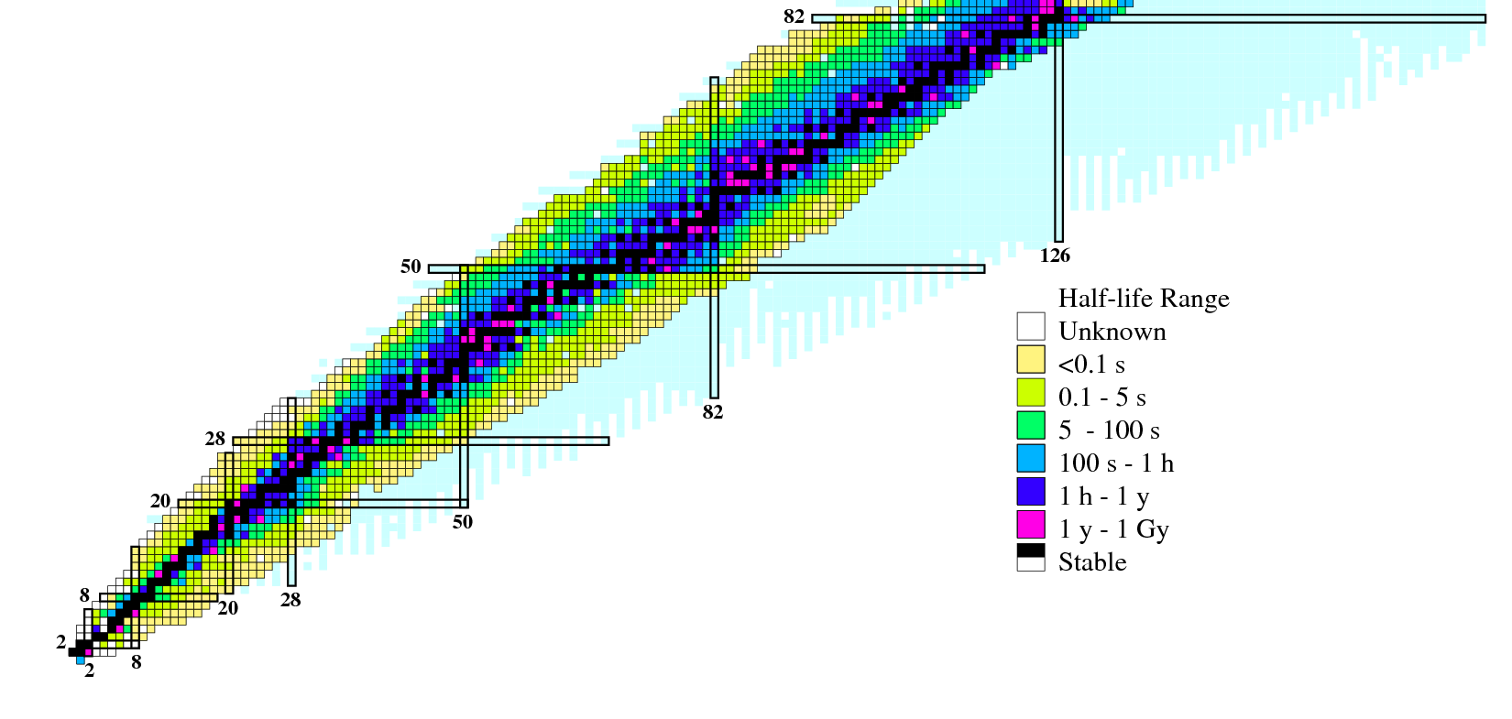
The “true” periodic table (including isotopes)
Are there any other useful environmental tracers?
Different elements
(adding protons)
Potentially useful in environmental sciences
Different isotopes
(adding neutrons)

Slide 4
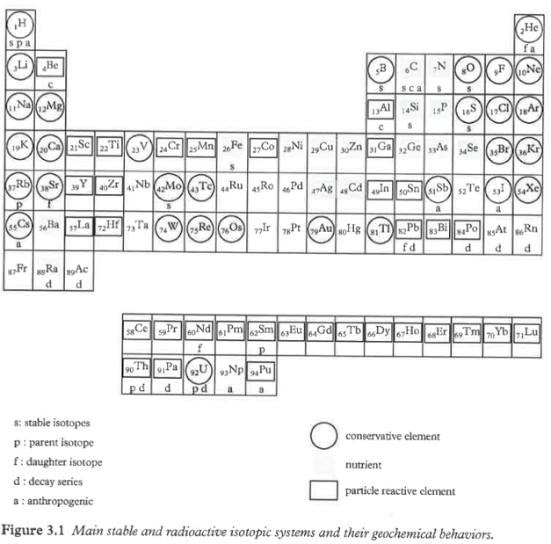
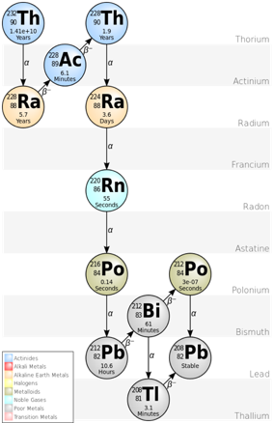
Shape-shifters... (radioactive parents to radiogenic daughter)
Geochemical behaviour of various element and isotopes
Radioactive decay chain
Jeandel & Roy-Barman (2016)

Slide 5
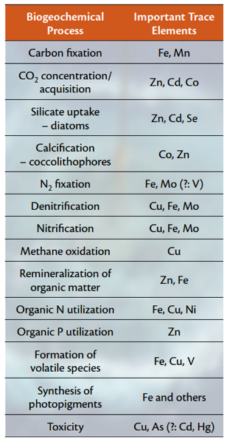
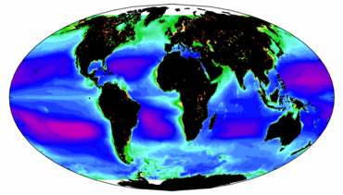
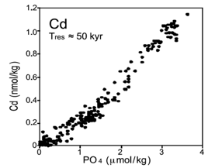
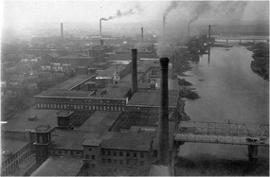

Why study trace elements and isotopes in the ocean?
Anderson et al. (2014)
Essential micronutrients
e.g. Fe, Mn, Zn, Cd, Ni, Cu
Paleo-proxies
e.g. Cd, Zn, Ce, Ba, Nd
Chl-a
Based on a
limited dataset
Pollutants
e.g. Pb, Hg
Industrial resource
e.g. REE, Ni, Cu, Zn, Mn

Slide 6
New tracers = new constraints on environmental change
Analyze multiple elements, constrain multiple processes
Sources
Redistribution
Sinks
Ecosystems
= different
particle types
•
•
•
•
•
Dust
•
•
•
Estuaries
Rivers
•
•
•
•
•
•
•
•
•
photosynthesis
•
•
•
•
•
•
•
•
•
•
•
•
•
•
•
pH-gradient
•
•
O₂-gradient
•
Diagenesis
regeneration
•
Complexation
M+L=ML
•
precipitation
•
•
•
•
•
•
•
•
•
•
•
•
•
•
•
•
•
•
•
lysocline
•
•
•
Hydrothermalism
•
•
•
•
•
•
•
•
•
•
•
Nepheloid layers
Boundary
exchange
•
•
•
•
•
•
•
•
•
•
•
•
Scavenging
*=paleo-proxies (coral/microfossils)

Slide 7
Evolving with our time
Are metals the pollutants of tomorrow?
Carbon economy
Climate Change
Acidification, hypoxia
Opportunities
Carbon
From local to global scales
Episodic events leave a trace (accountability)
Pollution = “tracer release experiment”
Opportunities for industry partnerships
Low-carbon economy
Metals
Pollution & toxicity
Disposal
of tailings + wastes
+ pollution
Offshore oil & gas
(exploitation + decommissioning)
Deep sea mining
Global
pollution
(e.g. Pb, Hg)
oil
oil
Nautilus Minerals
Coastal
ecosystem
Metal-fertilization
bioaccumulation
Shelf dynamics
•
•
•
Ventilation
(follow pulse)
Bottom Boundary Layer
Benthic ecosystems
Notes:
Changing focus, add on new problems and new opportunities

Slide 8
Trace elements as micronutrient

Slide 9
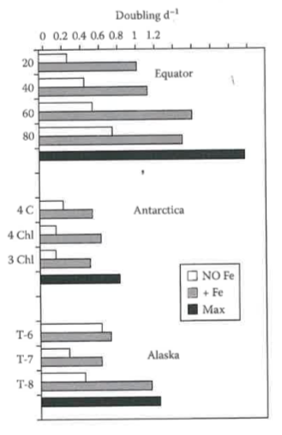
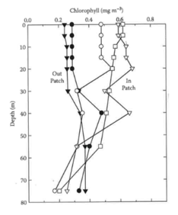
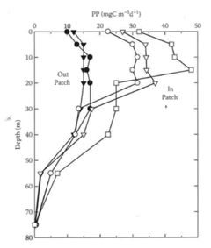
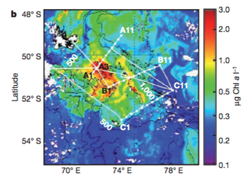
Iron limitation: experimental + natural addition & response
IRONEX I, II
SOFeX,
SOIREE,
EisenEx
Natural (Kerguelen)
Millero (2013, ch.9), Blain et al (2007)

Slide 10
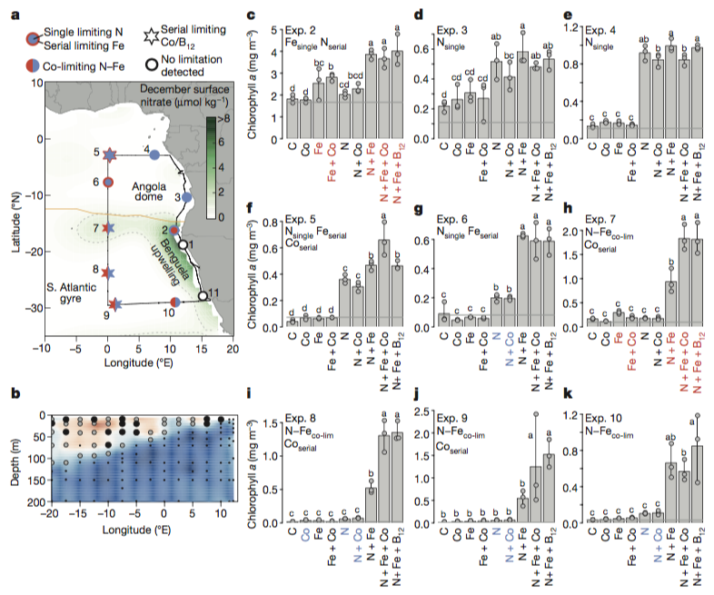
Micronutrient co-limitation: addition experiments
N-alone
Serial limitation
Colimitation
Browning et al. (2017)

Slide 11
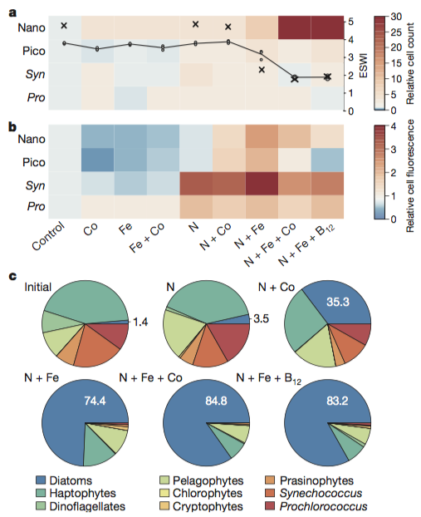
Micronutrient co-limitation: ecosystem response
Experiment 8
Ecological response
Physiological response
Diatom dominance to total Chlorophyll a
Browning et al. (2017)

Slide 12
TEI distribution
(internal fractionation and upwelling)

Slide 13
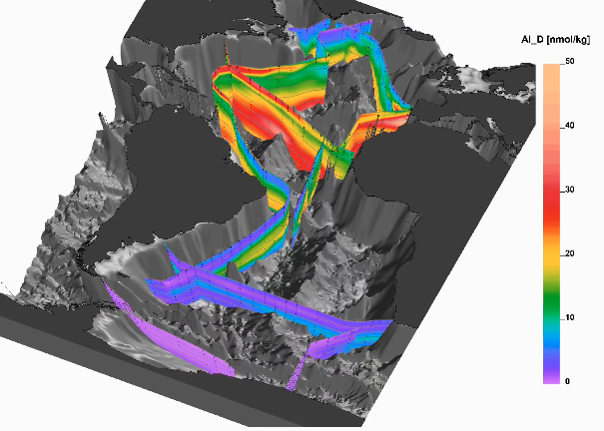
GEOTRACES: Intermediate Data Product
A wealth of new and very valuable data … more coming
New observations reveal a complex set of simultaneous processes at play

Slide 14
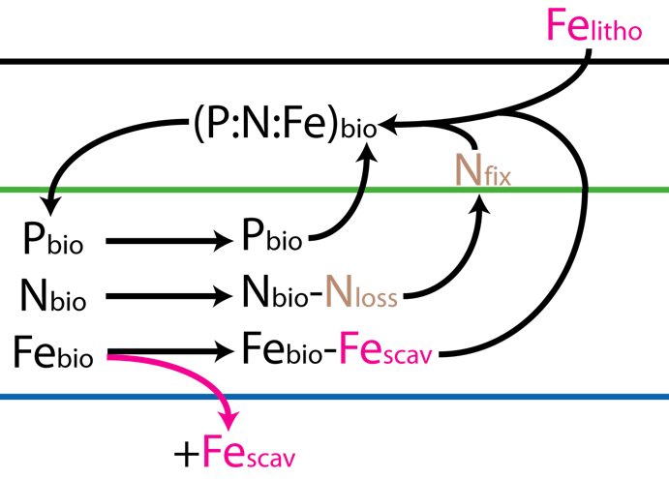
Internal processes affect stoichiometric relationships
e.g. scavenging causes fractionation
Ocean surface
sediments

Slide 15
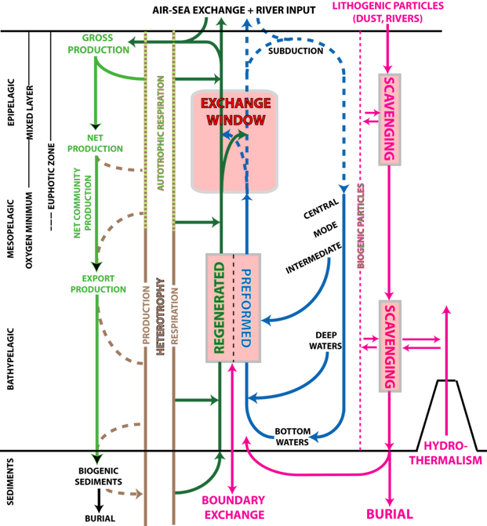
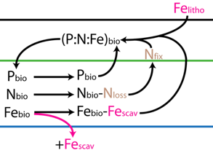
TEI biogeochemistry: Multiple processes at play

Slide 16
Zn*, Cd*
How to make sense of this mess?
Use multiple elements to constrain processes
Fe, Mn
C, N
Bio-limiting
Si, P
Ni, Cu
Macro-
nutrients
Complexity of biogeochemical cycles
Micronutrients
Ce*, Ba*
Also study
characteristic
tracers not
affected by
biology
REE*
Redox-
sensitive
Al
pH-sensitive
scavenging
Lithogenic
sources
[Abiotic]
[Abiotic]
*=paleo-proxies
Notes:
Residence time of some elements
Fe 500yrs
Mn 60yrs
Ni 6000yrs
Cu 5000yrs
Zn 50000yrs
Cd 50000yrs
Al 200yrs
REE 500-6200yrs
Ce 100yrs
Ba 10000yrs
C 83000yrs
N 3000yrs (NO3)
P 69000yrs (PO4)
Si 20000yrs

Slide 17
TEI and looking for new tracers
(Rare earth elements)

Slide 18

Looking for new & potentially useful oceanographic tracers
The lanthanides (rare earth elements)

Slide 19
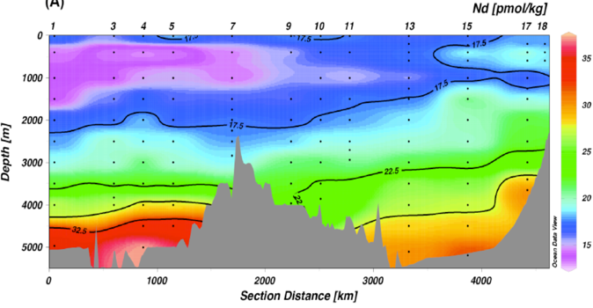
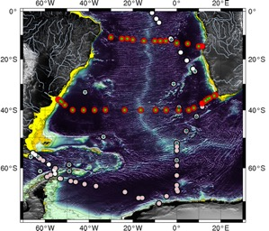
Measured Nd concentrations along 10ºS in the Atlantic
End-member mixing analysis: example
observation - transport = biogeochemistry
Neodymium (Nd)
Zheng et al. (2016)
Interpretation?
Is this pattern due to physical transport,
  or interior biogeochemical processes?

Slide 20
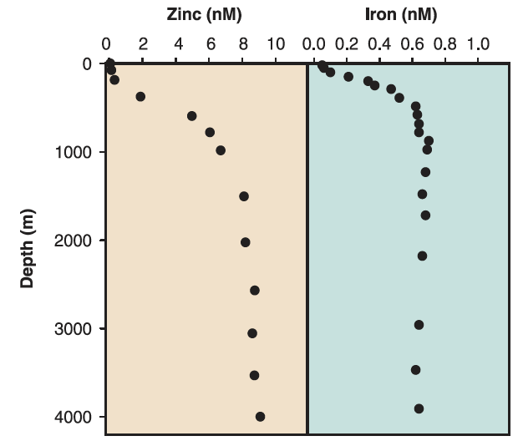
The tracer interpretation problem
Historically… only few vertical profiles were available
This lead typically to local 1D vertical interpretations
Up
Down
Morel and Price (2003)
The role of biogeochemistry is overestimated ?

Slide 21

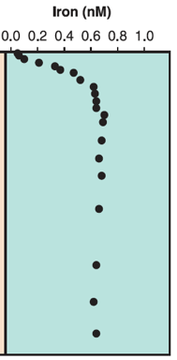
The tracer interpretation problem
Alternative interpretation:
Measured profile is due to transport from the surface
South
North
Up
Morel and Price (2003)
Down
The role of biogeochemistry is underestimated ?

Slide 22
Global tracers: looking for anomalies
Deviations from end-member mixing – quantify deviations
observation - transport = biogeochemistry
Deviation from mixing line
represents the influence of biogeochemistry
✖
observation
Water mass #2
Non-conservative tracer
Mixing line
(= influence of transport alone)
Water
mass #1
This concept can be extended to N dimensions
Conservative tracer (e.g. salinity)

Slide 23
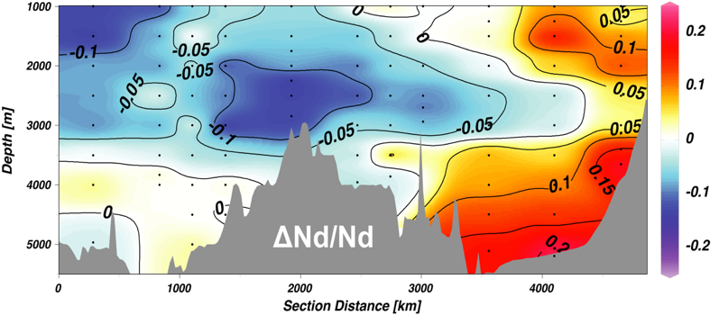
Fraction of Nd that cannot be explained by mixing alone
End-member mixing analysis: results
observation - transport = biogeochemistry
1
2
4
3
Zheng et al. (2016)
1
>80% of measured Nd distribution reflects transport
Mid-depth Nd source from boundary (New source?)
Deep source possibly due to carbonate dissolution (recycling?)
Strong sink due to hydrothermal scavenging
2
3
4

Slide 24
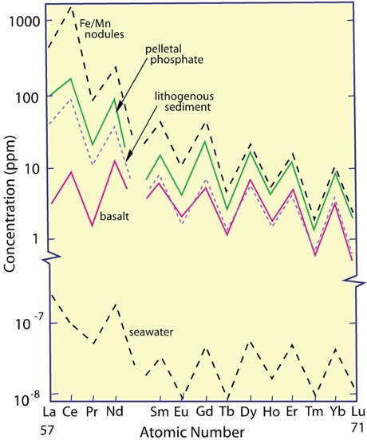
Rare earth elements
Concentrations in various environments
La Lanthanum
Ce Cerium
Pr* Praseodymium
Nd Neodymium
(Pm) Promethium
Sm Samarium
Eu Europium
Gd Gadolinium
Tb* Terbium
Dy Dysprosium
Ho* Holmium
Er Erbium
Tm* Thulium
Yb Ytterbium
Lu Lutetium
LREE
Lanthanide contraction
HREE
*=mono-isotopic

Slide 25
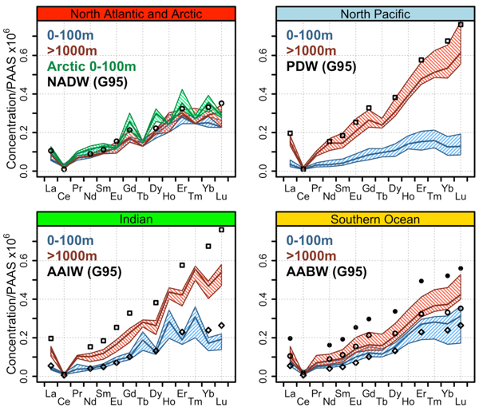
(G95=end-members calculated by German et al. 1995)
REE form “patterns” – the pattern itself is a tracer
Concentrations divided by crustal abundance (e.g. PAAS)
*
=mono-isotopic
La Lanthanum
Ce Cerium
Pr* Praseodymium
Nd Neodymium
(Pm) Promethium
Sm Samarium
Eu Europium
Gd Gadolinium
Tb* Terbium
Dy Dysprosium
Ho* Holmium
Er Erbium
Tm* Thulium
Yb Ytterbium
Lu Lutetium
LREE
25%
Median
75%
*
*
*
*
*
*
*
*
Lanthanide contraction
HREE
*
*
*
*
*
*
*
*

Slide 26
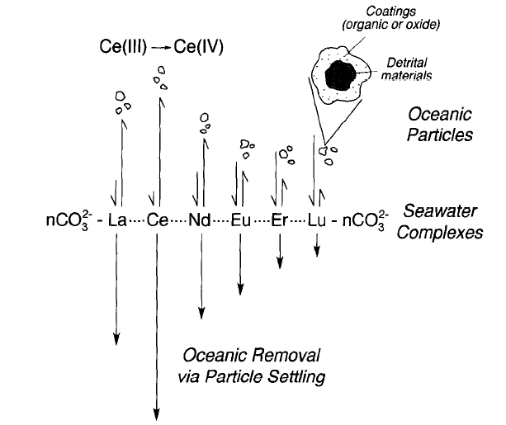
Rare earth elements
Competitive equilibrium: complexes (HREE) vs particles (LREE)
La Lanthanum
Ce Cerium
Pr* Praseodymium
Nd Neodymium
(Pm) Promethium
Sm Samarium
Eu Europium
Gd Gadolinium
Tb* Terbium
Dy Dysprosium
Ho* Holmium
Er Erbium
Tm* Thulium
Yb Ytterbium
Lu Lutetium
LREE
Lanthanide contraction
HREE
Sholkovitz et al. 1994
*=mono-isotopic

Slide 27
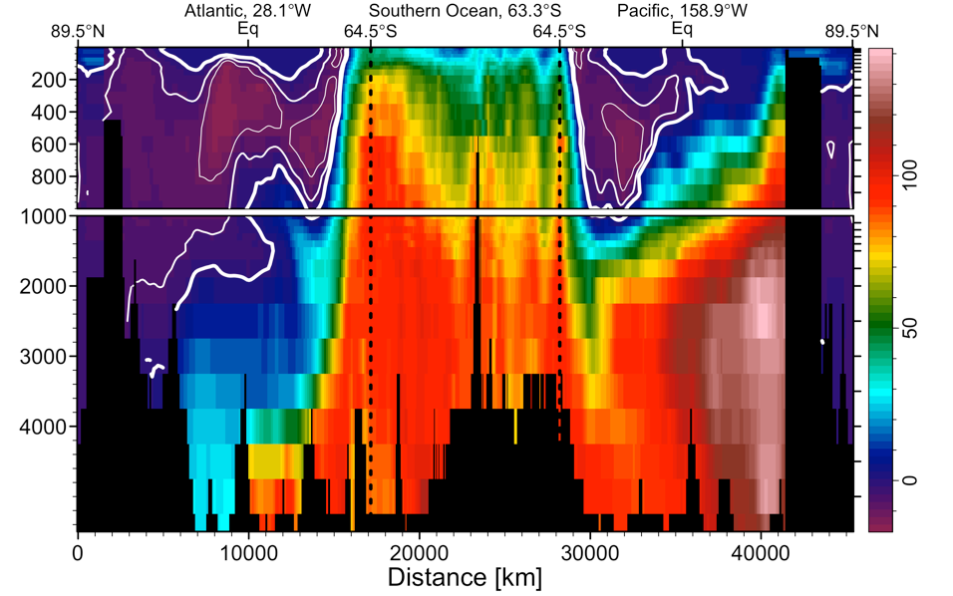
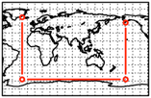
Are REE useful circulation tracers?
Si*[=Silica-Nitrate] distribution
Notes:
WHAT IS RELATION WITH SI*

Slide 28
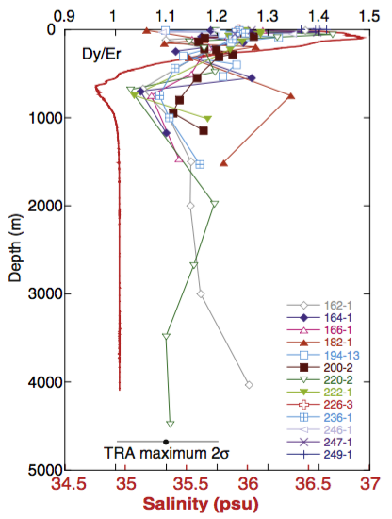
Anomalies in the REE pattern as a tracer
What is the source of the low Dy/Er observed in the Caribbean?
Osborne et al. (2015), Marine Chemistry
Is the minimum significant?
P=0.88^{N}
P≤0.05 ➔ N≥23
(0.05≤0.22²)

Slide 29
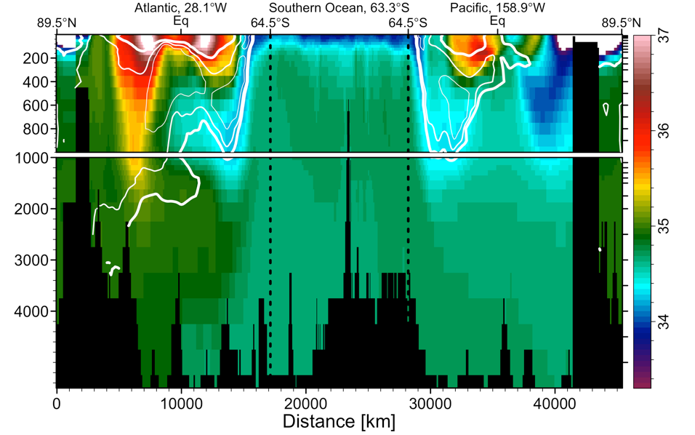
Are REE useful circulation tracers?
Salinity
Notes:
WHAT IS RELATION WITH SI*

Slide 30
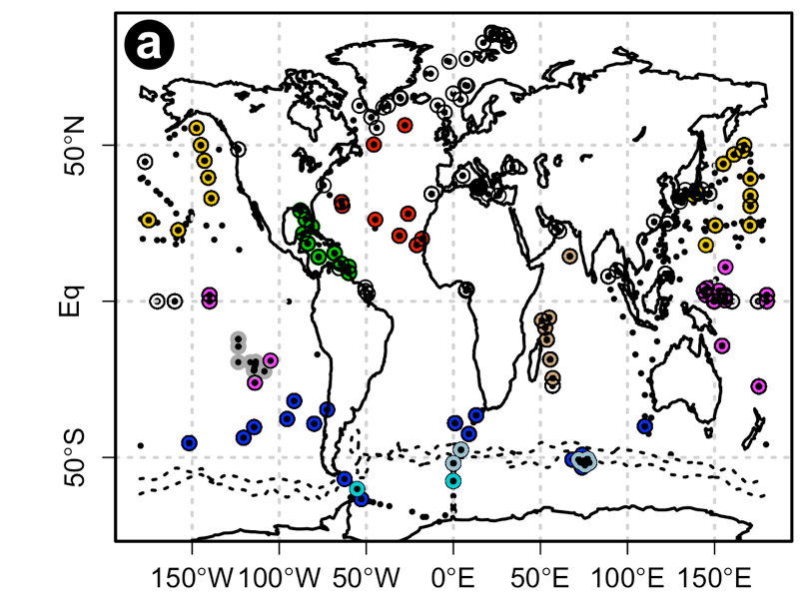
Anomalies in the REE pattern as a tracer
A global dataset: ability to spatially track features
Osborne et al. (2015), Marine Chemistry

Slide 31
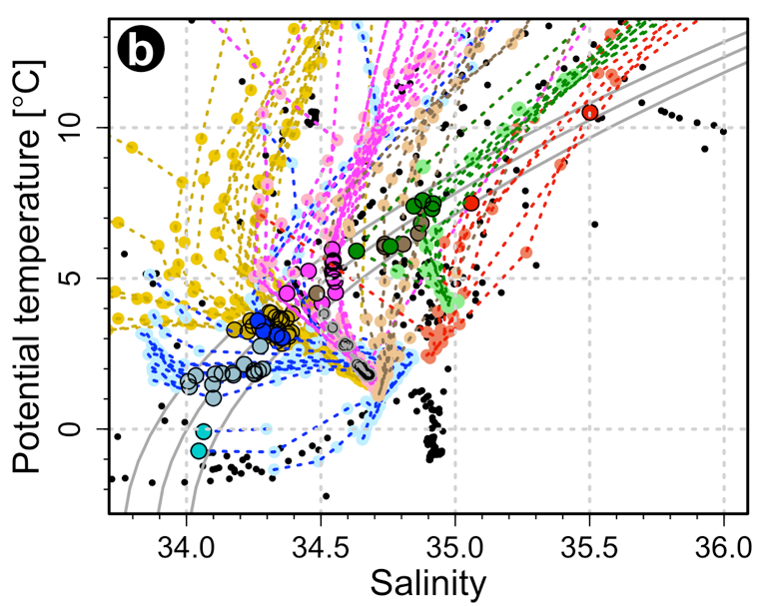
Anomalies in the REE pattern as a tracer
A feature coherent with AAIW over large distances
Osborne et al. (2015), Marine Chemistry
AAIW

Slide 32
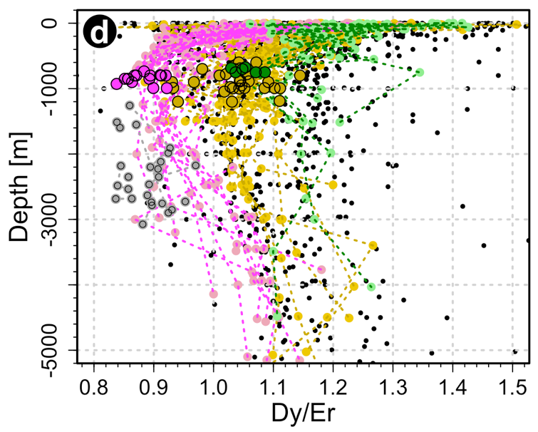
Anomalies in the REE pattern as a tracer
An ubiquitous feature
Osborne et al. (2015), Marine Chemistry
AAIW
S.Pac
N.Pac
Carribean
data

Slide 33
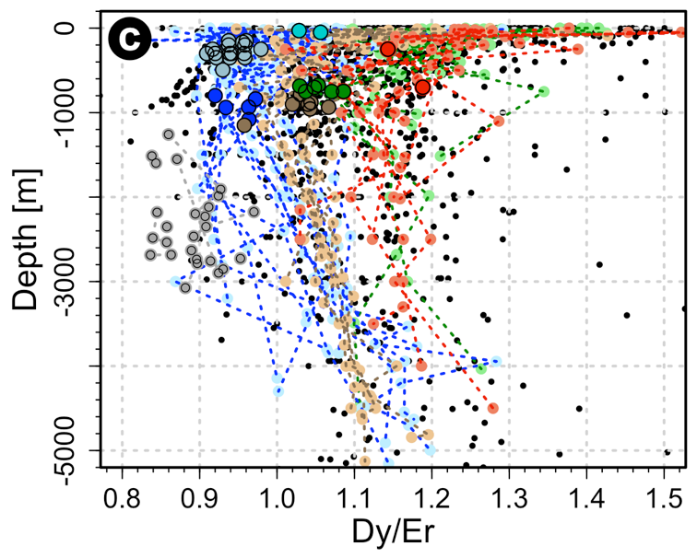
Origin of the low Dy/Er ratio?
AAIW = STMW + AASW + UCDW/PDW
AAIW formation: Carter et al. (2014)
AASW
STMW
AAIW
PDW
East Pacific
Rise (1981)
Carribean
data

Slide 34
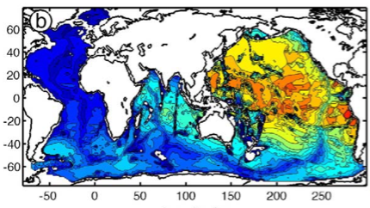
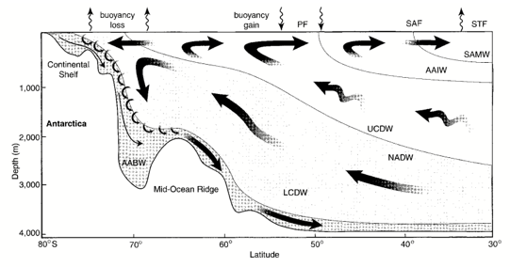
The low Dy/Er ratio as a tracer for the fate of upwelled PDW?
low Dy/Er ratio reflect hydrothermal influence
can it be used to trace fate of upwelled PDW/UCDW?
Bianchi et al. (2010)
Vertical inventory of non-atmospheric 3He >1000m
=> hydrothermalism is
most intense in the
Pacific
Speer et al. (2000)
Southern Ocean overturning “cartoon”
How does
AAIW form?
Must contain PDW/UCDW

Slide 35
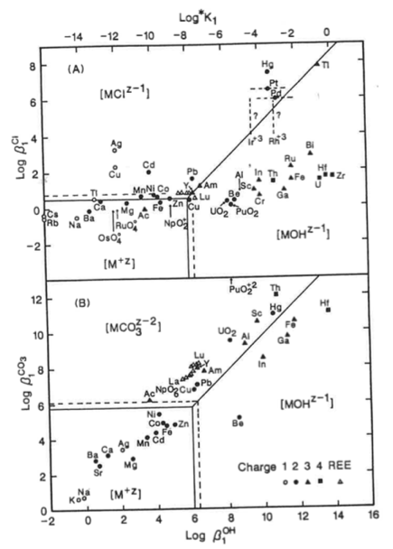
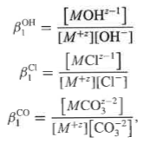
Complexation tendencies in standard surface seawater at 25C
Li (1997)

Slide 36
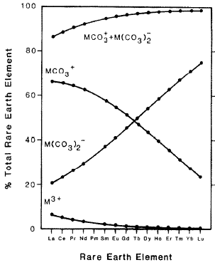
Rare earth elements
Basic chemistry: a coherent group of element with a shrinking atomic radius
La Lanthanum
Ce Cerium
Pr* Praseodymium
Nd Neodymium
(Pm) Promethium
Sm Samarium
Eu Europium
Gd Gadolinium
Tb* Terbium
Dy Dysprosium
Ho* Holmium
Er Erbium
Tm* Thulium
Yb Ytterbium
Lu Lutetium
LREE
Lanthanide contraction
Cantrell and Byrne (1987)
REE speciation in seawater
HREE
*=mono-isotopic

Slide 37
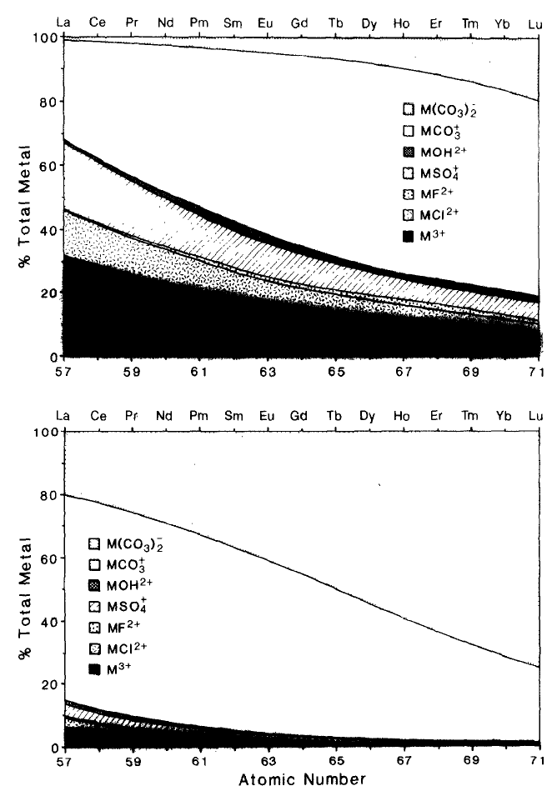
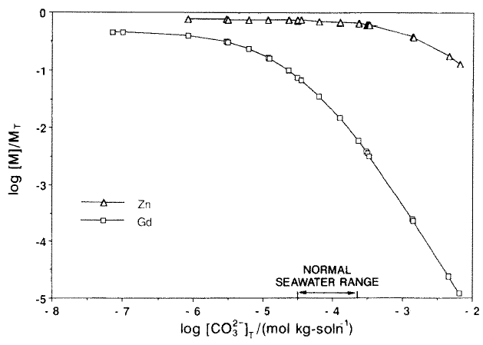
REE complexation/cycling is pH dependent
pH=7.5
Deep Ocean
Amount of free-metal (M³⁺) decreases with increasing pH
  Acidification mobilizes free-ions
  Sensitivity is strong in seawater pH range
Enhanced solution complexation of HREE diminishes affinity for particles
[Free]/[total]
REE (Gd)
Zn
pH=8.0
Shallow Ocean
More free
More acidic
Stanley and Byrne 1990

Slide 38
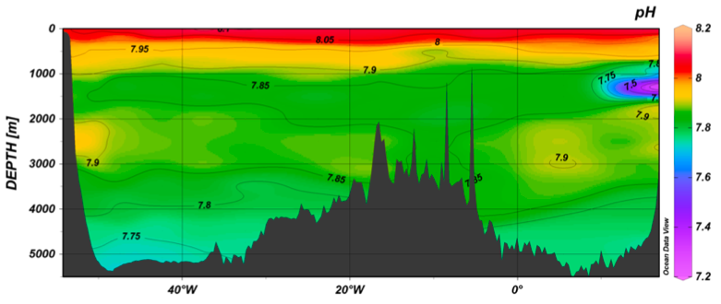
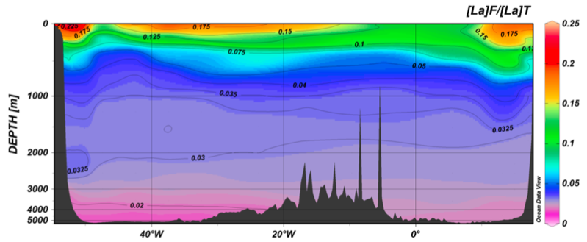
Dependency of REE complexation in seawater
Multiple species present at seawater pH

Slide 39
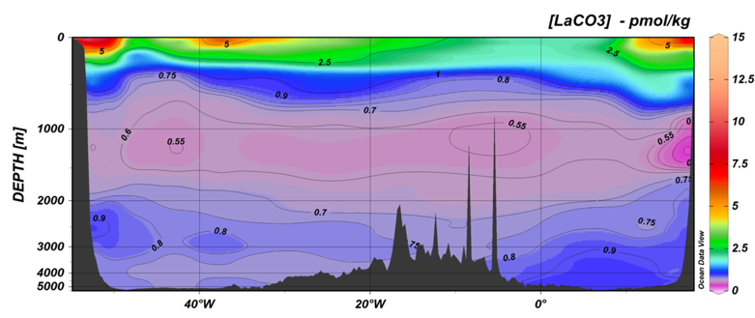
pH-dependency of REE complexation in seawater
Acidification will modify REE complexation: REEs as canaries in a coal-mine?
pH
Argentina
South Africa
GEOTRACES
GA10
La(CO₃) [pmol/kg]
Shital Visana, M.Sc. 2017
Notes:
This patter is actually a good reflection of PH. Now since the sensitivity of the REE sequence to pH evolves along the sequence, REEs are ideal acidification tracers and another reason why it’s urgent to get them measured on as many GOSHIP cruises as possible.

Slide 40
TEI and boundaries
(isotopes of neodymium)

Slide 41
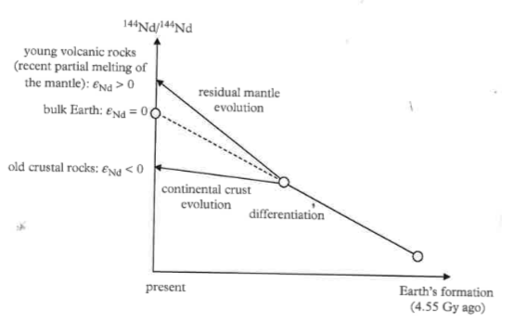
Neodymium isotopes, isotopic systems and plate tectonics
¹⁴⁷Sm ➔¹⁴³Nd (1.06 x 10¹¹yr)
¹⁴⁴Nd (stable)
Excess of ¹⁴³Nd
Deficit of ¹⁴⁴Nd
Radioactivity
  Parent=147Sm ➔Daughter=143Nd
Crustal differentiation & plate tectonics
  Sm/Nd of crust lower than mantle (for chemical reasons)
¹⁴³Nd/¹⁴⁴Nd
Deficit in ¹⁴³Nd
More ¹⁴⁴Nd from differentiation
(less Sm, more Nd)
Chondritic reservoir
Jeandel & Roy-Barman (2016)
age

Slide 42

Neodymium isotopes
(P=¹⁴⁷Sm ➔D=¹⁴³Nd; S=¹⁴⁴Nd as reference)
CHUR = chondritic uniform reservoir
εNd is high
  More “radiogenic” = more from Sm decay
  related to mantle, i.e. new lava
εNd is low
  Less “radiogenic” = less from Sm decay
  related to old continental crust

Slide 43
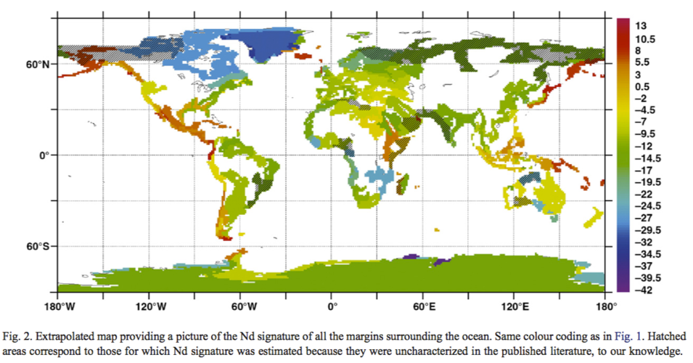
εNd signature on ocean margins
Jeandel et al. (2007)

Slide 44
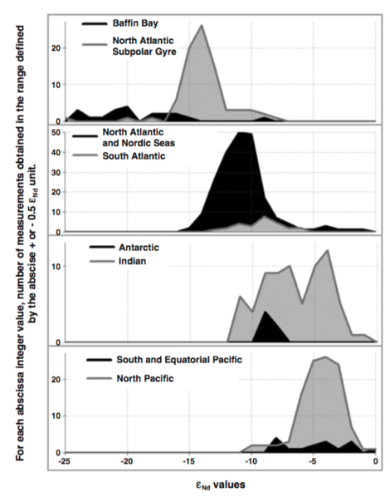
Neodymium isotopes in different ocean basins
(Atlantic = lower eNd = less radiogenic)
Lacan and Jeandel (2005)

Slide 45
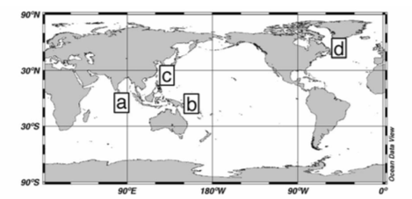
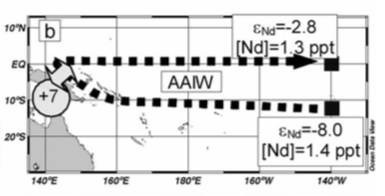
Neodymium isotopes – necessity for boundary exchange
Lacan and Jeandel (2005)

Slide 46

Continental particulate flux
(~ 20 x dust flux, dust~dissolved river flux)
Jeandel & Roy-Barman (2016)

Slide 47
Transients TEI and pollution\(the story of Pb)

Slide 48

New measurements of Pb concentration in the ocean
Pb is unlike anything else

Slide 49


GA03: Compare Pb with CFC11

Slide 50


GA02: Compare Pb with Silicate

Slide 51

Transient tracers
³H-³He; CFCs; bomb ¹⁴C; ⁹⁰Sr; …

Slide 52


Global scale variability: Lead (Pb) and lead isotopes
Turning environmental pollution into a global scientific experiment
A metal transient tracer – susceptible to the particle field
Seawater concentrations

Slide 53

A reconstruction of Pb emission rates from 1850 to 2000
Shifting emissions from the UK, USA to Asia and
from the Northern to Southern hemisphere
Andrew Jamieson, M.Sc. 2017
Notes:
I will now be moving on to the tracer I want to mention today, that is Pb.

Slide 54


There’s no hiding!
Corals record everything
Lead (Pb) and lead isotopes
Fingerprinting pollution by tracking Pb isotopes
²⁰⁴Pb (primordial)
²⁰⁶Pb, ²⁰⁷Pb, ²⁰⁸Pb (radiogenic)
²¹⁰Pb (radioactive)
Pb emissions come
in different (national) flavours!
USA

Slide 55


Pb as a global pollutant with a regional flavour
Exploit the information content of isotopic signature
Pb deposition originating from Beijing
Results from HYSPLIT
(84hours, 1/12/2016)
Andrew Jamieson, M.Sc. 2017
Andrew Jamieson, M.Sc. 2017

Slide 56



Modeling Pb and its isotopes
A first attempt at modeling anthropogenic Pb in the ocean
ECCO 1x1
GA02
Ongoing project with S. Khatiwala,
E. Boyle (MIT), T. Van der Flierdt & M. Rehkampfer (Imperial College)
ECCO 1x1

Slide 57
TEI, radioactivity, particle scavenging and fluxes
(Uranium and Thorium decay series)

Slide 58

Marine particles & scavenging
Jeandel & Roy-Barman (2016)

Slide 59

Radon 222 as a tracer
245500 yr
²³⁴U
75380 yr
²²⁶Ra
²²²Rn
+
²²²Rn
1602 yr
²³⁰Th
²²⁶Ra
²²²Rn
3.82 days
λ_{1/2}=3.82 days
A time-dependent tracer of near-bottom mixing + sediment flux on a time scale of ~15 days

Slide 60

Radon 222 as a tracer: vertical mixing
Abyssal recipe
Munk (1966)
K_{v}~1.3 cm²/s
Benthic boundary layer
(typically <100m thick)
Sarmiento et al. (1978)

Slide 61

Radium 228 as a tracer
²³²Th
²²⁸Ra
²³²Th
²²⁸Ra
λ_{1/2}=5.7 years
Presence in seawater indicative of recent contact with ocean boundaries

Slide 62


“Unintended?” results from Radium 228
(data largely from TTO+SAVE)

Slide 63

Importance of dust
Dust important source for many elements
Direct measurements in ocean are sparse (islands?)
Most of what we know about dust is from atmospheric models
  Models disagree by factor 10 (Textor, et al. 2006, Huneeus et al 2011, Evan et al. 2014)
Goal: a technique that does not require continuous presence/sampling and that can produce a “climatological” dust deposition estimate: dissolved tracers?
  With Al (MADCOW, Measures and Vink 2000, Measures and Brown 1996)
  But Al has no “clock” and is less particle-reactive than Th
  Use Th instead? ➔ Hsieh et al. (2011), Hayes et al. (2013), Deng et al. (2014)
Mahowald et al. (2005)
Average of 3
reanalysis-based
models
g/m2/yr
Notes:
So since Al has no “internal” clock and is though to be less particle reactive than Th, Th is currently being evaluated as a potential lithogenic tracer. Note, that it’s one thing to detect presence of lithogenic influence, it is another to try to quantify the lithogenic fluxes.

Slide 64

²³⁰Th ²³²Th
Oceanic distribution
of ²³⁴U is well-known
(Very soluble)
Lithogenic source
Dominant isotope
Th is insoluble
Particle-reactive
Notes:
Before going further, let me just give you a brief introduction on what Th230 and Th232 are and where they come from. Both are part of radioactive decay chains. Th230 is a daughter in the 238U chain, same as Th234, which is used often to study export production. Like Th234, Th230 is very particle reactive, while 234U, its parent, is very soluble. The difference between Th234 and Th230 is their decay, 24 days for Th234, 75000 years for Th230. But since they are particle reactive, their abundance is dictated by scavenging.

Slide 65
Basic principle
lithogenic
source
We want that ➔
²³²Th
Dissolved ²³²Th is
“easily” measureable
What is ?
(Hsieh et al. 2011, Hayes et al. 2013, Deng et al. 2014)
Notes:
Here is a description of the basic principle behind claims that Th isotopes can be used to quantify dust flux. Note, this is identical in concept to the Th234 method, except that we here measure Th232 and not carbon.
Imagine a box near the surface of the ocean, the residence time is the ration between inventory and fluxes in/out of the box. The problem is that we don’t know either fluxes for Th232.
We know the flux in of Th230 pretty well, however, as it is dominated by U234 decay. If the residence time of Th230 and Th232 are identical, one can use the Th230 clock to infer the flux of Th232.

Slide 66
Estimating dust fluxes from Th isotopes: Basic principle
lithogenic
source
lithogenic
source
We want that ➔
²³²Th
Dissolved ²³²Th and ²³⁰Th
are “easily” measureable
²³⁰Th
²³⁴U decay
?
=
If is small, one can
estimate easily.
If ²³⁰Th behaved like ²³²Th
one may use in place
of
What is ?
(Hsieh et al. 2011, Hayes et al. 2013, Deng et al. 2014)
Notes:
Here is a description of the basic principle behind claims that Th isotopes can be used to quantify dust flux. Note, this is identical in concept to the Th234 method, except that we here measure Th232 and not carbon.
Imagine a box near the surface of the ocean, the residence time is the ration between inventory and fluxes in/out of the box. The problem is that we don’t know either fluxes for Th232.
We know the flux in of Th230 pretty well, however, as it is dominated by U234 decay. If the residence time of Th230 and Th232 are identical, one can use the Th230 clock to infer the flux of Th232.

Slide 67

Estimated precision
Overall:
solubility
Lithogenic
correction for ²³⁰Th
Dust concentration
10%
5%
30%
10%
20%
50%
Relative errors
56.5%
62.1%
Notes:
So how well does this approach work? Before discussing the potential pitfalls of the concept, let’s first assume that the concept hold and let’s see what sort of precision one can expect from this, based on considerations on measurement uncertainties and variability of some numbers.
The overall expression above also accounts for a correction for the lithogenic Th230 addition, and converts Th232 fluxes to dust fluxes by assuming a solubility and and lithogenic Th232 abundance.
Based on realistic errors, the overall precision is about 50-60%.

Slide 68


Estimated precision
Overall:
solubility
Lithogenic
correction for ²³⁰Th
Dust concentration
…now, if one quantity was perfectly known
Solubility is by far the biggest uncertainty, dust abundance second
NB: This assumes that inventory errors scale with measurement errors!
(One BIG issue is “how does one define the domain over which to calculate inventories?)
Notes:
If we now assume that each quantity in turn is perfectly known, we not that the overall error does not decrease much, a few percent at best.
Except for solubility. This has the largest effect as solubility also has the largest error. So if that method were to hold, one would achieve better results if one could constrain solubility better. This is also good news in the sense that measurement errors on Th isotope abundances are reasonably well-constrained.

Slide 69
Does it work in a model?
Precision is OK, but does that simple conceptual approach actually hold?
  1) create a model of Th230 and Th232 with known dust flux
  2) can the exact dust flux be recovered?
Try in a “best case” scenario
  Steady state, no seasonal cycle/variability
  Simple particle fields with smooth vertical profiles
Look for sensitivity/flaws + ways to address them
Notes:
So we saw that, if these equations were exact, the precision would be about 50%, but do these equations actually hold in an advective ocean?
To address this, first, lets create a model of Th isotopes, and see how well it works. Let’s try first is a rather simple configuration, exclude all temporal variability.

Slide 70

Forward modeling: model architecture, the example of Th

Slide 71


Model setup
Prescribing the particle field
Interior distribution
shape functions
POM
Car
Opal
dust
Notes:
To prescribe the interior particle field, we first establish the surface production for 4 different particle types. These surface fields come from satellite data and models.
We then propagate these production estimates to depth assuming remineralization shape functions. Martin Curve for Organic, exponential for Carbonates and Opal. No dissolultion for dust.

Slide 72

Reconstructions
Dust flux – ECCO 1ºx1º
Qualitative agreement
g/m2/yr
Dotted contours = “true” dust
Notes:
Now that we have established the model flaws and have a sense for the magnitude of the errors, lets see if we can recover the dust flux from these models.
This figures show the reconstructed dust fluxes, the “true” fluxes are in dotted lines.
We see a generally good qualitative agreement.
There are broad regions where the model seem to underestimate the true dust.

Slide 73

Reconstructions
Relative error of reconstructed dust flux – ECCO 1ºx1º
Quantitative disagreement
(model-truth)/truth
Notes:
Now that we have established the model flaws and have a sense for the magnitude of the errors, lets see if we can recover the dust flux from these models.
This figures show the reconstructed dust fluxes, the “true” fluxes are in dotted lines.
We see a generally good qualitative agreement.
There are broad regions where the model seem to underestimate the true dust.

Slide 74

Reconstructions
Relative error of reconstructed dust flux – ECCO 1ºx1º
Changing the relative strength of scavenging
shown
strongest
More insoluble
Th-like
weakest
Les insoluble
Al-like?

Slide 75

Reconstructions
Relative error of reconstructed dust flux – ECCO 1ºx1º
Integrate shallower? … 21m?
More insoluble
Th-like
Les insoluble
Al-like?

Slide 76
Dust flux reconstructions
The shape of the vertical profiles of Th230 and Th232 differ
Vertical evolution of I₂₃₂/I₂₃₀ also controls F_{dust}!
How deep should we integrate?
Hsieh et al. (2011) ➔ 25 m
Deng et al. (2014) ➔ 250 m
Hayes et al. (2013) ➔ 500 m
?
The ratio I₂₃₂/I₂₃₀ depends on the relative shapes of isotopic profiles

