Slide 1

Purpose:
The purpose of a Generic Emergency Evacuation Plan (GEEP) is to enable visitors to the building with restricted mobility or those who may not be able to evacuate unaided to become familiar with the layout, evacuation procedures, available equipment and communication devices. If you feel that this document does not provide you with sufficient information or that you require further assistance, please contact the Imperial College London, Security Team on 020 7594 8910.
The building:
The Sir Michael Uren building is comprised of 13 floors. All floors are accessible by using the lift. There are seven Fire Exits available from the ground floor. The building has two staircases to the South of the building which are protected by fire doors on all levels. The building has an evacuation lift at the South West end which can be used for evacuation until the arrival of the Fire and Rescue Service.
Due to the nature of the buildings design, it is not recommended that persons with any significant mobility constraints should use the building without a comprehensive Personal Emergency Egress Plan (PEEP) being put in place.
Action required on hearing the Fire Alarm:
If able, you should leave the building immediately by the nearest fire exit (see attached floorplan) and report to the assigned assembly point for the building.
Other recommendations:
Not all fire escapes are accessible by wheelchair and visitors to Imperial College London should familiarise themselves with the floor layout of the building they are in. Floor plans and evacuation equipment locations have been provided with this document.
Fire Safety
Generic
Emergency
Evacuation
Plan
Sir Michael Uren
Building
A vibrating alert system is installed in this building. If you would like access to a pager, please contact Imperial College London, Security Team on 020 7594 8910.

Slide 2
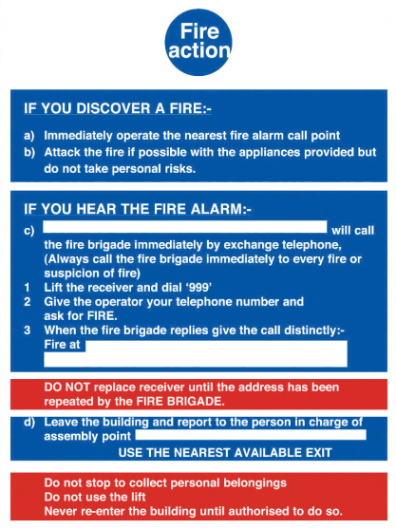
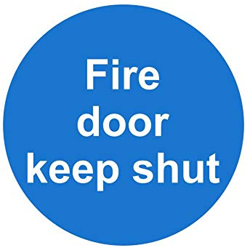

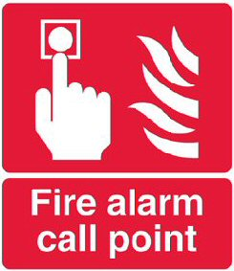

Fire Safety
General
Emergency
Evacuation
Plan
Fire
Safety
Information
Fire Action Notices can be found in any area within the College and stipulate action in the event of discovering a fire or in the event of the fire alarm sounding in the building.
Please familiarise yourself with the instructions stated in the notice and comply in the event of a fire or fire alarm.
In the event of fire. Do not call 999. Call Security on 0207 589 1000 and allow them to manage the incident.
Fire Doors are designed to protect escape routes within buildings and limit the growth of a fire. Any door labelled with one of the above signs will resist a fire for a minimum of 30 minutes.
Please ensure that you do not prevent any door with this label from shutting and if you find a door that does not shut then please report it to a member of staff.
To maintain security and safety on site, many doors are secured with magnetic locks that only release when the correct key card is used or when the fire alarm activates.
Should you come to a fire escape route door that appears to be locked (or has not released correctly) there will be a green break glass unit nearby which will release the door.
Push the plastic window in to operate the lock override.
The fire alarm systems in all of our buildings rely on smoke and heat detectors in much the same way as any system that you might have at home.
Our buildings are far more complex than domestic premises therefore we include the additional measure of Fire Alarm Call Points which will trigger the fire alarm system in a building.
If you see fire, ensure your own safety first and if possible activate a call point by pushing the plastic window

Slide 3
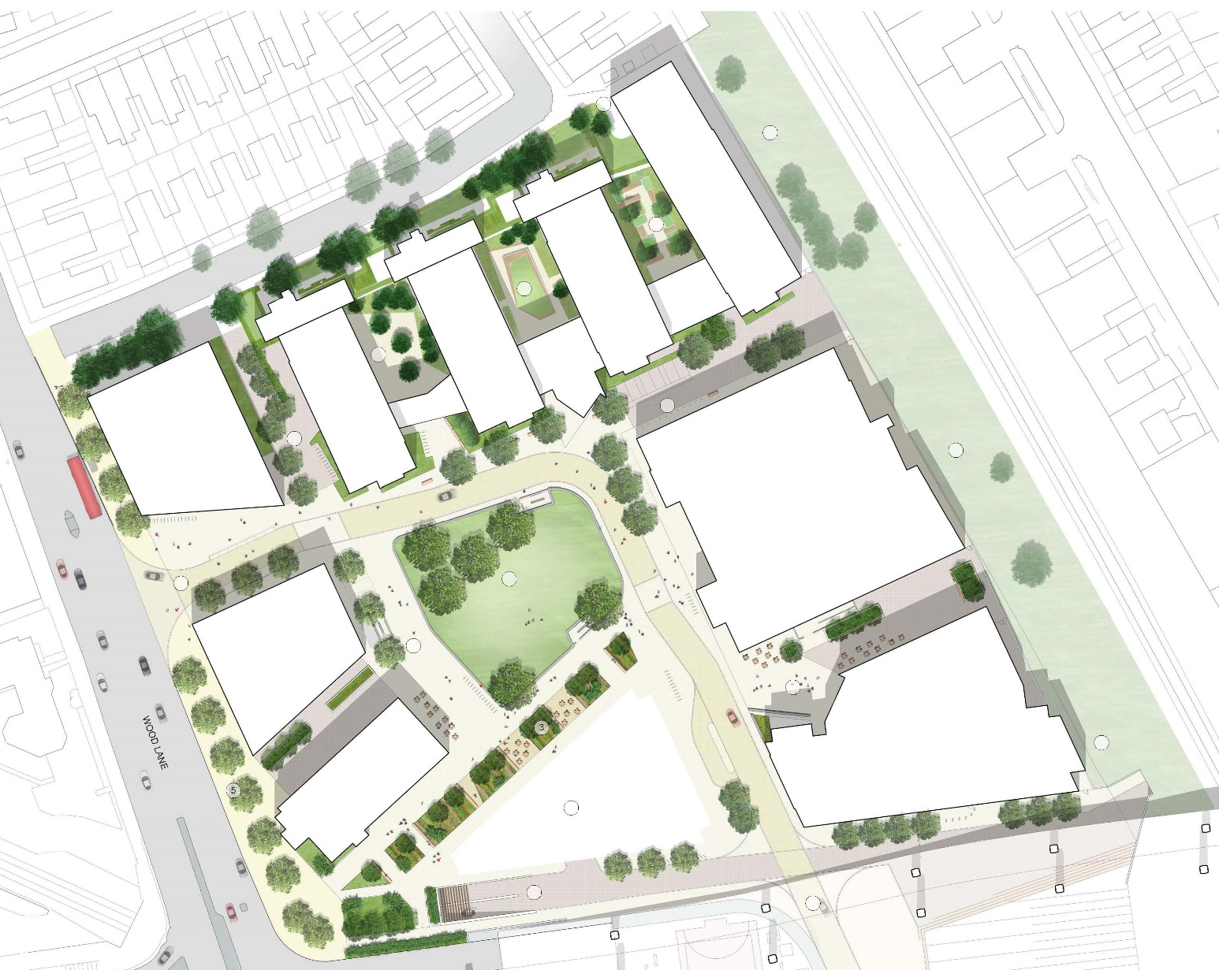

Fire Safety
General
Emergency
Evacuation
Plan
Assembly
Point
Grad Pad
MSRH
I-HUB
Sir Michael
Uren Hub
KEY
Site Assembly Point
(Perkin’s Green)

Slide 4
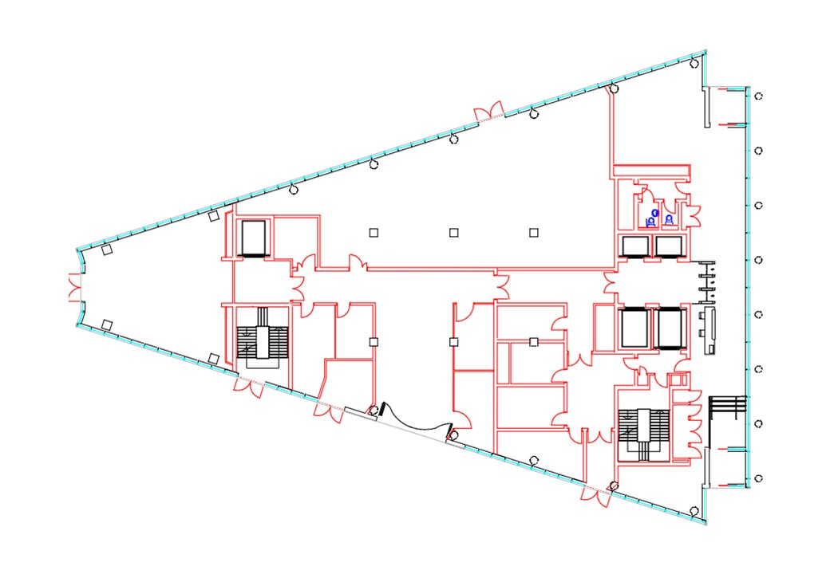


Fire Safety
General
Emergency
Evacuation
Plan
Sir
Michael
Uren
Level: G
KEY
Safe Route
Evac Lift
Refuge Point

Slide 5
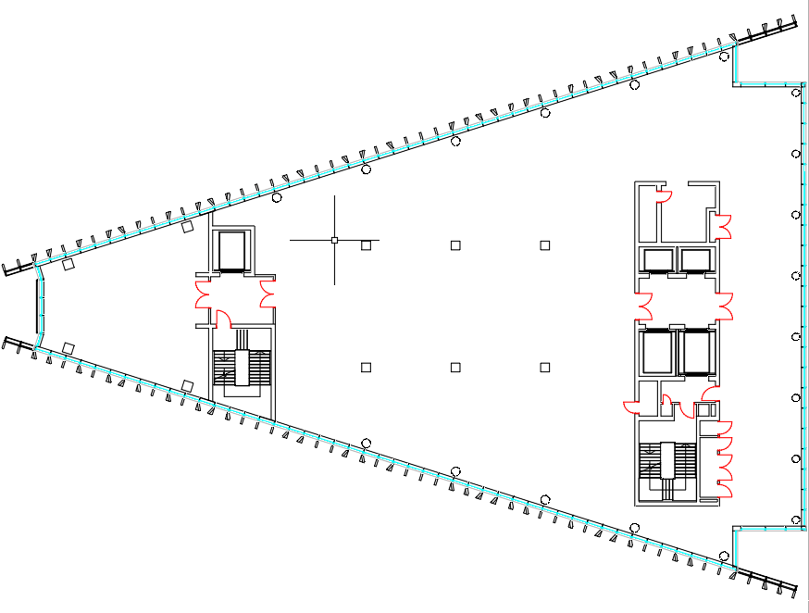
Fire Safety
General
Emergency
Evacuation
Plan
Sir
Michael
Uren
Level: 1
KEY
Safe Route
Evac Lift
Refuge Point

Slide 6
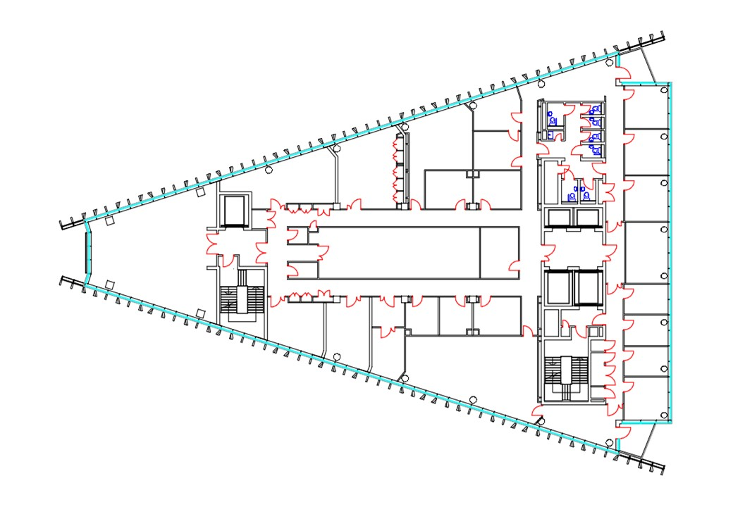
Fire Safety
General
Emergency
Evacuation
Plan
Sir
Michael
Uren
Level: 2
KEY
Safe Route
Evac Lift
Refuge Point

Slide 7
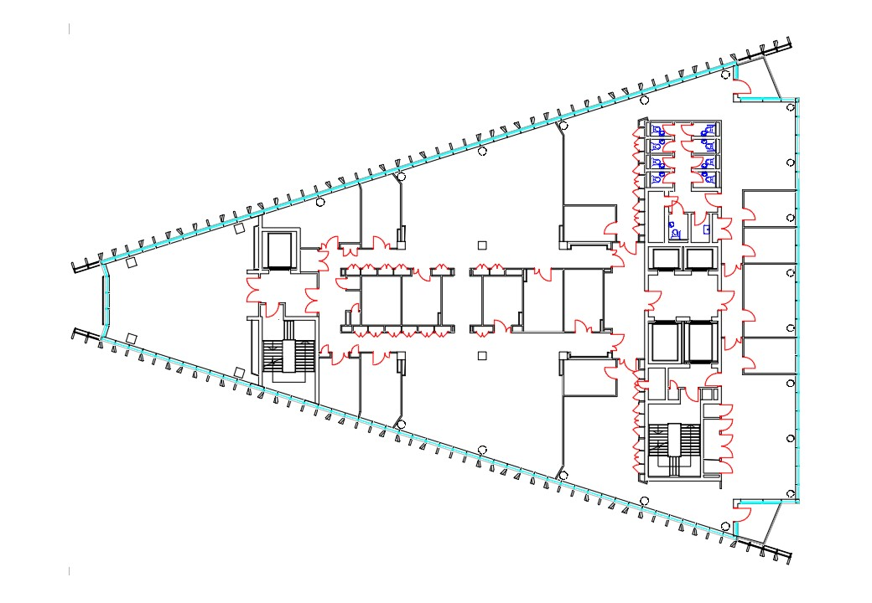
Fire Safety
General
Emergency
Evacuation
Plan
Sir
Michael
Uren
Level: 3
KEY
Safe Route
Evac Lift
Refuge Point

Slide 8
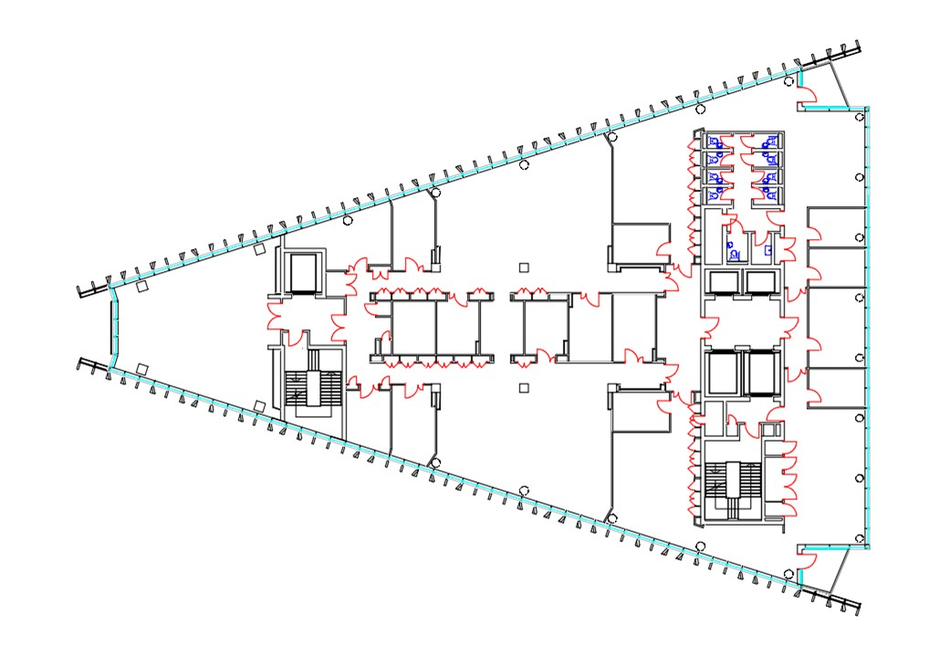
Fire Safety
General
Emergency
Evacuation
Plan
Sir
Michael
Uren
Level: 4
KEY
Safe Route
Evac Lift
Refuge Point

Slide 9
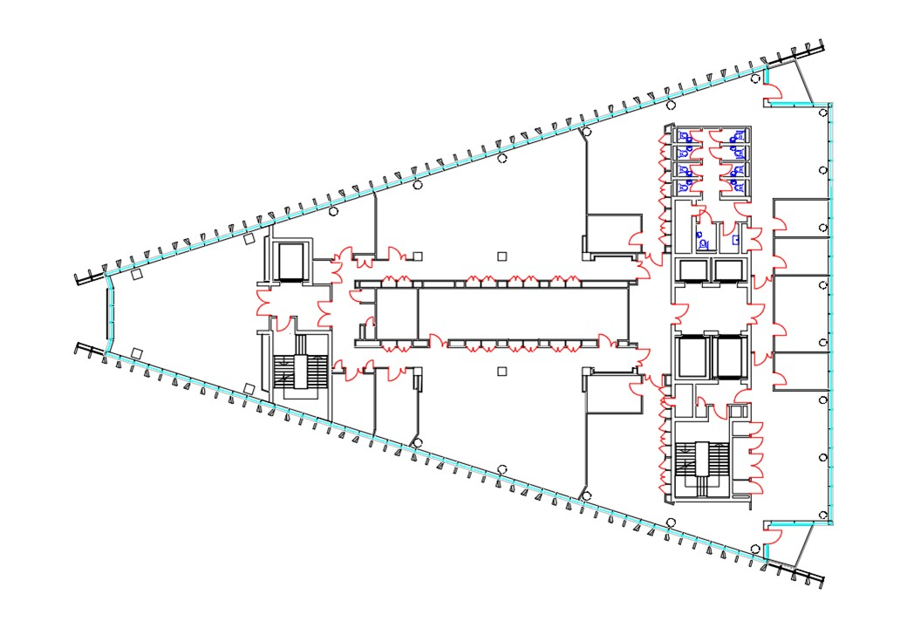
Fire Safety
General
Emergency
Evacuation
Plan
Sir
Michael
Uren
Level: 5
KEY
Safe Route
Evac Lift
Refuge Point

Slide 10
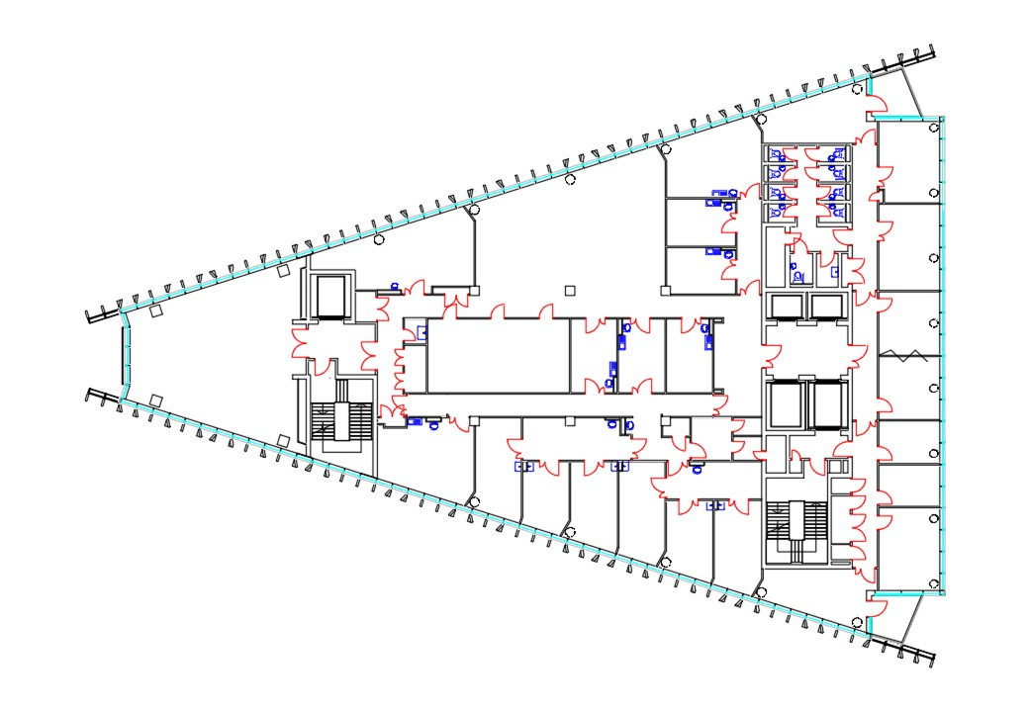
Fire Safety
General
Emergency
Evacuation
Plan
Sir
Michael
Uren
Level: 6
KEY
Safe Route
Evac Lift
Refuge Point

Slide 11
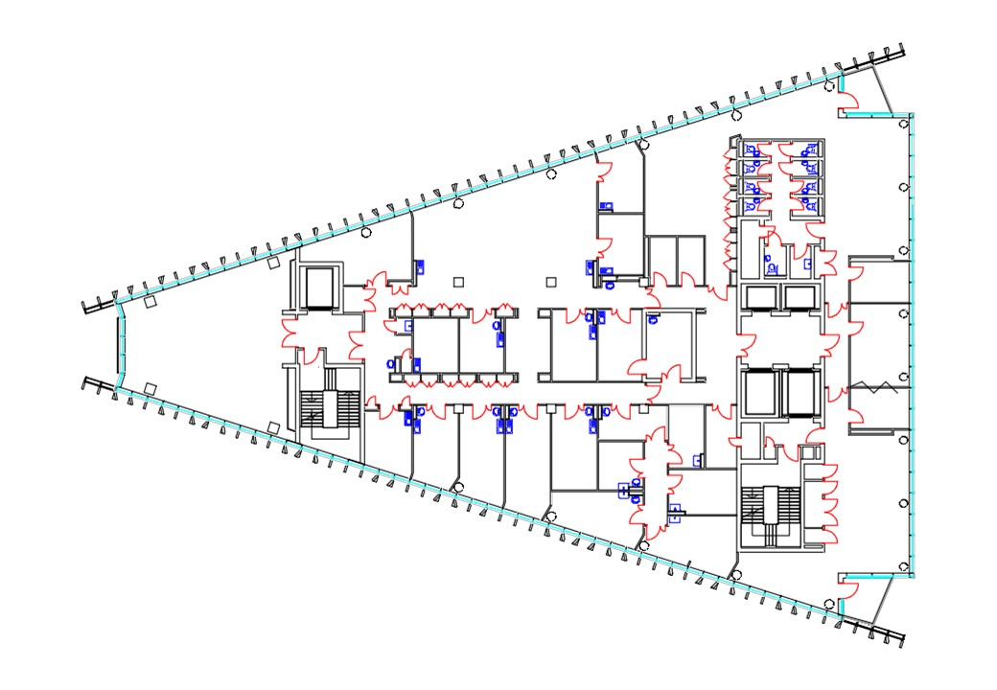
Fire Safety
General
Emergency
Evacuation
Plan
Sir
Michael
Uren
Level: 7
KEY
Safe Route
Evac Lift
Refuge Point

Slide 12
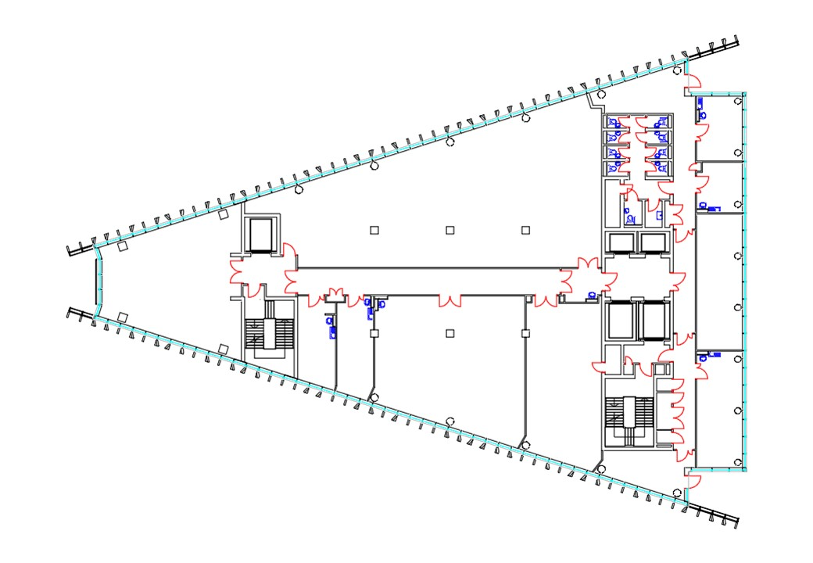
Fire Safety
General
Emergency
Evacuation
Plan
Sir
Michael
Uren
Level: 8
KEY
Safe Route
Evac Lift
Refuge Point

Slide 13
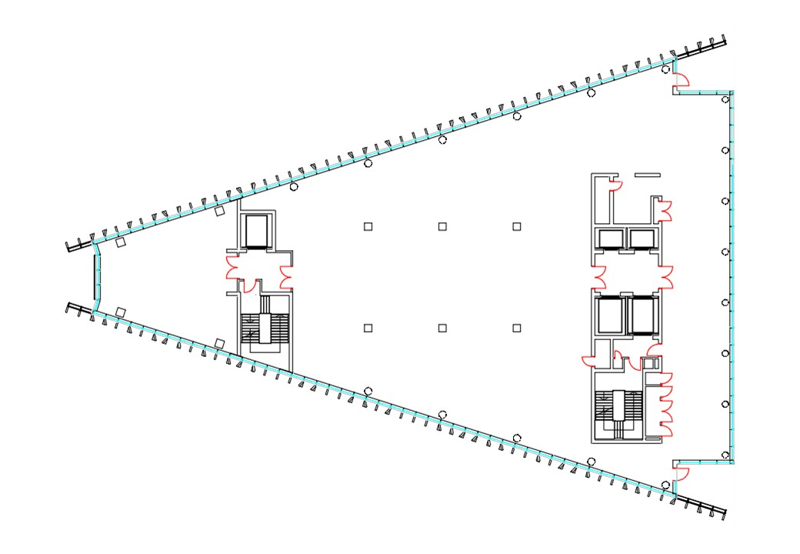
Fire Safety
General
Emergency
Evacuation
Plan
Sir
Michael
Uren
Level: 9
KEY
Safe Route
Evac Lift
Refuge Point

Slide 14
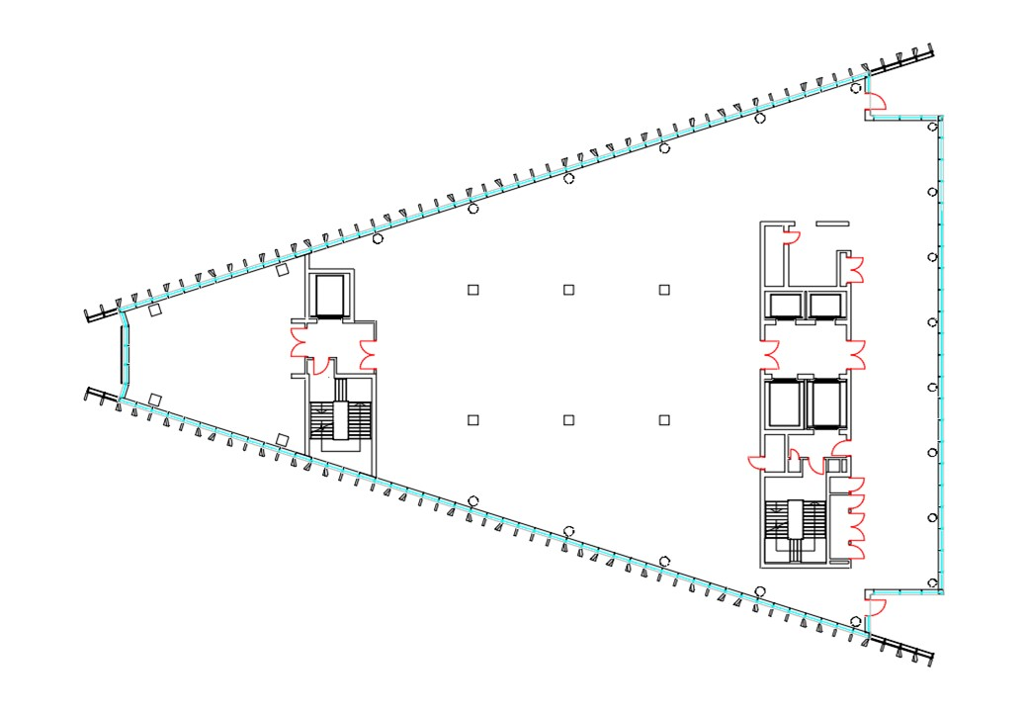
Fire Safety
General
Emergency
Evacuation
Plan
Sir
Michael
Uren
Level: 10
KEY
Safe Route
Evac Lift
Refuge Point

Slide 15
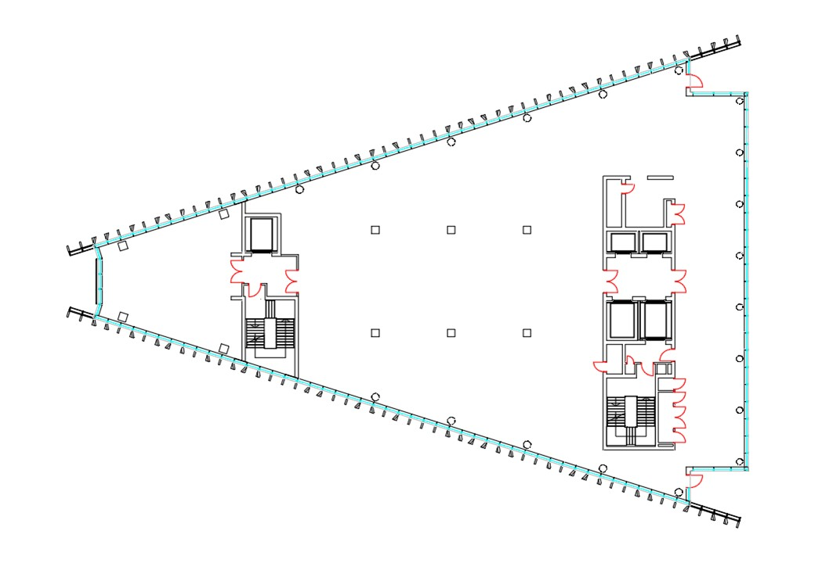
Fire Safety
General
Emergency
Evacuation
Plan
Sir
Michael
Uren
Level: 11
KEY
Safe Route
Evac Lift
Refuge Point

Slide 16
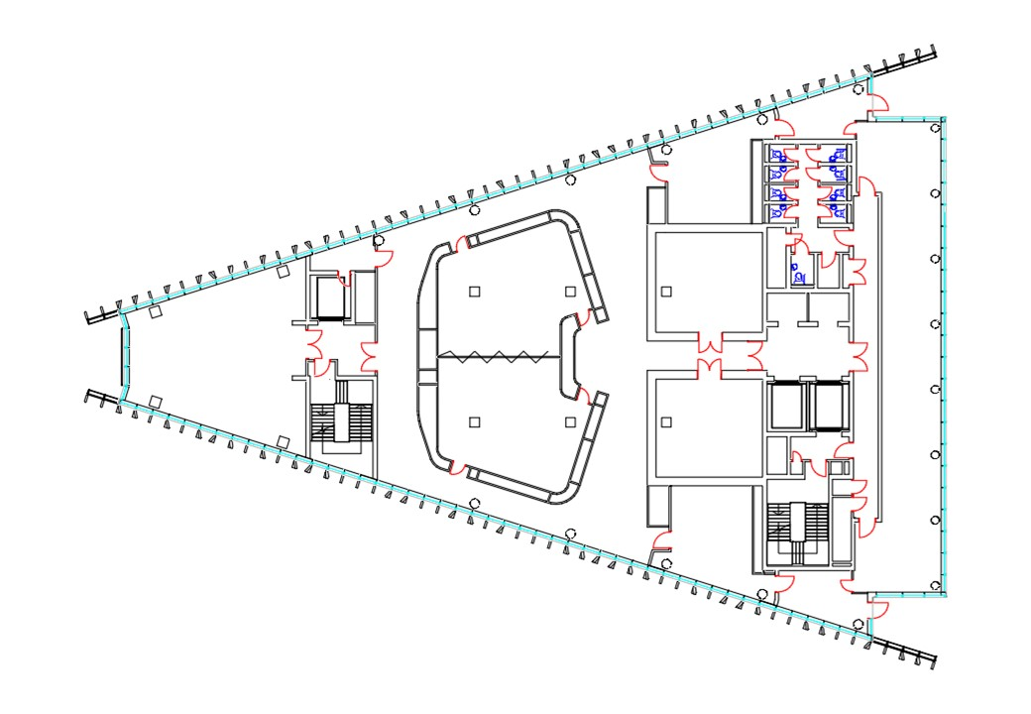
Fire Safety
General
Emergency
Evacuation
Plan
Sir
Michael
Uren
Level: 12
KEY
Safe Route
Evac Lift
Refuge Point

