Slide 1
Your USS pension
Carey Southward – Head of Pensions & Benefits

Slide 2
Different types of pension
Defined Benefit (DB)
A Defined Benefit pension allows you to build up a guaranteed retirement income based on:
Your salary, and
Your length of membership in the scheme.
Your retirement income is paid from the date you retire until your death, providing long-term financial security.
Defined Contribution (DC)
A Defined Contribution pension is a personal savings pot that builds up over time through:
Your contributions, and
Your employer’s contributions.
These contributions are invested to help your savings grow.
At retirement, you can access your pension pot flexibly, choosing how and when to draw your savings.

Slide 3

USS is a hybrid pension scheme – DB and DC
Retirement Income Builder (DB)
Earnings up to £71,484
Guaranteed lifetime pension on retirement
Pension builds up each year at 1/75 salary
Automatic tax-free lump sum of 3 times pension
Minimum pension age is 55
Normal pension age is 66
Investment Builder (DC)
Earnings over £71,484
20% paid into savings pot
Into savings pot you can control
10 investment funds
Access pension savings flexibly from minimum pension age
Can transfer in pensions from other providers
Able to pay extra contributions (AVC’s)

Slide 4
How pension builds up - illustration
Current Salary: £40,000 a year
Inflation: 3% each year
Salary increases: 4% each year

Slide 5
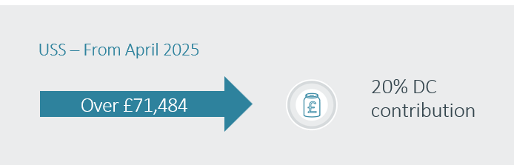

Slide 6
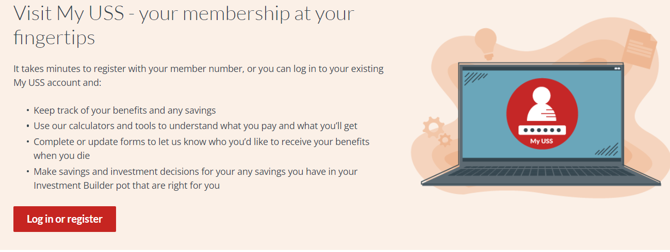
Managing your USS pension

Slide 7
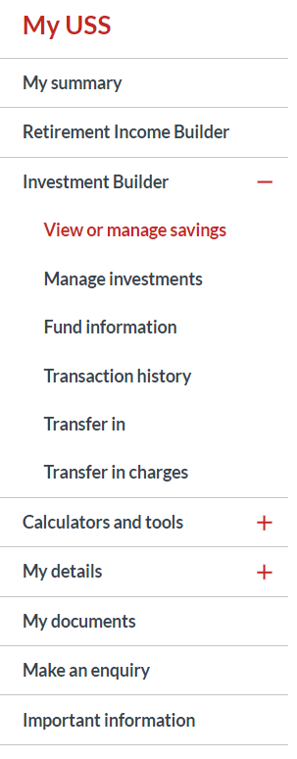
My USS

Slide 8
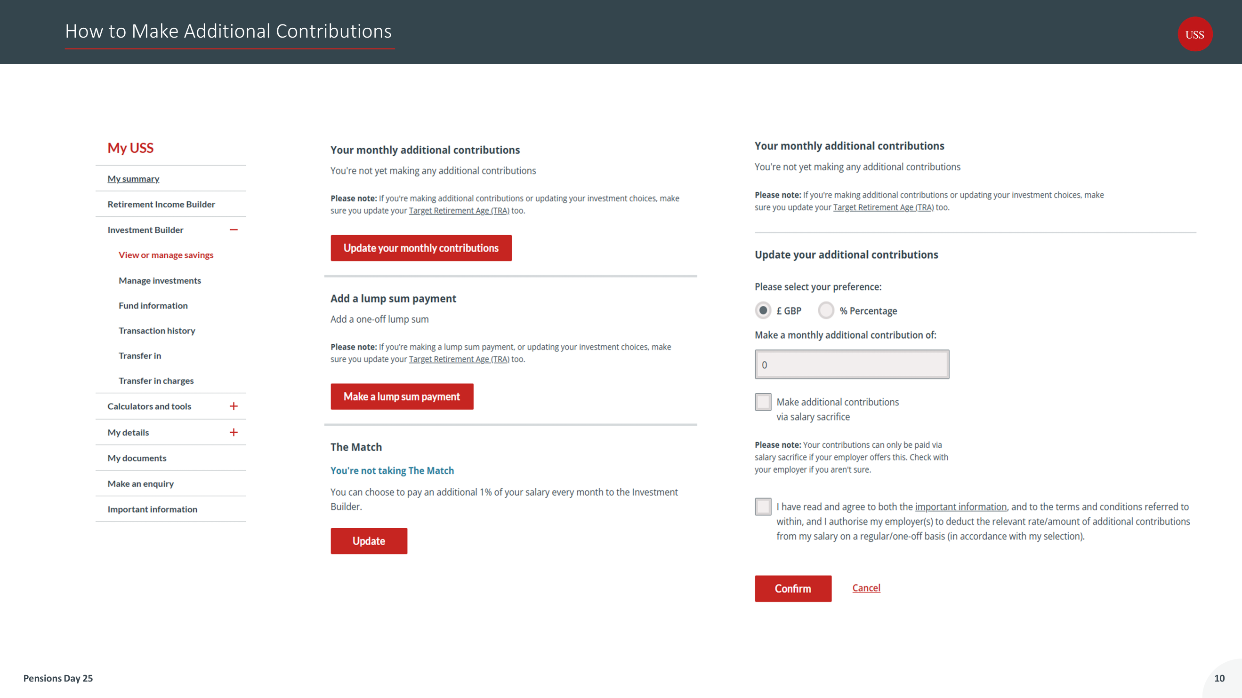

Slide 9
National Insurance and State Pension You need 10 qualifying years on your NI record to get any new State Pension A qualifying year is one where you paid NIC’s from your salary, received credits if you were unemployed, a parent or a carer Paid voluntary contributions to fill gaps in last 6 tax years To receive a full State Pension (£230.25 p/w) you need 35 qualifying years. In between 10 and 35 years your State Pension is pro-rated Check you record on .gov.uk or the HMRC app

Slide 10
PensionSmart (Salary Exchange)
Saves you (and Imperial) money
Reduces National Insurance Contributions
Default option (except casual workers)
Can opt-out of PensionSmart and stay in scheme
No refund of contributions if you leave the scheme
Can use for monthly AVC payments to Investment Builder fund but not one-off lump sum payments
Does not reduce pensionable salary

Slide 11
PensionSmart (Salary Exchange)
💼 Without Salary Exchange:
Gross Salary: £40,000
Pension Contribution: £2,440 (employee-paid)
Employee NI: £2,194.40
Take-Home Pay: £35,365.60
💼 With Salary Exchange:
Gross Salary: £37,560 (after salary reduction)
Pension Contribution: £2,440 (employer-paid)
Employee NI: £1,999.20
Take-Home Pay: £35,560.80
💡 Summary of Savings:
Employee NI Savings: £195.20 per year
Take-Home Pay Increase: £195.20 per year
Even though your gross salary is reduced, your take-home pay actually increases slightly,
thanks to the NI savings.

