Slide 1
Design of CO₂ Storage in Depleted Oil Reservoirs
Oranan Ariyarit
Supervisor: Prof. Martin J. Blunt
Co-supervisor: Asst. Prof. Gege Wen

Slide 2
Outline
PhD research aim
Preliminary study: 1D simulation
Example results
Ongoing and future work plan
Latest updates on CCS in Thailand

Slide 3
PhD research aim

Slide 4
Research aim
Understand three-phase flow behaviour at field scale using pore-scale insights
Determine optimum CO₂ injection strategies for long-term storage in offshore Thailand
Notes:
Understand 3-phase flow consequences in field scale based on pore scale insight.
โดยเฉพาะผลจาก low gas rel perm

Slide 5
Preliminary study: 1D simulation

Slide 6
1D Simulation framework
One-dimensional (1D) reservoir simulation
Fractional flow analysis for multiphase systems
Investigation of CO₂ displacement processes
Immiscible and miscible 1D displacement modelling
Relative permeability sensitivity analysis
Notes:
1D simulation → which is already done
Study fractional flow
Study displacement process
ดูว่า %oil recovery กับ amount of CO2 storage มันสอดคล้องกับ analytical solution หรือป่าว
Immiscible and miscible 1D displacement modelling (waterflooding and gas flooding, secondary and tertiary recovery)

Slide 7
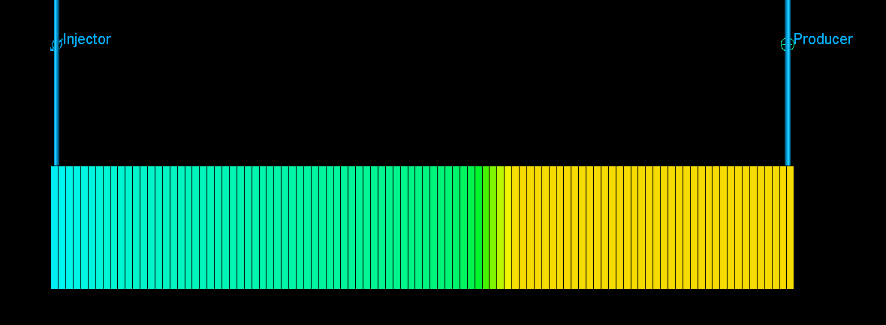
1D Simulation framework (continued)
Simulator : E100
Domain
    Length (x-axis) : 150 m
    Width (y-axis) : 5 m
    Height (z-axis) : 5 m
    Number of grid blocks : 600
Outputs
    Shock front
    Oil recovery (%)
    CO2 storage capacity
Injector
Producer

Slide 8
Example results

Slide 9
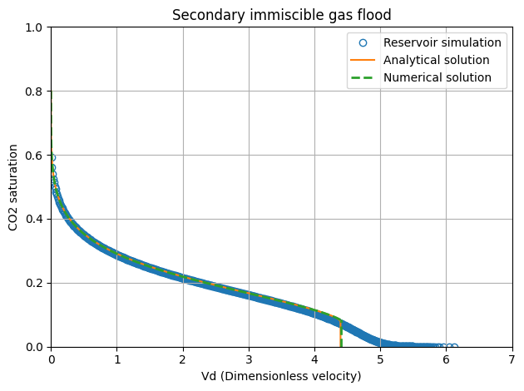
Immiscible gas flood

Slide 10
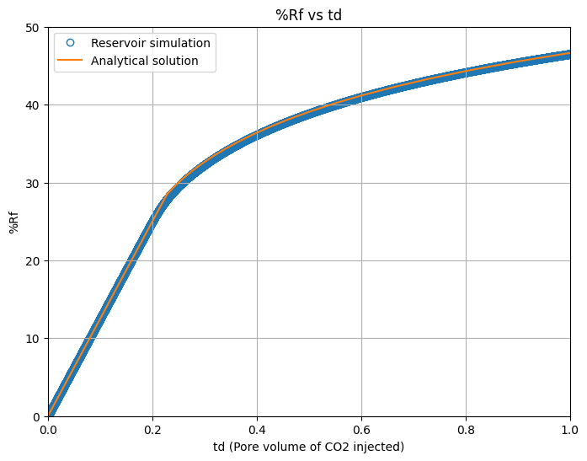
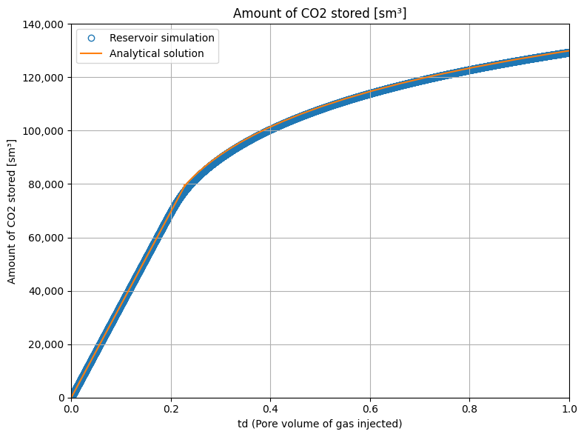
Immiscible gas flood (continued)
%Rf
CO₂ storage capacity

Slide 11
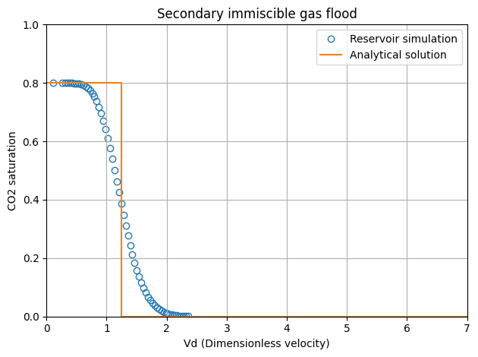
Miscible gas flood

Slide 12
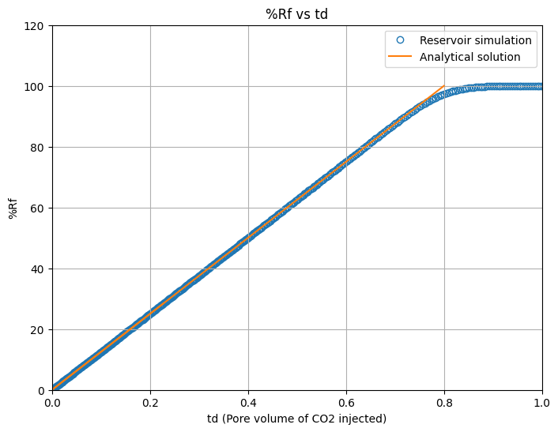
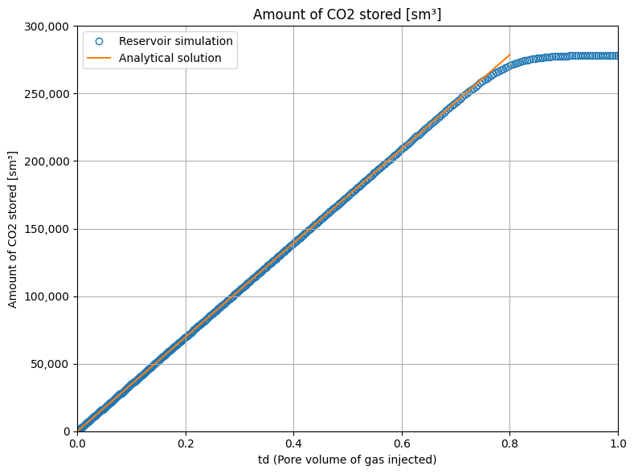
Miscible gas flood (continued)
%Rf
CO₂ storage capacity

Slide 13
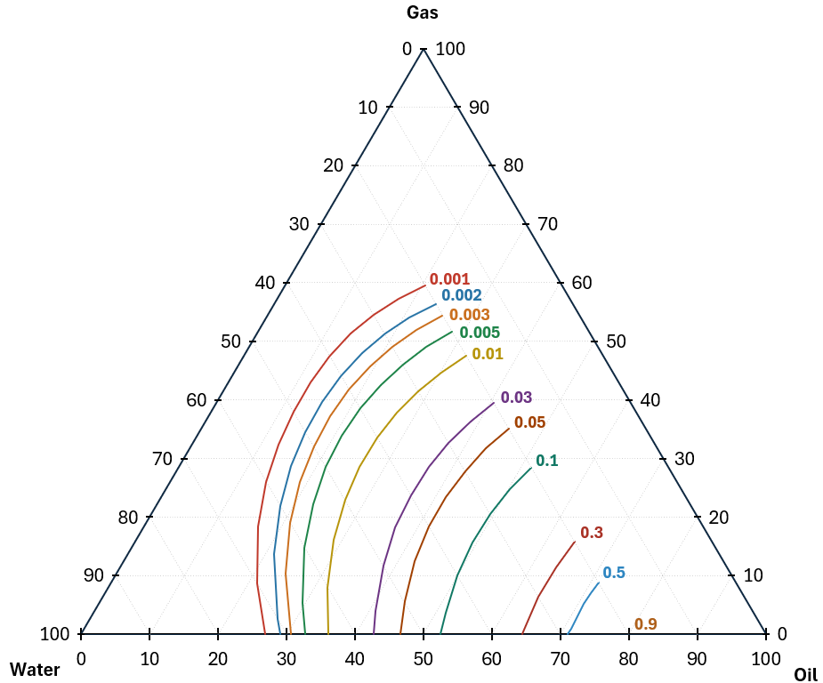
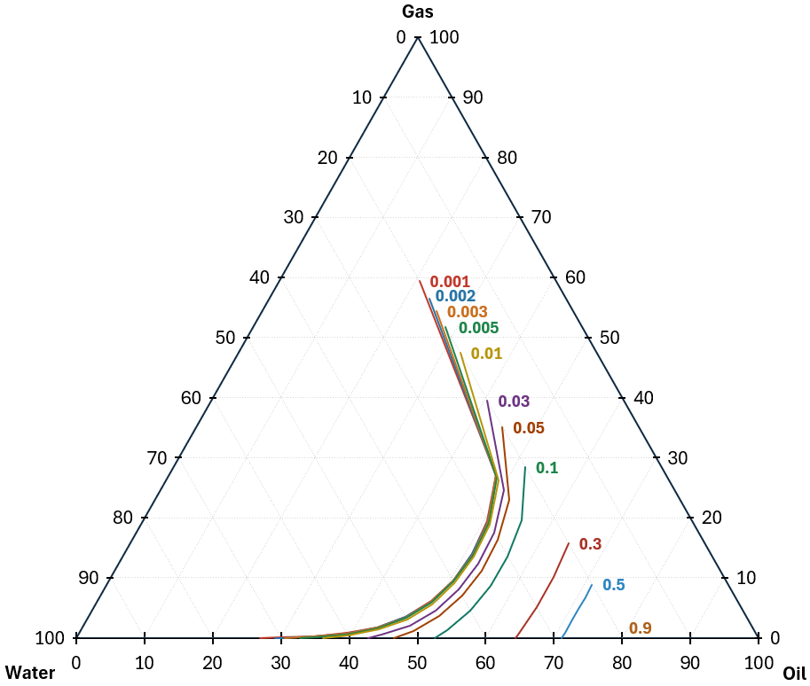
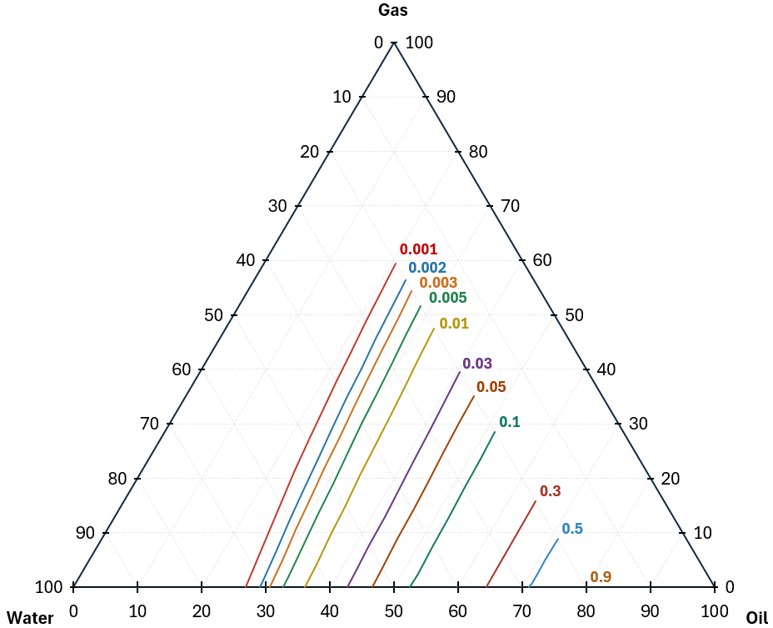
Relative permeability models
Stone 1 Stone 2 Baker
Gas
Gas
Gas
Water
Oil
Water
Oil
Water
Oil
Different relative permeability yields different production profiles.
Future work will focus on the low gas relative permeability in the presence of mobile water.
Ref. : S. Masalmeh, A. Farzaneh, and M. Sohrabi, “Gas/co2 mobility under 2-phase and 3-phase flow in carbonate for co2-eor and ccs projects,” in IOR+ 2025-23rd European Symposium on IOR, vol. 2025, no. 1. European Association of Geoscientists & Engineers, 2025, pp. 1–23.

Slide 14
Ongoing and future work plan

Slide 15
Planned work
Three-dimensional (3D) reservoir simulation
Sensitivity analysis of relative permeability parameters
Design and optimisation of CO₂ storage in offshore Thailand
Notes:
3D simulation → plan to do
Conducting sensitivity of relative permeability
โดยจะทำทั้ง miscible และ immiscible flooding ผลที่ได้จะต้องสอดคล้องกับ analytical solution
เฝ้าสังเกตเรื่อง low gas rel perm

Slide 16
Latest updates on CCS in Thailand

Slide 17
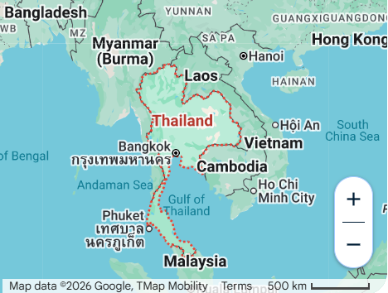
Carbon storage potential in the Northern Gulf of Thailand
On 6 January 2026, the Cabinet approved in principle the adoption of Carbon Capture and Storage (CCS) as a key measure for greenhouse gas reduction, with the Northern Gulf of Thailand designated as a priority area to support Thailand’s long-term transition to a low-carbon economy.
More information:
https://carboncapturemagazine.com/articles/pttep-to-join-thailand-in-northern-gulf-of-thailand-ccs-study
https://www.thansettakij.com/sustainable/net-zero/648287
Notes:
อนุญาตให้ สผ เข้าพื้นที่ไปสำรวจ CCS ได้

Slide 18
Acknowledgement
Department of Mineral Fuels, Ministry of Energy of Thailand

Slide 19
Thank you

