Slide 1
Department of Electrical and Electronic Engineering
Day One Safety Induction
Zia Rahman
Department Safety Officer
September 2026

Slide 2


Slide 3
Student Essential Online Courses
Requirement for new, existing and post graduate students
As part of our commitment to your learning, we have developed six online units that make up the Student Essential Training programme. They are designed to give you the knowledge you need to understand Imperial's values and expectations around academic conduct, safety and behaviour. The training takes around four hours to complete in total. Training programme link can be found on the SE Webpage.
Courses include:
Fire Safety (new) , Cyber Security: We are all in this together (new) , Freedom of Speech (new)
Consent Matters (updated), Plagiarism Awareness (updated), EDI for Students (revised).
A deadline of 1st October has been set for the completion of Fire Safety, Cyber Security, Freedom of Speech, and Consent Matters units by new taught students.
Students will have the autumn term to complete the two remaining units – Plagiarism Awareness and EDI for Students.

Slide 4
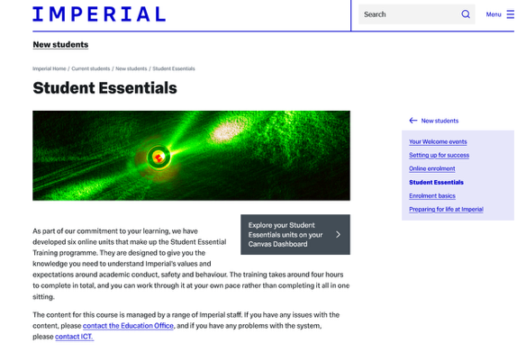

Student Essential Online Courses
Student Essential Webpage
CANVAS Dashboard

Slide 5
Emergency Contact Numbers
In the event of an emergency anywhere on campus
Please dial 4444 from any internal phone
Store and dial 0207 589 1000 from your mobile phone
Both numbers will direct you to our 24 hour Security Office based in Sherfield Building
999 or 111 can be dialled for incidences taking place outside of buildings.

Slide 6
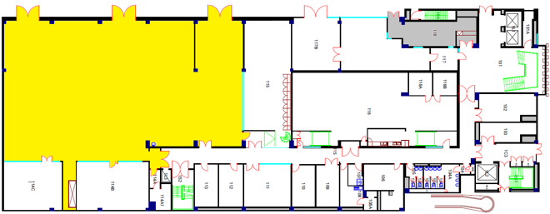
Level 1 floor plan
EE Stores [118]
Yr 1&2
Electronics
Lab
[114]

Slide 7
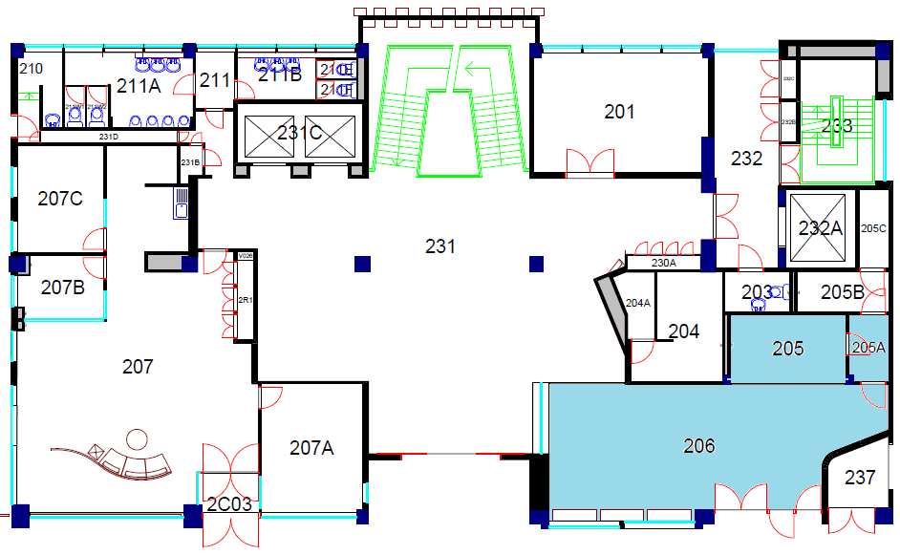
Level 2 Floor Plan
EE Cafe

Slide 8
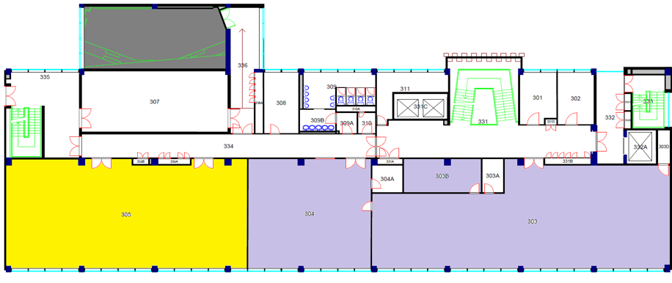
Level 3 Floor Plan
MSc Lab [303B]
Teaching Space
[305]
Post Graduate
Breakout Space
[305]
MSc
Computer Lab
[303]
MSc
Study Space
[303]

Slide 9
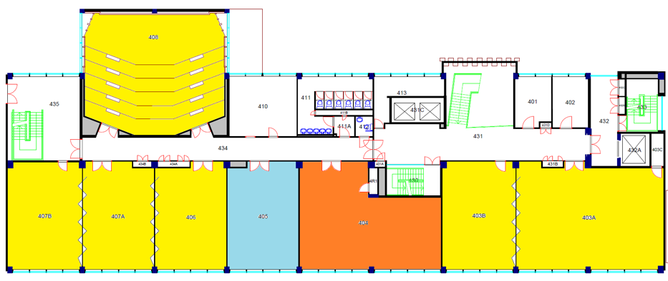
Level 4 Floor Plan
Lecture Theatre
[408]
Teaching Space
[407B / 407A / 406]
Teaching Space
[403B / 403A]
Yr 1&2 Breakout Space
[405]
Yr 1&2
Study Lab
[404]

Slide 10
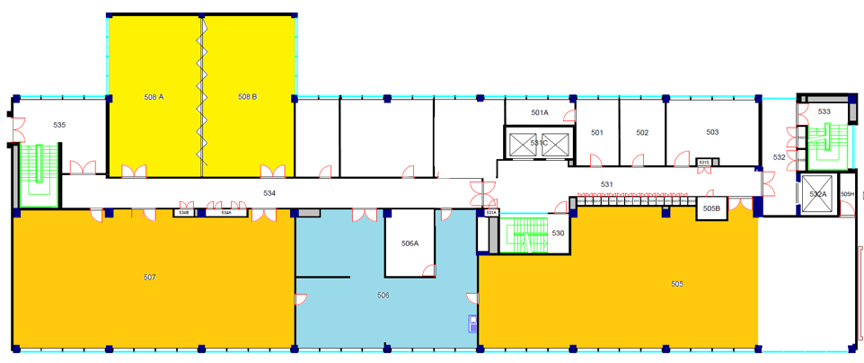
Level 5 Floor Plan
Teaching Space
[508A / 508B]
Yr 3&4
Computer Lab and Teaching Room
[507]
Imperial
College
Robotics
Society
Yr 3&4
Projects Lab
[505]
Yr 3&4 Breakout Space

Slide 11
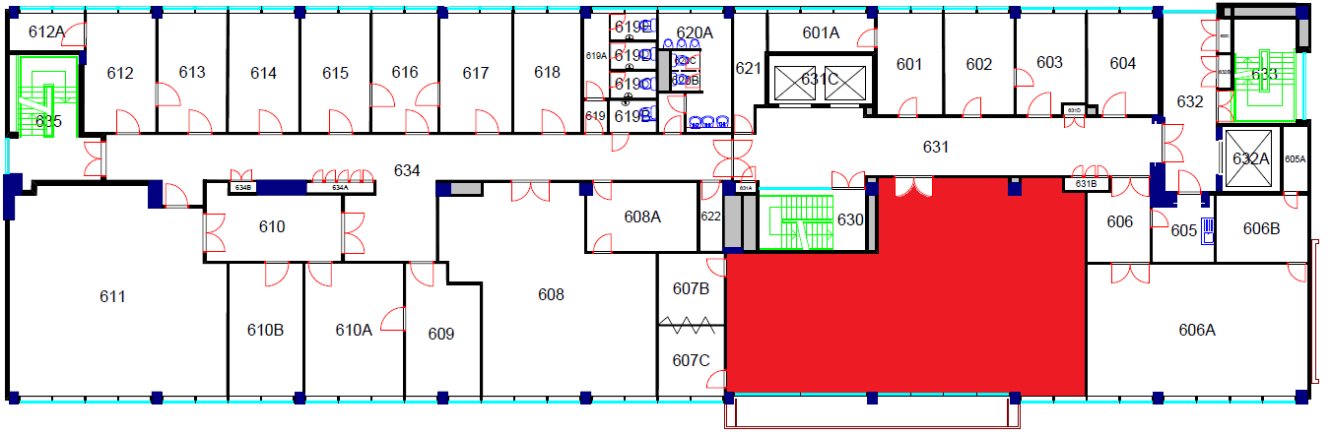
Level 6 Floor Plan
EE Education Support
(Ayrton Room)

Slide 12

Electrical Engineering Building Plan
Level 11 > Control & Power (CAP) Research Group
Level 10 > Intelligent systems (IS) Research Group
Level 9 > Circuits & Systems (CAS) Research Group
Level 8 > Comm & Signal Processing (CSP) Research Group
Level 7 > Optical & Semiconductor Devices (OSD) Research Group
Level 6 > Education Support Office / Student Wellbeing Office
Level 5 > Teaching Rooms / Yr 3 & 4 Project and Computer Lab
Level 4 > Teaching Rooms / Yr 1& 2 Comp lab & Breakout room
Level 3 > Teaching Room / MSc Breakout room & Comp Lab
Level 2 > Cafe
Level 1 > Yr 1 & 2 Electronics Lab and EE Stores

Slide 13
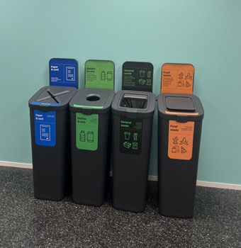
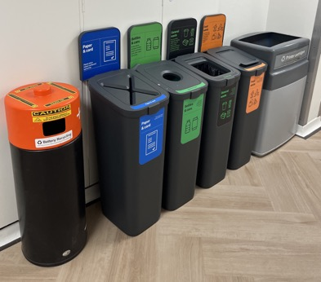
Waste and Recycling Points
Waste and recycling points are located across all central corridor and break out rooms.
Waste point on Level 1 includes a Battery Bin as well as an Ammo box for used lithium batteries.
Waste streams have been easily colour coded and separated for convenience. By putting items in the correct bin you help Imperial reduce waste, cut costs and increase recycling rates.

Slide 14
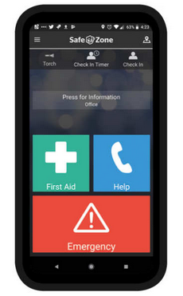

SafeZone App
SafeZone has been designed to contact the Security Team and locate you anywhere on campus.
Download the app

Slide 15
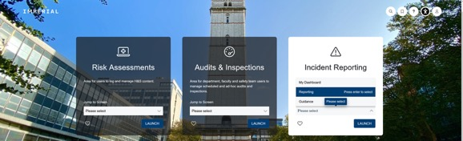
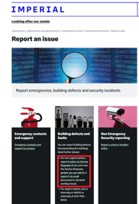
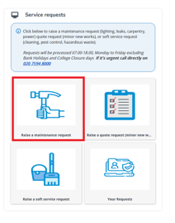
CORESTREAM and Building Defects
Please report all accidents and incidents using the online
CORESTREAM form
Please report all building defects via the online Customer Service Centre

Slide 16
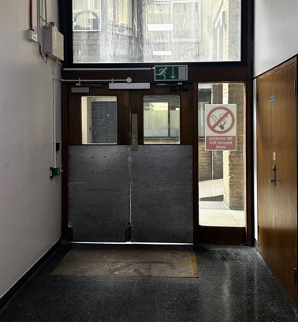
FIRE EXIT ROUTE VIA NORTH STAIRCASE
Level 1 Loading Bay exit

Slide 17
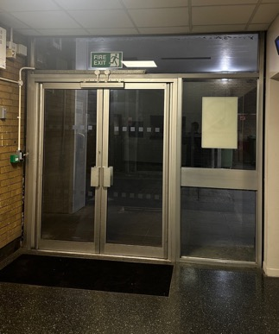
FIRE EXIT ROUTE NEAR CENTRAL STAIRCASE
Level 1 Passenger Lift / Ayrton Road

Slide 18
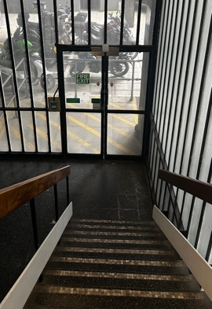
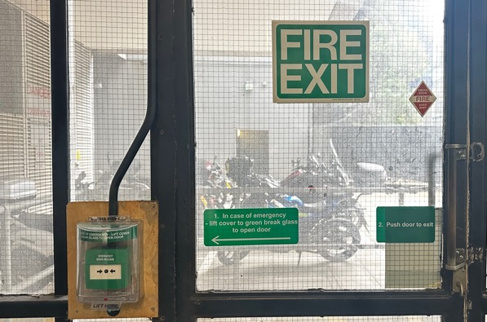
FIRE EXIT VIA SOUTH STAIRCASE
Level 1 Motorcycle Bays / Assembly Point (F)

Slide 19
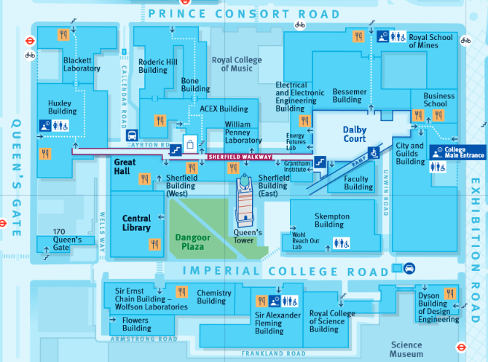
Fire Assembly Point
Follow Fire Exit route from the building to Assembly Point F (Queen’s Lawn Car Park)
F

Slide 20
First Aid
Please call 4444 (from internal phone) or dial 0207 589 1000 (from mobile phone) to call Security Officers who are all first aid trained

Slide 21

Personal Emergency Evacuation Plan (PEEP)
Should you have a temporary or permanent disability at any time when on site, please contact Zia Rahman to arrange an evacuation plan specific to your needs.
Mr Zia Rahman
Department Safety Officer
Office: 302
Mob: 07852 850 186
Email: z.rahman@imperial.ac.uk

Slide 22
Hazardous Areas / Procedures
Use of laboratory or workshop equipment is prohibited without permission and UG students must be supervised
Department Safety Officer
Zia Rahman : z.Rahman@imperial.ac.uk
Departmental Chemical Safety
Dr Zahid Durrani : z.durrani@imperial.ac.uk
Departmental Laser Safety
Prof. Andrew Holmes : a.holmes@imperial.ac.uk

Slide 23
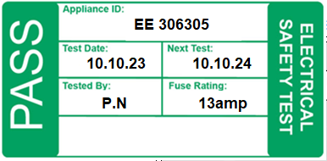
Dept. policy on electrical equipment
ALL mains-powered electrical equipment you bring into the building should have a valid Portable Appliance Test (PAT) label
If there is no label, or the test period has expired, you MUST NOT use the equipment or adaptors
Please contact Laboratory Manager Paul Norman (p.norman@imperial.ac.uk) throughout October to arrange a PAT for all equipment likely to be used on site

Slide 24
Dept. Notices and Safety Committee
Department Safety Notice board is located on the level 1 corridor
Departmental Safety Committee meet three times throughout the academic year. If you have anything you wish to raise, please contact your Undergraduate representative
Further guidance and information can be found on the EEE Department Safety page.

