Slide 1


COLLABORATE
An efficient, UK-wide, real-world-data-enabled, adaptive, 2-randomisation, controlled trial to determine clinical efficacy, effect size, and safety of widely used enteral feeds in reducing necrotising enterocolitis, mortality, and cognitive impairment in preterm babies born below 29 weeks' gestation
Site Initiation Visit slides for consent and randomisation roles
Supported by:
NEC UK, Bliss, Adult Preemie Advocacy Network, British Association for Neonatal Neurodevelopmental Follow-Up, Neonatal Nurses Association, British Association of Paediatric Surgeons, and The George Institute for Global Health

Slide 2
Study Objectives
Randomised study primary objectives
To assess, in babies born <29 weeks gestation, the efficacy of pasteurised Human Donor Milk (pHDM) compared with Preterm Formula, when used as a supplement should there be insufficient milk from their own mother (Own Mother's Milk), on “survival to 34 weeks postmenstrual age without surgical necrotising enterocolitis (NEC)” (primary outcome), language and cognitive development at age 2-years, and other outcomes
To assess, in babies born <29 weeks gestation, the efficacy of routine cow-milk based protein-carbohydrate fortification of human milk feeds (Own Mother’s Milk and pHDM) compared with no routine fortification on “survival to 34 weeks postmenstrual age without surgical necrotising enterocolitis (NEC)” (primary outcome), language and cognitive development at age 2-years, and other outcomes
Mechanistic objective (sub-study led by Professor James Boardman, University of Edinburgh)
To determine if pHDM and Preterm Formula exert different effects on neurodevelopment through the mechanism of altered cerebral white matter microstructure (sub-study)
NHS Value objective (led by Professor Ramon Luengo-Fernandez, University of Oxford)
To establish if the additional cost of pHDM to the NHS is justified through a reduction in NEC

Slide 3
2-randomisation design, eligibility criteria
Babies can participate in either or both randomisations
Randomisation 1
When attending clinician decides supplementary feed is required
Randomisation 2
When receiving 60-120ml/kg/day human milk
Exclusion: Baby has already received pHDM or Preterm Formula
Exclusion: Baby has already received Fortifier
Inclusion criteria
Supplemental pasteurised human donor milk
Routine fortification
Babies born <29 weeks gestation
No condition precluding enteral feeding
Maternal intention to express breast milk
Parent/guardian verbal consent (document in eCRF)
No routine fortification
Supplemental
preterm Formula
Routine fortification
No routine fortification

Slide 4





Study Flowchart
Participant randomised to R1 (formula top up or pHDM top up) and/or R2 (fortifier or no fortifier) when criteria met
Check eligibility
Discuss study at appropriate time, provide PIS
Outcome data from EPR (Badger.net) auto-uploaded to study database
(quarterly via NNRD)
2-year PARCA-R assessment sent electronically to parent
Randomise via study database
Document allocation in medical notes, attach cot card
Eligibility, Study introduced
Randomised
(recruited)
Final data collection timepoint
Ensure participants’ EPR data is complete
NNU Admission
Add all infants <29 weeks gestation to screening & enrolment log
NNU Discharge
Randomised Intervention(s) received
Randomised feed to continue until 34 weeks PMA
Safety reporting from randomisation to NNU discharge, 34 weeks PMA, or death (whichever is first)
Protocol compliance reporting
Consent
Parent verbally consents to R1 and/or R2 prior to any supplemental feed or fortifier
Enter ancillary outcome data to eCRF
Sign parent up to ePARCA-R
Document verbal consent in study database
Provide copy of consent form to parent and upload to medical notes
Infant may be transferred to a step-down unit (continuing care site) during this time

Slide 5


Study procedures : consent, randomisation, interventions

Slide 6
Eligibility and Consent
Eligibility assessed by member of the clinical care team after admission to NNU
  Parents must consent to their baby's data to be included in NNRD
Screening log
Document all babies <29 weeks gestation, template electronic log in site file, send to study team every 2 months (remove identifiable data first)
Verbal consent
  Study discussed at an appropriate time and prior to any supplemental feed or fortifier
  Provide PIS part 1 and 2, ensure parents have adequate time to consider
        Parent information available in English and the ten other most prevalent UK languages
        Verbal consent statement completed by site staff electronically in Open Clinica
          Back up paper statement, if used should be transcribed into OpenClinica as soon as possible
          Once transcribed, paper statement should be confidentially destroyed, it will not be used as source data
          Individual OpenClinica user account required to document verbal consent in OpenClinica
        Parents can consent to either R1 and/or R2, and can consent to R2 later
  Copy of consent statement downloaded from OpenClinica and provided to parent
  Participation documented in medical/research records
OpenClinica: Schedule the Eligibility Visit on the participants record to record consent. Refer to the OpenClinica guide for further information

Slide 7
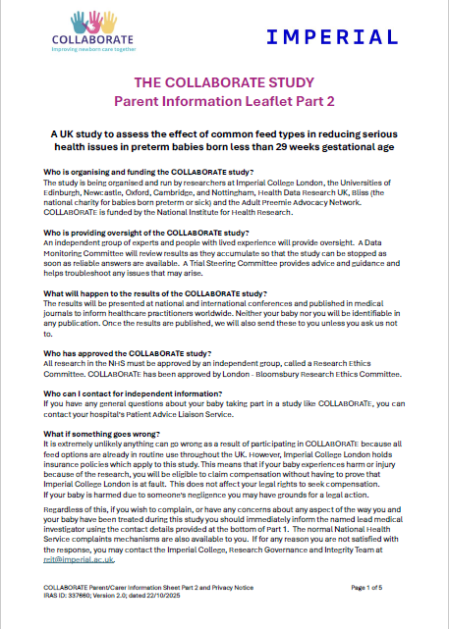
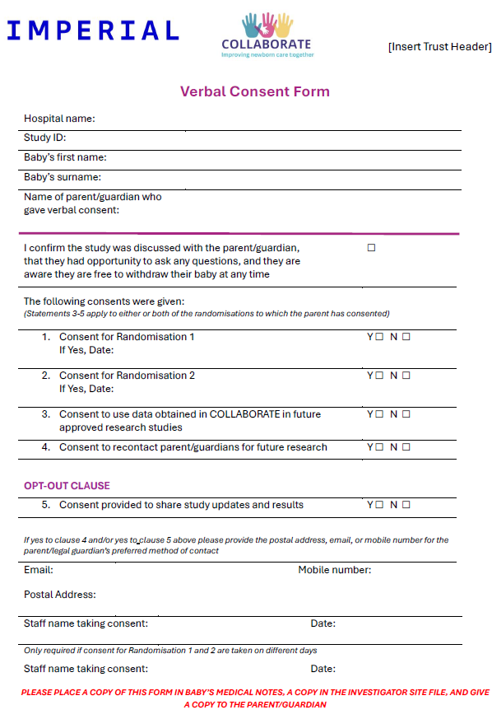
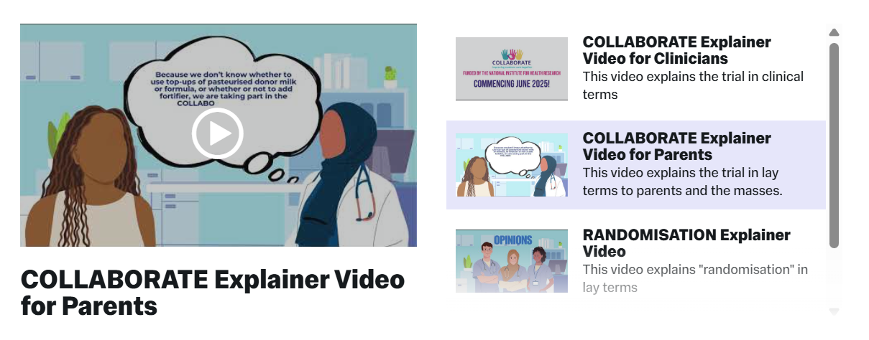
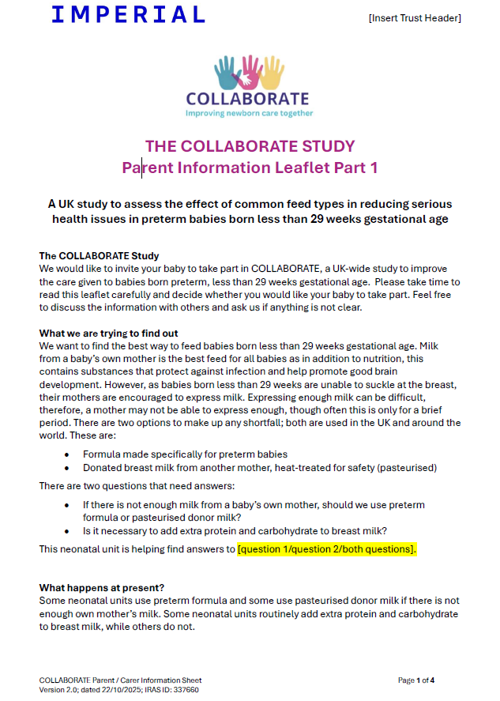

Patient facing and engagement material
Verbal Consent statement
Videos explaining the study, randomisation and NNRD linked in PIS 1
https://www.imperial.ac.uk/neonatal-data-analysis-unit/collaborate/
Posters/flyers
Cot cards and paper note labels
PIS part 1&2
PIS available in:
Polish; Romanian; Punjabi; Urdu; Portuguese; Spanish; Arabic; Bengali; Gujarati; Italian

Slide 8
Randomisation
Timings of randomisation discussed on previous slide (Slide 3: Study design)
Process
  Randomise via OpenClinica with individual user account (user account granted when required study and database training completed)
  First ensure the CRFs have been fully completed within the Eligibility Visit, including consent, eligibility, participant ID, and randomisation stratification
  Schedule the Randomisation Visit
  On the Randomisation Eligibility Form, confirm that the participant is eligible for randomisation, select ‘Randomise’, the date of randomisation will auto-populate
  Randomisation assignment may take 10-20 seconds to appear on the assignment form. Please wait until the Randomisation Assignment form status changes to “Data Entry Started” (orange pencil icon) before opening the form to view the allocation. Once the allocation has been generated, click complete and confirm the form.
  Input the allocation on provided Cot cards and stickers for paper medical notes to remind staff and parents of study and allocation, add a flag if using electronic records
Refer to the OpenClinica guide and randomisation video for further information
Notes:
Randomised = recruited

Slide 9

Interventions
All interventions (formula, pHDM, fortifier) are standard hospital stock used as part of standard of care
Ensure any protocol deviations, unexpected Serious Adverse Reactions or participant withdrawals are reported to the core research team (i.e. lead research nurse or PI at Investigator Site) who will complete the relevant form on Open Clinica.
Additional guidance:
Refer to the discretionary fortification guidance and mineral and supplementation guidance available in the Investigator Site File maintained by the core research team.

Slide 10
Key Study Documents
Document | Version and Date
Protocol | V3.0 09/01/2026
Eligibility checklist | V1.0 27/01/2026
Parent Information Sheet part 1 | V2.1 12/12/2025
Parent Information Sheet part 2 | V2.0 22/10/2025
Verbal consent statement | V2.1 12/12/2025
Flyers | V2.3 04/04/2025
Cot labels | V1.0 15/08/2025
Paper Notes Labels | V1.0 15/08/2025
Mineral and vitamin supplementation | V1.2 21/01/2026
Discretionary fortification guidance | V1.2 21/01/2026
eCRF data entry manual | V1.0 05/02/2026
eCRF data entry manual (consent and randomisation) | V1.0 19/06/2026
Safety reporting manual | V1.0 09/02/2026

Slide 11
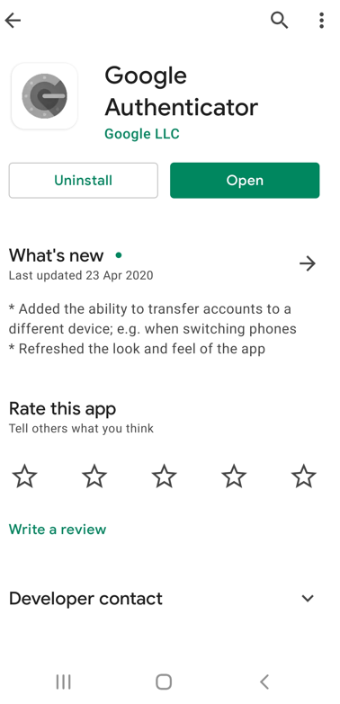
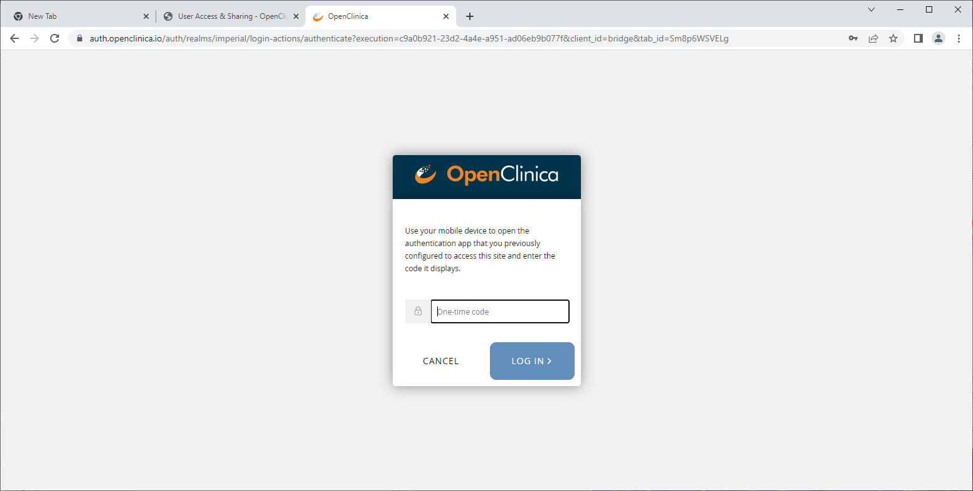
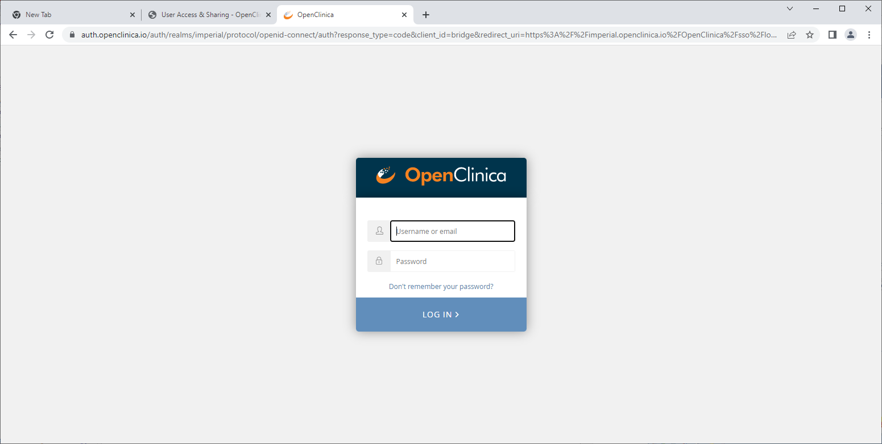
Account set up - OpenClinica
Receive a link from OpenClinica via email from donotreply@openclinica.io to set up the account, when you click the link it will show your username the account has been created for
If you already have an Imperial OpenClinica Account, log in as normal and click ‘change’ when logged in to access the Collaborate study.
If you do not already have an Imperial OpenClinica account:
      When you click the link, you will be instructed to enter a new password (at least 1 lower case letter, 1 special character and 1 digit)
      Log in using your username and new password
      Multi-factor authentication is required: Install Google Authenticator app, scan the QR code on screen, a one-time code will be generated in the app
      Enter the one-time code, when you next log in, you will just need to enter the one-time code from your authenticator app
      Any issues contact cds_support@imperial.ac.uk as they may need to reset your account
      OpenClinica URL: https://imperial.openclinica.io/OpenClinica/MainMenu
Refer to the OpenClinica guide for further information
Notes:
If you can’t scan a QR code on your phone, there is an alternative option using a code – the instructions will be on screen

Slide 12
GCP – Key Principles
Principle 1: Participant Safety and Ethics
Follow ethical standards (Declaration of Helsinki, GCP and regulations)
Ensure participant rights, safety and well-being throughout study conduct
Avoid excluding populations unnecessarily
Maintain confidentiality and ensure qualified oversight
Principle 2: Informed Consent
Participation must be voluntary and fully informed
Consent must be freely given and documented
Provide clear, relevant, understandable information; may be adapted for emergency settings
Principle 3: Independent Review
All trials require independent ethical review and approval
Comply with the approved protocol
Principle 4: Scientific Soundness
Study must be scientifically robust and evidence based
Design should reflect current knowledge of the therapeutic area
Protocol may be updated as new evidence emerges
Principle 5: Qualified Staff
Conducted by appropriately trained and experienced staff
Investigators must be suitably qualified with an appropriate medical registration (non-medical investigators require medical oversight)
ICH HARMONISED GUIDELINE FOR GOOD CLINICAL PRACTICE E6(R3)

Slide 13
GCP – Key Principles
Principle 6: Quality by Design
Quality should be built into trial design from the start
Focus on participant safety and reliable data
Avoid unnecessary procedures and monitor compliance
Principle 7: Risk-Proportionality
Ensure trial design and processes are risk proportionate and aligned with data collection (minimise burden on participants and investigators)
Apply risk-based practices in line with GCP and sponsor guidance
Principle 8: Clear Protocols
Protocol should be clear, concise, feasible, and aligned with trial objectives
Support transparency and reproducibility
Know where to access key documents (e.g. monitoring and data management plans)
Principle 9: Reliable Results
Ensure accurate, complete, and timely data collection
Follow protocol and report deviations
Use validated systems for data capture and maintain clear documentation
Support participant compliance and contribute to data quality
Principle 10: Roles and Responsibilities
Roles and responsibilities should be clear and documented
Work within delegated tasks and limits
Record all activities and maintain training
Escalate issues and support team accountability
ICH HARMONISED GUIDELINE FOR GOOD CLINICAL PRACTICE E6(R3)

Slide 14





GCP – Informed Consent
GCP – Informed Consent
Informed consent
Ongoing throughout the study, not a one-time event
Participants give consent and can withdraw anytime without a reason
Process is a shared responsibility across the research team
Voluntary consent
Given freely, without pressure or influence
Requires full understanding and decision-making capacity
Time must be allowed for questions, answers and participant to decide whether they wish to take part
Declining participation must be respected and participants should be assured that this will not affect their care
Fully informed participants
Use REC-approved Participant Information Sheet (PIS) to discuss the study with the participant
Answer additional questions and allow discussion with others (family members or healthcare professionals)
Supplement with additional materials (e.g., videos) where applicable
Document consent
COLLABORATE uses verbal consent which is recorded directly on the study database
Back-up paper verbal consent can be used where necessary
ICH HARMONISED GUIDELINE FOR GOOD CLINICAL PRACTICE E6(R3)

Slide 15
Link to NIHR training
https://learn.nihr.ac.uk
Good Clinical Practice (GCP) Introduction: E6(R3)
Good Clinical Practice (GCP) Refresher: GCP E6(R3)
Link to GCP guidelines: https://database.ich.org/sites/default/files/ICH_E6%28R3%29_Step4_FinalGuideline_2025_0106.pdf
Study queries: collaborate@imperial.ac.uk

