Slide 1

Antimicrobial Citizen Engagement (ACE) project

Slide 2
TABLE OF CONTENTS
01
02
03
ANTIMICROBIAL RESISTANCE
CITIZEN SCIENCE
ACE PROJECT
04
05
RESEARCH CONDUCT
NEXT STEPS…..
What is it and how does it occur?
What is it?
Where do I come in?
How do I do it right?
What do I do now?

Slide 3
Antimicrobial Resistance
01

Slide 4

WHAT IS ANTIMICROBIAL RESISTANCE?
01
03
02
BACTERIA
RESISTANCE
ANTIMICROBIALS
These can be helpful or unhelpful… the unhelpful ones can make you sick & are sometimes called GERMS
Antimicrobial Resistance (AMR) is what we call it when the germs find ways to avoid being killed by the antibiotic medicine.
These are medicines which treat infections caused by bacteria & fungi
Not all germs are bacteria, some are fungi and some are viruses. AMR does not apply to viruses.
This is like the germs having superpower, so they are sometimes called “super-bugs”
Antimicrobials don’t work on viruses
Notes:
Helpful bacteria can be used to make food like yogurt, or bread in the case of yeast…..or medicine….like penicillin.
Unhelpful ones, if they get in your body can make you sick- e.g. anyone had tonsilitis- most likely a bacteria called streptococcus pyogenes? Food poisoning? Most likely a bacteria called E-coli
Viruses- COVID-19, Flu, common cold.

Slide 5
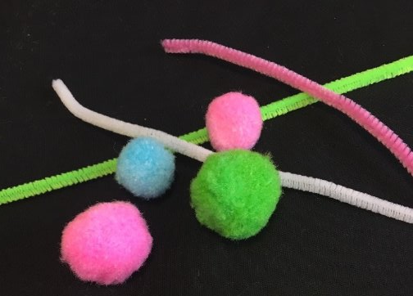
HOW DOES AMR HAPPEN?
Let’s demonstrate by building our own bacteria
1. Bacteria have two sets of DNA: choose 2 pom-poms to represent this
2. The DNA is surrounded by something called a cell wall –choose 1 pipe-cleaner and wrap is around the DNA
Everyone hold up their bacteria and look at the others around you. They are all the same, roughly, but there are some differences, in the colours chosen in how the pipe-cleaner is wrapped. This is called
NATURAL VARIATION
Notes:
To do this, we are going to use some very high tech scientific tools……pom-poms and pipe-cleaners.
HAND AROUND MATERIALS FOR THEM TO CHOOSE
Can anyone tell me what DNA is? DNA are like the instructions or blue print, that tell a cell or organism how to develop and work
GET THEM TO CHOOSE POM-POMs, CHOOSE PIPECLEANERS AND MAKE BUGS AND COMPARE BUGS- STEPS 1-3
NATURAL VARIATION, is the same as any species of animal being fundamentally the same, but with differences in size, colour, ability depending on slight differences in their DNA which cause them to develop slightly differently.

Slide 6
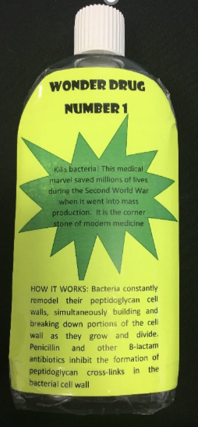
NATURALLY OCCURING RESISTANCE
Let’s demonstrate
It kills all bacteria
EXCEPT
those with a --------
colour pom-pom.
The -----colour pom-pom gives the bacteria naturally incurring (intrinsic) resistance
Sometimes, this
”natural variation” can lead to a bacteria, a developing which has a “super-power” making it resistant to antimicrobials
Notes:
These naturally resistant bacteria with “super powers” are sometimes called mutants…. Just like in comic books, cartoons or films. Their super-power may mean that they can just throw back out the medicine (like in X-men where Wolverine can just heal himself all the time) or change their appearance so the medicine doesn’t recognize them….. Like mystique
Lets demonstrate by adding some antimicrobials to the environment
TELL EVERYONE ELSE WITHOUT AN ______ COLOUR POM-POM TO TAKE THEIR BACTERIA TO PIECES, IT HAS BEEN KILLED

Slide 7
SELECTION PRESSURE
Build your bacteria again.
Remember wonder-drug number 1 is still in the environment
Selection pressure is also known as Evolutionary pressure or Natural Selection ..
Notes:
Ok, so now we are going to ask you to build your bacteria again, REMEMBER that wonderdrug no.1 is still in the environment and that a XXXXX colour pom-pom confers natural resistance
ASK EVERYONE TO HOLD UP THEIR POM-POMS AGAIN AND COMPARE …they should by and large have the resistance conferring pom-pom
Those of you who choose the ----- colour pom-pom due to the presence of wonder-drug no. 1 were responding to what is called “selection pressure”… that means only certain creatures survive and thrive due to the environment they live in.
Does anyone knows of another name for this process where only the best suited to their environment survive ?

Slide 8
AQUIRED RESISTANCE
If you didn’t
choose an ----- coloured pom-pom, don’t worry.
Bacteria can share their DNA with each other, giving the “resistance” superpower to other bacteria
Bacteria can share their DNA not only with their own species, but also ACROSS species.
As a result of this ability and how fast bacteria grow and evolve, AMR is now a threat to people across the world.
Notes:
Selection pressure means that bacteria aquire resistance through the process of evolution.
However if you didn’t respond to selection pressure…. Don’t worry
HANDS UP WHO NEEDS RESISTANCE DNA…..
HAND OUT THE ”RESISTANCE” Pom-pom to anyone who needs it

Slide 9
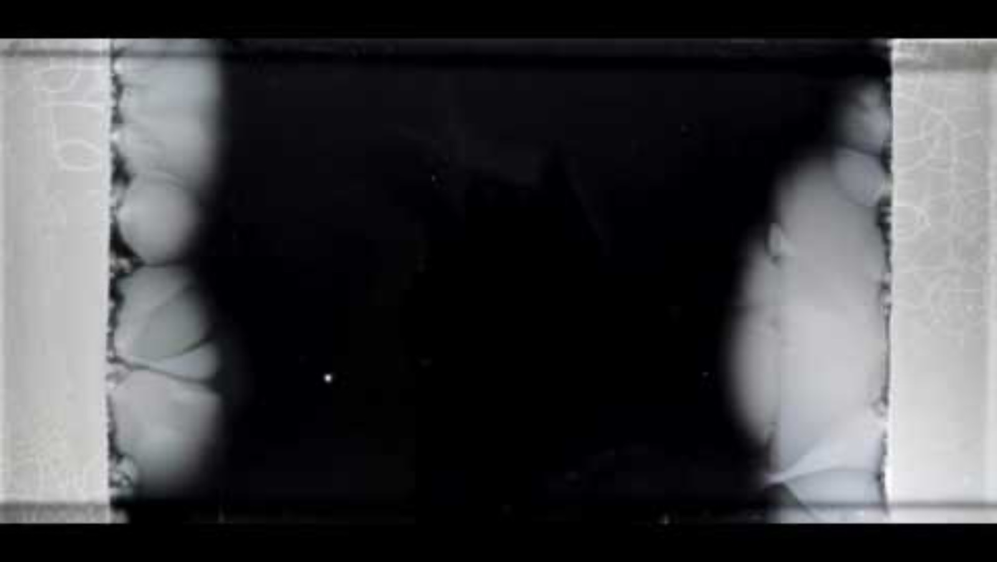
Lets demonstrate…
By showing you selection pressure, naturally occurring resistance and acquired resistance in real time……
You can see that putting antimicrobials in the environment causes AMR to occur.
Every time we use antimicrobials there is a chance they will do this.
So we should only use them when were really need them and we should use them properly.
Notes:
Before I start the video, let me just explain some terms you will hear. The bacteria they are growing are called E.coli (you heard me mention that at the start as a bacteria that often causes tummy upsets). You will hear the speaker mention a petri dish… this is just a container to grow bacteria in and agar… which is a sort of jelly that you can grow bacteria in.
IF VIDEO DOESN’T PLAY TRY THIS LINK https://www.youtube.com/watch?v=plVk4NVIUh8
So hands up if you found that a bit scary? Can any of you explain why it scares you?
Antimicrobial Resistance, if we can’t slow it down, will mean that our medicines for certain infections will not longer work and we will no longer be able to treat them.
This means infections which we have effectively been treating with antibitoics including things you may of heard of like Scarlet Fever and TB will no longer be curable.

Slide 10

Antimicrobials & Modern Medicine
Notes:
What is worse is that many things modern medicine can do now, due to our ability to control infection won’t be possible in the future because of AMR.
Hands up if any of you know you were born by caesarian section, or any of your siblings?
Does anyone here have grand parents who have had hip replacements, or relatives who have had any kind of surgery (*****or cancer treatment?****)
YOU COULD PLAY JENGA HERE, MAYBE HANDING AROUND BLOCKS FOR THEM TO READ AS YOU BUILD THE TOWER, OR GETTING VOLUNTEERS TO REMOVE ABX BLOCKS FROM A READY BUILT TOWER

Slide 11
02
CITIZEN SCIENCE

Slide 12
WHAT IS CITIZEN SCIENCE?
“CITIZEN ENGAGEMENT” just means members of the public being interested in hearing about research.
"RESEARCH” just means a careful investigation or study to discover something or understand something.
Lots of organisations, like NASA and wildlife charities ask citizens to help with research projects by doing things like gathering data. This is called “CITIZEN SCIENCE”

Slide 13
ACE PROJECT-
Where do I come in?
03

Slide 14
WHY DO WE NEED YOUR HELP?
WE WANT YOU TO ASK YOUR PARENTS, GRAND-PARENTS, TEACHERS AND OTHER TRUSTED ADULTS HOW THEY GET THEIR ANTIMICROBIALS & WHAT THEY DO WITH THEM.
You should now understand WHAT AMR is, WHY it happens and WHY it is a Global threat.
But LOTS of people don’t understand this and some things that they do can make AMR worse.
These things include how they get antimicrobials and what they do with them.
If we can understand what people are doing, we can do more to help them do the right things slowing down AMR.
Notes:
SO WE ARE ASKING YOU ALL NOW, TO BECOME CITIZEN SCIENTISTS FOR US.
THE SURVEY IS ANONYMOUS (DOESN’T RECORD WHO IS GIVING WHICH ANSWERS) AND ASKS HOW THEY GET THEIR ANTIMICROBIALS AND WHAT THEY DO WITH THEM

Slide 15
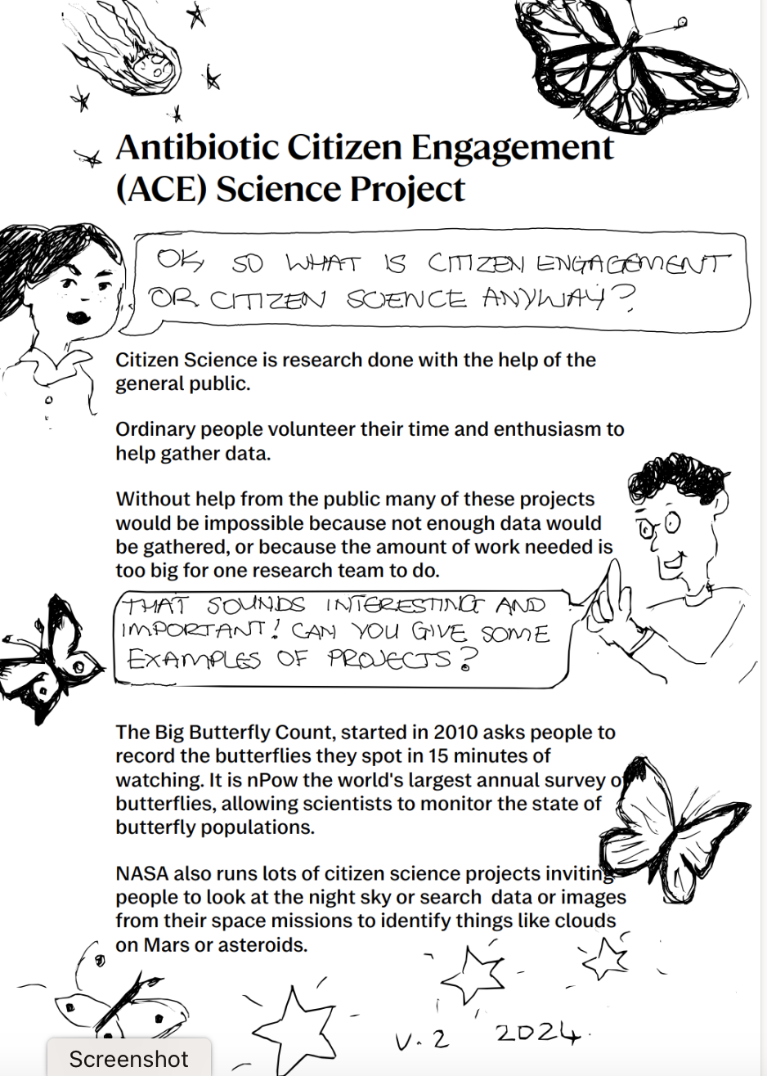

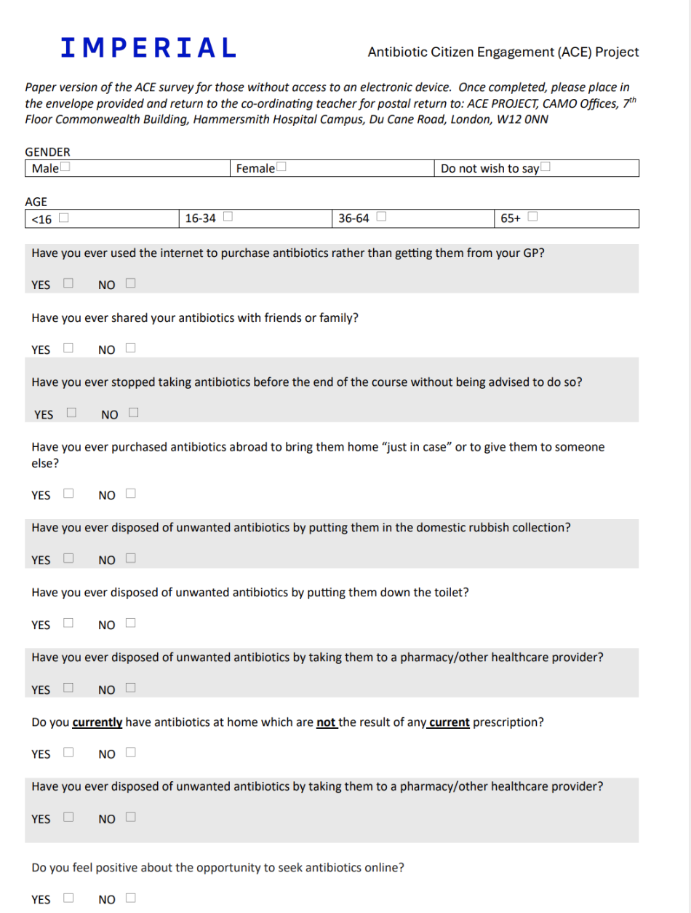
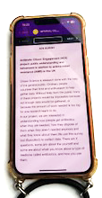
YOUR RESEARCH TOOLS!
We will give you a special badge you can wear to show you are an “ACE” Researcher.
We will give you a booklet with more details about the project, to read and show those you involve.
We will give you training in the next part of the session.
Now Pay ATTENTION !
We will give you a survey with the questions you need to ask already written (online, on App or on paper if you prefer).

Slide 16
RESEARCH CONDUCT
How do I do it right?
04

Slide 17
WHAT MAKES AN ACE RESEARCHER?
1. SAFETY- Only collect answers from people you KNOW and TRUST
2. RESEARCH DESIGN- only survey people over the age of 16 only survey each person once.
3. ACCURACY- always record the answers faithfully and NEVER make up results
4. CONSENT - always use the booklet & consent form on the back
5. CONFIDENTIALITY- never discuss who gave which answer.
Notes:
You will remember the definition of research is CAREFUL investigation or study. What this this mean?
RESEARCHERS MUST ALWAYS BE SAFE,,, whether in a laboratory or doing field work like this… DO NOT APPROACH STRANGERS!!
RESEARCHERS ALWAYS CAREFULLY DESIGN THEIR EXPERIMENTS SO THAT THE RESULTS ARE MEANINGFUL AND CAN BE REPRODUCED AND RESULTS COMPARED…for example the annual Big Butterfly Count asks people to record the number of butterflies they see in any given 15 minutes, on any sunny day between 18th July and 10th August. They do not do the survey in winter, or at night or in the rain or in different months each time.
In our case our survey is ONLY designed to be answered by those who can get antimicrobials on their own – i.e. those who are 16 and above, and is designed to only be answered ONCE by any one person….so if YOU have already surveyed Miss Saunders, she cannot answer the survey again even for a different researcher
Research is serious business and what you are doing is important- record the answers you are given carefully and NEVER make up results.
Any research involving people requires their CONSENT – in other words their agreement,
Whether you are testing a new experimental medicine or only asking people questions, those people taking part must be told WHAT you are doing, WHY you are doing it, HOW you are doing it and WHAT happens to the results.
Luckily for you all that information is given in the booklet and the consent form on the back. You should NEVER force (or nag!) anyone to take part if they do not want to…. ”NO” means “NO!”
CONFIDENTIALITY- this means not discussing who gave which answers, either with other researchers (i.e. each other) or with other people you are surveying. IT IS VERY IMPORTANT. As a researcher you are asking people to TRUST you with their information and so it is wrong to discuss their information with others. What is more, if you do discuss it you are unlikely to get truthful results……. If you knew 100 people gave one answer, would you feel comfortable giving a different answer, even if it was the truth?
For the same reason even our researchers do not know who gave which answers.

Slide 18
05
NEXT STEPS!
(what do I do now?)

Slide 19
WHAT DO I DO NOW?
Read your ACE booklet and instructions and put on your badge!
When you get home, download the free app to your phone or device, or if you don’t have one, ASK PERMISSION, from your parents to download it to a device of theirs.
Survey those in your household who are +16, remembering to get their consent first
Discuss with your parents who else they think you should survey, over the next two weeks; this may include grandparents, family friends or other 16 + members of sporting, religious or community groups to which you belong.
Notes:
Your parents have already had a letter home about the project, so will know something already and we hope will help you in this important work!

Slide 20
While we would prefer your results via the electronic survey we also have paper versions for you to use if easier… just return them to Miss Saunders who will post them to us.
To download the app to your Phone go to the Appstore.
Search Epicollect5 download
Click add project and search IMPERIAL COLLEGE ACE.
To access the survey online by computer. Go to your usual web-browser
(e.g. Safari or Chrome or Firefox) and type: www.epicollect.net and press return.
To download the app to your device, go to the Appstore.
In the search, type Epicollect5 and download
Click add project and search IMPERIAL COLLEGE ACE
.
Notes:
Miss Saunders will also set up school computers to access the survey, so you can survey your teachers.
If we get enough data, we will come back and show you what your findings are!

Slide 21
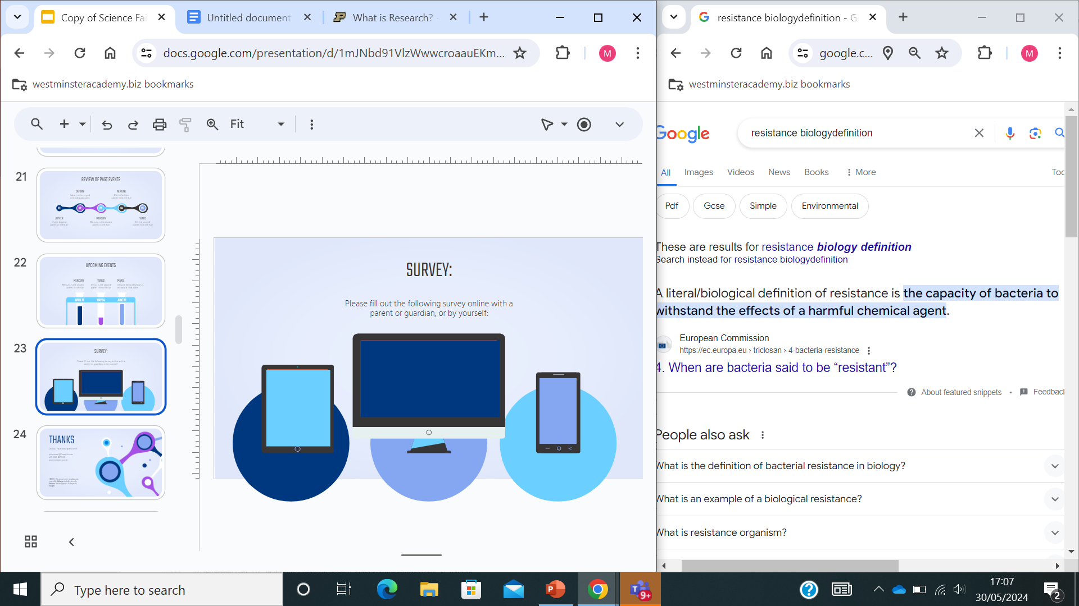
THANK YOU
Do you have any questions?

