Slide 1
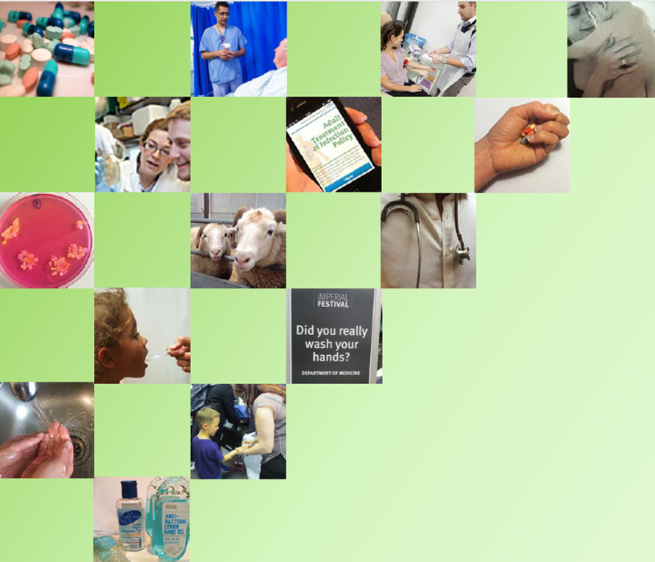


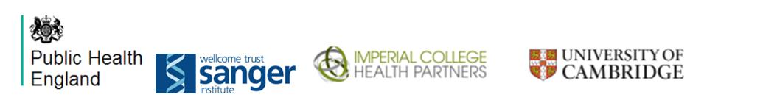

Hand Hygiene
Health Protection Research Unit in Healthcare Associated Infection and Antimicrobial Resistance at Imperial College London.

Slide 2
I am learning…
Why I should wash my hands
When to wash my hands
How to wash my hands

Slide 3
What are Microbes ?
Microbes are tiny living things
They are so small that they cannot be seen by the naked eye
Microbes can be helpful, or unhelpful
Notes:
Microbes are tiny living things that cannot generally been with the naked eye. Microbes as a term covers a number of subgroups- bacteria, fungi and viruses

Slide 4
You will all have experienced helpful Microbes
Hands up if you have ever eaten bread?
Hands up if your mummy or daddy drinks wine or beer?
both bread and wine or beer are made using a helpful microbe (yeast)
Hands up if you have ever had a yogurt or yogurt drink ?
yogurts and yogurt drinks called probiotics, are made using helpful microbes
(live active yogurt cultures)
Hands up if you have ever had to have medicine from the doctor ?
medicine prescribed by the Doctor may have been an antibiotic. One of the first antibiotics available was penicillin- it is made from a helpful microbe- Penicilium mould

Slide 5
You will all have experienced unhelpful microbes
Hands up if you have ever had a cold runny nose, sneezing and temperature?
These are usually the sign of a colds caused by an unhelpful microbe (rhinovirus) or the ‘flu caused by an unhelpful microbe (influenza)
Hands up if you have ever had a tummy ache or were sick ?
Tummy upsets can be due to food which hasn’t been cooked enough to kill off unhelpful microbes (salmonella or E. coli) it can also be caused by other unhelpful microbes passed on by people not washing their hands properly after going to the toilet (norovirus)

Slide 6
Unhelpful microbes are sometimes called
GERMS
or
BUGS
or Bacteria
For microbes to make you ill, they have to get into your body first…….

Slide 7


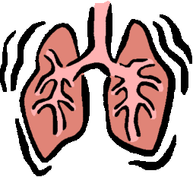


How do unhelpful microbes get into your body?
You might EAT them because food is not cooked properly
You might BREATH them in if someone hasn’t covered their mouth or nose when coughing or sneezing
Or most likely you will
accidentally
TRANSFER them from
dirty hands to your
mouth
They might get in through a CUT or scrape
Notes:
For unhelpful microbes to make you ill, they first need to get into your body….ask the children to call out the routes through which they think this can happen.

Slide 8
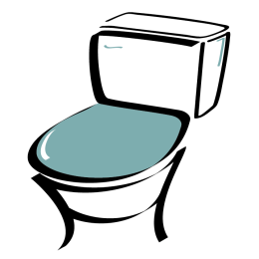
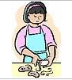
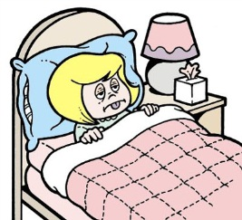
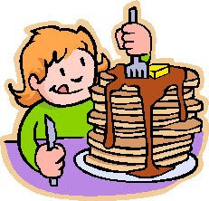
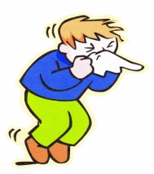
WHEN should we wash our hands?
After using the toilet
After touching animals
before, during and after preparing food
Before and after visiting ill people, for example in hospital
After coughing, sneezing or blowing your nose
Before eating
Notes:
Ask the children to call WHEN they think they should wash hands

Slide 9
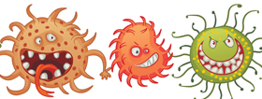
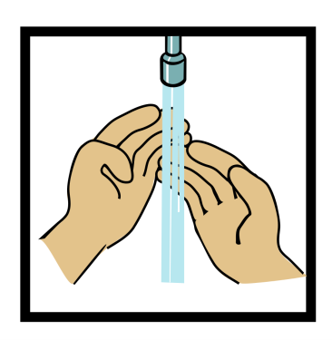
Washing hands
People carry around 3,200 bacteria of 150 different types on their hands!
…so washing hands is one of the best ways to stop bacteria getting into the body or travelling from one person to another.
However, washing with water alone is not enough, this will get rid of visible dirt but not invisible unhelpful bacteria…
Notes:
NOW TRY THE HAND WASHING EXPERIMENT

Slide 10
HAND WASH ACTIVITY!
Which group ended up with the most bacteria on the hands of the person at the end of the line?
Which group ended up with the least bacteria on the hands of the person at the end the line?
If you want to remove the most bacteria should you:
  a.) not wash hands
  b.) wash hands in water
  c.) wash hands in soap and warm water?
Notes:
To show you this, we are going to do an experiment……

Slide 11
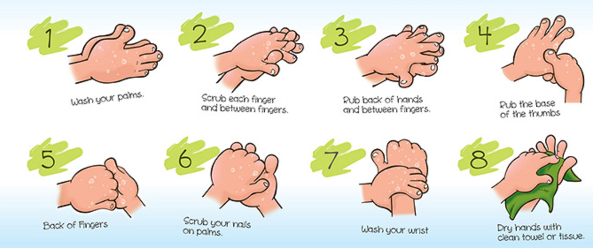
How to wash your hands- PROPERLY

Slide 12
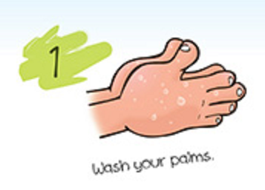

Slide 13
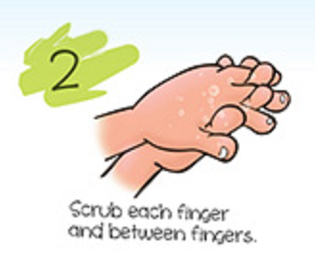

Slide 14
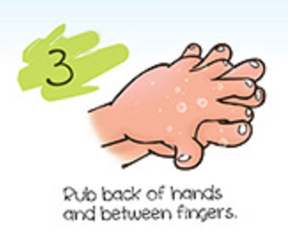

Slide 15
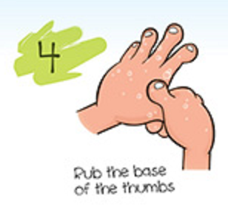

Slide 16
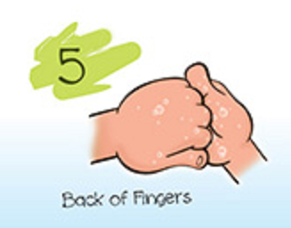

Slide 17
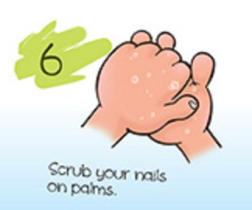

Slide 18
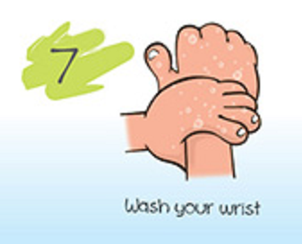
…washing hands should take at least 20 seconds!

Slide 19


Wash your hands…

