Slide 1

Hand Washing

Slide 2
We are learning:
when we should wash our hands.
how we should wash our hands.
how to investigate the best way to wash hands.

Slide 3
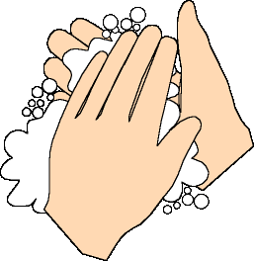
Have you washed your hands today?

Slide 4
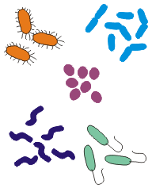
Why do we wash our hands?
There are around three trillion bacteria on your body right now!

Slide 5
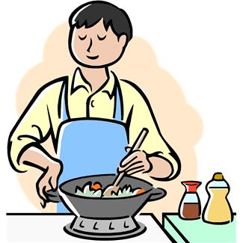

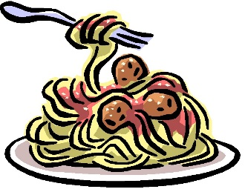
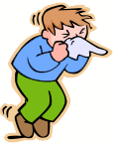
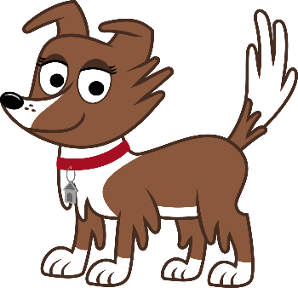
When should we wash our hands?

Slide 6
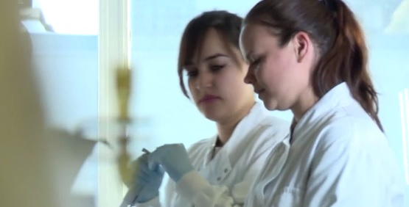

Slide 7

Do not wash
Cold water
Hot water
Hot water and soap

Slide 8
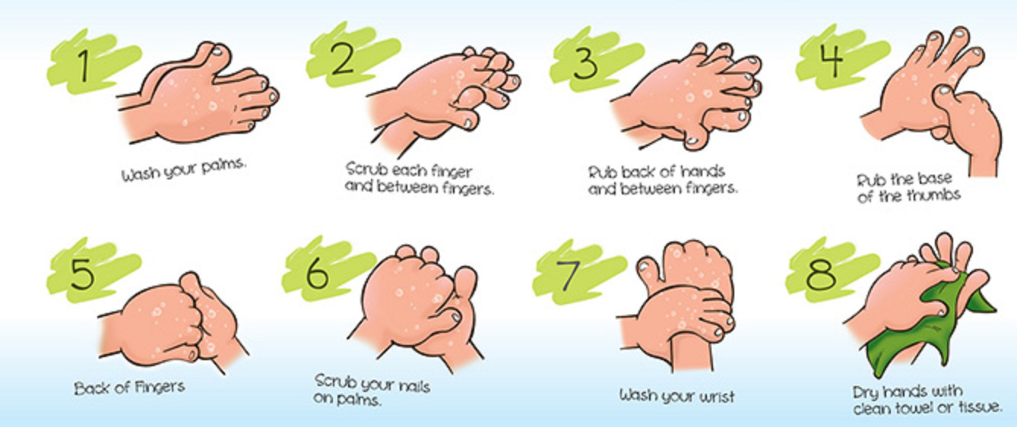
How to wash your hands

Slide 9
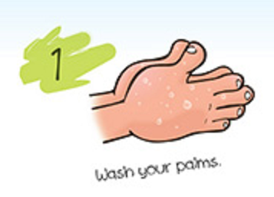

Slide 10
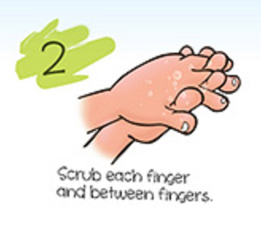

Slide 11
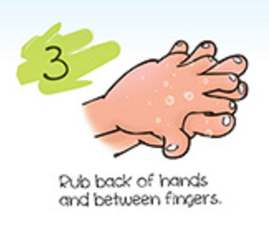

Slide 12
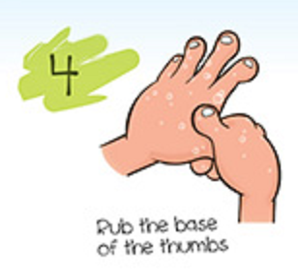

Slide 13
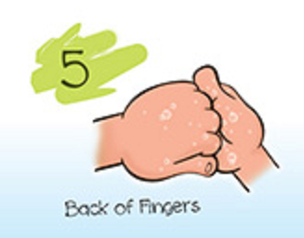

Slide 14
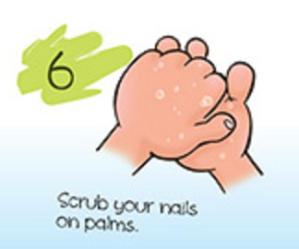

Slide 15
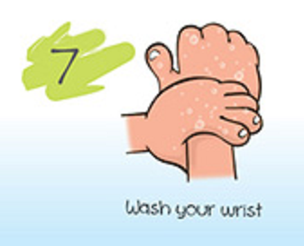

Slide 16

Wash your hands…
…for at least 20 seconds!

Slide 17
Quiz!
True or False?

