Slide 1

Net Impact Project
Nocturia Guidance for GPs & primary care professionals
Austen El-Osta & Eva Riboli-Sasco
Self-Care Academic Research Unit (SCARU)
Imperial College London
Professor Marcus Drake
Department of Surgery and Cancer
Imperial College London

Slide 2
Nocturia may be present if the rate of urine production by the kidneys is increased, either at night or all the time
Nocturia may be driven by problems in several body systems affecting urine production or sleep quality
There may be no clear reason for an individual patient experiencing nocturia, or it can be multifactorial
What is nocturia?

Slide 3
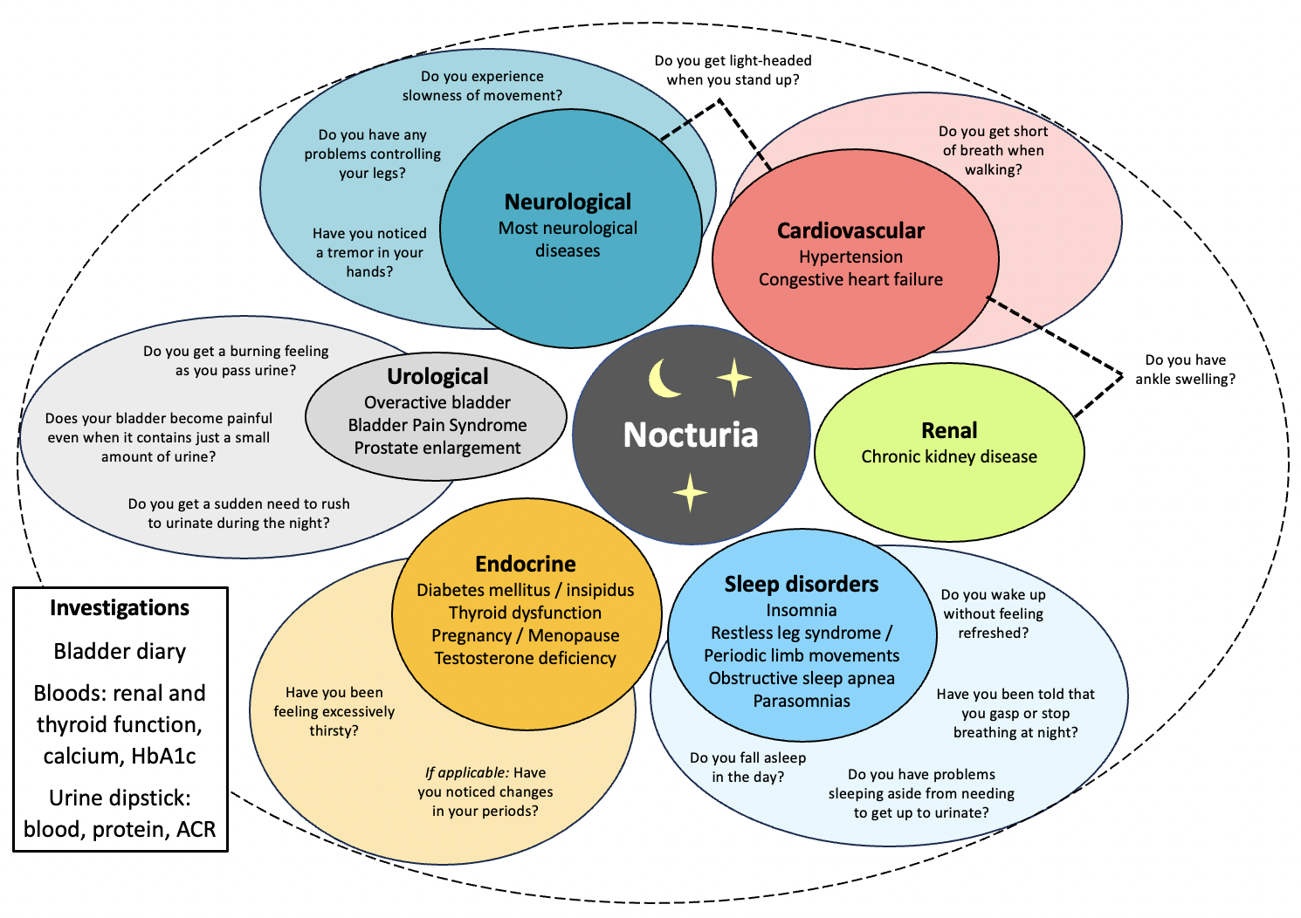
PLANET diagram: Assessment of Nocturia
PLANET: PLanning Appropriate Nocturia Evaluation and Treatment
2

Slide 4



Review of the patient’s medical history & physical examination are essential to assess the potential cause(s) of nocturia.
However, they should be supplemented with the following resources…
How to assess Nocturia?

Slide 5
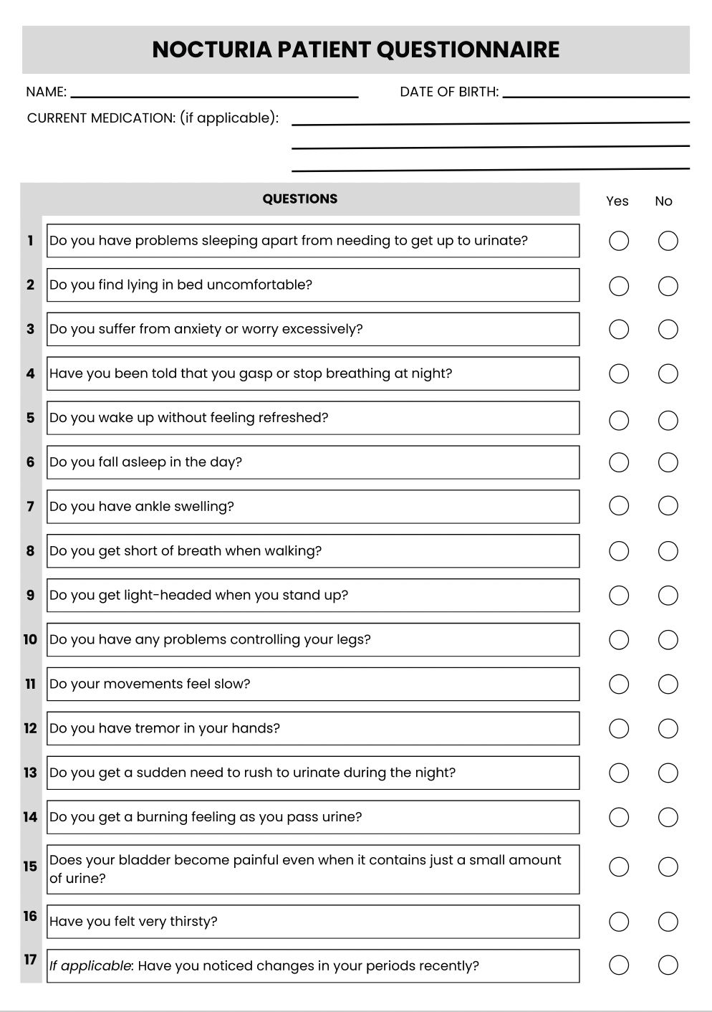
Resource 1: Nocturia Patient Questionnaire
Option 1
(Recommended)
Option 2
Fill in during the consultation by asking the questions directly to the patient
Print or send
to the patient for them to fill in at home

Slide 6
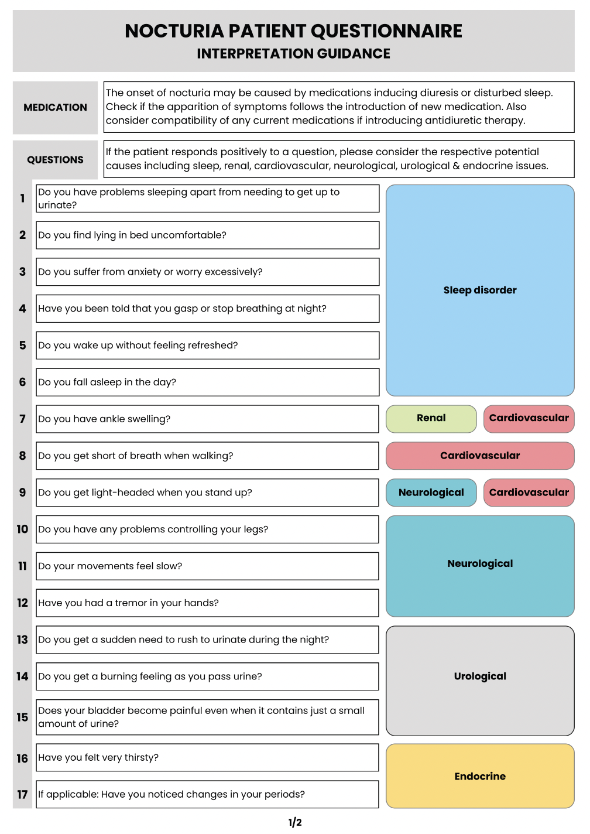
Nocturia Patient Questionnaire – Interpretation guidance
Sleep disorder
The patient’s responses can guide the identification of the medications & body system(s) causing nocturia
Renal
Cardiovascular
Neurological
Urological
Endocrine

Slide 7
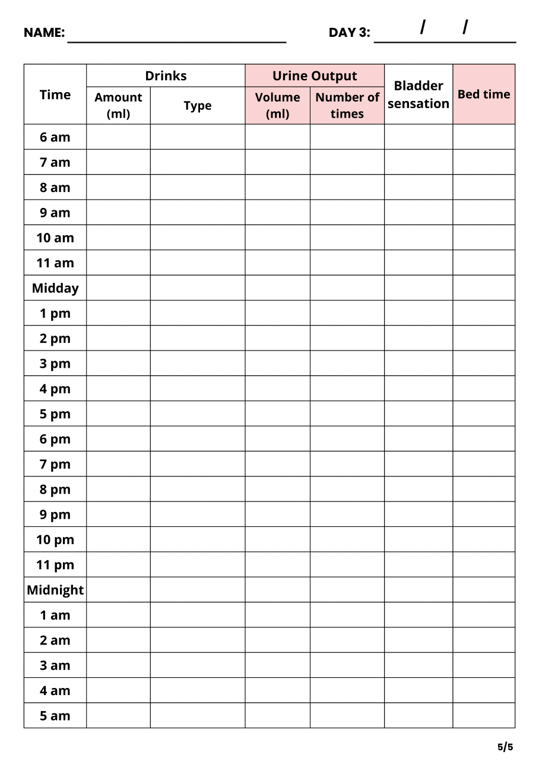
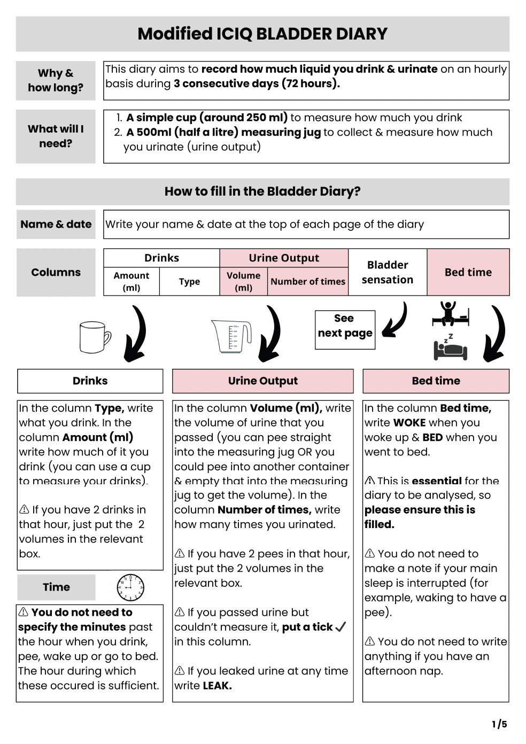
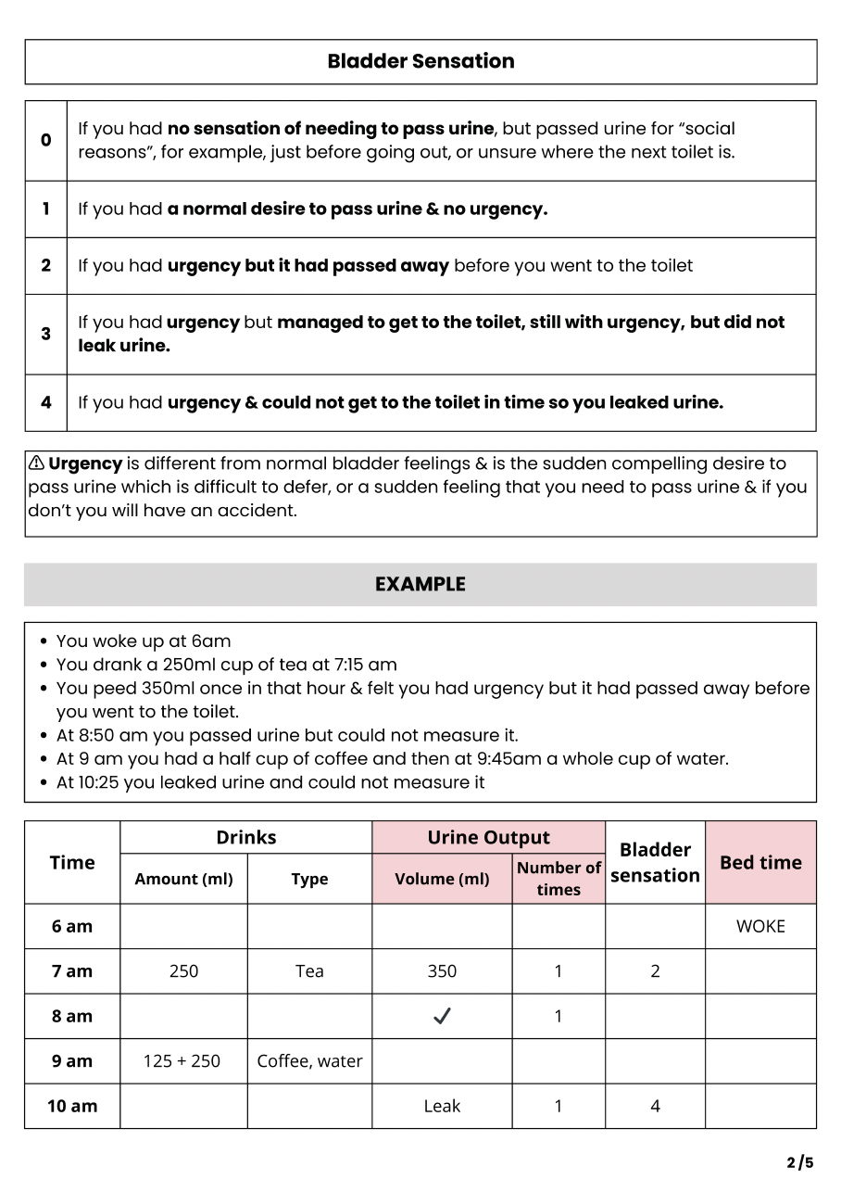
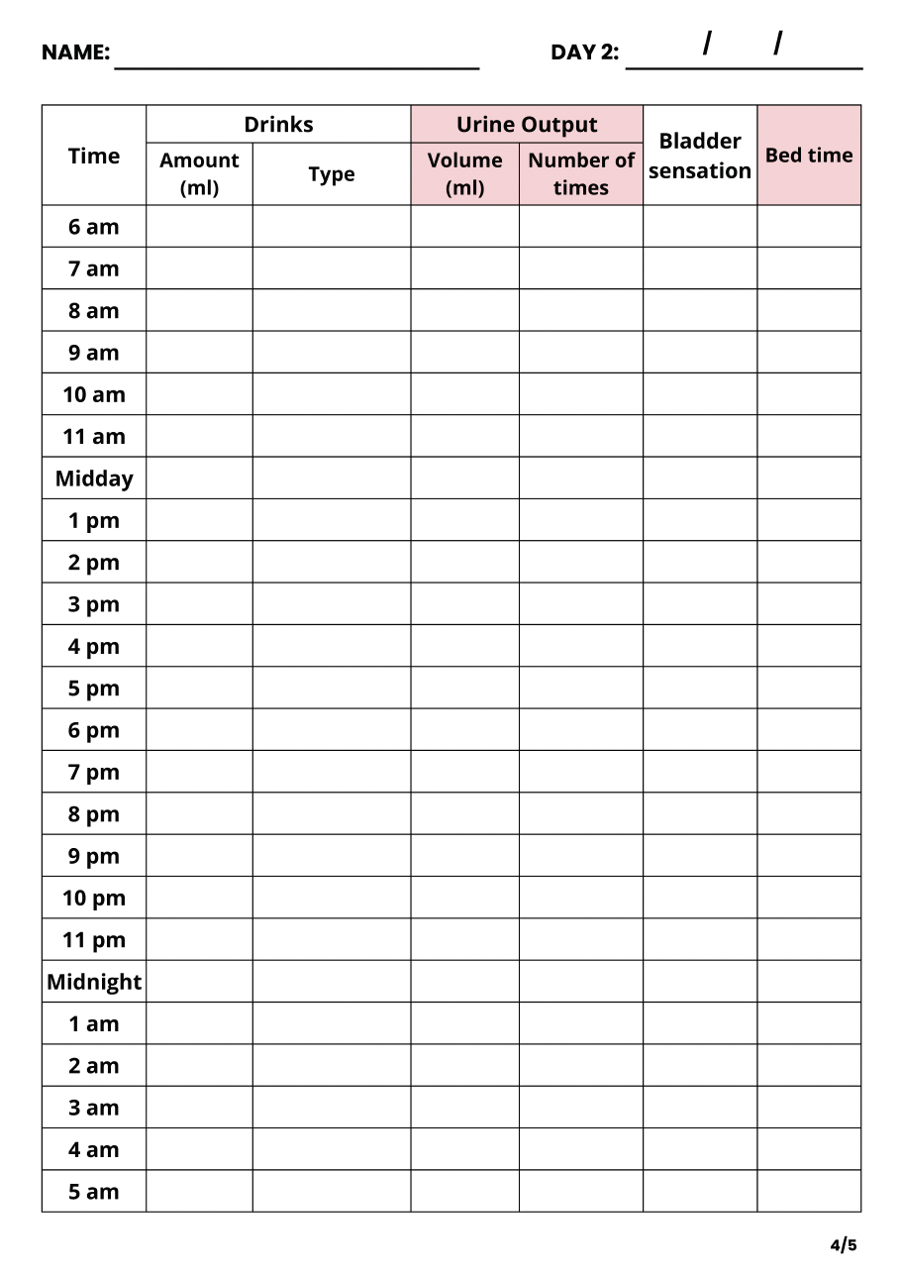

Resource 2: Modified ICIQ Bladder Diary
The Bladder Diary must be filled at home by the patient during 3 consecutive days

Slide 8
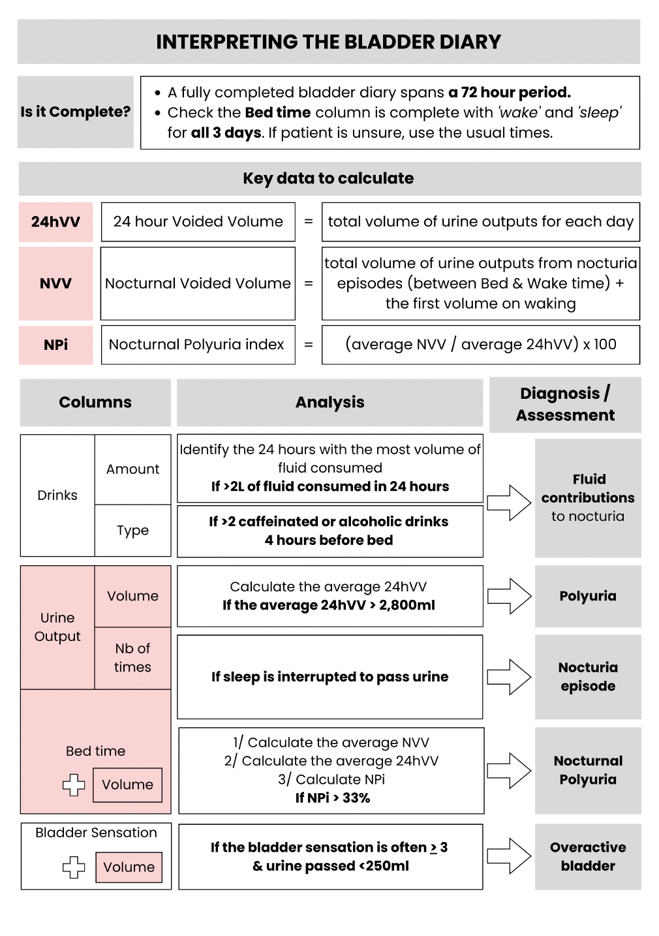
Modified ICIQ Bladder Diary – Interpretation guidance
A completed Bladder Diary can help you:
Identify nocturia episodes
Identify the fluid contributions to nocturia
Diagnose polyuria & nocturnal polyuria
Assess whether the patient has an overactive bladder

Slide 9

Referral to urology is inappropriate if the nocturia is due to a non-urological medical problem affecting urine production or sleep
Referrals to secondary care should be in line with guidance for the causative condition
Referrals

Slide 10
Final comments
Patient self-care can make a big difference for some, but not all
If nocturia isn’t bothersome, don’t investigate in detail or aim to treat
Some causes of nocturia cannot be treated effectively or safely

Slide 11
Key references
Publications
  Smith M, Dawson S, Andrews RC, Eriksson SH, Selsick H, Skyrme-Jones A, et al. “Evaluation and Treatment in Urology for Nocturia Caused by Nonurological Mechanisms: Guidance from the PLANET Study.” European urology focus. Vol. 8,1 (2022): 89-97. doi:10.1016/j.euf.2022.01.007.
  Accessible at: https://pubmed.ncbi.nlm.nih.gov/35101453/
  Drake MJ, Worthington J, Frost J, Sanderson E, Cochrane M, Cotterill N, et al. “Treatment of lower urinary tract symptoms in men in primary care using a conservative intervention: cluster randomised controlled trial”. BMJ. 2023;383. doi:10.1136/bmj-2023-075219
  Accessible at: https://www.bmj.com/content/383/bmj-2023-075219

