Slide 1

Associate Principal Investigator (PI) Scheme
NIHR RDNCC
WARRIORS

Slide 2
"This is the first time I am able to understand the process of research”
-Associate PI Alumni
Associate Principal Investigator (PI) Scheme

Slide 3
What is the Associate Principal Investigator Scheme?
A six month, in-work training opportunity, providing practical experience for health and care professionals starting their research career.
A chance of experience what it means to work on and deliver an NIHR Portfolio trial, under the mentorship of an enthusiastic Local PI.
A chance to receive formal recognition of engagement in NIHR Portfolio research studies, through certification of ‘Associate PI’ status (endorsed by the NIHR and Royal Colleges)
Associate Principal Investigator (PI) Scheme

Slide 4
Aims of the Associate PI Scheme
To integrate clinical research into clinical training
To develop doctors, nurses, and healthcare professionals to be the PIs of the future
To engage, recognise, and promote healthcare professional engagement in NIHR portfolio research, consistently
To increase opportunities for patients to be involved in high quality research to ultimately improve care
Associate Principal Investigator (PI) Scheme

Slide 5
Structure of the Associate PI Scheme
Open to any health and care professional who is not currently fully funded to work in research, and is willing to make a significant contribution to the conduct and delivery of a study at a local level
Participation in the Associate PI Scheme does not absolve local PIs of their legal responsibilities at site
Commitment of at least 6 months to complete the checklist of activities required for gaining Associate PI status
There is no funding associated with the Associate PI Scheme. Applicants will take part in the Scheme alongside performing their core role
Applicants must register prospectively - retrospective recognition is not supported
Associate Principal Investigator (PI) Scheme

Slide 6
Associate PI Scheme – Endorsements
The Scheme is endorsed by the NIHR Research Delivery Network, and the following Royal Colleges:
Royal College of Anaesthetists
Royal College of Emergency Medicine
Royal College of Physicians
Royal College of Radiologists
Royal College of Surgeons (England)
Faculty of Intensive Care Medicine
Royal College of Ophthalmologists
Royal College of General Practitioners
Royal College of Pathologists
Chartered Society of Physiotherapy
College of General Dentistry
Royal College of Midwives
Royal College of Obstetricians and Gynaecologists
Royal College of Nursing
Royal College of Psychiatrists
Royal College of Paediatrics & Child Health
Royal College of Speech & Language Therapists
Faculty of Dental Surgery of the Royal College of Surgeons Edinburgh
Council for Allied Health Professions Research
Royal College of Occupational Therapists
Faculty of Physician Associates
Royal Pharmaceutical Society
College of Radiographers
Faculty of Occupational Medicine
Associate Principal Investigator (PI) Scheme

Slide 7
Associate PI Scheme – GMC Acknowledgment
“
The Associate PI Scheme provides participating health and care professionals with hands-on research experience as a development opportunity that addresses many of the GMC’s generic professional capabilities through a research lens. It also supports doctors to demonstrate many of the expectations in Good Medical practice for appraisal purposes, and assists in further embedding a culture of research.
- General Medical Council
”
Associate Principal Investigator (PI) Scheme

Slide 8
Associate PI Scheme - Study Eligibility Criteria
On the NIHR portfolio
Non-commercial & Commercial studies
At least six months of recruitment activity left.
Have a Clinical Trials Unit (CTU), Sponsor or equivalent organisation managing the study
Under a specialty that is currently supported by the Scheme
Provide an Associate PI the opportunity to:
  Facilitate patient level consent.
  Get involved with a local research team, interacting with multiple members to deliver the study.
  Learn more about a patient pathway that will require coordination/have multiple interactions/FU time points/liaison between different departments to deliver.
Associate Principal Investigator (PI) Scheme

Slide 9
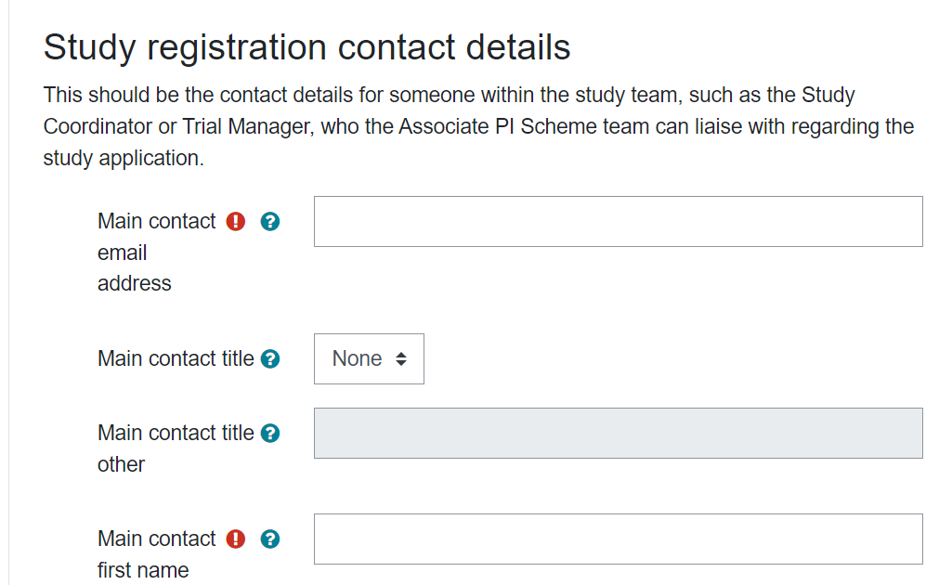
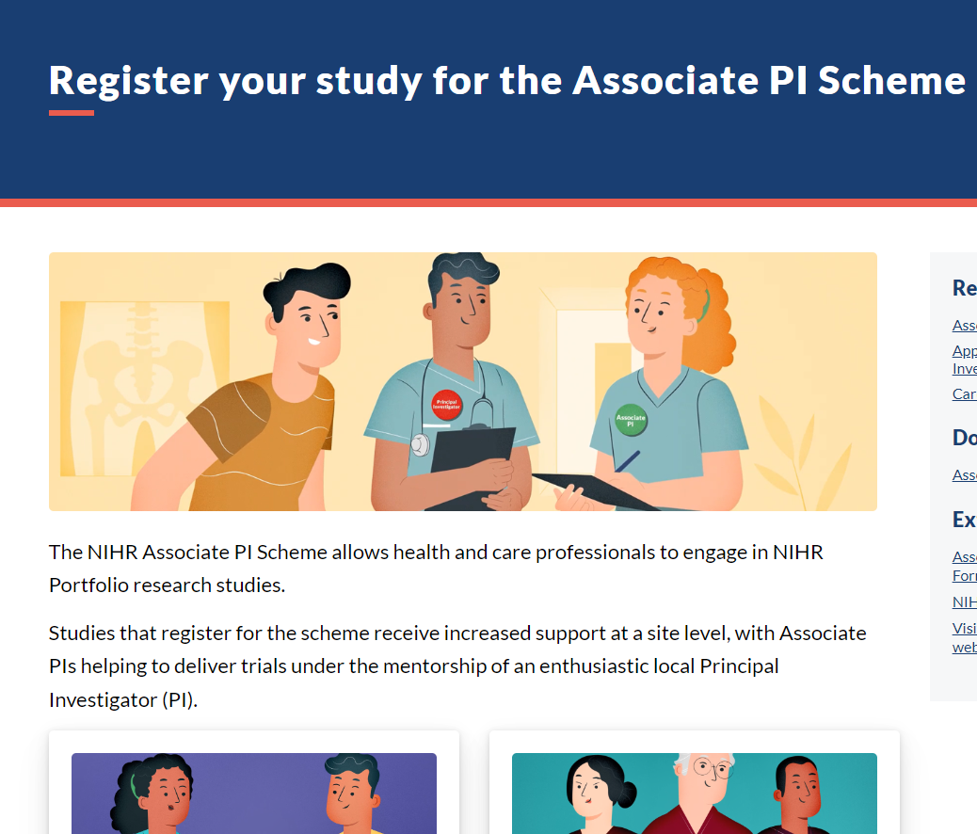
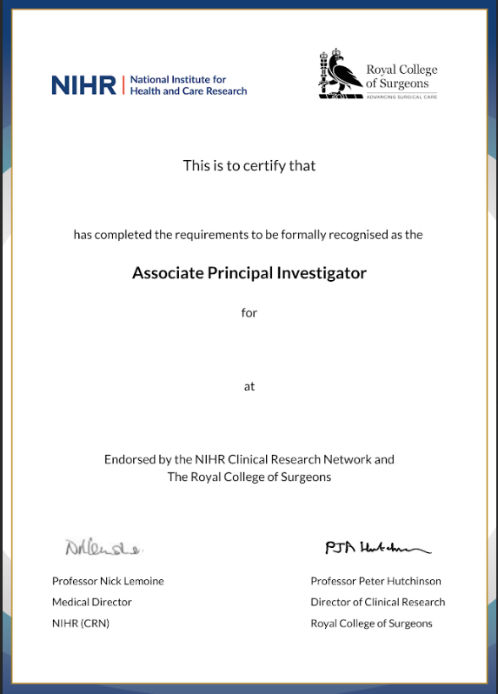
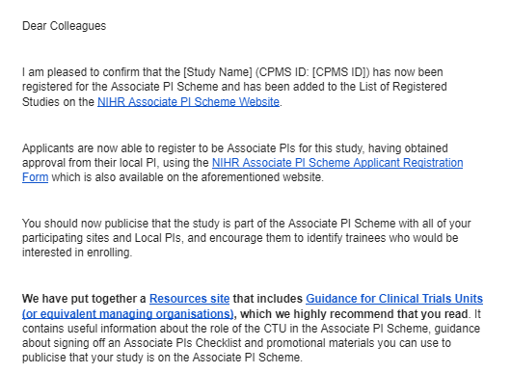
Associate PI Scheme Study process
Check Study Eligibility
Complete the Application form
Approval Sought
Study Active
Monitor Trainee progress
Certificate awarded
Before registering a study, check it meets the study eligibility criteria - Full details can be found on the NIHR Associate PI Scheme Website:
www.NIHR.ac.uk/AssociatePIScheme
Complete the Associate PI Scheme Study application form.
Approval will be sought from the Chief Investigator and Managing Organisation Signatory
(Director or Deputy Director of the CTU/Sponsor).
Once confirmation is received from the CI and Managing Organisation, the study is registered as ‘Active’ on the Scheme and Associate PIs can apply.
NOTE: It’s important for the study team to promote their newly registered status, at all of their recruiting sites.
The Associate PI trainee works alongside their Local PI for 6 months,
the Local PI acts as a mentor during their time on the Scheme.
The Associate PI trainee fills in their checklist as they go.
The National Study team are given access to the Associate PI Scheme study coordinator dashboard to monitor trainees supporting their study(ies).
The Checklist gets signed off by Local PI and National Study Coordinator.
The Associate PI trainee must then Submit their completed and fully signed Checklist.
Certificate is issued, officially confirming ‘Associate PI’ status.
Associate Principal Investigator (PI) Scheme

Slide 10
Associate PI Scheme - Trainee Eligibility Criteria
Your chosen study must already be registered on the Associate PI Scheme
Applicants can only be an Associate PI for one study at a time
One Associate PI Trainee, per study, per site, at any one time
Not eligible if your role is specifically funded to work on research
Associate PI Trainees must be able to commit to 6 months of working on a study at their site
Applicants must gain prior approval from their Local PI
Associate Principal Investigator (PI) Scheme

Slide 11
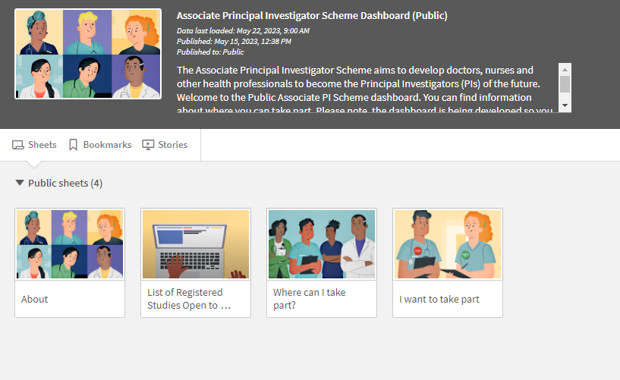
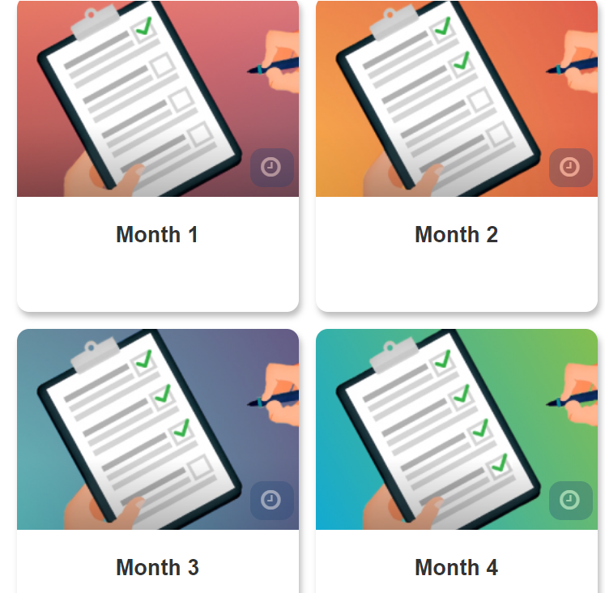
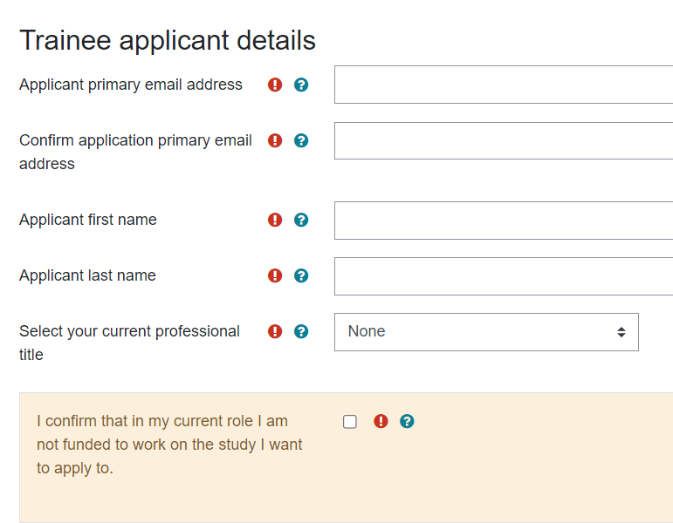
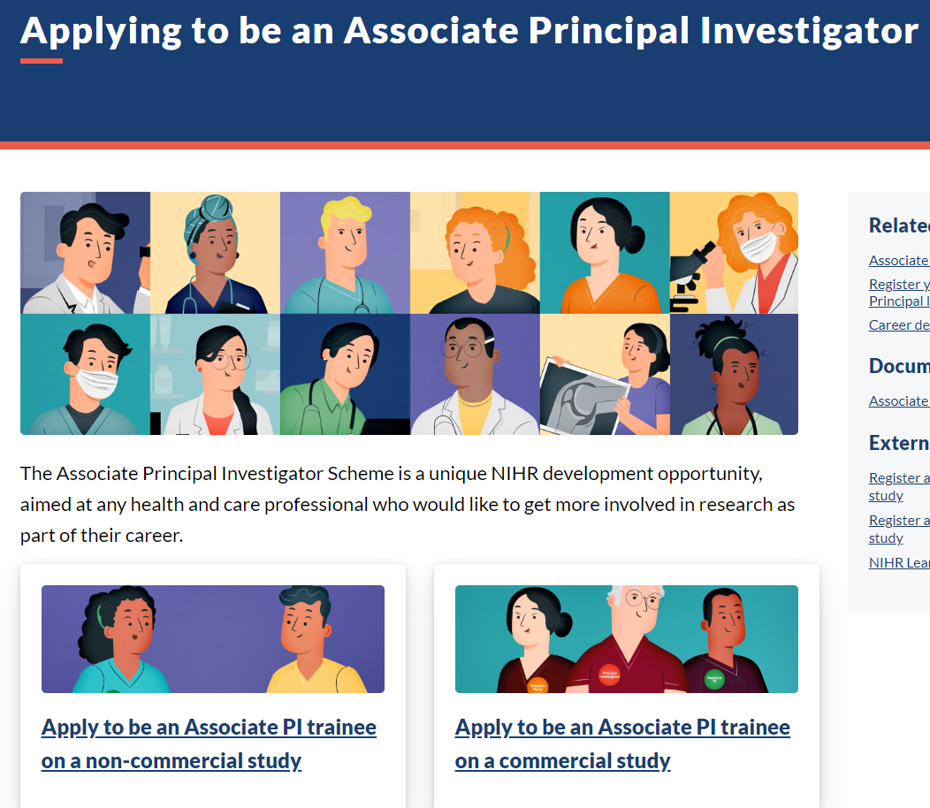
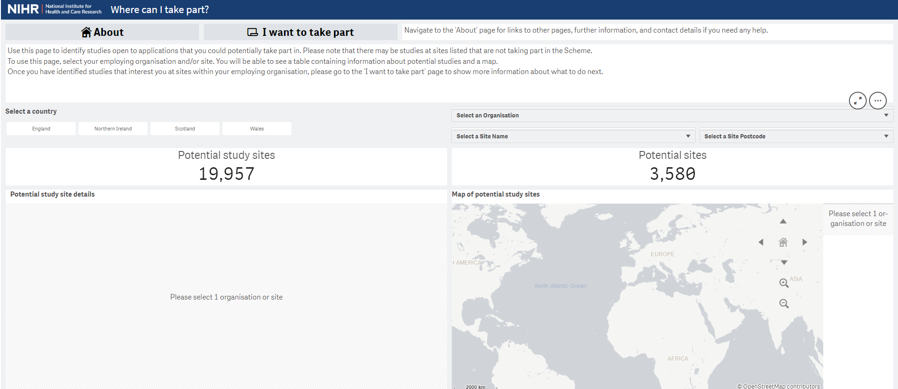
Associate PI Scheme Trainee process
Check your eligibility
Find a study
Complete the Application form
Access to online learning
Complete Associate PI Checklist
Certificate awarded
Before you begin, check you meet the trainee eligibility criteria - Full details can be found on the NIHR Associate PI Scheme Website:
www.NIHR.ac.uk/AssociatePIScheme
To identify a study that is registered onto the Associate PI Scheme and open to recruitment at your local site, visit the Associate PI Scheme dashboard, and the ‘Where can I Take Part?’ tool.
Applicants must gain prior approval from their Local PI.
Complete and submit the Associate PI Trainee application form.
Once successfully registered onto the Scheme, you will be given access to the Associate PI Scheme Learning Pathway in NIHR Learn.
The Associate PI Trainee works alongside their Local PI for 6 months.
The Local PI acts as a mentor during their time on the Scheme.
The Associate PI trainee fills in their checklist as they go, and completes the Associate PI Scheme Learning Pathway in NIHR Learn.
The Checklist gets signed off by Local PI and National Study Coordinator.
The Associate PI trainee must then Submit their completed and fully signed Checklist.
Certificate is issued, officially confirming ‘Associate PI’ status.
Associate Principal Investigator (PI) Scheme

Slide 12
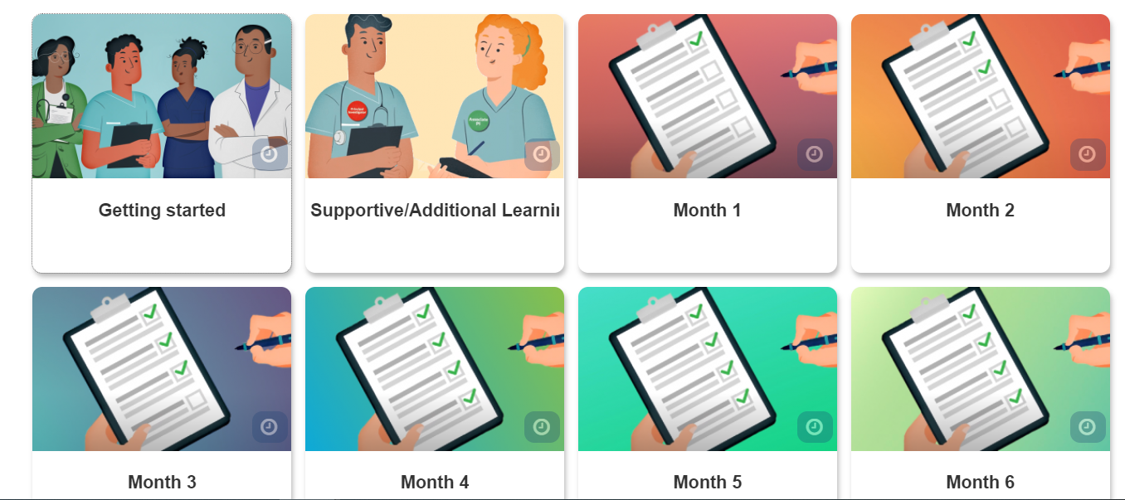
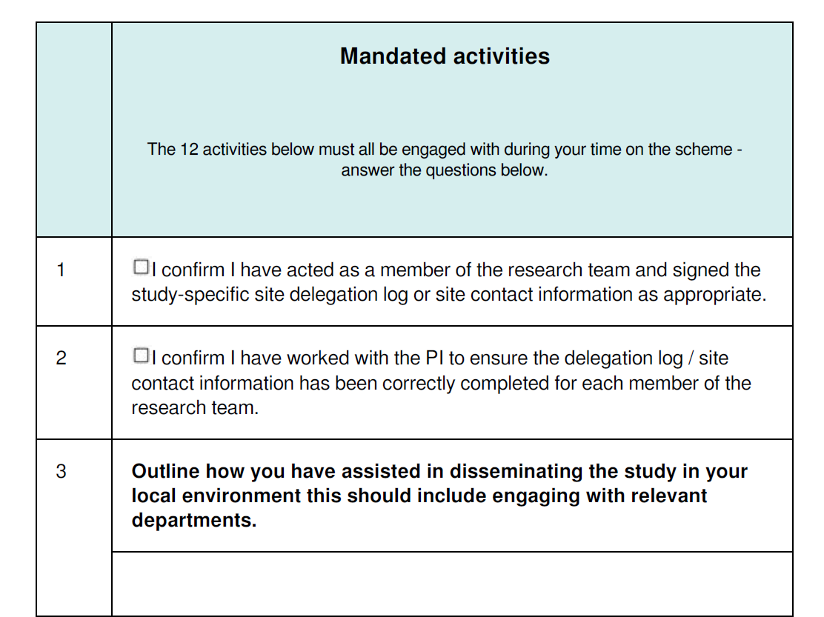
Associate PI Scheme - Checklist Activities
What does the Checklist cover?
Signature on study-specific delegation log
Dissemination to the department
Engagement with staff, research team meetings (Diary of research team meetings)
Site log, protocol amends, data returns and quality
Train staff (GCP, protocol)
Screening logs, recruitment/consent of patients or facilitating consent of patients
Deputising for PI
PPI activities
Activity is evidenced via an online Checklist hosted on NIHR Learn
Associate Principal Investigator (PI) Scheme

Slide 13
Benefits of the Associate PI Scheme
For the Associate PI
Experience of research with the oversight of the local enthusiastic PI
Learns about the challenges and practicalities of delivering a portfolio study
Evidenced activity via the Checklist
Participation is recognised through certification for their training portfolio
Portfolio Career benefits
Associate PIs will be acknowledged in the primary publication(s) from the study
For the PI
Additional support with the delivery of the study
Developing the PIs of the future
For Study Team/CTU
Increased support for the trial at sites - managing delegation logs, etc.
Increased Data Quality
Speedier Delivery
Enhanced Recruitment
For the Patients
Increased opportunities to be involved in high-quality research
Associate Principal Investigator (PI) Scheme

Slide 14
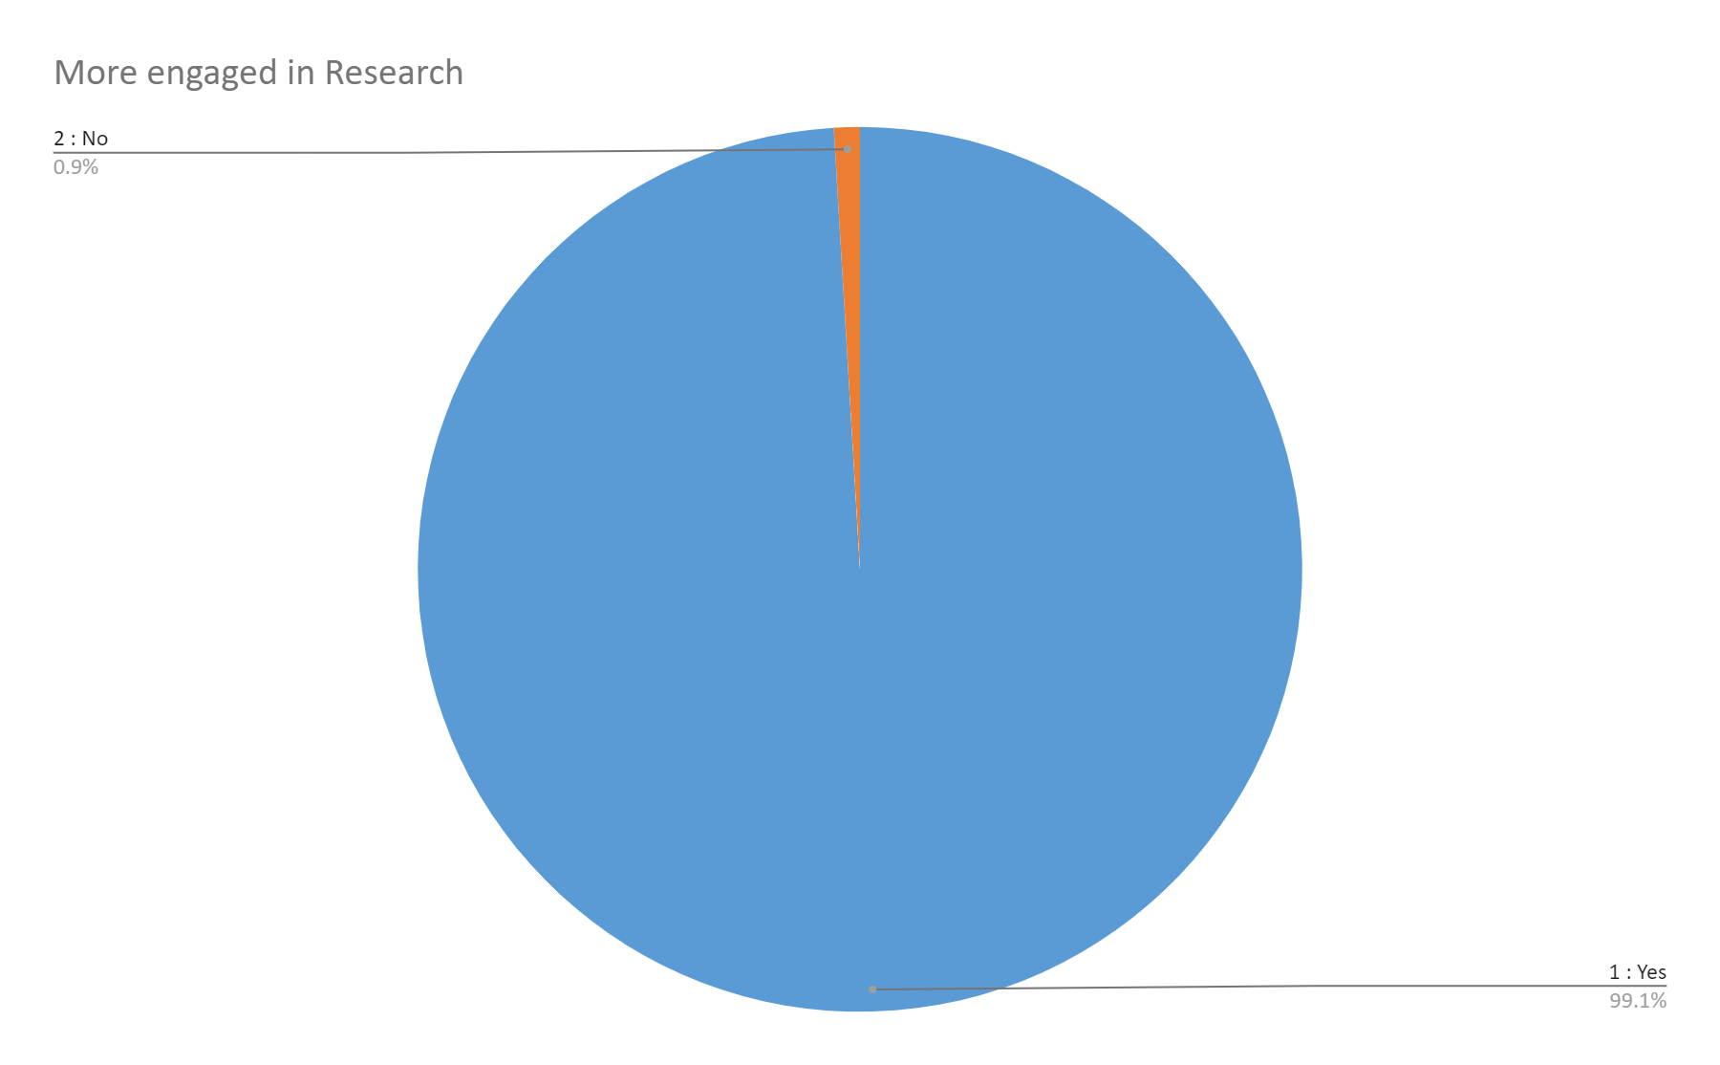

Alumni Survey feedback
99.1% of Associate PI Alumni will stay engaged with research following completion of the scheme. (n=846)
“Going through the Associate PI Scheme made me think critically about the delivery of a study on a multi-site level, and I’m still engaged with the study I worked on as part of my Associate PI Scheme tenure. Since finishing my tenure I've started a pre-doctoral fellowship, and am hoping to undertake some research of my own within head and neck cancer."
- Florence Cook, Associate PI Alumni. Senior Specialist Dietitian (Head and Neck Oncology), UCLH
Associate Principal Investigator (PI) Scheme
Associate PI Trainees are asked to complete an optional feedback survey upon completion of the scheme. To date, 1,619 trainees have completed the scheme and, of those, 846 individuals have responded to the survey as of June 15th 2023.

Slide 15
Feedback from the Associate PIs who are taking part in the Scheme
“Participating in the Associate PI Scheme has opened doors for me to gain a greater understanding of research within the NHS. I gained new skills that I can use in my current role, and the development opportunities have also helped contribute towards my revalidation. The application process is easy and I gained lots of transferable skills.”
- Amanda Hill, Hepatology Nurse Specialist and Associate PI Alumni
“This is my first formal research role in the UK and it gives me a good view of the logistics and the workings of the research side of things in collaboration with the clinical side.A fantastic opportunity for me and one that I am very happy that I had the chance to take up.”
- Adithya Pathanki, Associate PI Alumni. Senior Clinical Fellow- HPB and Liver Transplant
"Excellent scheme for getting HCPs more involved in research!"
"This is the first time I am able to understand the process of NHS research”
"Fantastic opportunity to take part in research and gain detailed experience. I’m learning about what conducting a clinical trial truly entails”
"It has been great playing a leading role while being fully supported by the research team. I have enjoyed putting the GCP principles into practice"
"I am learning skills that will help me as I progress in my career"
Associate Principal Investigator (PI) Scheme

Slide 16
Feedback from study teams who are taking part in the Scheme
“At the Royal Liverpool University Hospital we believe that encouraging trainees to participate in research is key for successful recruitment. In our Trust, Associate PIs have been successfully recruiting to Associate PI studies, particularly over the weekends and out of hours.”
- REMAP-CAP Principal Investigator.
"We couldn’t have effectively delivered the SIP-SMART 2 study locally without having an Associate PI at our site, that person was key to us recruiting to time and target."
- Roganie Govender, Chief Investigator
“The Sunflower Study has benefitted hugely from being an early adopter of the NIHR Associate PI Scheme. The contributions of Associate PI Trainees have been invaluable, particularly in the recruitment of study participants at evenings and weekends.”
- Sunflower Study Manager
Associate Principal Investigator (PI) Scheme

Slide 17
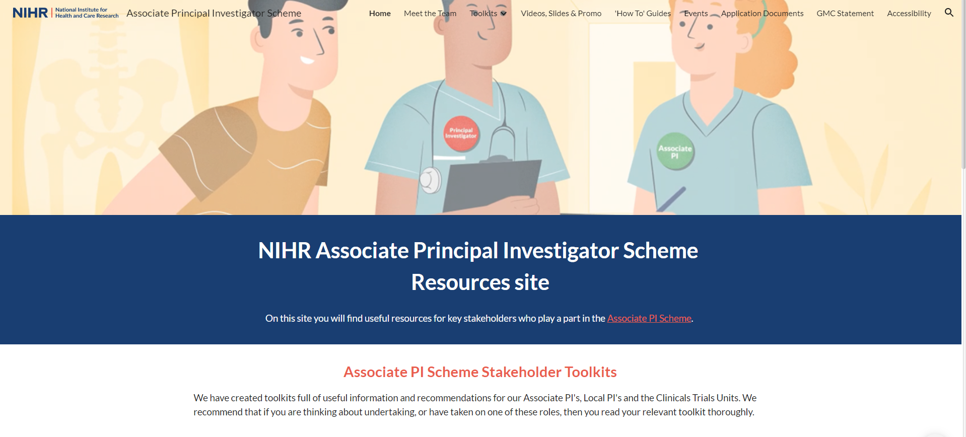

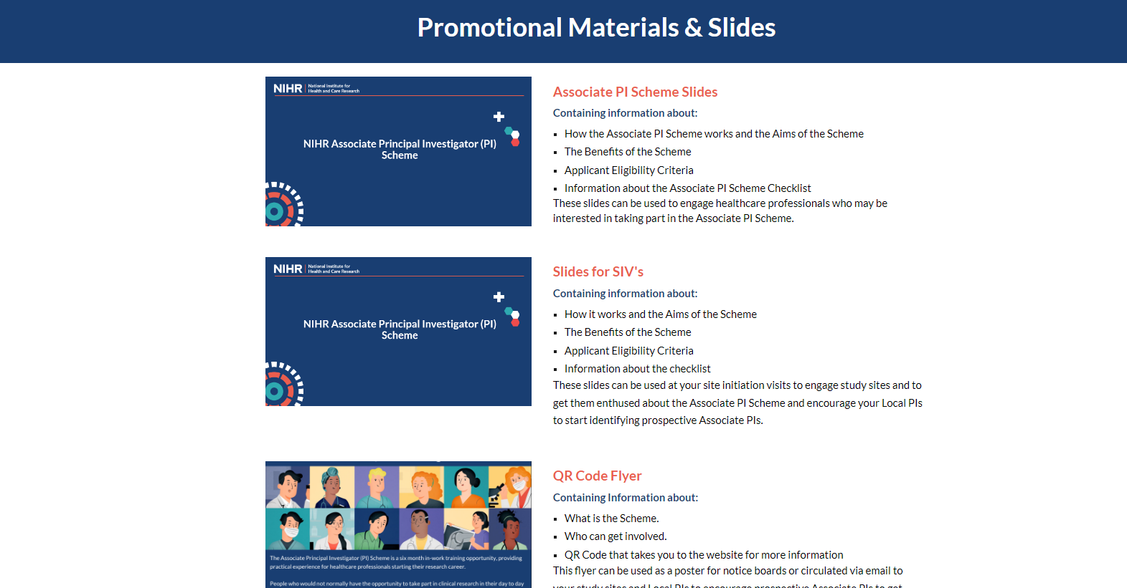
Check out our Additional Resources Website (linked)
Toolkits
Slides
How to Guides
Trainee stories
Study Registration Badge New*
Leaflets- Update leaflet available shortly*
Media packs with pre-approved website wording, social media templates, Newsletter templates
Associate Principal Investigator (PI) Scheme

Slide 18



How to get involved
Go to the NIHR Associate PI Scheme Website:
www.NIHR.ac.uk/AssociatePIScheme
To register a study, submit an Application Form on NIHR Learn
To register to be an Associate PI, submit an Application Form on NIHR Learn
Before you get started, we highly recommend watching the “How to” videos available here
Associate Principal Investigator (PI) Scheme

Slide 19
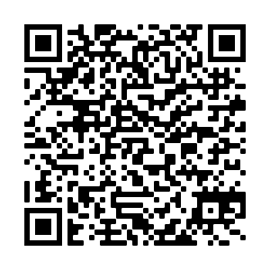
For further information,
visit the website at
www.NIHR.ac.uk/AssociatePIScheme
or scan the QR code below

