Slide 1



Graduated Compression stocking as an adjunct to Extended duration pharmacological thromboprophylaxis for venous thromboembolism prevention
(The GRACE multi-centre randomised controlled trial)

Slide 2
Background:
Hospital-acquired thrombosis - any venous thromboembolism (VTE) related event within 90 days of hospital admission (DVTs and PEs)
  UK annual VTE-related mortality: 32,000 fatalities
  £640 million per annum
  Surgery – established risk factor for VTE
Certain surgeries high risk of VTE (40-60% in elective joint replacement and 15-40% in general surgery patients) & require extended duration pharmacological thromboprophylaxis post discharge
NICE guidelines (2018): ALL patients undergoing abdominal, thoracic, spinal, bariatric, head and neck, and elective joint surgery should be treated with GCS and to consider treatment with GCS for all those undergoing cardiac, vascular and ear, nose and throat surgery
Costs £8.3 million per year in this group, complication rate 5%

Slide 3
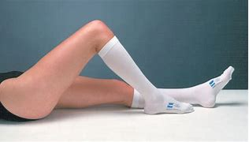
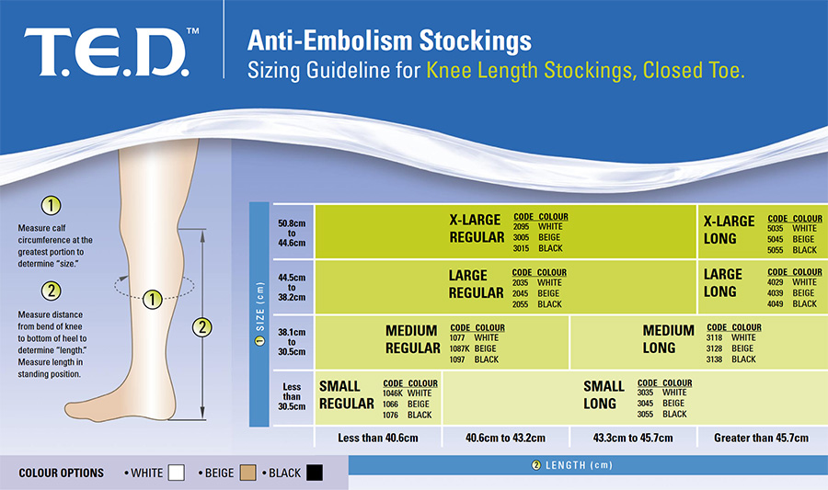
Graduated compression stockings
Notes:
You probably all know this but Graduated compression stockings (GCS), also known by the brand name TED Stocking comes in different color and size.
TED stockings tend to be not that well fitting and takes a lot of nursing time trying to get these fitted appropriately.

Slide 4
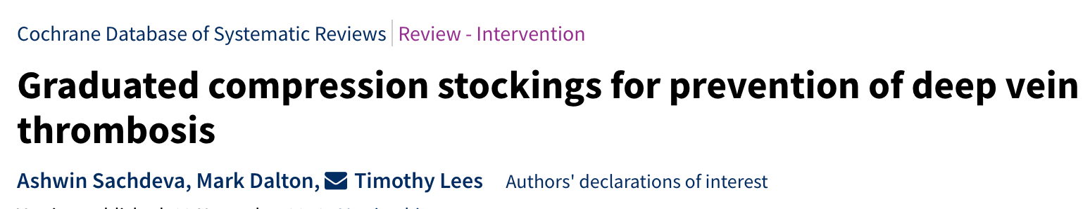
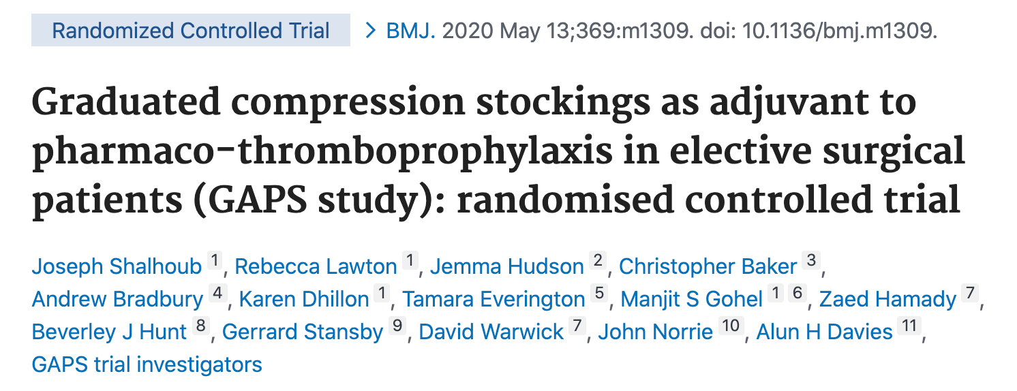
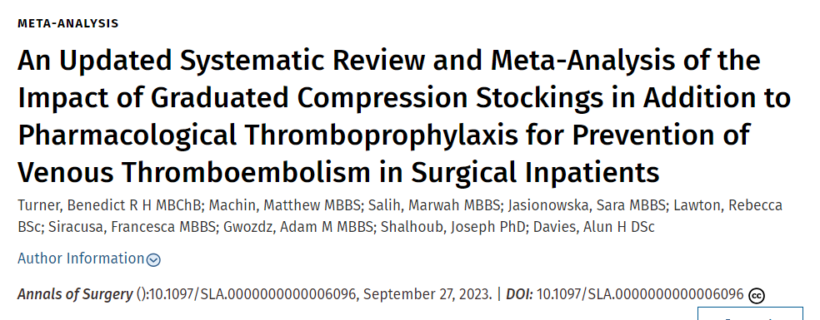
What is the evidence on graduated compression stockings?
2018 Cochrane Review (Sachdeva et al., 2018): GCS benefit, but small trials, didn’t include stroke/orthopaedic patients, many funded by stocking manufacturers.
GAPS trial (Shalhoub et al., 2020): No additional benefit of GCS (when combined with LMWH) compared to LMWH alone for patients who undergo elective surgery and are at moderate or high risk of venous thromboembolism. GAPs excluded the highest risk patients so results cannot be extrapolated.
2023 Updated Systematic review (Turner et al., 2023): no additional benefit for GCS in preventing VTE and VTE-related mortality
Notes:
A Cochrane Review which reported benefit for GCS included small trials (18-440 patients), only one of which was published this millennium, and many of these trials were funded by stocking manufacturers. Two large recent trials that did not supports the use of GCS were excluded from this review in stroke and orthopaedic patients
GAPS trial showed No additional benefit of GCS (when combined with LMWH) compared to LMWH alone for patients who undergo elective surgery and are at moderate or high risk of venous thromboembolism. GAPs excluded high risk patients so results cannot be extrapolated.
2023 Updated Systematic review from this group no significant differences in rates of DVT, PE and VTE-related mortality between pharmacological prophylaxis alone versus pharmacological prophylaxis with additional GCS

Slide 5
Aim: To evaluate the potential benefit of Graduated Compression Stockings (GCS) in addition to extended duration pharmacological thromboprophylaxis (EDPTP) post discharge for elective surgical patients at highest risk of venous thromboembolism (VTE)
Eligibility
Inclusion:
Adults (≥18 years of age)
Participants undergoing surgery; risk assessed as requiring EDPTP
Exclusion:
Contraindications to EDPTP or GCS
Individuals requiring therapeutic anticoagulation e.g., anticoagulation for previous DVT (antiplatelet use is not an exclusion)
Known thrombophilia or thrombogenic disorder
Trial Outcomes:
Primary Outcome: Imaging-confirmed lower limb DVT with or without symptoms, or PE with symptoms, occurring up to 90 days post-surgery
Secondary Outcomes:
Mortality at 90 days
Adverse events with GCS
Adherence with GCS
Adherence with EDPTP
Safety outcome measures
Notes:
The aim of GRACE is to evaluate the potential benefit of Graduated Compression Stockings (GCS) in addition to extended duration pharmacological thromboprophylaxis (EDPTP) for elective surgical patients at highest risk of venous thromboembolism (VTE).
We will include adults 18 years and over that are undergoing surgery which requires extended (post discharge) thrombopropholaxis. Exclusions are Contraindications to blood thinners or GCS, anyone that requires therapeutic anticoagulation or known thrombophilia or thrombogenic disorder.
Antiplatelets are not an exclusion and IPC is allowed.
The primary outcome is Imaging-confirmed lower limb DVT with or without symptoms, or PE with symptoms, occurring up to 90 days post-surgery, secondary outcomes are mortality at 90 days, AE from GCS, adherence and safety outcome measures.

Slide 6
Examples of elective surgeries that require EDPTP post discharge
Orthopaedic surgery (total hip replacement, total knee replacement
Colorectal surgery (colectomy, splenectomy)
Upper gastrointestinal surgery (oesophagectomy, gastrectomy)
Urological surgery (cystectomy, nephrectomy)
Gynaecological oncology surgery (radical hysterectomy, radical trachelectomy)
Notes:
Emergency

Slide 7

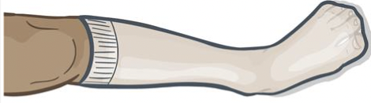
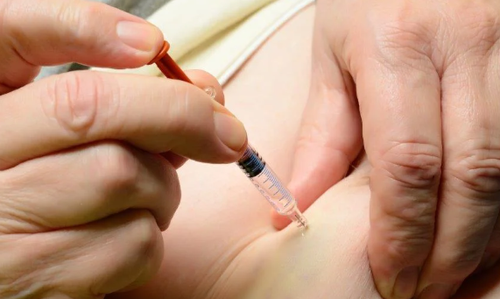
Sample Size
Sample size N=4696 (90% power at a 1-sided 2.5% level of significance, to detect a non-inferiority margin of 1.5%, assuming 8% DVT rate)
40 to 50 NHS Trusts/Health Boards, 8 to 10 patients per site per month (200 per site in total)
EDPTP + Stockings (Control arm)
EDPTP Alone (Intervention)
Notes:
Recruitment is 24 months.

Slide 8
EDPTP
EDPTP includes any anti-thrombotic agent prescribed at a prophylactic dose for
prevention of VTE post discharge, including:
Low-molecular weight heparin (LMWH) e.g. Tinzaparin, Enoxaparin, Dalteparin,
Directly acting Oral AntiCoagulants (DOACs) e.g. Rivaroxaban, Apixaban
Antiplatelet therapy e.g. Aspirin
GCS
GCS are elastic stockings worn on the lower limbs, often referred to by one of the brand names ThromboEmbolic Deterrent (TED®) stockings:
Either below-knee or above-knee compression stockings may be used.
The duration of stocking use in the control arm should be as per local policy for example, until ambulant, discharge or post discharge. This can vary across the specialities / operations.
The intervention arm is no GCS during the admission (or beyond).

Slide 9

Identification of Participants
The direct care team identifies patients and invites them to speak to a research nurse
The research nurse/practitioner pre-screens the relevant patient lists and identifies any potentially eligible patients
AND/ OR
The research nurse/practitioner will explain the study and provide the PIS/ICF to the participant via email/post
The research nurse/practitioner will obtain informed consent & will screen the patient (prior to / on the day of surgery)
Notes:
Research team can pre-screen preop assessment list or day care procedure list and identify eligible patients-> then approach the patient or the specialty team and provide PIS to the patient (via email/post/in person) and the consent can be obtained prior to / on the day of surgery by econsent, verbal over the telephone or in writing.

Slide 10
Screening
Reasons for inclusion/non-inclusion will be logged anonymously along with a minimum data set of age and reason for exclusion.
The anonymised pre-screening logs will be entered onto the database to monitor recruitment.
Please update screening log on a regular basis (weekly)
Notes:
We do ask you to complete a screening log and log reasons for inclusion/non inclusion in the pre screening log, and update the REDcap database regularly

Slide 11
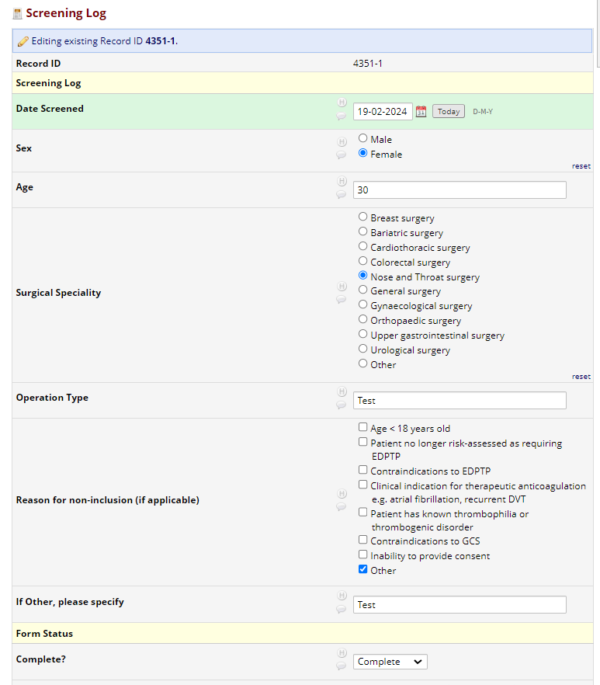
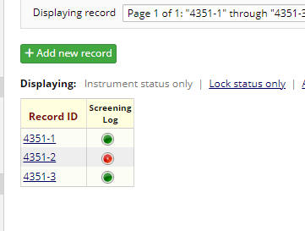
Screening
Notes:
We do ask you to complete a screening log and log reasons for inclusion/non inclusion in the pre screening log, and update the REDcap database regularly. Only screen those who would usually receive EDPTP for that type of operation.

Slide 12
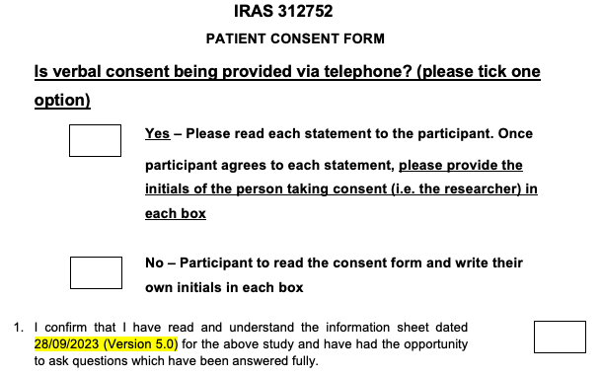
Consent
  Consent can be obtained:
  Written (in person)
  Electronically (via the REDCap e-consent function)
  Verbally (via telephone) – Please remember to post/email a copy of the consent form to the participant
    If consent is obtained verbally via telephone, please ensure the researcher initials is entered into the boxes
Notes:
Depending on patient and staff preference, consent can either be obtained in person, most likely on the day of procedure as the patient will be physically in the hospital. Verbally over the phone, copy of consent should posted or emailed to the patient. Electronically via REDCap, if this is indicated during screening, it will ask for email to be entered and this will allow patient to complete it online and this will be automatically transcribed into REDCap.

Slide 13
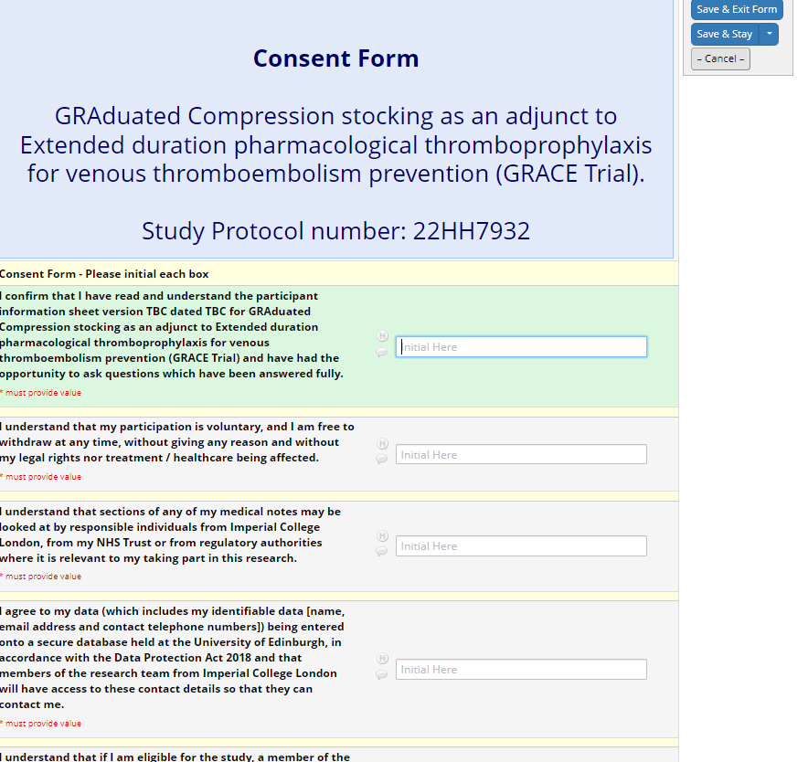
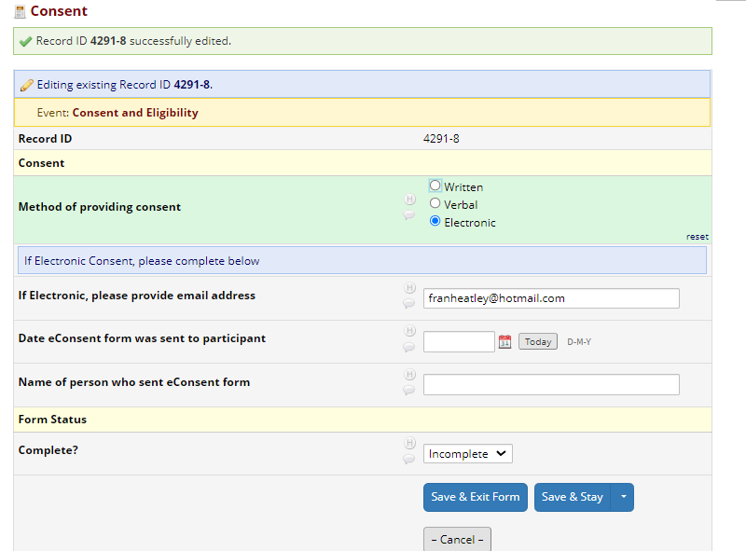
Consent
Notes:
Depending on patient and staff preference, consent can either be obtained in person, most likely on the day of procedure as the patient will be physically in the hospital. Verbally over the phone, copy of consent should posted or emailed to the patient. Electronically via REDCap, if this is indicated during screening, it will ask for email to be entered and this will allow patient to complete it online and this will be automatically transcribed into REDCap.

Slide 14
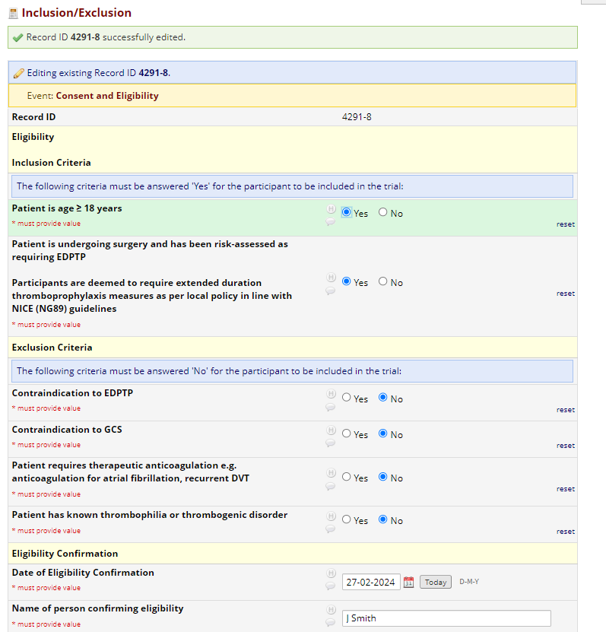
Eligibility Confirmation
Sites must confirm within REDCap that the patient is eligible for inclusion

Slide 15
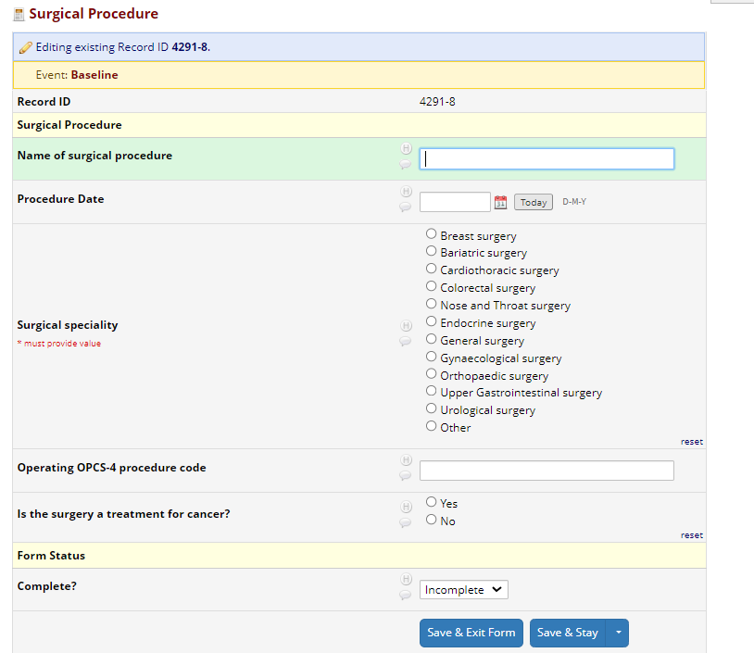
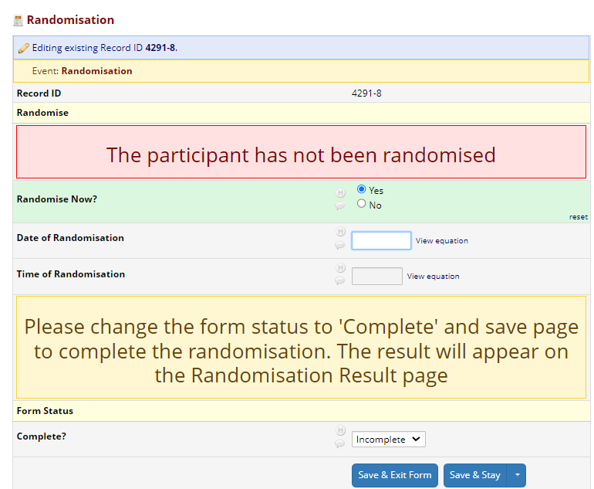
Randomisation
Notes:
Randomisation can only be complete once the consent and eligibility form is fully complete. You will also need to complete the surgical speciality as randomisation will be stratified by this.Click yes to randomise now and the allocation will appear on the next screen

Slide 16
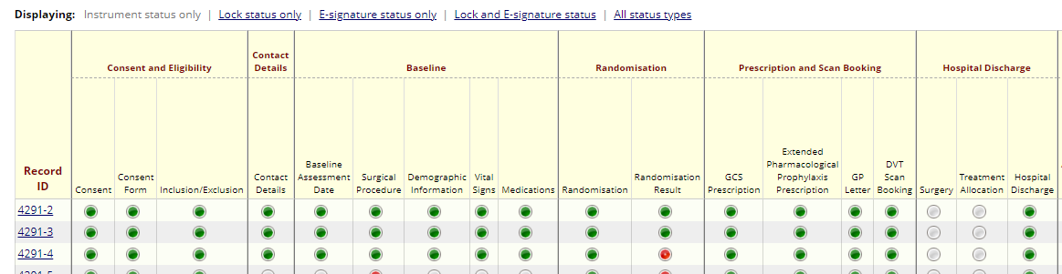
Baseline Data Collection
Demographic information & vital signs
Employment status
Current medications
Notes:
If the patient is eligible, the baseline information can be collected.
This can only be collected on OR prior to the day of procedure (i.e. not after the day of procedure).

Slide 17
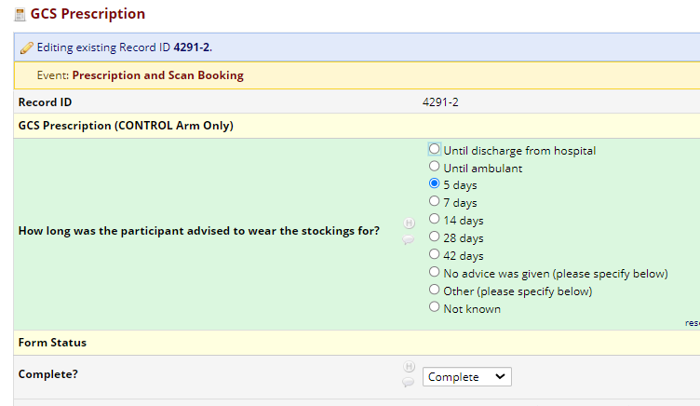
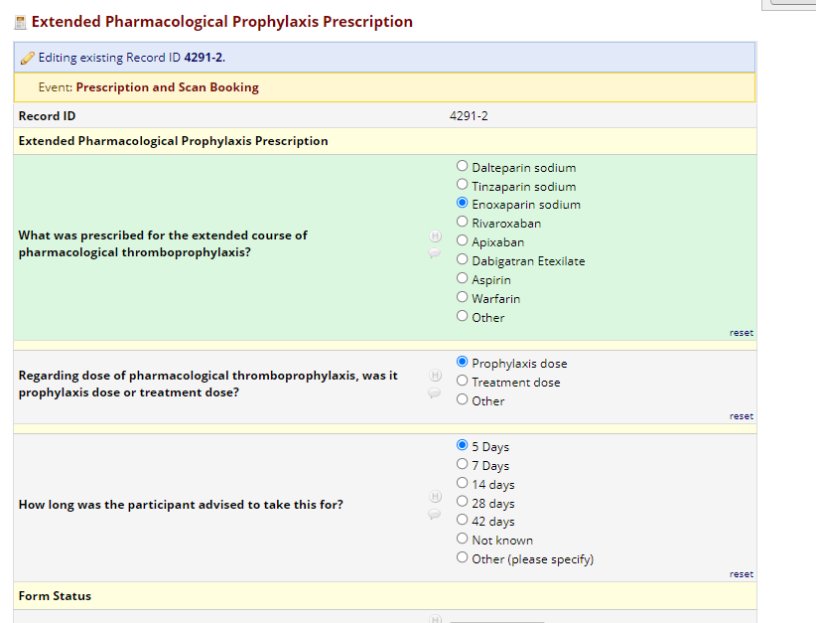
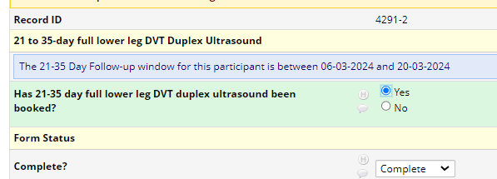
Baseline Data Collection
Notes:
Check if patient is in hospital that they receive EDPTP on discharge

Slide 18
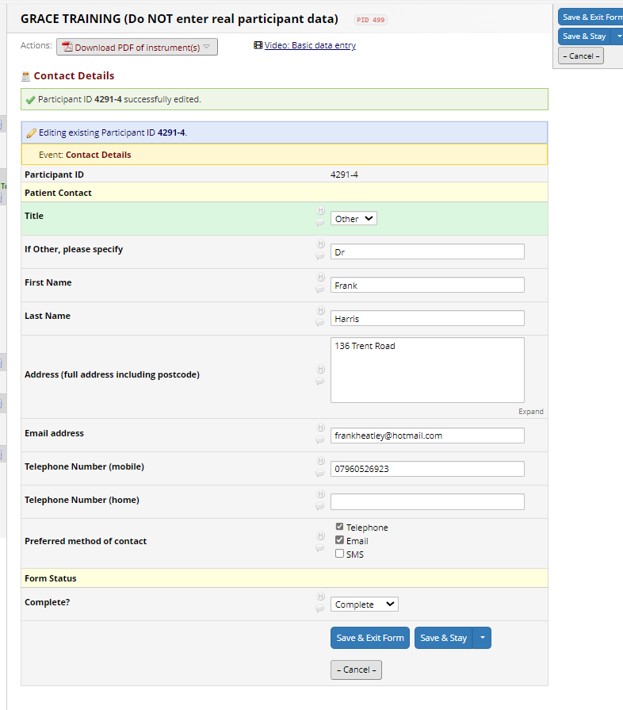
Contact details form

Slide 19
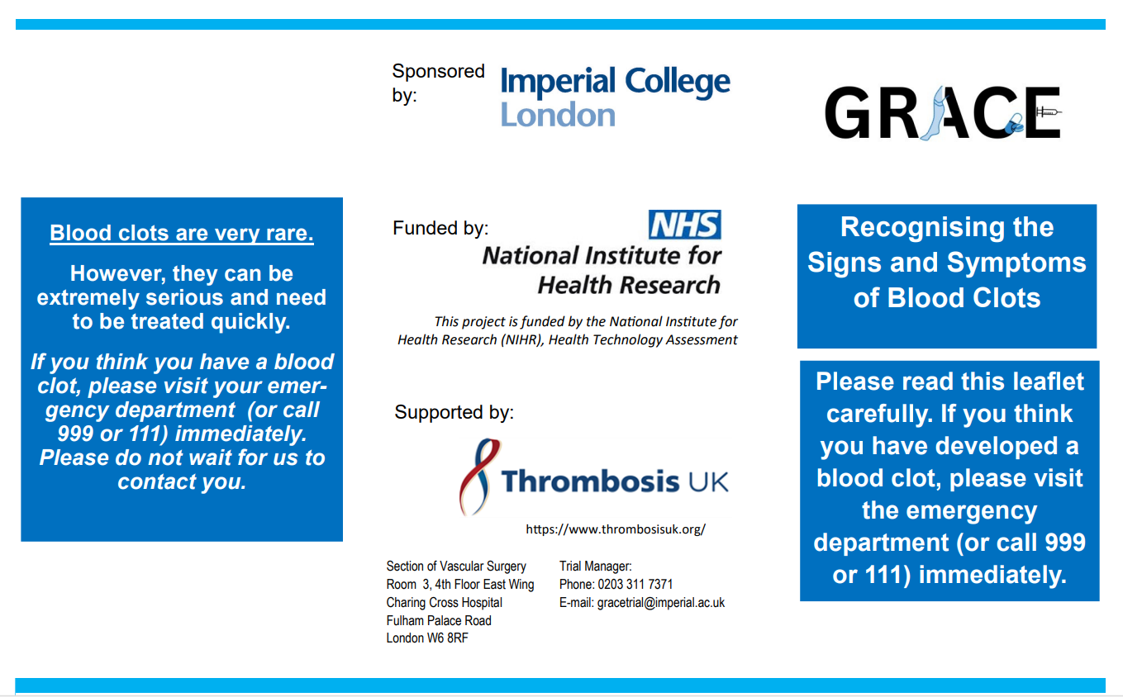
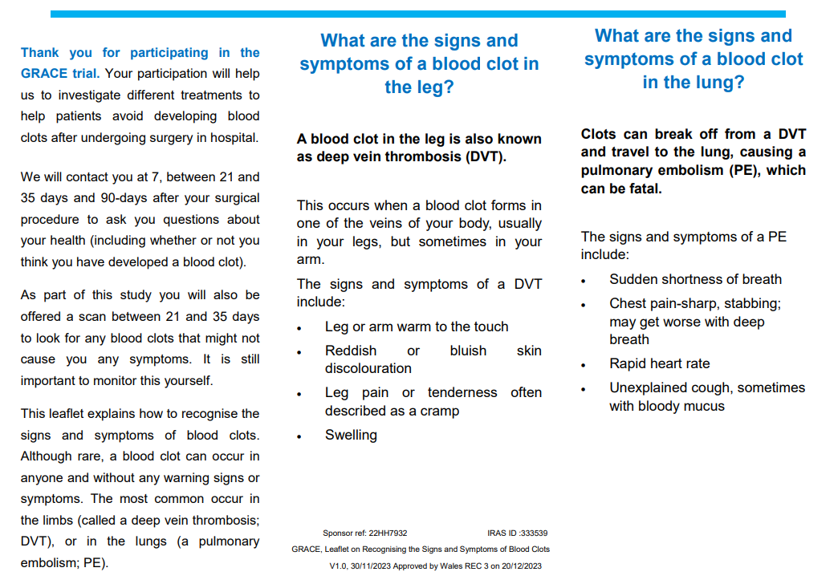
Blood Clot Leaflet
Please remember to provide the ‘Signs and Symptoms of blood clots’ Leaflet to participants after consent has been obtained

Slide 20
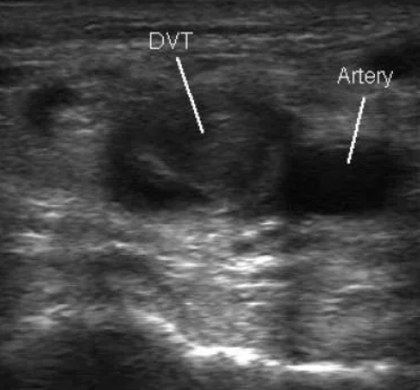
Follow-Up
  Conducted centrally by the Trial coordinating centre (Imperial College London). Participants are contacted remotely (via telephone, email or SMS) at 7, between 21 and 35 days and 90 days:
  Self-reported VTE outcome
  Adverse events associated with GCS if applicable
  Participant reported adherence to GCS & EDPTP
  - Participants will undergo a bilateral full lower limb (groin to ankle) deep venous thrombosis scan at 21- 35 days post-intervention to identify asymptomatic DVT
  - timed to capture the peak onset of events
  - £10 per participant (avg), we reimburse on quarterly basis

Slide 21
DVT Scan
  Ensure you have a process in place for booking in the scans and patient flow if a DVT is identified at this scan

Slide 22
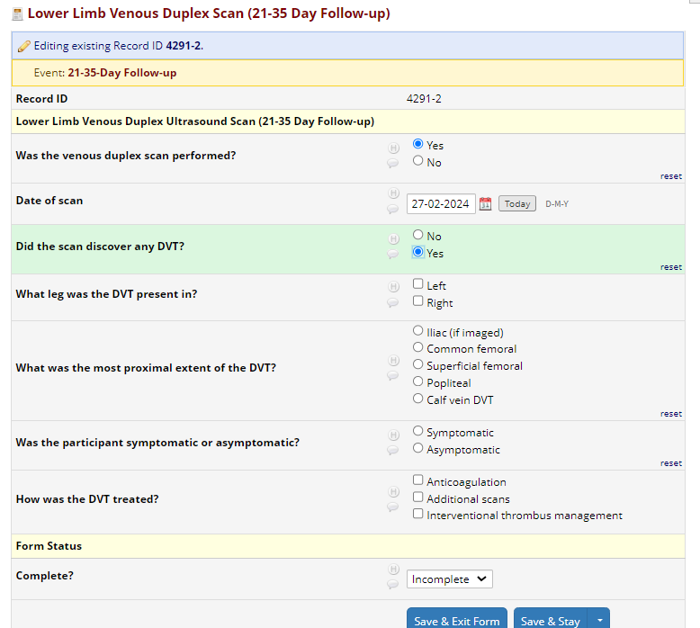
Follow-Up

Slide 23
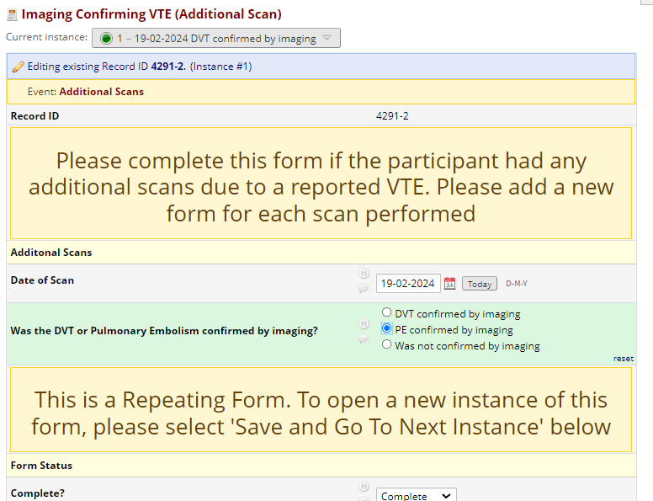
Follow-Up
Notes:
If a participant reports that they have been diagnosed with the DVT or PE outside the trial DVT scan we ask that it is image confirmed (this should have happened as part of standard care). Please complete the additional scan form.

Slide 24
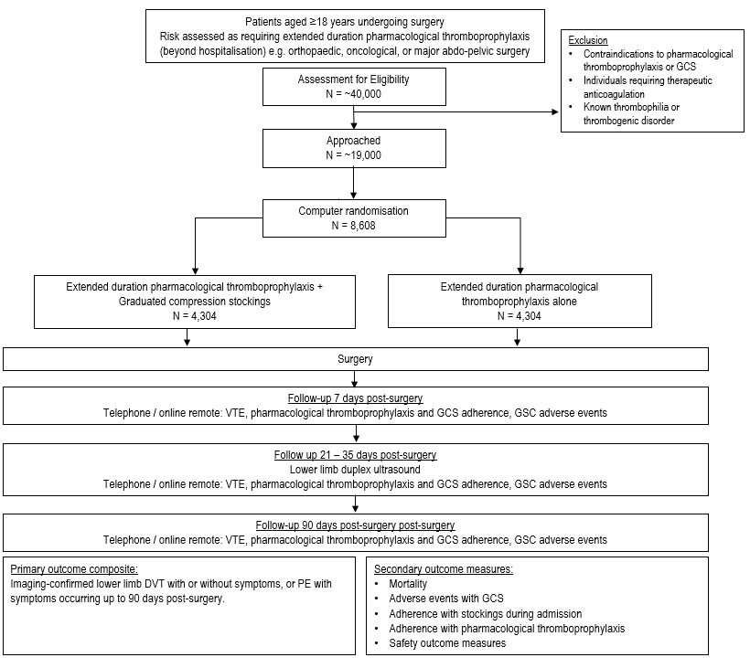
DVT Scan
Central f/u
Notes:
This is a study flowchart showing the DVT scan and central follow-up. We would ask that if a patient reports a VTE at the remote follow-up it is imaged confirmed (should be as per standard care) and that a CRF is completed to note this.

Slide 25
Withdrawal
Participants can withdraw from different aspects of the trial e.g. specific questionnaire completion, but will continue to be followed-up as per protocol unless they choose to withdraw completely.
The reason for their withdrawal will be recorded in the CRF/eCRF and medical records if offered.
Patients lost to follow up or withdrawn from the study will not be replaced.
Notes:
Please do not withdraw patients if they don’t receive their treatment allocation. All patients will be followed up unless they specifically ask not to be.

Slide 26
Withdrawal
Please do NOT withdraw patients without discussing this with us first
Patients may decide to not come to the scan but may be happy to be called, or may agree to be called at 90 days only
Primary outcome is the most important (VTE Y/N at 90 days)
Patients are NOT withdrawn if they do not receive their treatment allocation – they will still have scan and f/u calls
We will f/u ineligible patients
Notes:
Please do not withdraw patients if they don’t receive their treatment allocation. All patients will be followed up unless they specifically ask not to be.

Slide 27
Adverse Event Definition
Adverse Event (AE): any untoward medical occurrence, unintended disease or injury or any untoward clinical signs (including an abnormal laboratory finding) in subjects, users or other persons whether or not related to the investigational medical device.
Severity of Adverse Events
Definitions for assessment of severity:
Mild: Awareness of event but easily tolerated
Moderate: Discomfort enough to cause some interference with usual activity
Severe: Inability to carry out usual activity
Only AEs related to the GCS will be collected
AEs are collected centrally by the coordinating centre.
IF SITE BECOMES AWARE OF AN AE (RELATED TO GCS) PLEASE COMPLETE THE AE FORM ON REDCap
Notes:
Only AEs related to the GCS will be collected, if the site is randomised to GCS arm. (patients reported). But If you become aware of any AE please complete the AE form on REDCap

Slide 28
Serious Adverse Event Definition
Serious Adverse Event (SAE): Any AE that:
Results in death;
Is life-threatening*;
Requires hospitalisation or prolongation of existing inpatient’s hospitalisation**;
Results in persistent or significant disability or incapacity;
Is a congenital abnormality or birth defect;

Slide 29
* “Life-threatening” in the definition of “serious” refers to an event in which the patient was at risk of death at the time of the event; it does not refer to an event which hypothetically might have caused death if it were more severe.
** “Hospitalisation” means any unexpected admission to a hospital department. It does not usually apply to scheduled admissions that were planned before study inclusion or visits to casualty (without admission).

Slide 30
Definitions for Assessment of SAE Causality
Unrelated: No evidence of any causal relationship between the study procedure and the AE.
Unlikely: Little evidence to suggest a causal relationship. There is another reasonable explanation for the event (e.g. the patient’s clinical condition, concomitant medication).
Possible: Some evidence to suggest a causal relationship. However, the influence of other factors may have contributed to the event.
Probable: Evidence to suggest a causal relationship and the influence of other factors is unlikely.
Definite: There is clear evidence to suggest a causal relationship and other possible contributing factors can be ruled out.
Notes:
Causality of the AE will be determined, according to these definitions

Slide 31
SAE Reporting Procedures
SAE details are to be entered into REDCap for the CI to assess within 24 hours of knowledge of the event.
If the REDCap system is unavailable, sites will email the completed paper SAE form to the coordinating centre: gracetrial@imperial.ac.uk
The responsible PI should assign the causality of the event by logging into the eCRF.
The Trial Manager may contact sites to obtain further information about the SAE.
Any follow-up information regarding a SAE must also be reported immediately.
Follow up of patients who have experienced a SAE should continue until recovery is complete.
Notes:
SAEs should to be entered onto the REDCap system within 24 hours knowledge of the event.
There is a paper SAE form in the CRFs if REDCap is unavailable.
The PI must assign causality.

Slide 32
Protocol Deviation / Violations
A protocol deviation occurs when a process or criteria has not been actioned in line with the approved protocol. For example, patient did not attend DVT scan.
  Minor occurrences which do not affect participant safety or the integrity of the research.
A protocol violation occurs when there is a consistent variation in practice from the defined protocol. For example, failure to obtain informed consent prior to initiation of study related procedures.
  A violation is a significant occurrence or event which may affect participant safety or the integrity of the research.
  Each episode of non-compliance of study protocol should be documented by completing the deviation/violation form in the REDCap eCRF, as soon as the investigator or designee is made aware of the event.
Notes:
Protocol deviation occurs when a process or criteria has bot been actioned in line with approved protocol
And protocol violation occurs when there is a consistent variation in practice from the defined protocol
Both protocol deviation and violations needs to be reported on the REDCap database as soon as you are aware of the event.

Slide 33
Participant Folder
Please create participant folders for each GRACE participant
Complete the paper CRF booklet for each participant
All source data to be entered/filed in the participant folder
Initial and date on any changes or corrections made
Notes:
Each participant should have a separate folder with the paper CRFs to be completed.
All source data must be filed in this folder.
Any corrections / changes to source data must be initialled and dated.

Slide 34
Investigator Site File (ISF)
Reviewed by the Trial Manager during monitoring visits.
Ensure the following documents are kept up-to-date:
  CV’s
  GCP certificates
  Delegation log
  Regulatory documentation
  Research approvals
All study staff will need to complete a training log
  To be updated for revised versions of or new study documentation (e.g. protocol, REDCap data entry guide)
Notes:
The ISF will be reviewed at monitoring visits so please ensure these documents are kept up-to-date
Each study staff member listed on the delegation log must complete a training log which will need updating if any documents are updated.

Slide 35
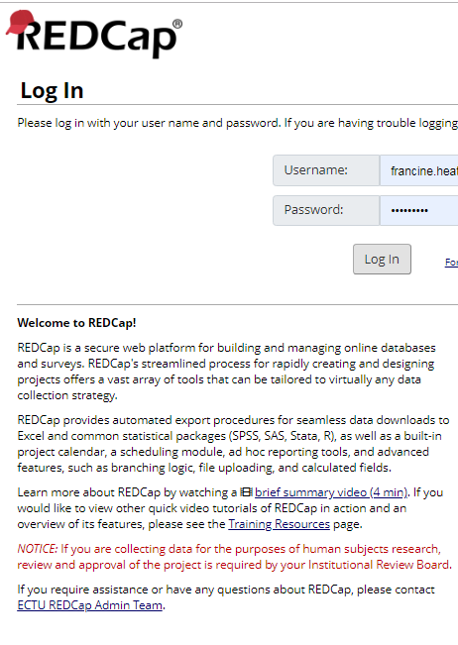
REDCap
Trial data to be entered onto electronic case report form (eCRF)
  Web-based, REDCap system
  Password protected; individual access
  Full, GCP-compliant audit trail
  Separate data entry guidelines provided
Notes:
The REDCap system is being used as the eCRF. Individual access will be granted once the site is activated
There is a REDCap guide included in the site file.
Ask if site is familiar with REDcap database

Slide 36
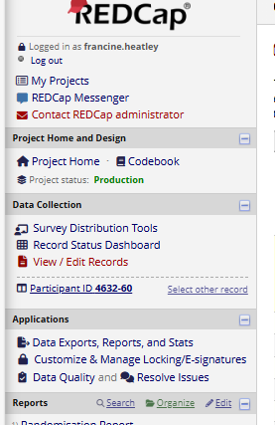
REDCap/Data entry
Please ensure participant mobile number is provided
  Important for follow-up (email sometimes goes into spam)
  Please ensure mobile number is entered correctly (i.e. no missing/extra digits)
We may raise data queries via REDCap (To see these please click ‘resolve queries’ on the left banner)
  Please answer these in a timely manner

Slide 37
Strategies to enhance recruitment
Screen lists/attend surgical units daily
Involve as many specialties as possible:
  E.g. ENT, general, colorectal, orthopaedics, gynaecology, urology
  Involve VTE lead/Medical Director to help promote study
Attend patient safety meetings to promote study/address concerns
Cover all hospitals within the Trust
CRN Workforce support scheme if capacity issues – contact us to make an application
If randomised to control:
  Ensure supply of stockings is in place
If randomised to intervention:
  Ensure patients are not given GCS
Notes:
These are some strategies that sites have reported working well for them.
Things like, screening the surgical lists daily, involving as many specialties as possible , involving the VTE lead and medical directors, attending patient safety meetings to promote the study. Covering all hospitals within the trust.
if you're having capacity issues and we can help you make an application to the CRN.
if you are randomised to intervention please ensure to supply stockings and if you are in control arm we are happy to provide stickers for you to use

Slide 38
NIHR Associate PI (API) Scheme
‘The scheme is open to health and care professionals who do not have research as a core part of their role but wish to gain skills and experience in participating in NIHR Portfolio research. This includes, but is not limited to, doctors, nurses, pharmacists and so on.’
APIs must commit 6-months to working on the study.
  Screening, consenting, promoting the study amongst clinicians
Instructions on how to register can be found on the NIHR Associate PI website or email the study team for more information.
Notes:
We are registered with the associated PI Scheme, find more information on NIHR website or get in touch with us

Slide 39
Sponsor Responsibilities
Arranging finance
Ethics Application and Amendments
GCP conduct (including trial management)
Safety Reporting
Monitoring
Database
Data Monitoring
Notes:
List of Sponsor responsibilities

Slide 40
Sponsor Agreement With Sites
Before activating the trial, it is the responsibility of the PI to:
Ensure all hospital staff involved in trial conduct:
- Have necessary experience
  - Have appropriate training
  - Are properly briefed
Once the trial is running, it is the responsibility of the PI to work to the agreement:
Ensuring all staff adhere to the Clinical Protocol, study related manuals and SOPs
Conveying communications e.g. from Chief Investigator and Sponsor to all local staff within the centre
Ensuring that any protocol amendments & changes to study manuals/CRFs are acted on appropriately and in a timely manner
Notes:
The next few slides are a list of the PI responsibilities:
Before activating the trial PI must ensure all hospital staff involved in the trial should have the appropriate training and experience.
Once the trial is running → ensure all staff adhere to the protocol, manual and SOPS; communicate to all local staff within the center; ensure to update amendments and changes

Slide 41
Sponsor Agreement With Sites
Principal Investigator’s responsibilities continued…
Maintaining the Investigator Site File (incl. delegation lists & authorised signatories)
Ensuring local adherence to the principles of GCP
Ensuring all site documentation is auditable
Accuracy, completeness and timeliness of data reporting
Responsibilities can be delegated, but the PI has overall responsibility
Registered with Associate PI Scheme
Notes:
Just to note that responsibilities can be delegated but the PI has overall responsibility.
The study is also registered with the Associate PI Scheme.

Slide 42
Study Organisation
Sponsor: Imperial College London
Funder: National Institute for Health Research (NIHR)
Database and Statistical Analysis: Edinburgh Clinical Trials Unit (ECTU)
Committees:
  Trial Steering Committee (TSC)
    Dr Lorna Aucott
    Miss Sophie Renton
    Miss Kirsty Wetherall
    Dr Stephen Gerry
    Ms Annya Stephens-Boal (PPI)
    Ms Dawne Long (PPI)
  Data Monitoring Committee (DMEC)
  Professor Peter MacCallum
  Professor Rod Taylor
  Professor Bruce Campbell
Notes:
Study sponsored by Imperial College London, run through the Edinburgh CTU.
We have TMG, TSC and DMEC committee's all set-up.
Funded by NIHR

Slide 43

Green light
Wait for the ‘green light’ to start recruiting as we need to ensure everything is in place.
Outstanding documentation
mNCA
C&C Approval
OID
Delegation log
Cvs/GCPs
Training certificates
Site contact details form
Localised study documents
eCRF request forms
DM PAD SIV Presentation

Slide 44
GRACE Contact Details
General queries: gracetrial@imperial.ac.uk
Prof Alun Davies (Chief Investigator): a.h.davies@imperial.ac.uk
Dr Francine Heatley (Trial Manager): f.heatley@imperial.ac.uk
Ms Rebecca Lawton (Trial Manager): r.lawton@imperial.ac.uk
REDcap queries (redcap.ectu@ed.ac.uk for technical advice ONLY – please contact gracetrial@imperial.ac.uk for data queries)
DM PAD SIV Presentation

Slide 45
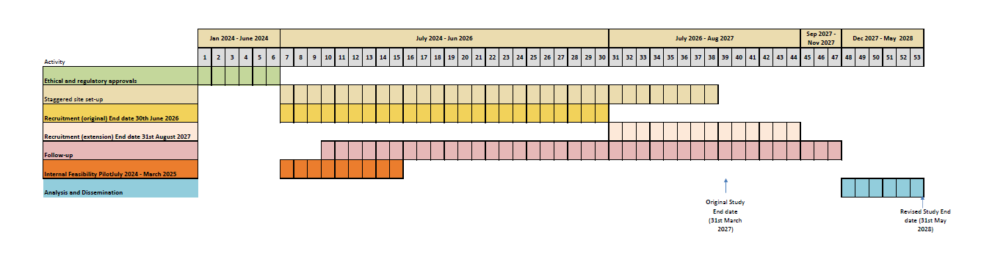
Timelines:
Official start date: 1st January 2024
Notes:
24 months of recruitment from 1st July 2024, 27 if we start in April as planned.

Slide 46

Thank you!

