Slide 1

Embracing Risk as a Space for Learning: Student-staff Partnership
Dr Tiffany Chiuª, Dr Deesha Chadha^{b}, Ms Marsha Maraj^{b}
Education Day
Thursday 9th May 2019
ª Centre for Higher Education Research and Scholarship, ^{b} Department of Chemical Engineering

Slide 2

Student-staff partnership in different areas of activities
Educational Research Partnership​
Curriculum Development Partnership
Independent Learning
Partnership
Rationales & Methods employed for student engagement
Values of partnership
Risks & Vulnerabilities

Slide 3

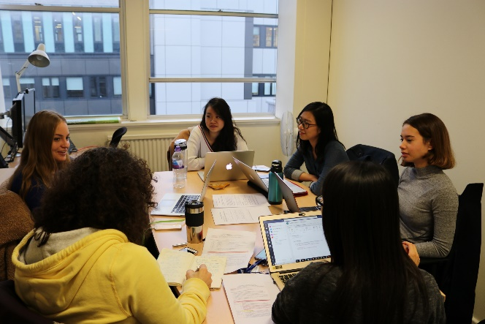
Educational Research Partnership
(Focus and rationale)
Project Team
Dr Tiffany Chiu (Project Lead)
Dr Magda Charalambous (Co-investigator)
Dana Chow (Student research partner)
Nadia Gjerdingen (Student research partner)
Shiyao Ke (Student research partner)
Maja Wojtynska (Student research partner)
Educational research project: explores views and expectations of what it means to be a university student (idealstudent.org)
Challenges of the transition from school to university; expectations of university students are not always made transparent
Enhancement of scholarship and interdisciplinary skills through a research partnership with students

Slide 4
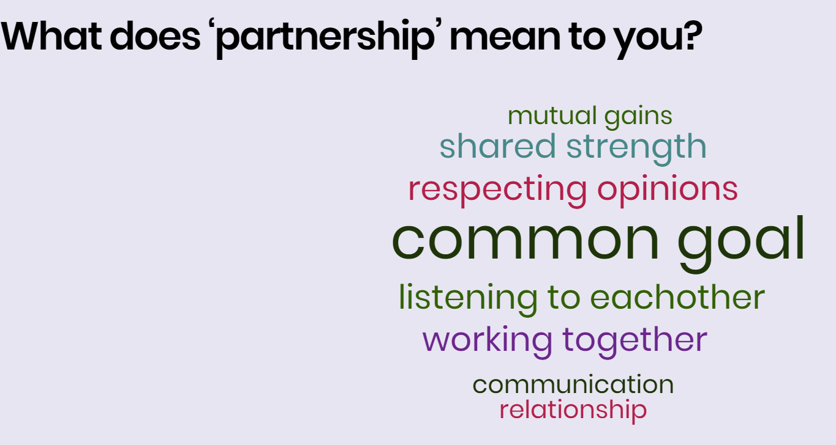
In the very first meeting…

Slide 5

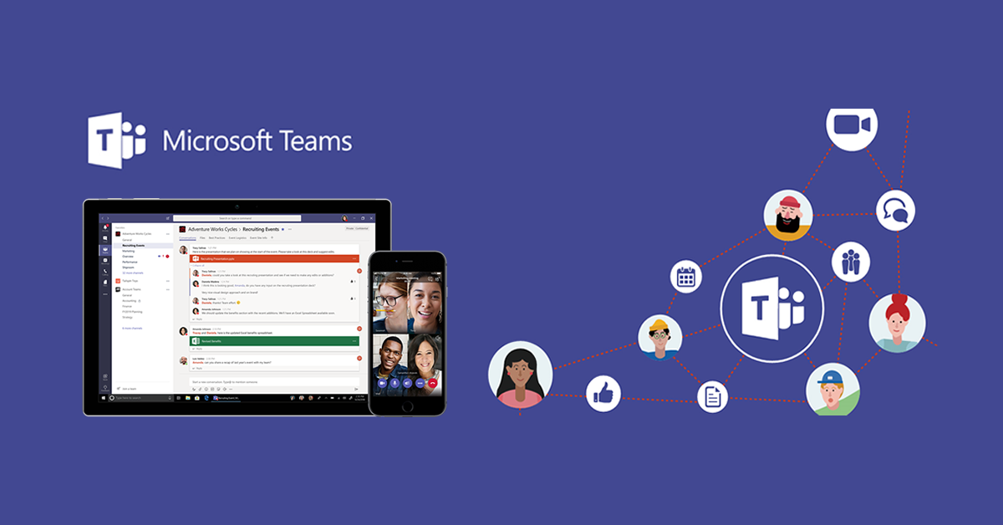
Project set-up
Microsoft Skype for Business, Office365 and Teams specialists 2019
MS Teams space (blended with formal & informal): Our main channel for constant communication, group/individual instant chat, files & thoughts sharing, research data collection & analysis track, and team meeting minutes repository.
Everything in one place: Avoid logging into different platforms

Slide 6
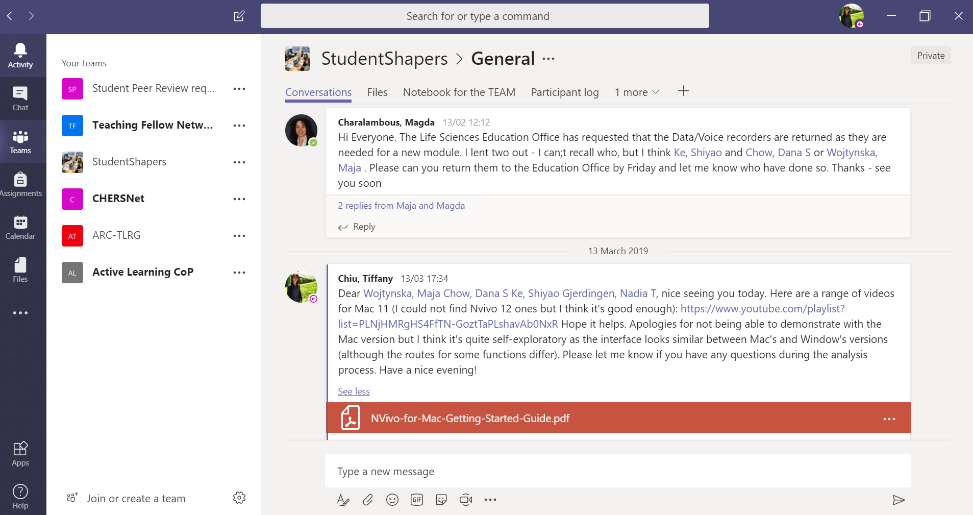


Slide 7
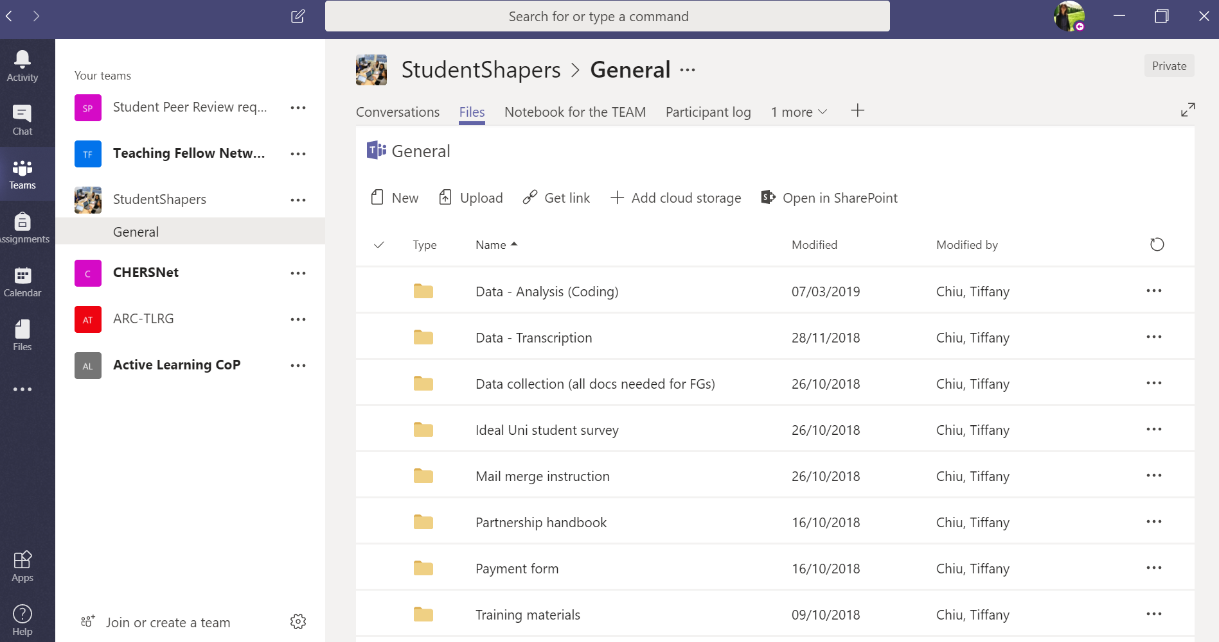


Slide 8
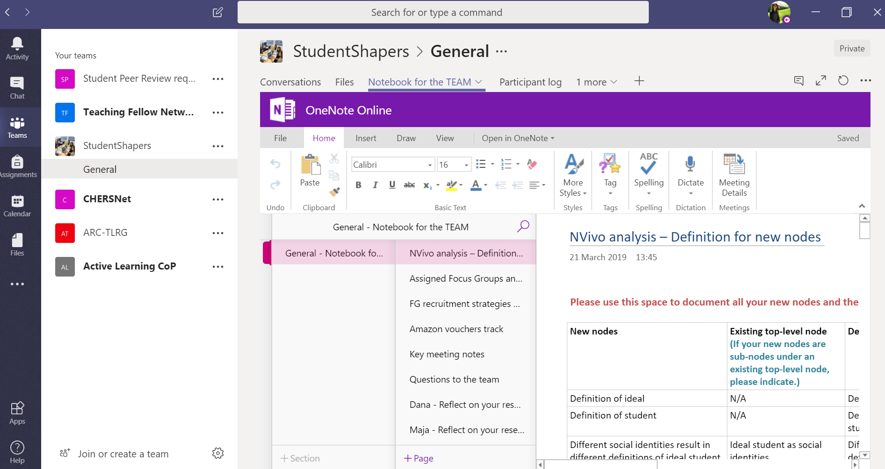

Embedded OneNote online: Safe space for critical reflection on research experience

Slide 9
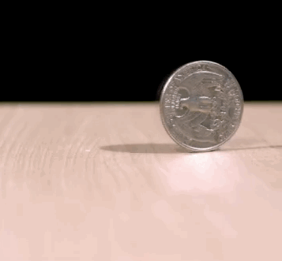
Ambivalence: Risks? Benefits?
Benefits
Flexible working schedule -> manageable around our other work (‘avoid dropping out’)
Freedom to try different things -> space to learn and reflect; transferable skills development
Perspectives from students and staff -> fostering creativity & innovation
Increased self-efficacy & personal development
Risks
Flexibility -> lacking full control of the project/timeline
Freedom to employ different strategies towards data collection & analysis -> inconsistency of data quality
Vulnerabilities in trying new things -> uncertainty; a double-edged sword; cf. ‘letting go of familiar ways of working’, trust
A significant time commitment
By GIPHY

Slide 10
These aspects make student-staff partnership work and plus…
Support
Bringing in various skills & personality

Slide 11



From students’ reflections: What does student-staff partnership mean to us now?
“… something new I would like to add is support system because I feel comfortable with raising any queries I have and my team is always open and receptive and tries their best to help me with my doubts.” (From student partner B)
“One of the reasons this project has been enjoyable is because I received great support and guidance from the supervisors and peers, and they have made the meetings very transparent with a friendly environment” (From student partner A)*
“… partnership benefits hugely from the differences between people, in terms of skills and personality. That this difference is actually something to celebrate, use, and thrive on in the sense that it enables understanding and respect of something a single person would have otherwise never seen” (From student partner C)

Slide 12

Fostering an inclusive learning environment
“I felt like there was a very clear end goal… that the path to achieving that goal had a structured overarching framework… but asked about our ideas and opinions and made decisions as a group on how to move forward. These decisions were also adjusted as we all learned things through our early experiences. I think the flexibility to do this, and the respect that was shown for all our ideas is amazing”
(Reflection from student partner D)*
Ellevate Network 2017

Slide 13

Curriculum Development Partnership
(Example of a negotiated project)
As part of the curriculum review and redesign process, attempts are being made to introduce interactive pedagogies into the classroom:
1st year chemistry module in chemical engineering
Emphasis on conceptual learning
  concept mapping, crossword puzzles, gaming app, Mentimeter
Action research aimed at further development of an interactive teaching-learning environment

Slide 14
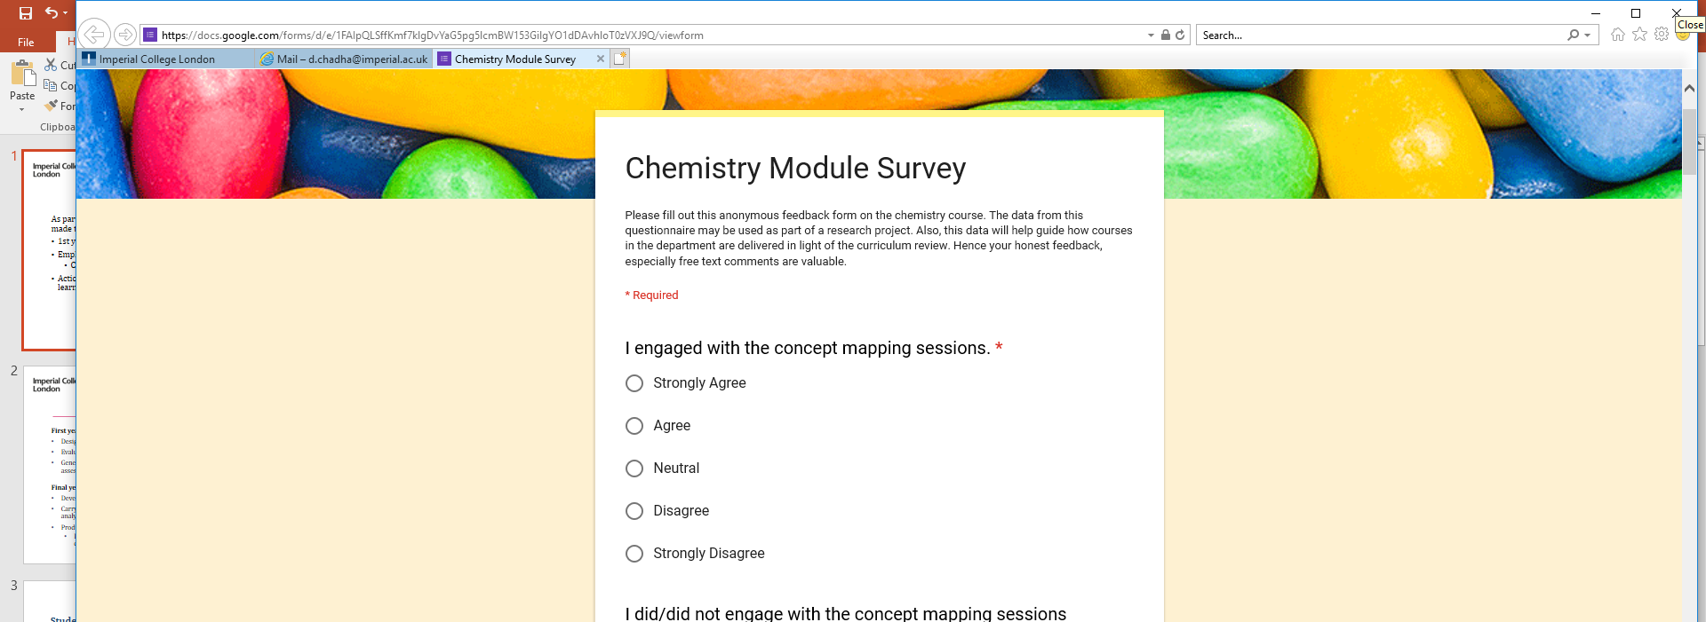
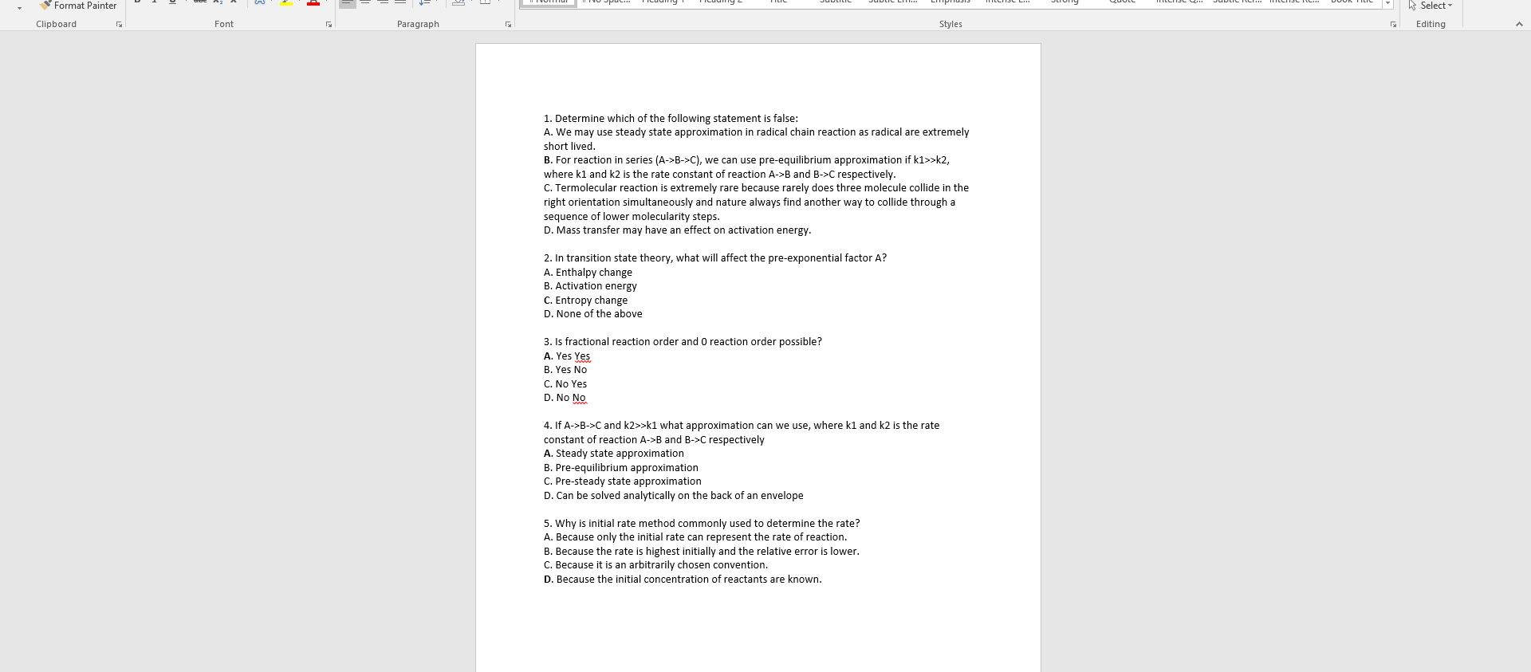
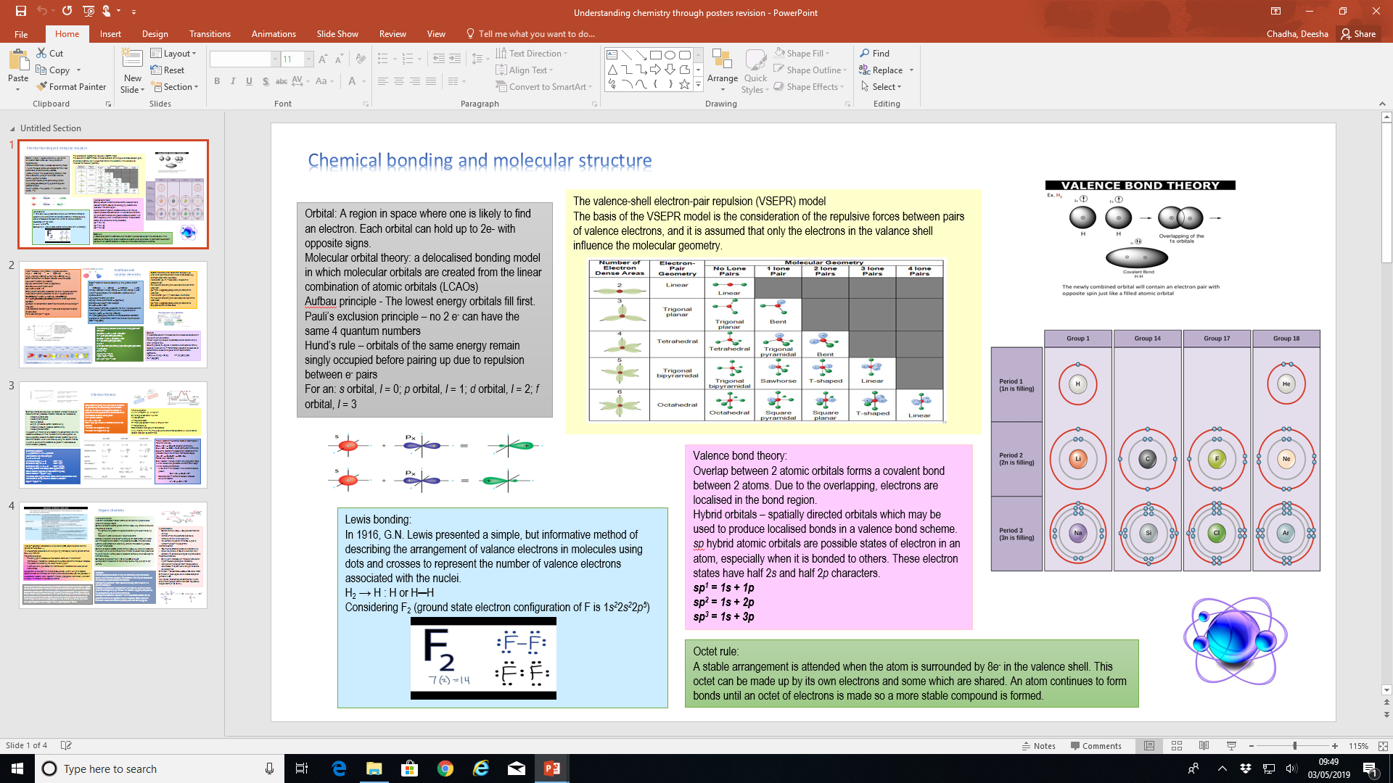
Student partners
First year students
Design questions for gaming app
Evaluate the functionality of the app
Generate ideas around the use of posters in assessment
Final year student
Develop an appropriate research question
Carry out data collection and preliminary analysis of data
Produce the 1st draft of the report
  Focus on recommendations and future developments

Slide 15

Students working in partnership with staff and their peers
Students | Situation | Risk
1st year | Reticent about putting forward ideas | Difficult to establish how much students understand about what is required and how ready they are to do the work – careful scaffolding needed
 | Students did not wish to meet collectively and regularly | Peer support and students’ capacity to form friendships is limited
 | Deadlines continually shifted as students found it difficult to manage workload | Deliverables not met in a reasonable time period
4th year | Set about conducting educational research based on engineering training | Student asks closed questions – support around methodological approach required
 | Found it difficult to analyse data | Simplistic data analysis

Slide 16

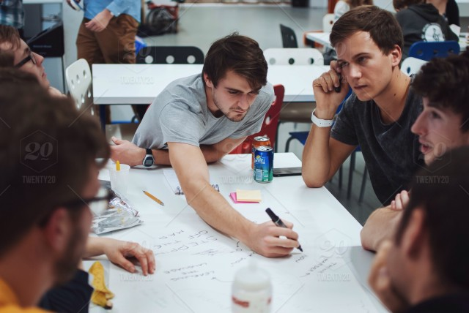

Independent Learning Partnership
Student-initiated partnerships vs. staff-initiated partnerships
Partnerships: as a means of continuing and supporting independent learning
  Guided independent learning (GIL):
    involvement of others to shape the learning situation (e.g. individual study, homework, problem sheets)
  Unguided independent learning (UIL):
    learning situations where the learner pursues knowledge without direct or implicit instruction (Cukurova et al., 2018)
    personal projects that are aligned with the curriculum but are not rooted in their assessment

Slide 17
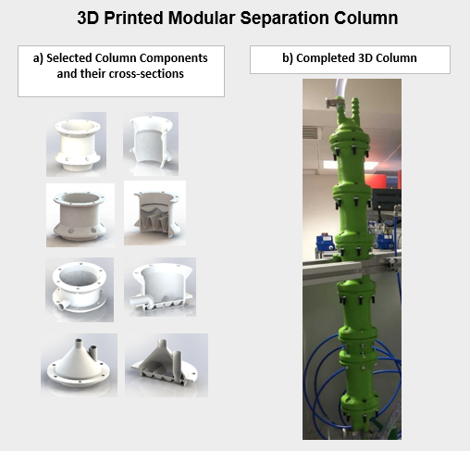
Student partners: Nikolaos Kalogeropoulos and Pierre Walker
Staff support: Colin Hale, Andrew Macey and Umang Shah
We examine the experiences of two engineering students:
who have created a student-led maker space
  based on interdisciplinary collaboration
to develop a working prototype of a 3D printed modular separation column
  to see “how the theory they had been taught could be transformed practically” (from Student A)
good example of an UIL type of activity

Slide 18
Rationale and support
Why are these kinds of project important?
Students working on independent-learning type projects of their choosing: are educationally valuable fosters interdisciplinary collaborative learning encourages entrepreneurship promotes independent and life-long learning
Levels of support required
This project required: academic and technical expertise to fine-tune and improve selected design variables technical support: setting up lab space, ensuring health and safety etc. other resources and funding

Slide 19
What does it mean for us and what are the risks?
Issues | Risks | Implications
Should we embed UIL student partnerships within the curriculum? | Students pursuing UIL projects related to their achievement goal orientations. Poor student engagement and motivation Issues surrounding inclusivity: not all students want this kind of project nor can they perform well at it Limited expertise | Careful consideration of the achievement goal orientations of our students Design of appropriate learning outcomes, assessment and feedback
How many students can we realistically support? | Managing a small number of student-led makerspaces is potentially easy and feasible Scaling up will require a careful planning of resources to manage: - Student expectations and experiences - Staff and departmental contributions | Academic and technical staff access, funding and laboratory scheduling Equity of resources

Slide 20


Concluding remarks
Successful student-staff partnerships
- Meaningful mutual engagement
- Clear delegated responsibility
- Open and honest communication
- Readiness
- Support and scaffolding
- Authentic and transformative learning experiences
- Transferable skills development
- Innovation and creativity
- Fluid and dynamic perceptions of partnerships
require…
lead to…

Slide 21
Risk as a space for learning and innovation. No risk, no gain.

Slide 22
References
Bovill, C., Cook-Sather, A., Felten, P., Millard, L. and Moore-Cherry, N., 2016. Addressing potential challenges in co-creating learning and teaching: Overcoming resistance, navigating institutional norms and ensuring inclusivity in student–staff partnerships. Higher Education, 71(2), pp.195-208.
Cook-Sather, A., Bovill, C., and Felten, P., 2014. Engaging students as partners in learning and teaching: A guide for faculty. San Francisco: Jossey-Bass.
Cukurova, M., Bennett, J. and Abrahams, I., 2018. Students’ knowledge acquisition and ability to apply knowledge into different science contexts in two different independent learning settings. Research in Science & Technological Education, 36(1), pp.17-34.
Hancock, J. and Lubicz-Nawrocka, T., 2018. Creating Spaces: Embracing Risk and Partnership in Higher Education. Teaching and Learning Together in Higher Education, 1(24), https://repository.brynmawr.edu/tlthe/vol1/iss24/5
Healey, M., Flint, A., and Harrington, K., 2014. Engagement through partnership: students as partners in learning and teaching in higher education. York, UK: The Higher Education Academy.
Healey, M., Flint, A., and Harrington, K., 2016. Students as partners: Reflections on a conceptual model. Teaching and Learning Inquiry, 4(2). http://dx.doi.org/10.20343/teachlearninqu.4.2.3
Marquis, E., Guitman, R., Black, C., Healey, M., Matthews, K.E. and Dvorakova, L.S., 2019. Growing partnership communities: What experiences of an international institute suggest about developing student-staff partnership in higher education. Innovations in Education and Teaching International, 56(2), pp.184-194.

Slide 23

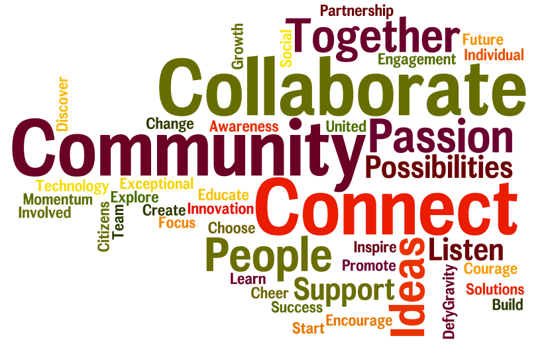
Any questions?
Dr Tiffany Chiu t.chiu@imperial.ac.uk
Dr Deesha Chadha d.chadha@imperial.ac.uk
Ms Marsha Maraj m.maraj@imperial.ac.uk

