Slide 1
Education Evaluation and Research
Prof Martyn Kingsbury
Dr Camille Kandiko Howson
Mr Eliel Cohen
Dr Julianne Viola
Mr Robert Cashman
Dr Monika Pazio

Slide 2
Overview
Evaluation Questions
Tools and Resources
From Evaluation to Research

Slide 3
Curriculum Evaluation
Learning and Teaching Strategy
Intended Learning Outcomes (Aims)
From final Curriculum Review Forms, most stated an intention to develop an evaluation plan and all Departments planned to collect new data

Slide 4
Levels of evaluation
Level 1: to inform your own teaching (e.g. at module-level)
Level 2: to inform those in a shared context (e.g. at year/course/departmental level)
Level 3: to inform the wider public (e.g. cutting-edge, innovative practices; large-scale impact on student outcomes)—may become educational research

Slide 5

Evaluation Questions

Slide 6
Evaluation Questions
Framed by:
  Intended learning outcomes (aims)
  Method of delivery (process change)
  What changed (outcome change)
These drive:
  Who you ask
  What you ask
  How you ask
  When you ask

Slide 7
Evaluation Questions
Method of Delivery
  Active Learning
  Assessment
  Innovative Practical Teaching
  Technology Enhanced Learning
Outcome Measures
  Learning Gain
  Student Experience and Development
  Teaching Experience

Slide 8
Evaluation Questions
Review evaluation questions and plot onto Curriculum Evaluation Matrix

Slide 10

Evaluation Tools and Resources

Slide 11
Overview of approaches
Existing data
  Historical comparison
  Challenge of isolating cause and effect
New data
  Sampling / Census
  Qualitative / Quantitative
  Direct / Proxy measures

Slide 12
15 Depts | Curriculum Review Evaluation Plans
9 | use SOLE data and feedback
9 | engage with Student Representatives
8 | analyse exam scores and other marks
8 | draw on informal feedback
5 | look at NSS data and comments
4 | measure improved well-being
4 | compare attendance data (in time-tabled and co-curricular activities)
1 | look at data on number of resits

Slide 13
What is learning gain?
  change in knowledge, skills, work-readiness and personal development, as well as enhancement of specific practices and outcomes in defined disciplinary and institutional contexts
  https://www.officeforstudents.org.uk/media/20ffe802-9482-4f55-b5a0-6c18ee4e01b1/learning-gain-project-final-evaluation.pdf

Slide 14
Dimensions of learning gain
measures of general cognitive gain –what students think and know;
measures of behavioural gain–measures of what students do and their engagement, including activities students have undertaken in preparation for the world of work;
affective gain–measures of how students feel and their development of soft and transferrable skills.

Slide 15
Imperial Vision Group Pilot: Student Information Dashboard
View information from new College-wide Banner system
Principles:
  To provide data to enhance the student experience for staff and students
  Sector-leading approach focusing on value-added and evidence-led enhancement
  Empower students with their own data
  Need baseline data for all students to deliver parity of experience
  Focus on individual student data
    Complemented by aggregate analysis through learning analytics

Slide 16
Strategy and Planning
National Student Survey (NSS) analysis and dashboards
  The dashboards show each year’s results and trends over time
  They have recently been expanded to include – where available – the survey results split by different student characteristics
UG Differential Outcomes analysis and dashboards
  These new dashboards look at student continuation into second year, final degree results obtained and destinations, split by various student characteristics
  They are aligned as far as possible with external measures and metrics (e.g. TEF metrics and UK Performance Indicators)
  For questions or access please contact r.cashman@imperial.ac.uk.

Slide 17
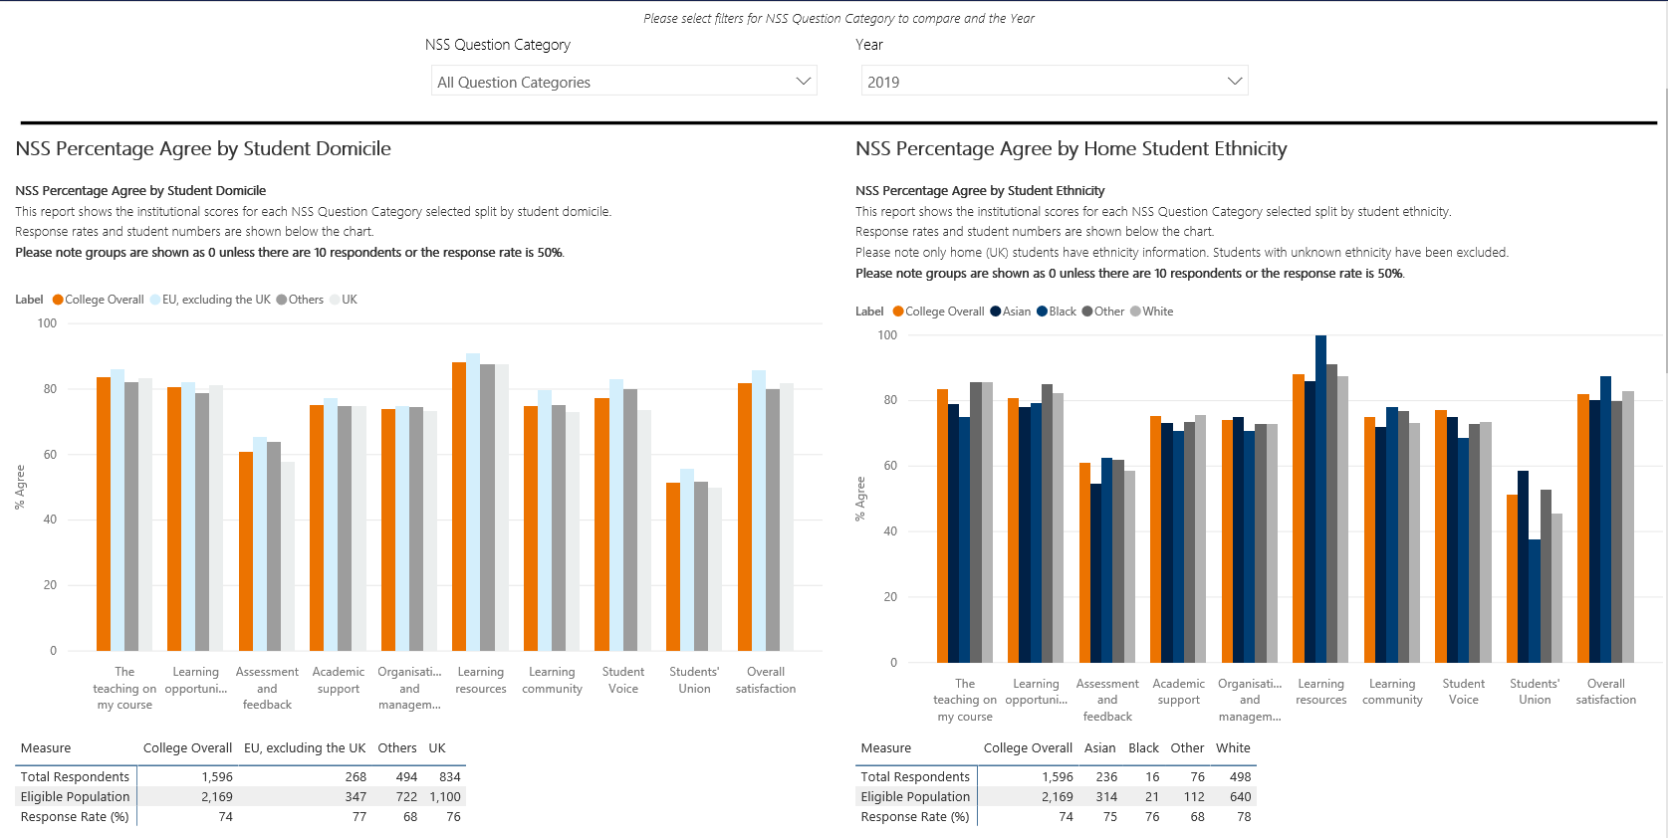

Slide 18
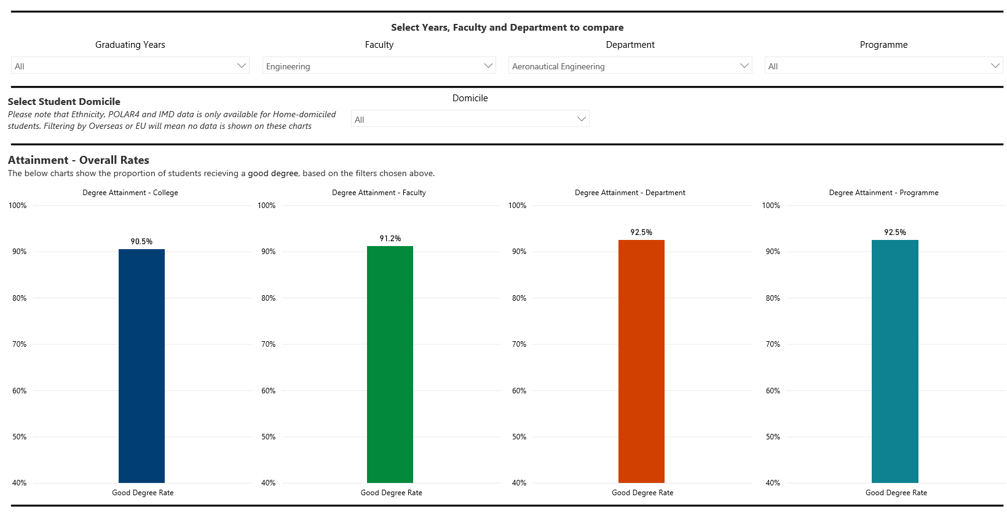

Slide 19
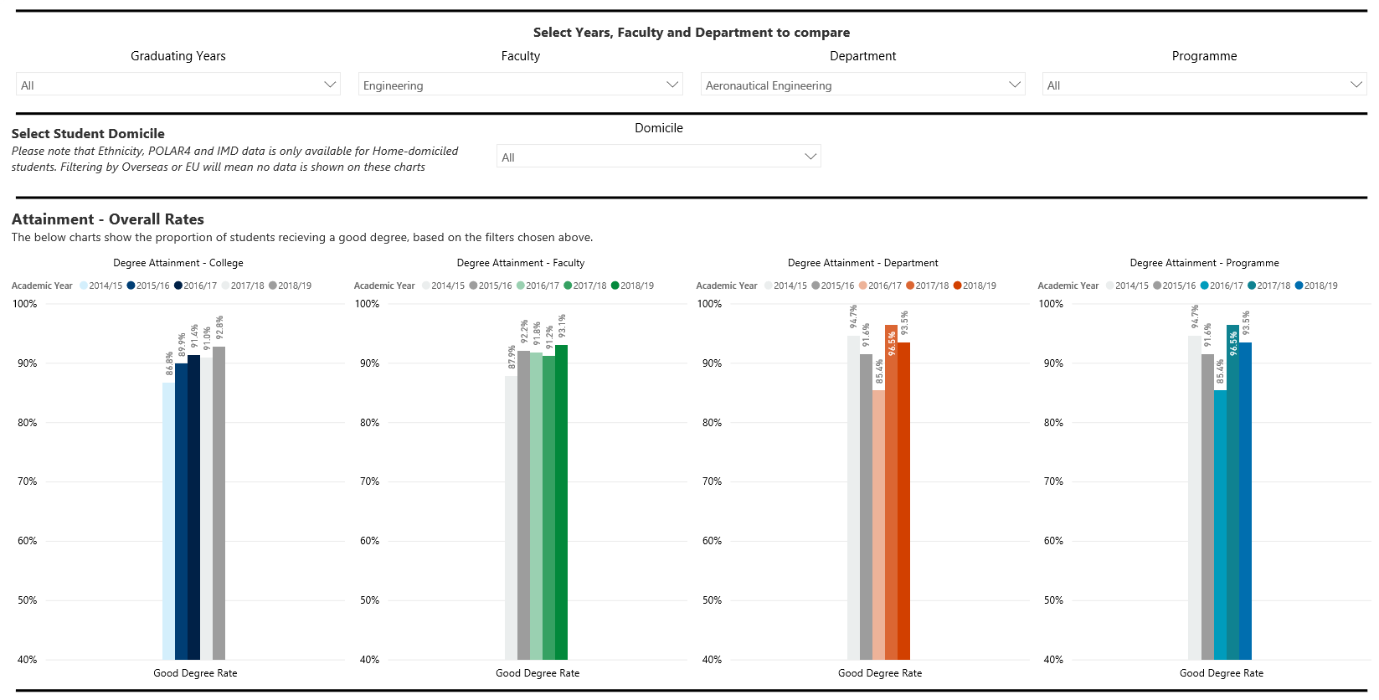

Slide 20

Introduction to the Evaluation Toolkit
You can access the Toolkit from the CHERS homepage
Or, you can bookmark the Toolkit page to your web browser!
http://www.imperial.ac.uk/education-research/evaluation/

Slide 21
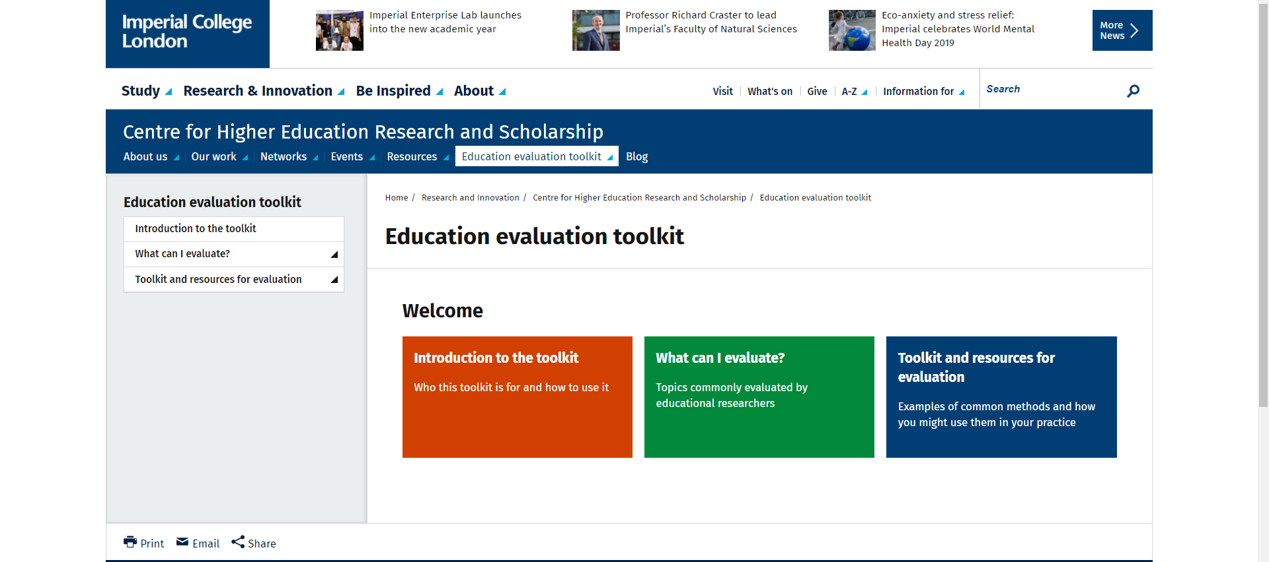
Education Evaluation Toolkit landing page
All of the content can be accessed via this sidebar
Content for each section can also be accessed by clicking on the coloured panels

Slide 22
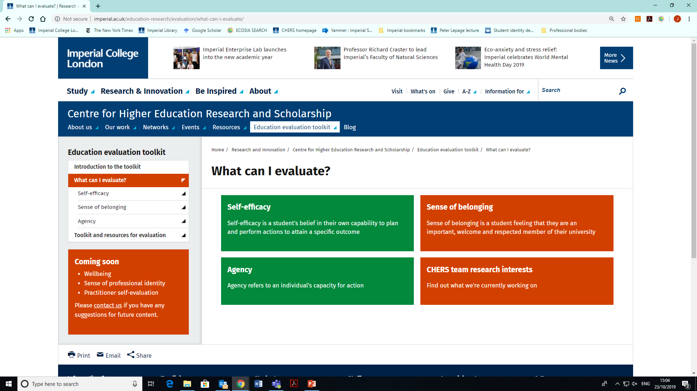
Overview: “What can I evaluate?”
More content coming soon!

Slide 23
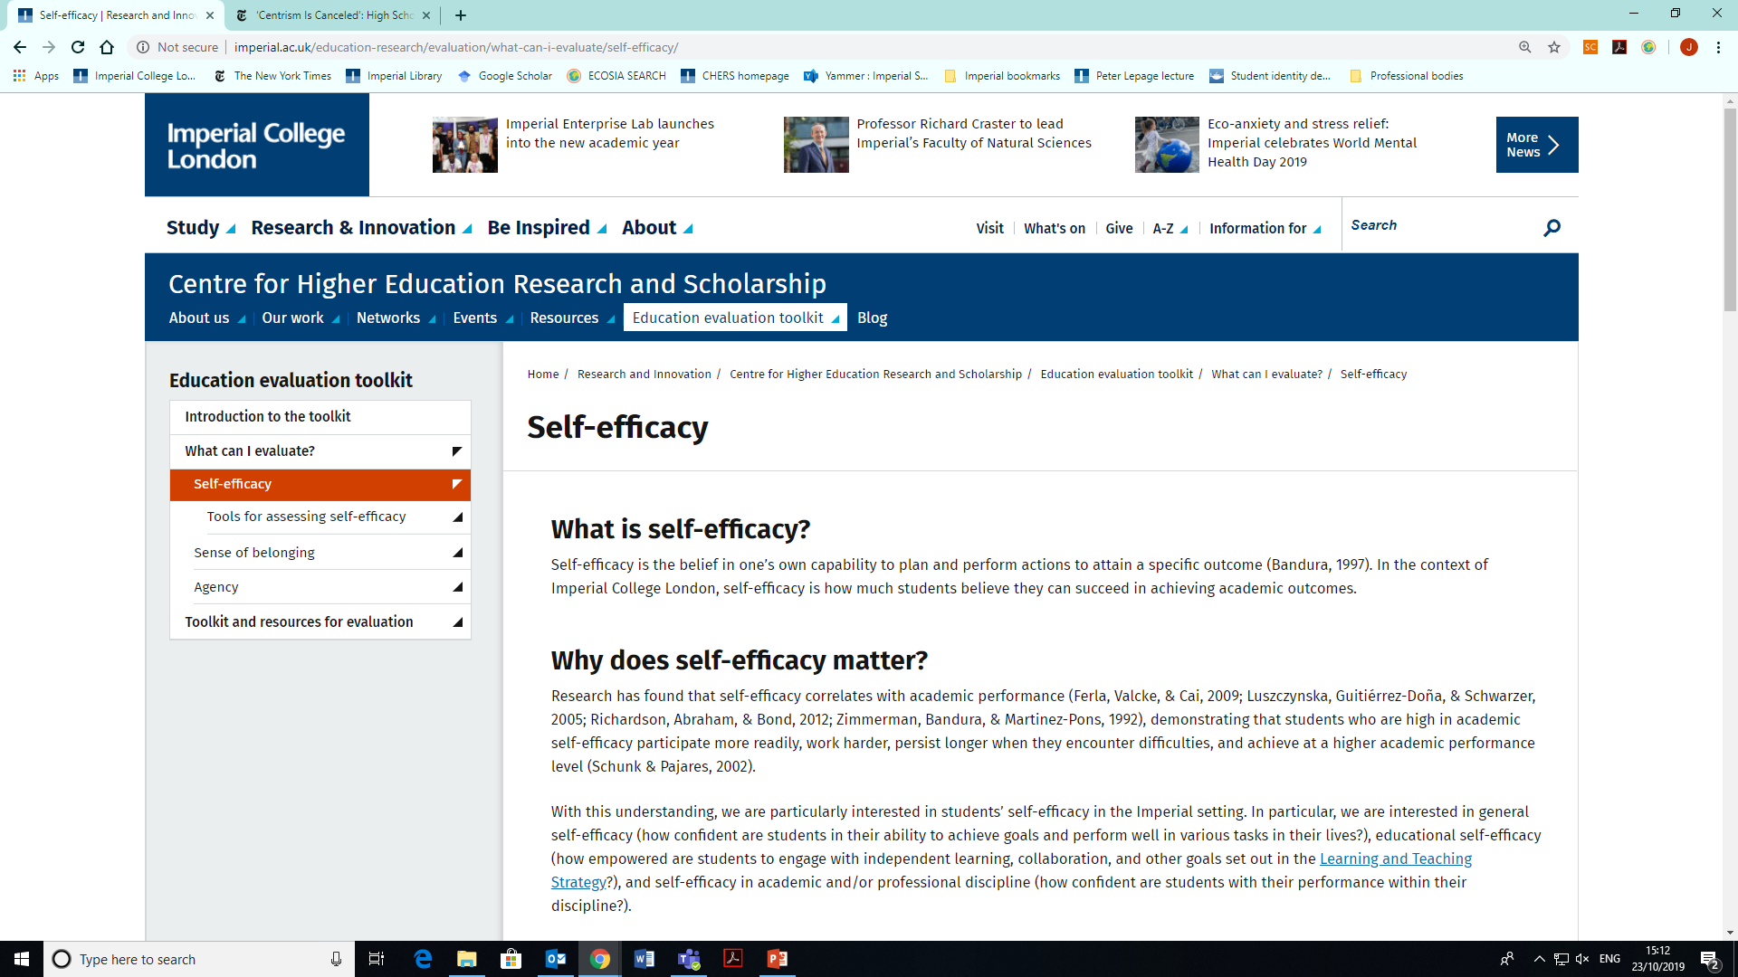
Topic: student self-efficacy
Scroll down for more!
Each topic has a set of tools you can use for evaluation, which you can access on this sidebar and also on the main content page

Slide 24
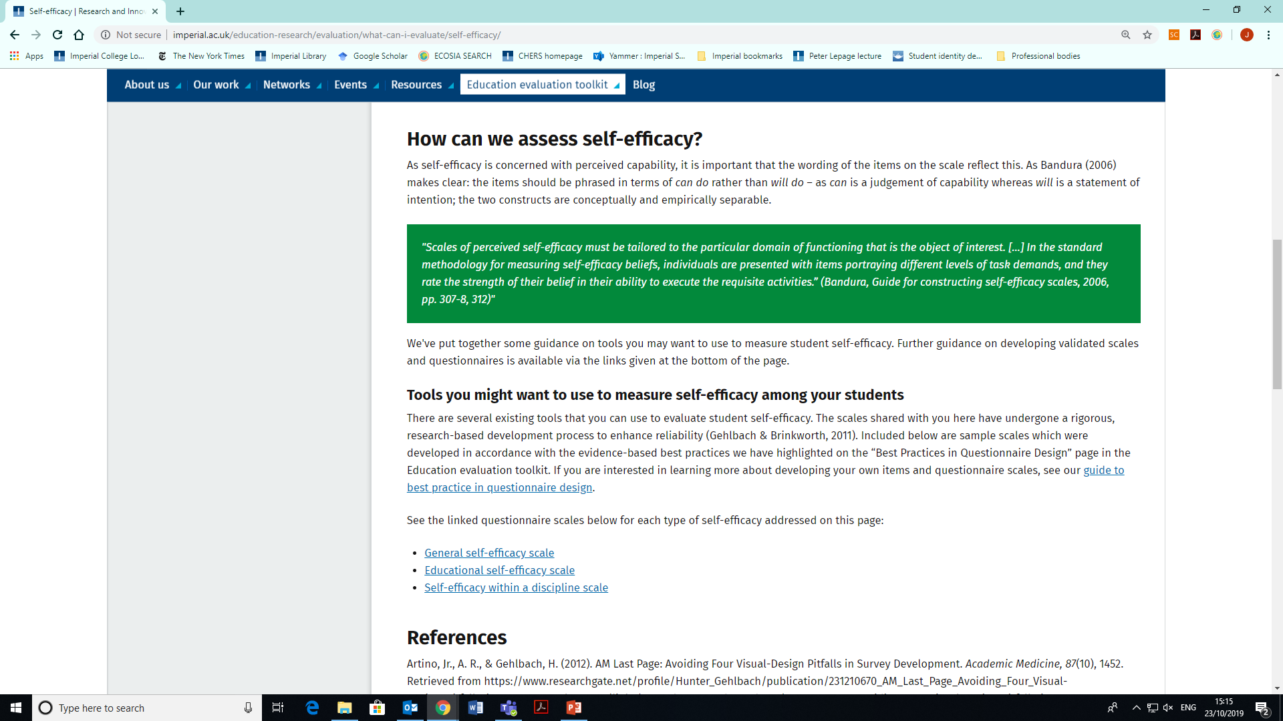
each topic has relevant tools linked at the bottom of the webpage…
Each tool is linked to its own webpage explaining the tool and how it might be useful to you

Slide 25
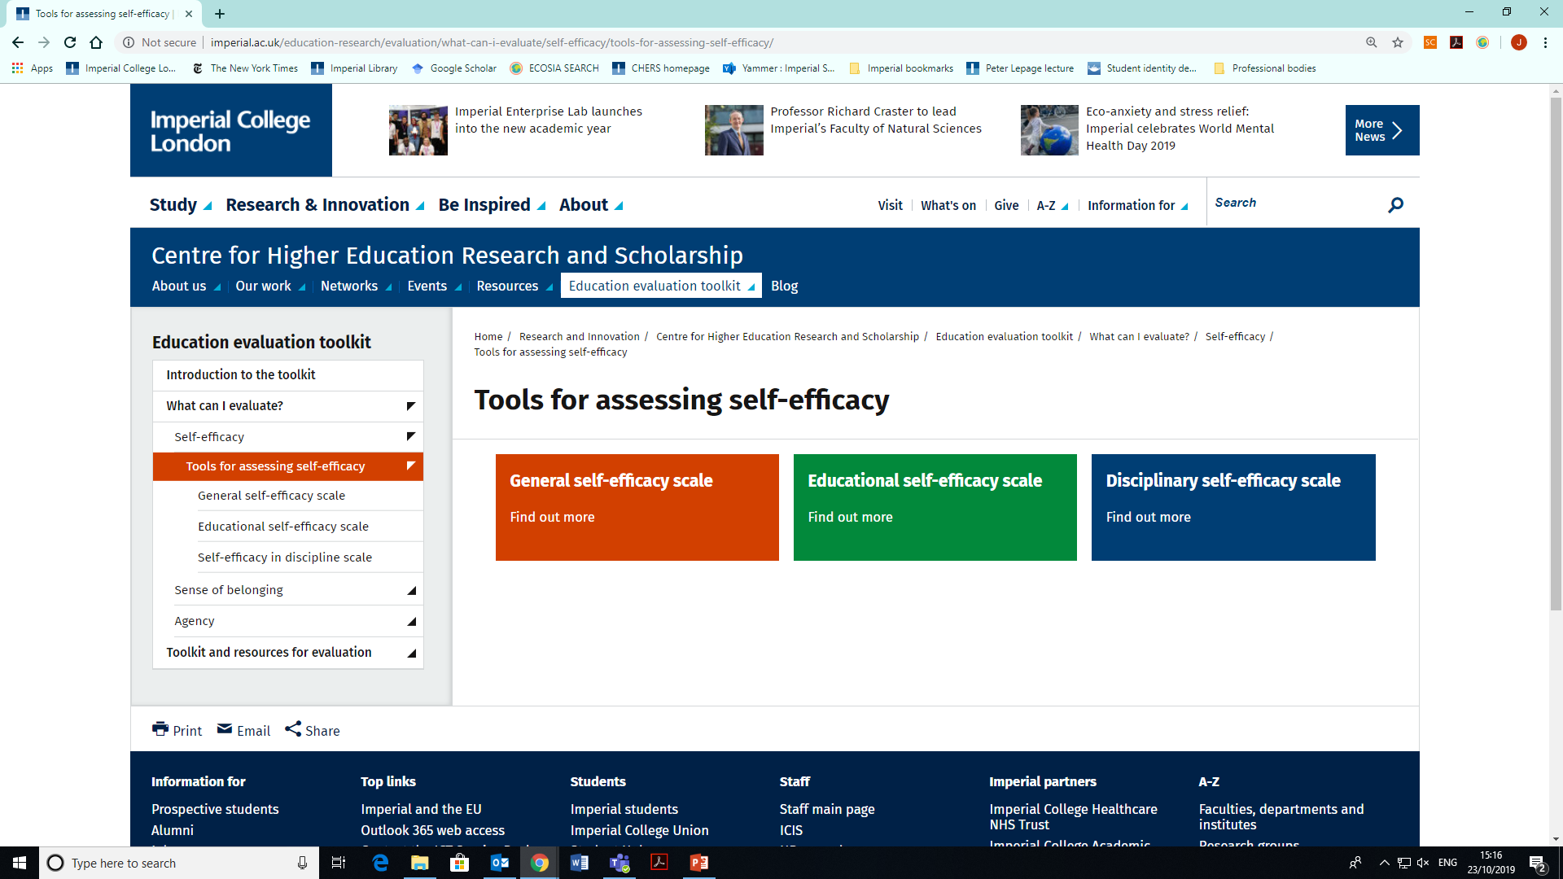
…and can also be accessed via the sidebar
The tool webpages are also accessible here

Slide 26
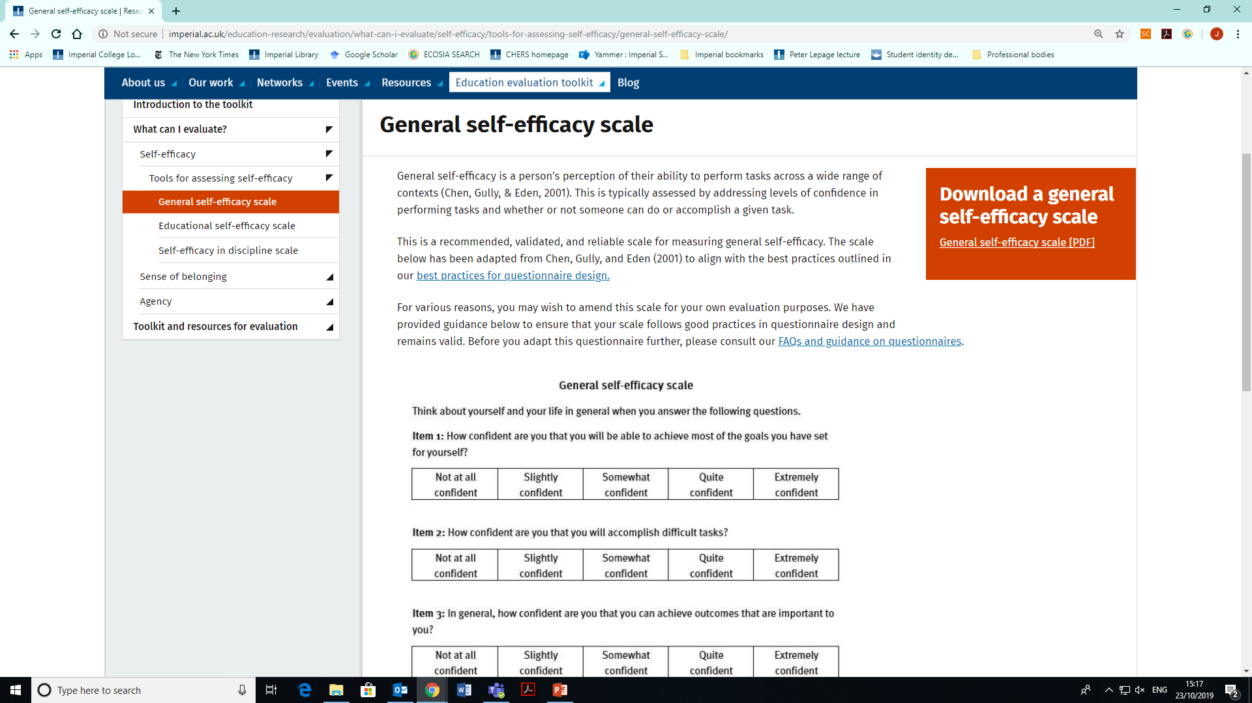
Most tools are available on the page. They are downloadable as well so you can adapt them for your evaluation.
Click to download the PDF of the tool

Slide 27

Overview: “Toolkit & Resources for Evaluation”
Click to expand and see what is available! More coming soon

Slide 28
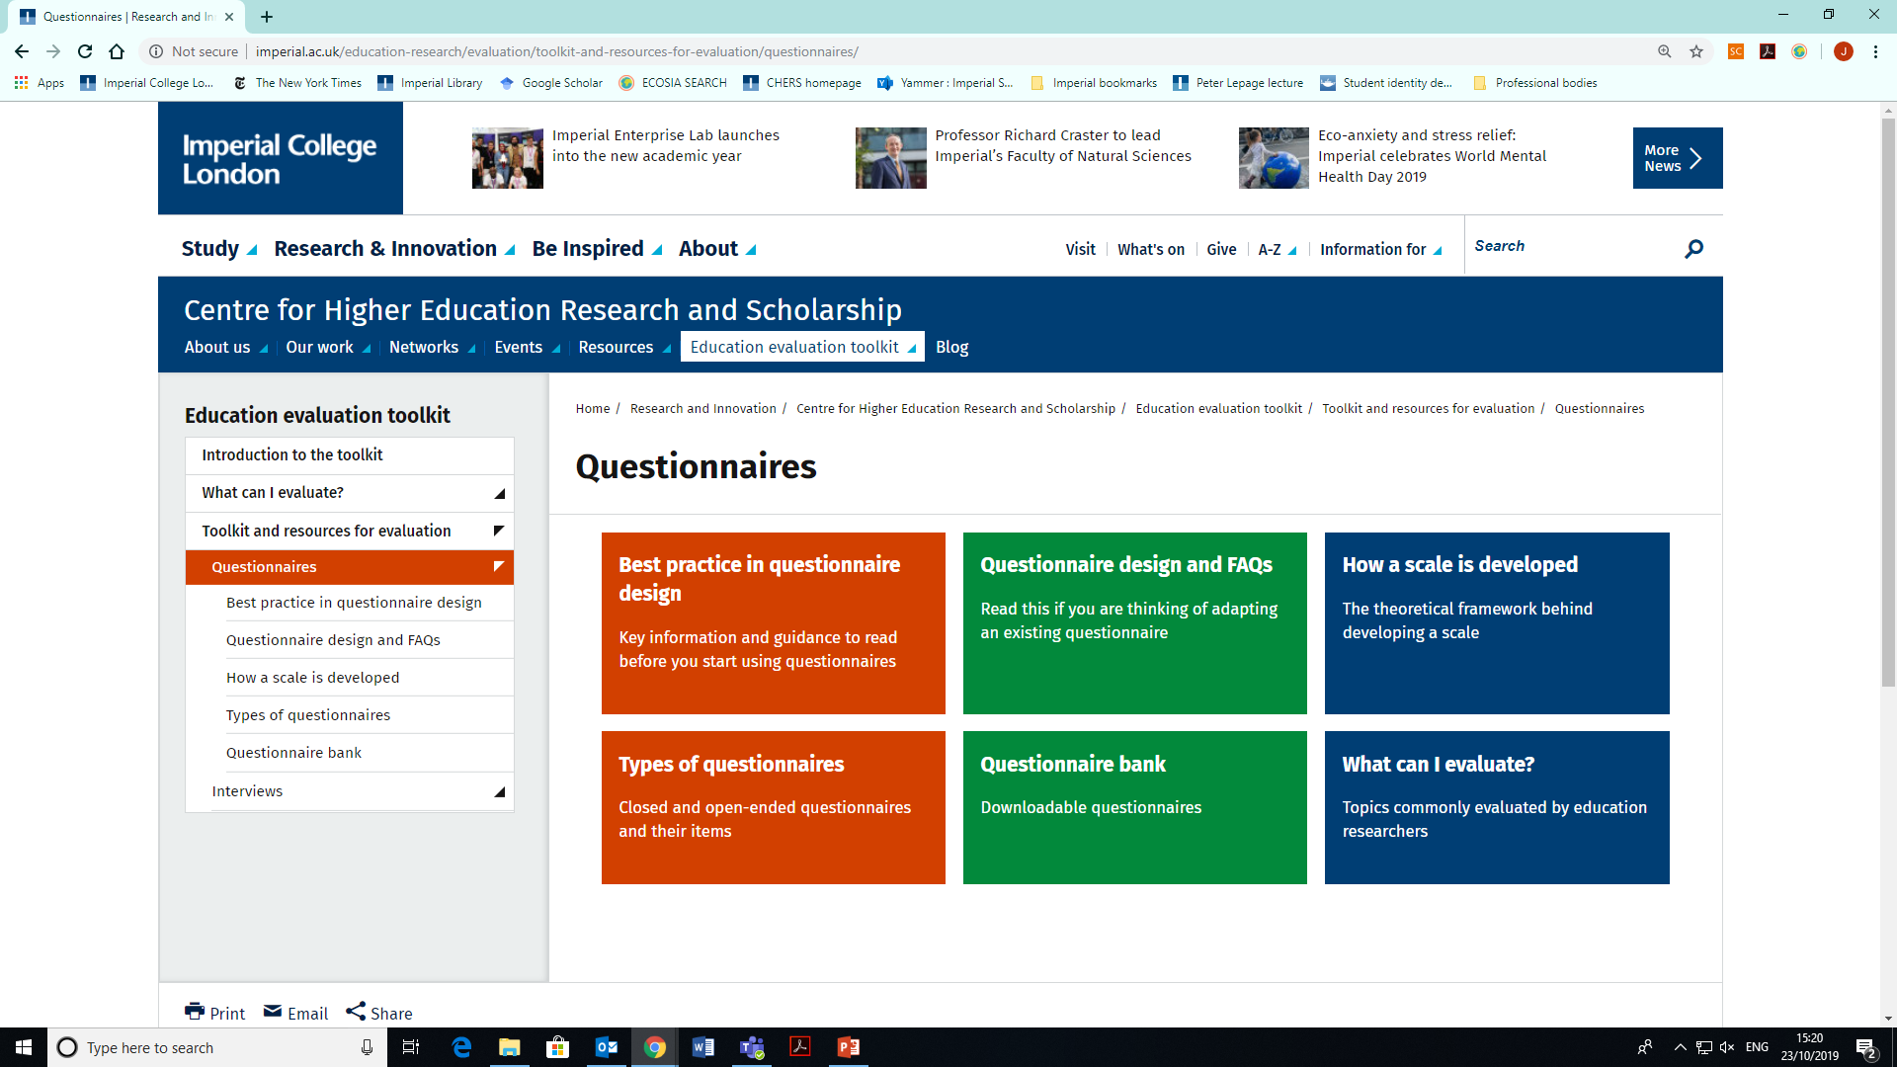
Overview: Questionnaires

Slide 29
Before getting started… take a look at the Best Practice in Questionnaire Design page.
Key information is in this section – we recommend that everyone read this!

Slide 30
Questionnaire Bank is a collection of all downloadable questionnaires within the Toolkit
The full collection of downloadable questionnaires is available here

Slide 31
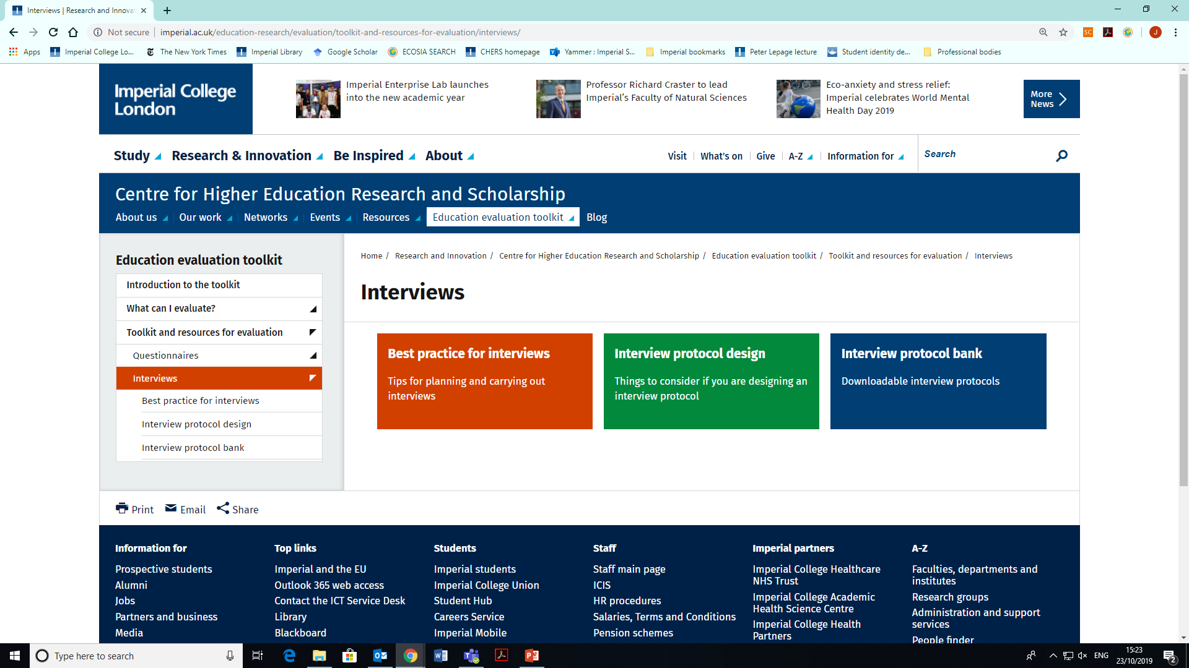
Overview: Interviews
Similar to the “Questionnaires” section, here you will find best practices for interviewing and designing your own interview protocol
We recommend that you read this before getting started
Downloadable protocols

Slide 32
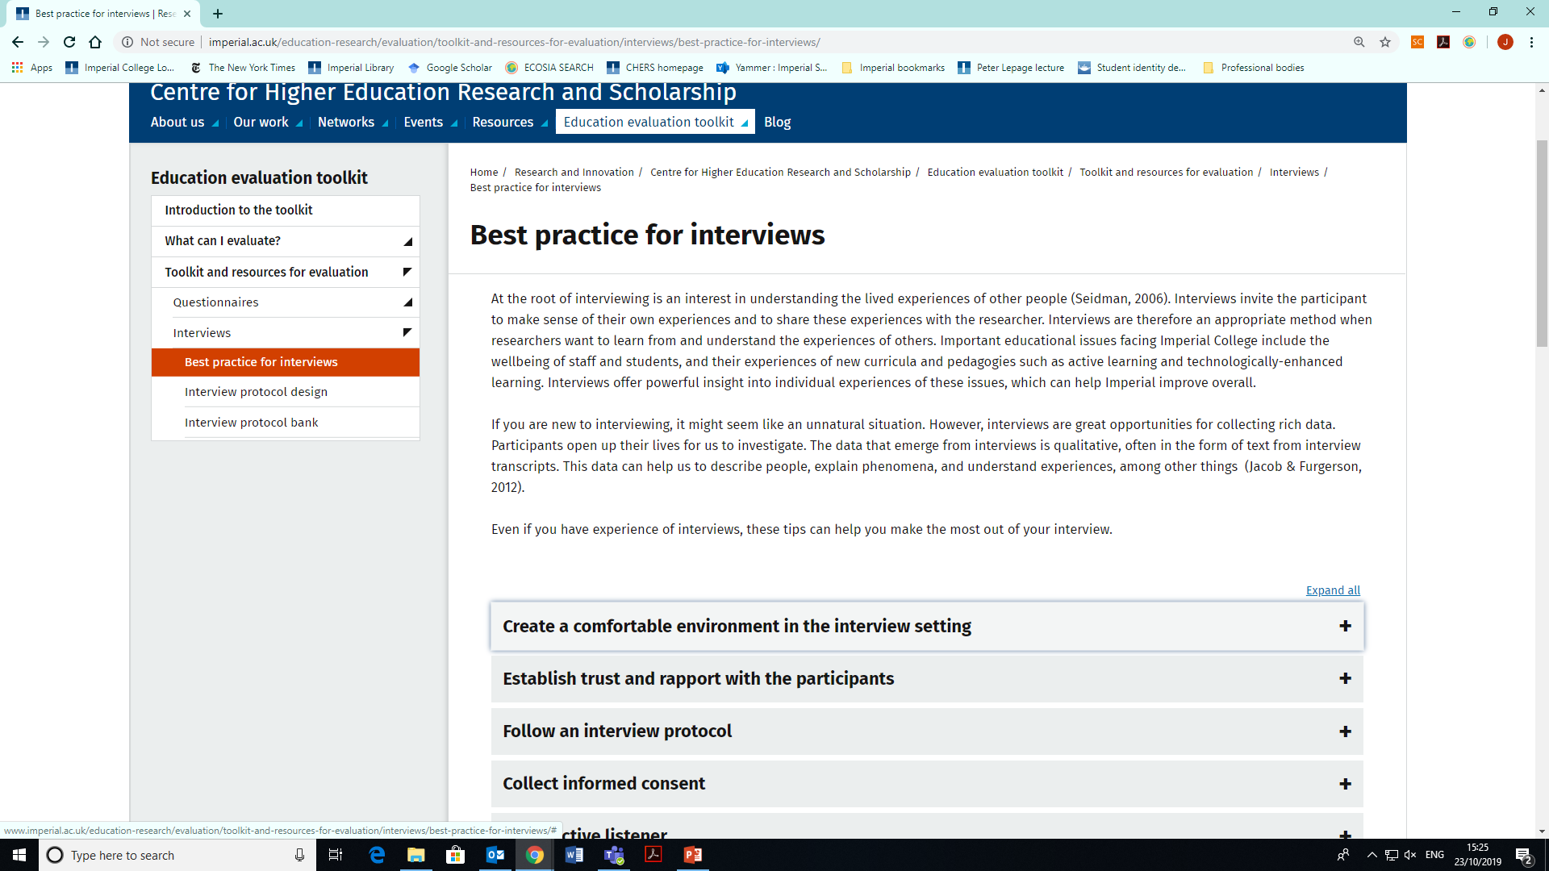
Best practice for interviews
Click to read tips for each best practice

Slide 33
Summary of topics and resources
Things to evaluate… | Sub-theme / focus | Available tools
Learning & Understanding | Concept Mapping | Scoring rubric (quantitative); Pro forma (qualitative)
 | Student Views on the ‘Nature of Science’ | Questionnaire; Structured interview protocol
 | Learning in the Laboratory | Questionnaire; Structured interview protocol
 | Self-regulated learning | Structured interview protocol
Self-evaluation | Self-reflection and Peer observation | Pro forma
 | Evidence-based practice | Inventories
Students’ self-efficacy | General self-efficacy; Educational self-efficacy; Disciplinary self-efficacy | Questionnaires (x3)
Students’ agency | Individual agency; Collective agency; Domain-specific agency | Semi-structured interview protocols (x3)
Students’ sense of belonging | n/a | Questionnaires (x2) Semi-structured interview protocol
http://www.imperial.ac.uk/education-research/evaluation/

Slide 34
Evaluation Approaches
Review topics, tools and resources from the Curriculum Evaluation Matrix Page 2

Slide 36

From Evaluation to Research

Slide 37
Developing Research Questions
REF Measures of Research Quality
  Originality
  Significance
  Rigour
Levels of pedagogic investigation
Level | Purpose of investigation | Evidence gathering processes will be | Investigation results in
1 | To inform oneself | Verified by self | Personal knowledge
2 | To inform a group within a shared context | Verified by those within same context | Local knowledge
3 | To inform a wider audience | Verified by those outside of that context | Public knowledge
Ashwin and Trigwell (2004: 122) Levels of pedagogic investigation

Slide 38
Role of CHERS/EDU
Information Consultation Collaboration

Slide 39


Conducting Ethical Research
Research or Evaluation?
Is the work:
Evaluative?
Non-contentious?
For an ‘internal’ audience?
Not going to be published?
will the work:
Answer a theoretically framed question?
Appeal to an ‘external’ audience?
If it may be published:
Anonymised, generalised narratives with pre-existing data – may be okay?
‘Safer’ to gain ethical approval
www.imperial.ac.uk/research-and-innovation/support-for-staff/education-ethics/the-eerp-process/

Slide 40
Summary of Resources
Evaluation Toolkit: https://www.imperial.ac.uk/education-research/evaluation/toolkit-and-resources-for-evaluation/
Strategic Planning Division
CHERS/EDU Staff
Ethics Template and Guidance
Drop-in sessions
Learning gain evaluation report https://www.officeforstudents.org.uk/media/20ffe802-9482-4f55-b5a0-6c18ee4e01b1/learning-gain-project-final-evaluation.pdf

Slide 41
Engage Students!
Challenge students
Support students
Inform students
Seek, ask and report on feedback
Provide opportunities for students
Hold students responsible
Work WITH not FOR students

Slide 42

Thank you!
Further enquiries contact: edu@imperial.ac.uk

