Slide 1
Undergraduate Medical Students’ Views on Sustainable Healthcare: Balancing Environmental Impact, Patient Safety & Autonomy
Dr Amirsaman Fathi, Dr Anna Ogier, Dr Noreen Ryan, Professor Omar Usmani
Faculty of Medicine
24/03/2025

Slide 2
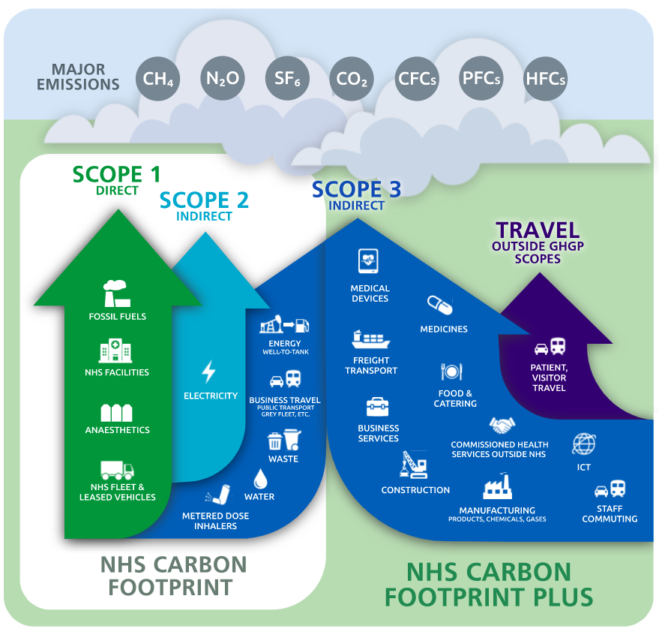
Healthcare Systems: Contribute a Significant Amount of Carbon Emissions
If global healthcare was a country, it would rank 5th in greenhouse gas emissions (1)
NHS: ~5% of the UK’s carbon emissions, 3.5% of all road travel (2)
NHS target: Net Zero by 2045 (3)
https://global.noharm.org/focus/climate/health-care-climate-footprint-report
https://www.imperial.nhs.uk/about-us/our-strategy/green-plan
https://www.england.nhs.uk/greenernhs/wp-content/uploads/sites/51/2020/10/delivering-a-net-zero-national-health-service.pdf

Slide 3

Clinical Practice: Growing Recognition of Importance of Embedding Sustainability
14. “Make good use of resources … taking into account responsibilities to patients and the wider population...”
15. “Choose sustainable solutions when you’re able to, provided these don’t compromise care standards…”
GMC Good Medical Practice 2024
Notes:
From an undergraduate perspective, specific recommendations include incorporating sustainability into quality improvement projects, developing interactive and practical learning experiences, and providing medical students with opportunities to engage in hands-on activities that demonstrate the environmental impact of healthcare practices. These curriculum changes aim to build students’ confidence in applying sustainability principles while balancing important considerations such as patient safety/autonomy. This focus aims to foster a holistic understanding of the environmental impacts of healthcare practices, encouraging future healthcare professionals to make informed decisions that balance patient safety, autonomy, and sustainability.

Slide 4
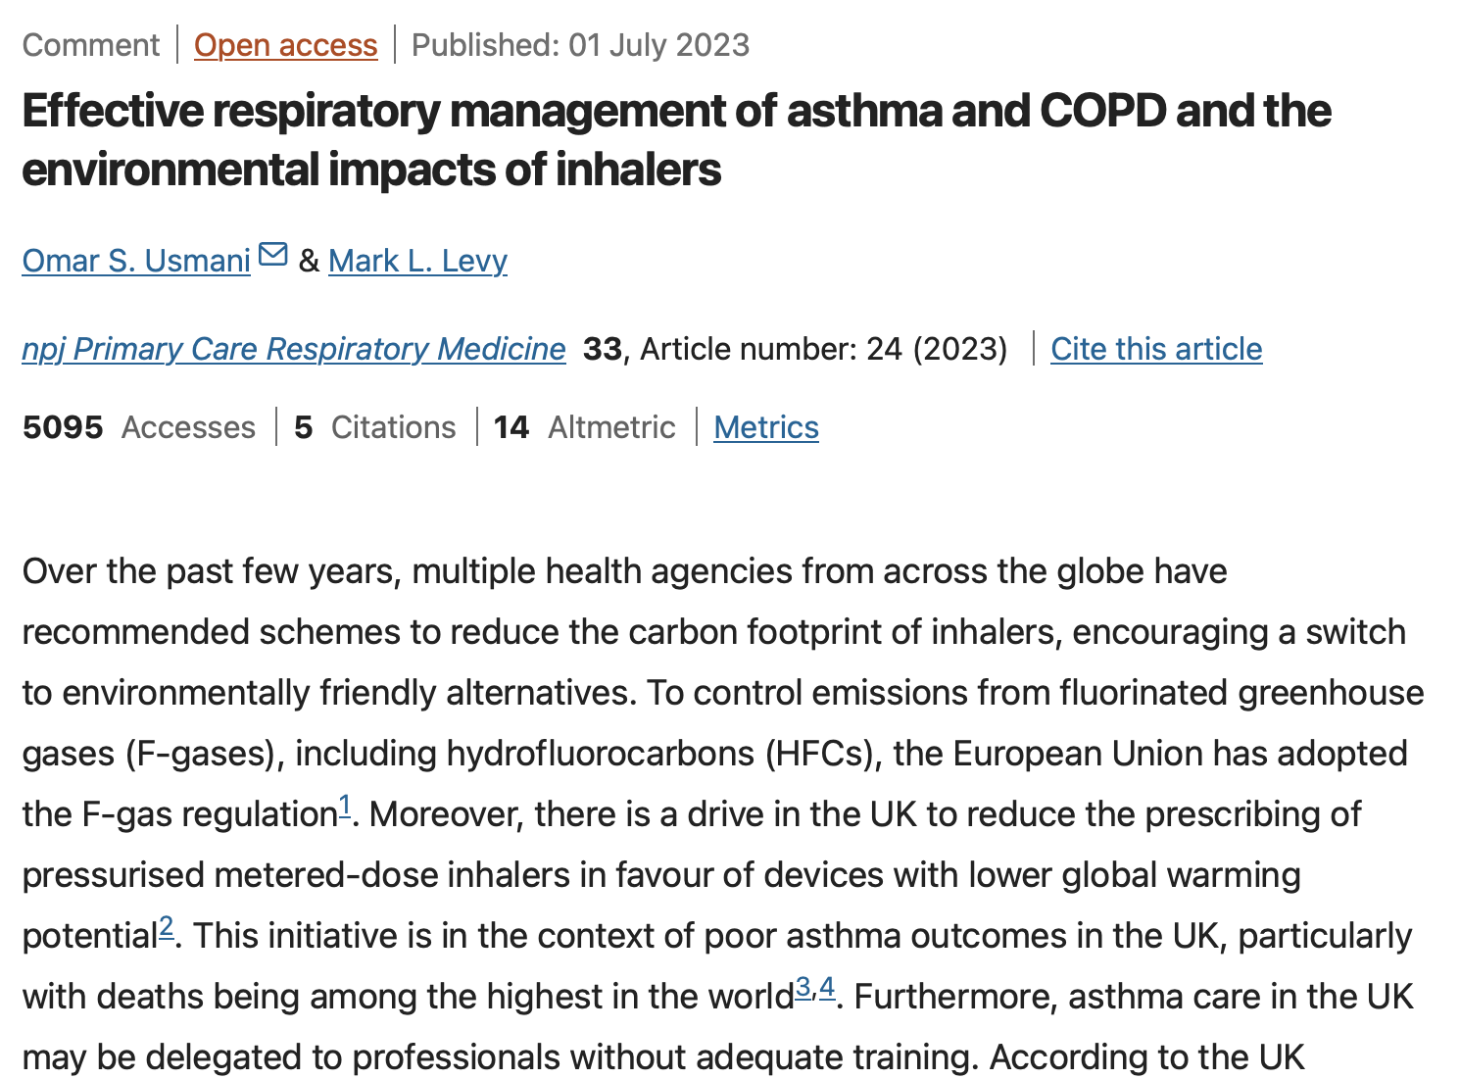
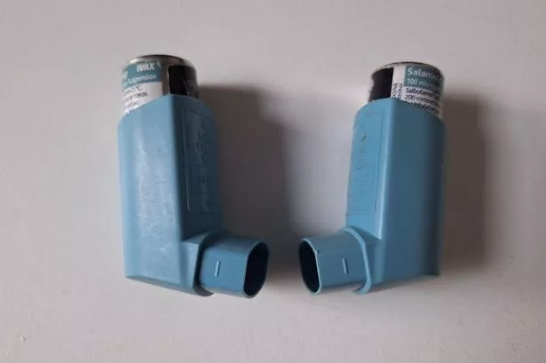
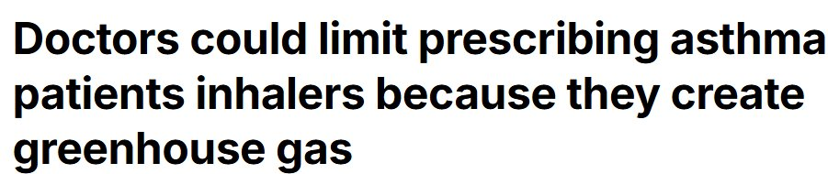
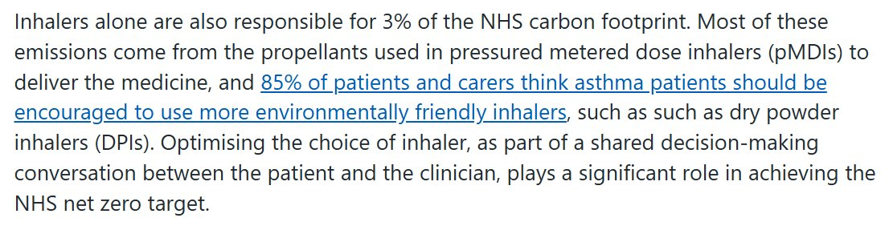
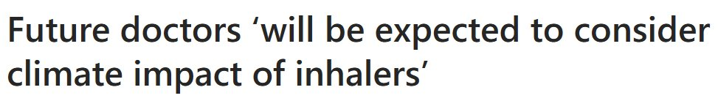
Respiratory Medicine: Pressurised metered-dose inhalers (pMDIs) contain hydrofluorocarbon (HFC) propellants which contribute to Global Greenhouse Gas Emissions
Current initiatives: Switch from pMDIs to DPIs to reduce environmental footprint
However, this transition is not without risks
Non-clinical switching risks ↑ exacerbations (1)
“Changing a patient’s prescribed inhaler when their condition is stable on their current device risks loss of disease control”
National Medicines Optimisation
1. Usmani OS, Bosnic-Anticevich S, Dekhuijzen R, Lavorini F, Bell J, Stjepanovic N, Swift SL, Roche N. Real-World Impact of Nonclinical Inhaler Regimen Switches on Asthma or COPD: A Systematic Review. J Allergy Clin Immunol Pract. 2022 Oct;10(10):2624-2637. doi: 10.1016/j.jaip.2022.05.039. Epub 2022 Jun 22. PMID: 35750323.

Slide 5


Research Methods: How Does Incorporating 'Sensible Sustainability' into the Medical Curriculum Affect Medical Students' Attitudes Towards Sustainable Healthcare
Third Year Medical students attended a one-hour lecture emphasising the integration of 'Sensible Sustainability' into healthcare decision-making.
Post-session Questionnaire : evaluating attitudes, knowledge, and clinical decision-making skills in response to the intervention.
Sensible Sustainability = Balancing patients' needs with critical analysis of sociopolitical issues

Slide 6
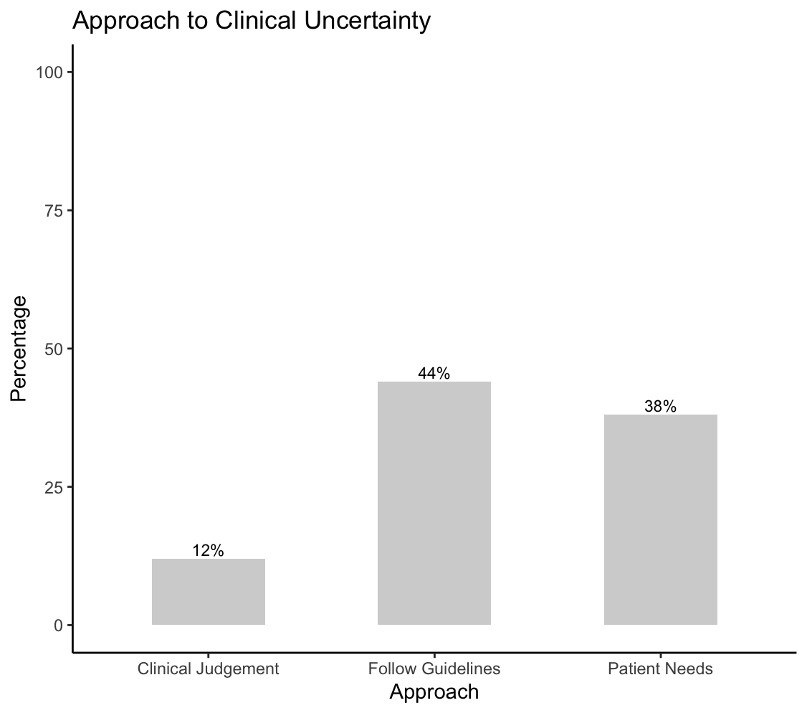
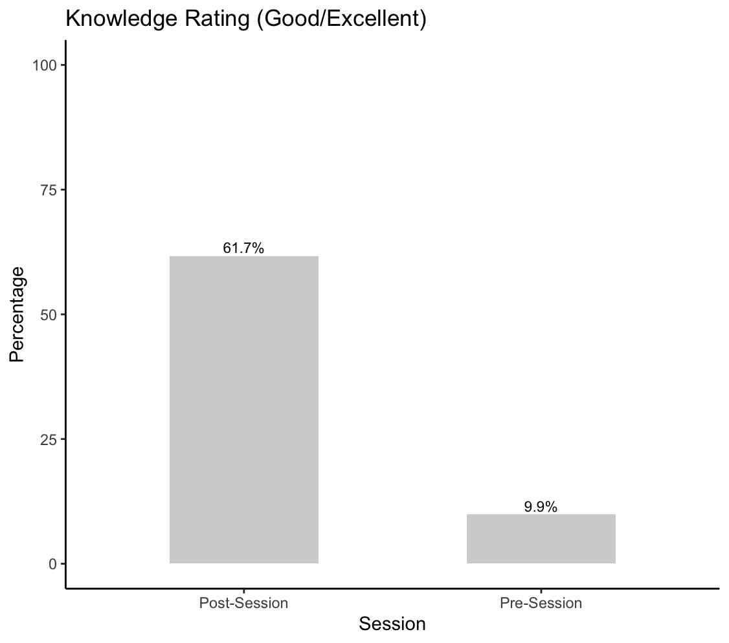
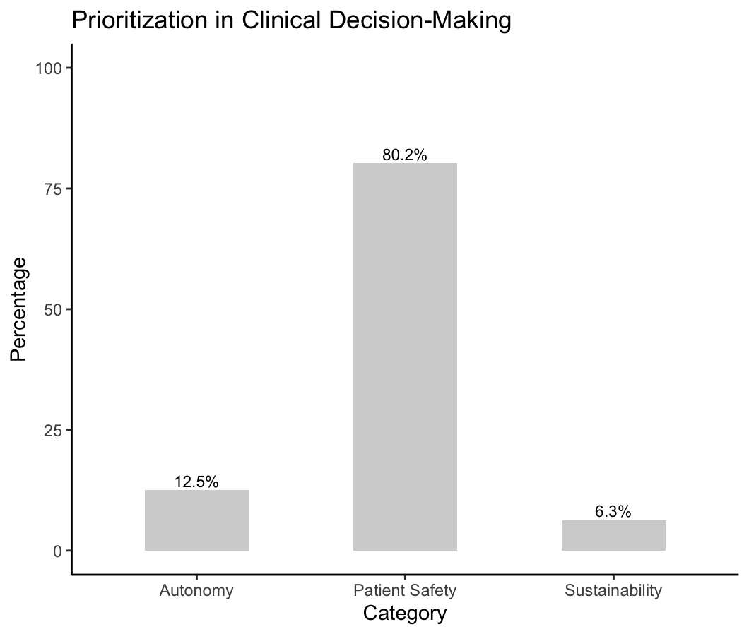
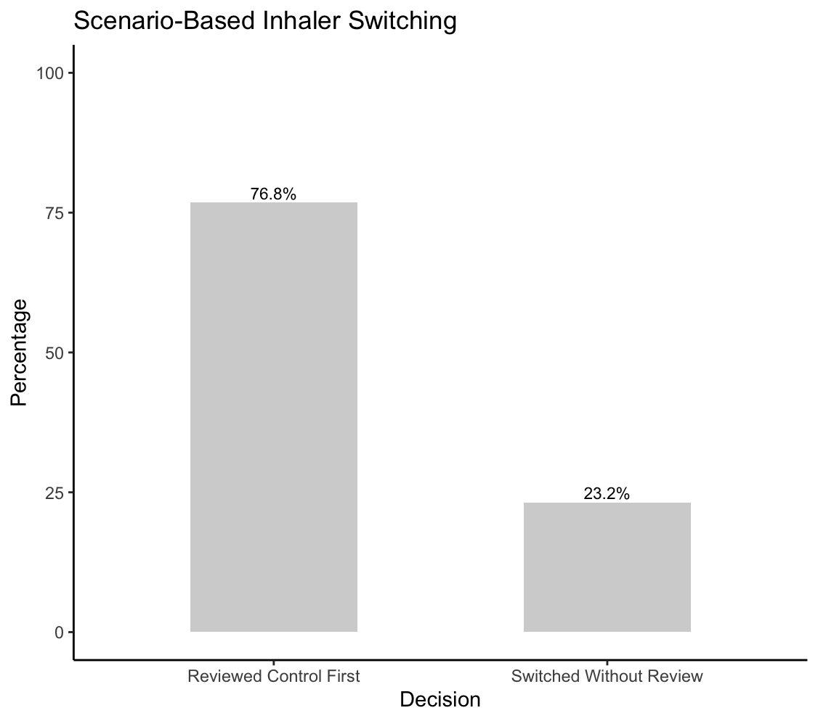
Results Summary: We recorded n=81 responses (of n=320 in Year 3).
Balancing sustainability with patient-safety
Prioritise patient Autonomy
Integrating guidelines with shared decision-making

Slide 7
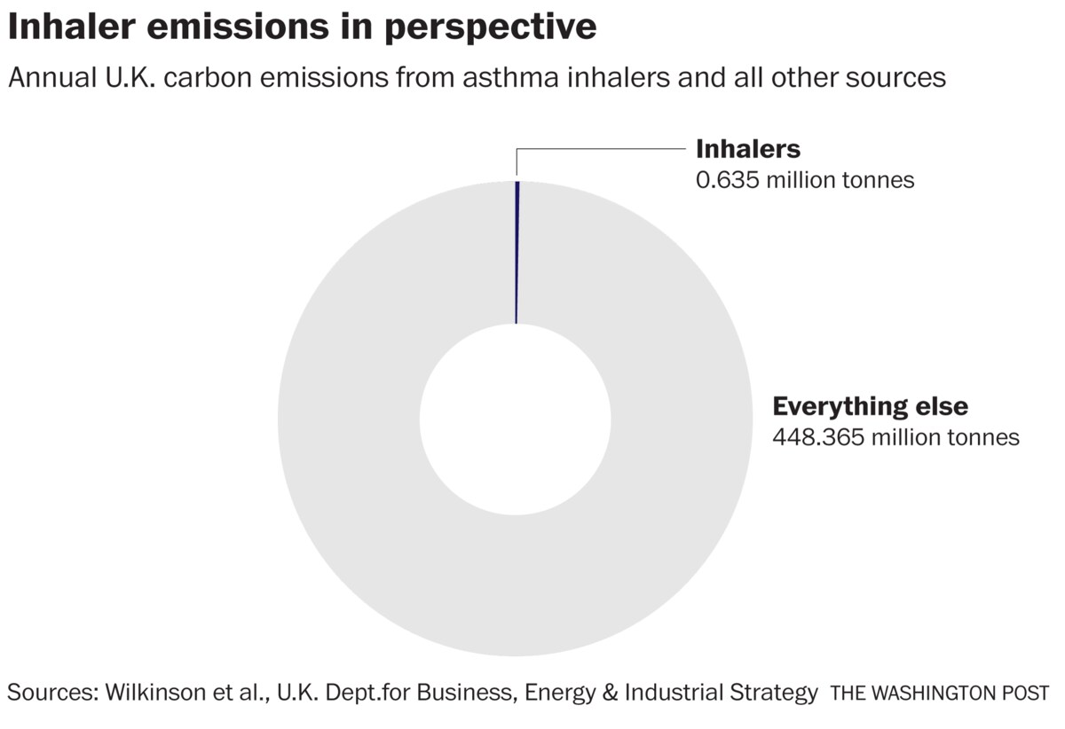
How Has this Lecture Impacted Your Attitude Towards Sustainability?
“Made me consider the balance between patient safety and the environment and how it makes sustainability in healthcare a far more complex issue to think about.”
“Improved my attitude and also helped me understand to balance the patient needs with sustainability”
“It’s made me actually the importance of sustainability in healthcare and how it’s important to actually understand and evaluate guidelines instead of just blindly following them ”
How Has Your Approach to Managing These Types of Situations Changed After Attending This Lecture?
“I will always be mindful of the environmental impact but to remember to treat the patient's condition first”
“Prioritise the patient… there are other ways of benefitting the environment. There is no blanket treatment for asthma ”
“Good asthma control with an inhaler that works for them is not only better for patients but also better for the environment than prescribing an inhaler that might on its own be more environmentally friendly, but does not work for the patient and leaves their asthma uncontrolled”

Slide 8
Summary
Embedding formal sustainability education using inhalers, medical students demonstrated a nuanced approach to “sensible” sustainable healthcare, balancing environmental considerations with clinical priorities.
Students’ emphasis on shared decision-making and patient-safety reflects their ability to critically appraise policies and integrate environmental responsibility into everyday patient-centred care.
Future directions: Expand to other areas of the curriculum, incorporate further interactive sessions.

Slide 9
Thank You
Any questions?

Slide 10
Results Summary
We recorded n=81 responses (of n=320 in Year 3).
Patient-safety was consistently prioritised over environmental concerns by 80.2% (n=65/81), autonomy by 12.5% (n=10/81), with 6.3% (n=6/81) favouring sustainability.
When managing clinical uncertainty, 44% opted to follow guidelines, 38% emphasised ‘patient needs’, with 12% relying on clinical judgement alone.
Presented with a scenario-based assessment prompting switching from a propellant-based metered-dose inhaler to a non-propellant dry-powder inhaler, 76.8% (n=43/56) opted to review the patient’s asthma control before switching.
Eight students (9.9%) rated their knowledge of sustainability as good (4-5/5) pre-session, increasing to 61.7% post-session (mean score pre-2.43±0.81 vs. post-3.68±0.70).

Slide 11
How Has this Lecture Impacted Your Attitude Towards Sustainability?
Results
“Made me consider the balance between patient safety and the environment and how it makes sustainability in healthcare a far more complex issue to think about.”
“It has shown me the balance between the two and it is not always as straight forward as some in healthcare might think ”
“Positive attitude towards sustainability as long as it doesn’t harm the patient”
“Improved my attitude and also helped me understand to balance the patient needs with sustainability”
“it’s made me actually the importance of sustainability in healthcare and how it’s important to actually understand and evaluate guidelines instead of just blindly following them ”

Slide 12
Scenarios Presented: How Has Your Approach to Managing These Types of Situations Changed After Attending This Lecture?
Results
“put patients at centre of care and best inhaler is one they can use”
“I will take a more holistic approach ”
“I will always be mindful of the environmental impact but to remember to treat the patients condition first”
“Prioritise the patient… there are other ways of benefitting the environment. There is no blanket treatment for asthma ”
“I’ll keep sustainability in mind in a more holistic way instead of just greenhouse gases”
“Good asthma control with an inhaler that works for them is not only better for patients but also better for the environment than prescribing an inhaler that might on its own be more environmentally friendly, but does not work for the patient and leaves their asthma uncontrolled”

